Slide 1
Python Class and Object
Justin Jian Chen

Slide 2
1
Python Class
and Object

Slide 3
Python Classes/Objects
Python is an object oriented programming language.
Almost everything in Python is an object, with its properties and methods.
A Class is like an object constructor, or a "blueprint" for creating objects.

Slide 4
Create a Class
To create a class, use the keyword class:
Example
Create a class named MyClass, with a property named x:
class MyClass: x = 5

Slide 5
Create Object
Now it can use the class named MyClass to create objects:
Example
Create an object named p1, and print the value of x:
p1 = MyClass() print(p1.x)

Slide 6
The __init__() Function
The examples above are classes and objects in their simplest form, and are not really useful in real life applications.
To understand the meaning of classes we have to understand the built-in __init__() function.
All classes have a function called __init__(), which is always executed when the class is being initiated.
Use the __init__() function to assign values to object properties, or other operations that are necessary to do when the object is being created:

Slide 7
Example
Create a class named Person, use the __init__() function to assign values for name and age:
class Person: def __init__(self, name, age): self.name = name self.age = age p1 = Person("John", 36) print(p1.name) print(p1.age)

Slide 8
Object Methods
Objects can also contain methods. Methods in objects are functions that belong to the object.
Let us create a method in the Person class:
Insert a function that prints a greeting, and execute it on the p1 object:
class Person: def __init__(self, name, age): self.name = name self.age = age def myfunc(self): print("Hello my name is " + self.name) p1 = Person("John", 36) p1.myfunc()

Slide 9
The self Parameter
The self parameter is a reference to the current instance of the class, and is used to access variables that belongs to the class.
It does not have to be named self , you can call it whatever you like, but it has to be the first parameter of any function in the class:

Slide 10
Example
Use the words mysillyobject and abc instead of self:
class Person: def __init__(mysillyobject, name, age): mysillyobject.name = name mysillyobject.age = age def myfunc(abc): print("Hello my name is " + abc.name) p1 = Person("John", 36) p1.myfunc()

Slide 11
3
Python Math

Slide 12
Python Math and Module
Python has a set of built-in math functions, including an extensive math module, that allows to perform mathematical tasks on numbers.
Python has also a built-in module called math, which extends the list of mathematical functions.
To use it, it must import the math module:
import math

Slide 13
Example
When imported the math module, it can start using methods and constants of the module.
The math.sqrt() method for example, returns the square root of a number:
Example
import math x = math.sqrt(64) print(x)

Slide 14
Function min() and max()
The min() and max() functions can be used to find the lowest or highest value in an iterable:
Example
x = min(5, 10, 25) y = max(5, 10, 25) print(x) print(y)

Slide 15
Function abs()
The abs() function returns the absolute (positive) value of the specified number:
Example
x = abs(-7.25) print(x)

Slide 16
Function pow(x, y)
The pow(x, y) function returns the value of x to the power of y (x^{y}).
Example
Return the value of 4 to the power of 3 (same as 4 * 4 * 4):
x = pow(4, 3) print(x)

Slide 17
Function math.ceil(), math.floor()
The math.ceil() method rounds a number upwards to its nearest integer, and the math.floor() method rounds a number downwards to its nearest integer, and returns the result:
Example
import math x = math.ceil(1.4) y = math.floor(1.4) print(x) # returns 2 print(y) # returns 1

Slide 18
6
Project

Slide 19
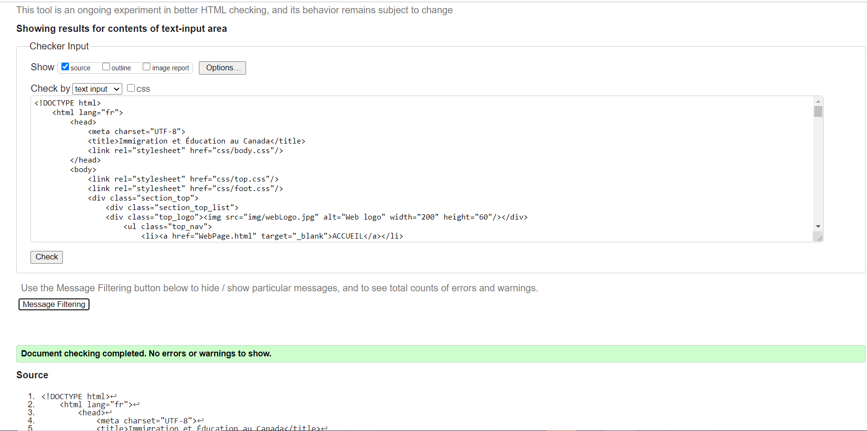
Markup Validator
https://validator.w3.org

Slide 20
Design of a static website
Web Presentation: April 11 11:00 AM
Eric 10 Mins
David 10 Mins
Vincent 10 Mins
Jeremy 10 Mins
Vivianne 10 Mins
Helen 10 Mins
Introduction of your project
Present the static website project
Functionality of website
Code resource and file structure
WebSite layout and design styling
Meet the acceptance criteria
https://github.com/jianchentech/WebCamp/blob/main/WebProject/WebStatic.md

Slide 21
Merci !
Avez-vous des questions ?

