Slide 1
Python Function Dictionary
Justin Jian Chen

Slide 2
1
Python Dictionary

Slide 3
Python Dictionaries
Dictionaries are used to store data values in key:value pairs.
A dictionary is a collection which is unordered, changeable and does not allow duplicates.
Dictionaries are written with curly brackets, and have keys and values
Example
car = { "brand": "Ford", "model": "Mustang", "year": 1964 } print(car)

Slide 4
Dictionary Length
To determine how many items a dictionary has, use the len() function:
Example
Print the number of items in the dictionary:
print(len(dict))

Slide 5
Dictionary Data Type
The values in dictionary items can be of any data type:
Example
String, int, boolean, and list data types:
car = { "brand": “Honda", “valid": True, "year": 1964, "colors": ["red", "white", "blue"] }

Slide 6
2
Access Dictionary

Slide 7
Accessing Items
Access the items of a dictionary by referring to its key name, inside square brackets:
Example
car = { "brand": “Honda", "year": 2019, "colors": ["red", "white", "blue"] }
Print(car[“year”])

Slide 8
Get Keys
Get a list of all the keys using keys() method in the dictionary:
Example
Get a list of the keys:
x = car.keys()

Slide 9
Get Values
Get a list of all the keys using values() method in the dictionary:
Example
Get a list of the Valuess:
x = car.values()

Slide 10
Get Items
Get a list of all the Items using items() method in the dictionary:
Example
Get a list of the Valuess:
x = car.items()

Slide 11
3
Change Dictionary

Slide 12
Change Values
You can change the value of a specific item by referring to its key name:
Example
car = { "brand": “Honda", "model": “Rav4", "year": 1989 }
Print(car) ## Before changing values car["year"] = 2020
Print(car) ## After changing values

Slide 13
Update Dictionary
The update() method will update the dictionary with the items from the given argument.
The argument must be a dictionary, or an iterable object with key:value pairs.
Example
car = { "brand": “Honda", "model": “Rav4", "year": 1989 }
car.update({"year": 2020})

Slide 14
4
Add Dictionary

Slide 15
Add Dictionary Items
Adding an item to the dictionary is done by using a new index key and assigning a value to it:
Example
car = { "brand": “Honda", "model": “Rav4", "year": 1989 }
car[“color”]= “red”
print(car)

Slide 16
Update Dictionary
Add a color item to the dictionary by using the update() method:
Example
car = { "brand": “Honda", "model": “Rav4", "year": 1989 }
car.update({“color": “blue"})
print(car)

Slide 17
5
Raspberry PI

Slide 18
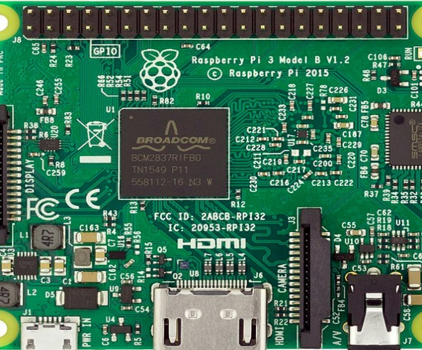
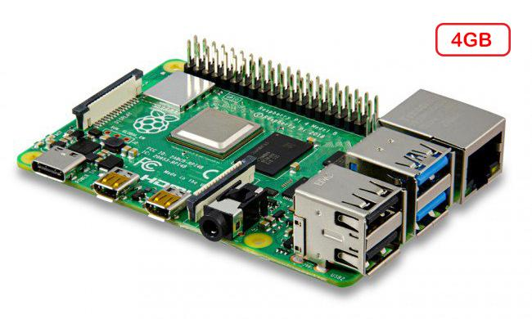
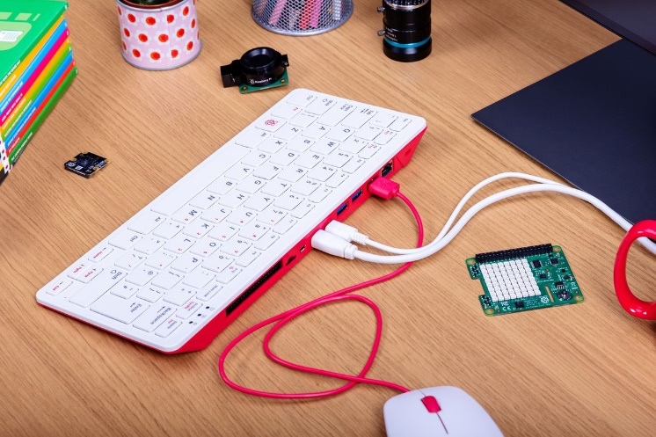
Raspberry PI
Raspberry Pi is the name of a series of single-board computers made by the Raspberry Pi Foundation
The original Pi had a single-core 700MHz CPU and just 256MB RAM, and the latest model has a quad-core 1.4GHz CPU with 1GB RAM. The main price point for Raspberry Pi has always been $35 and all models have been $35 or less, including the Pi Zero, which costs just $5
Raspberry PI was used to learn programming skills, build hardware projects, do home automation, and even use them in industrial applications.
Raspberry PI DIY

Slide 19
6
Project

Slide 20
Project – Guess Number Game
https://github.com/jianchentech/PythonLesson/blob/master/pythonProject/BeginnerProject/oddEvenCalculator.md
Deadline: February 13 11:50PM, 2021

Slide 21
Merci !
Avez-vous des questions ?

