Slide 1
Python Variable Scope
Justin Jian Chen

Slide 2
1
Python Scope

Slide 3
Variable
A variable is a label or a name given to a certain location in memory. This location holds the value you want your program to remember, for use later on. What's great in Python is that you do not have to explicitly state what the type of variable you want to define is - it can be of any type (string, integer, float, etc.). To create a new variable in Python, you simply use the assignment operator (=) and assign the desired value to it.

Slide 4
Initializing Variable
Assigning an initial value to a variable is called initializing the variable. You just initialized the variable: Var with a string value of “This is a variable” and variable Num with an integer or numeric value of 1.
The part to the left of the assignment operator is the variable name, and the right side is its value. The right-hand side can also be an arithmetic operation - in which case, it will be evaluated before the assignment occurs.
Example
Var = “This is a variable”
Num = 1
Bool = true
Sum = 1 + 2*3

Slide 5
Variable Scope
Not all variables can be accessed from anywhere in a program. The part of a program where a variable is accessible is called its scope. There are four major types of variable scope and is the basis for the LEGB rule.
Local
Enclosing
Global
Built-in

Slide 6
2
Local Scope

Slide 7
Local Scope
Whenever you define a variable within a function, its scope lies ONLY within the function. It is accessible from the point at which it is defined until the end of the function and exists for as long as the function is executing. Which means its value cannot be changed or even accessed from outside the function.

Slide 8
Example
def print_number():
first_num = 1
# Print statement 1
print("The first number defined is: ", first_num)
print_number()
# Print statement 2
print("The first number defined is: ", first_num)

Slide 9
Explanation
We were able to print the first_num variable by calling the function print_number() (# Print statement 1). But when trying to access and then print the same variable from outside the function (# Print statement 2), it raised a NameError. This is because first_num is "local" to the function - thus, it cannot be reached from outside the function body.

Slide 10
3
Global Scope

Slide 11
Global Scope
This is perhaps the easiest scope to understand. Whenever a variable is defined outside any function, it becomes a global variable, and its scope is anywhere within the program. Which means it can be used by any function.

Slide 12
Example
A variable created outside of a function is global and can be used by anyone:
x = 300 def myfunc(): print(x) myfunc() print(x)

Slide 13
4
Built-in Scope

Slide 14
Built-in Scope
This is the widest scope that exists! All the special reserved keywords fall under this scope. We can call the keywords anywhere within our program without having to define them before use.
Keywords are simply special reserved words. They are kept for specific purposes and cannot be used for any other purpose in the program.

Slide 15
Example
Keyword | Description
and | A logical operator
as | To create an alias
assert | For debugging
break | To break out of a loop
class | To define a class
continue | To continue to the next iteration of a loop
def | To define a function
del | To delete an object
elif | Used in conditional statements, same as else if
else | Used in conditional statements
except | Used with exceptions, what to do when an exception occurs
False | Boolean value, result of comparison operations
finally | Used with exceptions, a block of code that will be executed no matter if there is an exception or not
for | To create a for loop
from | To import specific parts of a module
global | To declare a global variable
if | To make a conditional statement
import | To import a module
in | To check if a value is present in a list, tuple, etc.
is | To test if two variables are equal
lambda | To create an anonymous function
None | Represents a null value
nonlocal | To declare a non-local variable
not | A logical operator
or | A logical operator
pass | A null statement, a statement that will do nothing
raise | To raise an exception
return | To exit a function and return a value
True | Boolean value, result of comparison operations
try | To make a try...except statement
while | To create a while loop
with | Used to simplify exception handling
yield | To end a function, returns a generator

Slide 16
5
Enclosed Scope

Slide 17
Enclosed Scope
As explained previously, the variable x is not available outside the function, but it is available for any function inside the function
What if we have a nested function (function defined inside another function)? How does the scope change?

Slide 18
Example
def outer():
first_num = 1
def inner():
second_num = 2
# Print statement 1 - Scope: Inner
print("first_num from outer: ", first_num)
# Print statement 2 - Scope: Inner
print("second_num from inner: ", second_num)
inner()
# Print statement 3 - Scope: Outer
print("second_num from inner: ", second_num)
outer()

Slide 19
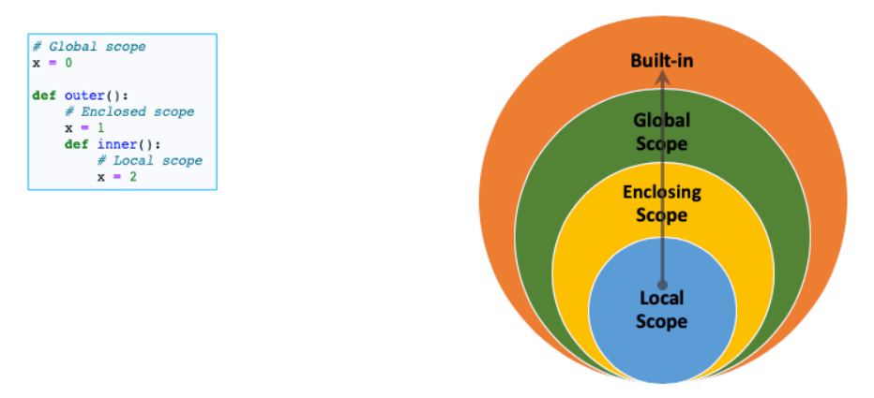
It needs to call print(x) within inner(), which is a function nested in outer(). Then Python will first look if "x" was defined locally within inner(). If not, the variable defined in outer() will be used. This is the enclosing function. If it also wasn't defined there, the Python interpreter will go up another level - to the global scope. Above that, you will only find the built-in scope, which contains special variables reserved for Python itself.

Slide 20
6
Project

Slide 21
Project – Guess Number Game
https://github.com/jianchentech/PythonLesson/blob/master/pythonProject/BeginnerProject/credentialCreator.md
Deadline: March 06 11:50PM, 2021

Slide 22
Merci !
Avez-vous des questions ?

