Slide 1

Web Programming
Javascripts
Jian Chen

Slide 2
1
Javascript DOM Intro

Slide 3
DOM Definition
"The W3C Document Object Model (DOM) is a platform and language-neutral interface that allows programs and scripts to dynamically access and update the content, structure, and style of a document."
Core DOM - standard model for all document types
XML DOM - standard model for XML documents
HTML DOM - standard model for HTML documents

Slide 4
HTML DOM
The HTML DOM is a standard object model and programming interface for HTML.
The HTML elements as objects
The properties of all HTML elements
The methods to access all HTML elements
The events for all HTML elements
The HTML DOM is a standard for how to get, change, add, or delete HTML elements.

Slide 5
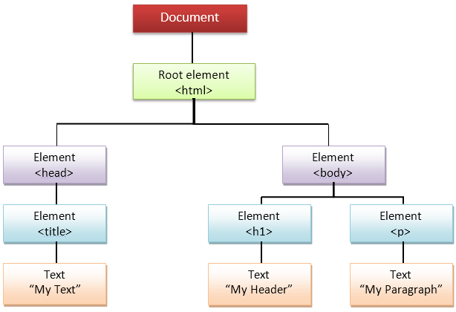
HTML DOM
When a web page is loaded, the browser creates a Document Object Model of the page.
The HTML DOM model is constructed as a tree of Objects
The HTML DOM Tree of Objects
<!DOCTYPE html>
<html>
<head>
<title>This is Demo of HTML</title>
</head>
<body>
<h1>This is heading</h1>
<p>The following is the input text</p>
</body>
</html>

Slide 6
Dynamic HTML
JavaScript can change all the HTML elements in the page
JavaScript can change all the HTML attributes in the page
JavaScript can change all the CSS styles in the page
JavaScript can remove existing HTML elements and attributes
JavaScript can add new HTML elements and attributes
JavaScript can react to all existing HTML events in the page
JavaScript can create new HTML events in the page

Slide 7
2
Javascript HTML DOM Methods

Slide 8
DOM Programming Interface
The HTML DOM can be accessed with JavaScript (and with other programming languages).
In the DOM, all HTML elements are defined as objects.
The programming interface is the properties and methods of each object.
A property is a value that you can get or set (like changing the content of an HTML element).
A method is an action you can do (like add or deleting an HTML element).

Slide 9
<html> <body> <p id="demo"></p> <script> document.getElementById("demo").innerHTML = "Hello World!"; </script> </body> </html>
getElementById is a method, while innerHTML is a property

Slide 10
getElementById Method
The most common way to access an HTML element is to use the id of the element.
getElementById method used id="demo" to find the element.
The innerHTML Property
The innerHTML property is useful for getting or replacing the content of HTML elements.
The innerHTML property can be used to get or change any HTML element, including <html> and <body>

Slide 11
3
Javascript Document

Slide 12
HTML DOM Document Object
The HTML DOM document object is the owner of all other objects in web page.
The document object represents the web page.
If it need to access any element in an HTML page, always start with accessing the document object.

Slide 13
Finding HTML Elements
Method | Description
document.getElementById(id) | Find an element by element id
document.getElementsByTagName(name) | Find elements by tag name
document.getElementsByClassName(name) | Find elements by class name

Slide 14
Changing HTML Elements
Property | Description
element.innerHTML = new html content | Change the inner HTML of an element
element.attribute = new value | Change the attribute value of an HTML element
element.style.property = new style | Change the style of an HTML element
Method | Description
element.setAttribute(attribute, value) | Change the attribute value of an HTML element

Slide 15
Adding and Deleting Elements
Method | Description
document.createElement(element) | Create an HTML element
document.removeChild(element) | Remove an HTML element
document.appendChild(element) | Add an HTML element
document.replaceChild(new, old) | Replace an HTML element
document.write(text) | Write into the HTML output stream

Slide 16
4
DOM Elements

Slide 17
Finding HTML Element by Id
The easiest way to find an HTML element in the DOM, is to use the element id, like id=“unique":
const element = document.getElementById(“unique");
If the element is found, the method will return the element as an object (in element).
If the element is not found, element will contain null.

Slide 18
Finding HTML Elements by Tag Name
Finds all <p> elements:
const element = document.getElementsByTagName("p");
Finds the element with id="main", and then finds all <p> elements inside "main":
const x = document.getElementById("main"); const y = x.getElementsByTagName("p");

Slide 19
Finding HTML Elements by Class Name
Find all HTML elements with the same class name, use getElementsByClassName().
Returns a list of all elements with class=“para".
const x = document.getElementsByClassName(“para");

Slide 20
Finding HTML Elements by CSS Selectors
Find all HTML elements that match a specified CSS selector (id, class names, types, attributes, values of attributes, etc), use the querySelectorAll() method.
Returns a list of all <p> elements with class="intro".
const x = document.querySelectorAll("p.intro");

Slide 21
Thanks for your attending
Jian Chen

