Slide 1

Web Programming Introduction
Jian Chen

Slide 2
Web Evolution
Contents
HTTP Protocol
Markup Language

Slide 3
1
Web Evolution

Slide 4
World Wide Web
Proposal
1989
Language
01
Hypertext-based
04
02
03
Deployed
Internet
1992
The equivalent term

Slide 5

Web History
Internet HIstory

Slide 6
Browser
01
NCSA Mosaic
First graphics browser: 1993
02
Netscape Navigator
1994 - 2007
The start of the browser war
03
Internet Explorer
Microsoft 1995

Slide 7
Browser
Opera
01
Safari
1996
2003
02
04
03
Chrome
Firefox
Google 2008
Mozilla 2004

Slide 8
Browser - IE
Internet Explorer
Microsoft 1995
01
Microsoft Edge
IE 6, IE 7
Successor to Internet Explorer
Windows 10
2015
05
02
Windows XP
Windows XP SP2
04
03
IE 10, IE 11
IE 8, IE 9
Windows 8
Windows 8.1
Windows Vista
Windows 7
Most Popular Web Browsers 1993 – 2020

Slide 9
The roles of the browser:
Communicate with the web server
Interpret the server response
Show page to user
Manage file cache
Manage cookies and sessions

Slide 10
2
HTTP Protocol

Slide 11
Communication protocol
Necessary for 2 machines to chat
It's basically a standard
The nature of the messages
The order of the messages
01
02

Slide 12
Les protocoles d'Internet :
01
POP
Post Office Protocol
Combined with SMTP in mail server
SMTP
Simple Mail Transfer Protocol
02
04
03
HTTP
HyperText Transfer Protocol
FTP
File Transfer Protocol

Slide 13
HTTP Method
GET
Read a resource at the given URL
PUT
Replace a resource at the given URL
PATCH
Modify a resource at the given URL
DELETE
Delete the resource at the given URL
POST
Add a resource to the URL

Slide 14
HTTP Reponse
Example HTTP response
HTTP/1.1 200 OK
Server: Microsoft-IIS/5.0
X-Powered-By: ASP.NET
Content-Location: http://darktranquillity.com/index.html
Date: Thu, 25 Aug 2011 20:24:52 GMT
Content-Type: text/html
Accept-Ranges: bytes
Last-Modified: Wed, 20 Jul 2011 20:34:04 GMT
ETag: "9e7ee5d1c47cc1:c53"
Content-Length: 2957

Slide 15
URI (URL)
This is the address of the site, Uniform Resource Identifier - URI
http://google.com
http://facebook.com

Slide 16
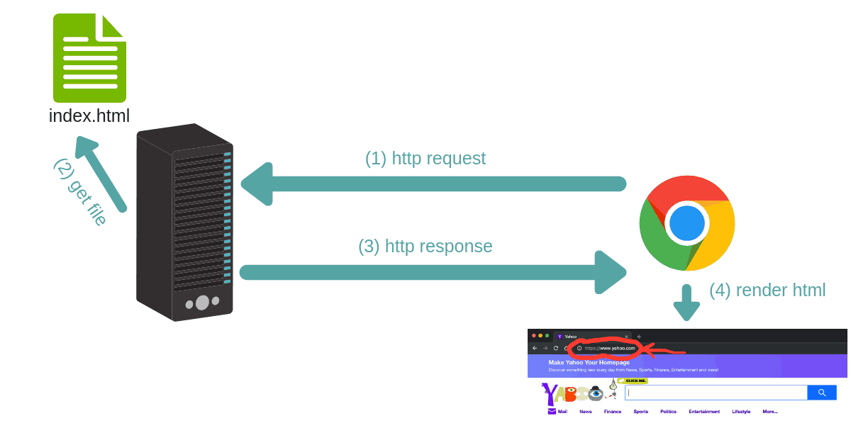
Client and Web Server

Slide 17
3
Markup Language

Slide 18
What is HTML?
HTML stands for Hyper Text Markup Language
HTML is the standard markup language for creating Web pages
HTML describes the structure of a Web page
HTML consists of a series of elements
HTML elements tell the browser how to display the content
HTML elements label pieces of content such as "this is a heading", "this is a paragraph", "this is a link", etc.

Slide 19
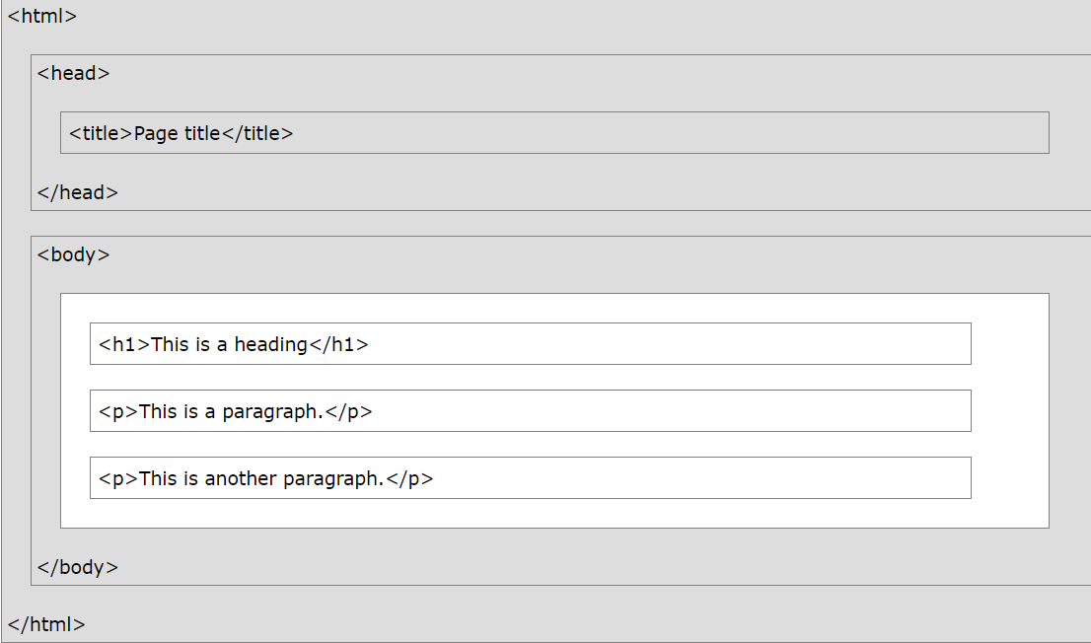
HTML Document and Structure
<!DOCTYPE html> <html lang="en"> <head> <meta charset="UTF-8"> <title>Web Title put here</title> </head> <body> <h1>First level heading</h1> <h2>Second level heading</h2> <p>First paragraph</p> </body> </html>

Slide 20
The <!DOCTYPE html> declaration defines that this document is an HTML5 document
The <html> element is the root element of an HTML page
The <head> element contains meta information about the HTML page
The <title> element specifies a title for the HTML page (which is shown in the browser's title bar or in the page's tab)
The <body> element defines the document's body, and is a container for all the visible contents, such as headings, paragraphs, images, hyperlinks, tables, lists, etc.
The <h1> element defines a large heading
The <p> element defines a paragraph

Slide 21
HTML Elements
An HTML element is defined by a start tag, some content, and an end tag:
<tagname>Content goes here...</tagname>
Start tag | Element content | End tag
<h1> | My First Heading | </h1>
<p> | My first paragraph. | </p>
<br> | none | none
Note: Some HTML elements have no content (like the <br> element). These elements are called empty elements. Empty elements do not have an end tag!

Slide 22
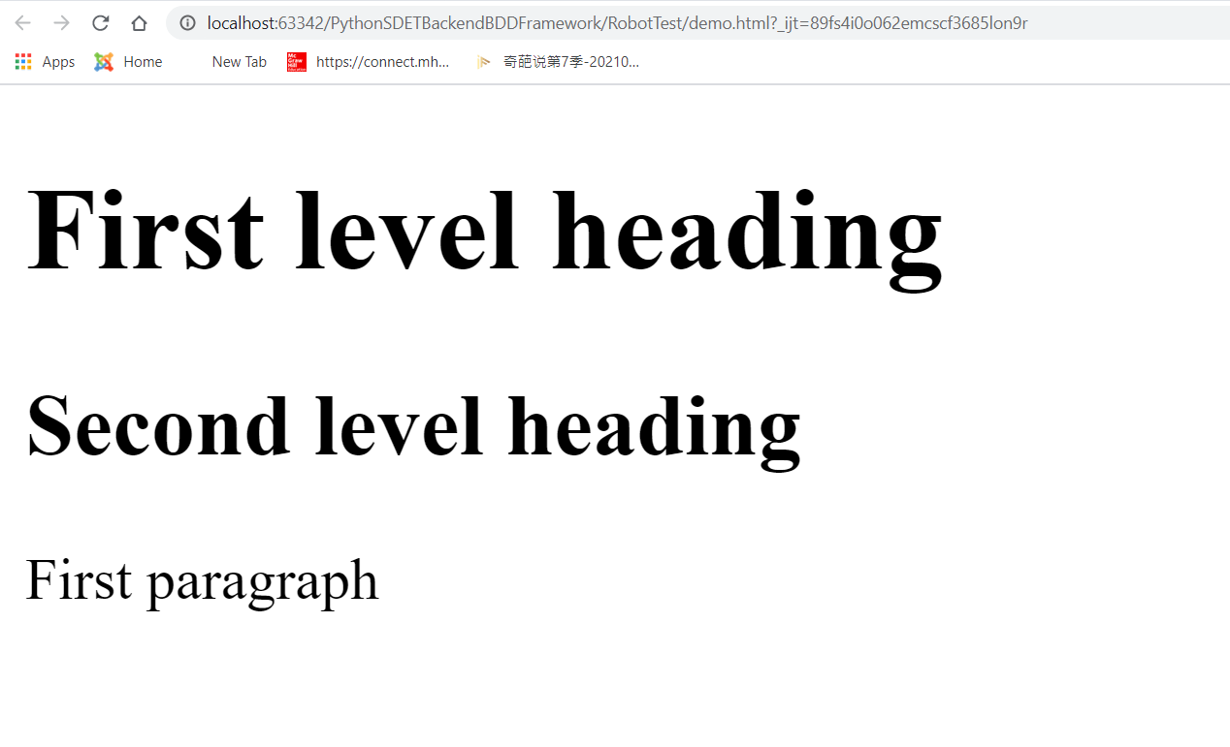
Web Browsers
The purpose of a web browser (Chrome, Edge, Firefox, Safari) is to read HTML documents and display them correctly.
A browser does not display the HTML tags, but uses them to determine how to display the document:

Slide 23
Thanks for your attending
Jian Chen

