Slide 1

Web Programming
PHP 3
Jian Chen

Slide 2
1
PHP Form Required

Slide 3
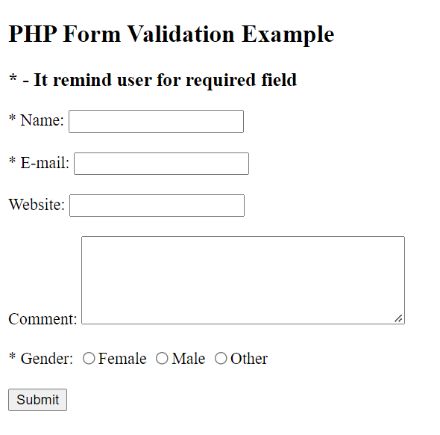
HTML Required Form

Slide 4
PHP Required Fields
From the following validation rules table, the "Name", "E-mail", and "Gender" fields are required. These fields cannot be empty and must be filled out in the HTML form.
Field | Validation Rules
Name | Required. + Must only contain letters and whitespace
E-mail | Required. + Must contain a valid email address (with @ and .)
Website | Optional. If present, it must contain a valid URL
Comment | Optional. Multi-line input field (textarea)
Gender | Required. Must select one

Slide 5
Error Handling
In the following code we have added some new variables: $nameErr, $emailErr, $genderErr, and $websiteErr. These error variables will hold error messages for the required fields. We have also added an if else statement for each $_POST variable. This checks if the $_POST variable is empty (with the PHP empty() function). If it is empty, an error message is stored in the different error variables, and if it is not empty, it sends the user input data:
if (empty($_POST["name"])) { $nameErr = "Name is required"; } else { $name = test_input($_POST["name"]); }

Slide 6
PHP - Display The Error Messages
Then in the HTML form, we add a little script after each required field, which generates the correct error message if needed (that is if the user tries to submit the form without filling out the required fields):
Name: <input type="text" name="name"> <span class="error">* <?php echo $nameErr;?></span> <br><br>

Slide 7
PHP - Validate Name
It need to check if the name field only contains letters, dashes, apostrophes and whitespaces. If the value of the name field is not valid, then store an error message:
$name = test_input($_POST["name"]); if (!preg_match("/^[a-zA-Z-' ]*$/",$name)) { $nameErr = "Only letters and white space allowed"; }
The preg_match() function searches a string for pattern, returning true if the pattern exists, and false otherwise.

Slide 8
PHP - Validate E-mail
It need to check whether an email address is well-formed is to use PHP's filter_var() function.
In the code below, if the e-mail address is not well-formed, then store an error message:
$email = test_input($_POST["email"]); if (!filter_var($email, FILTER_VALIDATE_EMAIL)) { $emailErr = "Invalid email format"; }

Slide 9
PHP - Validate URL
It need to check if a URL address syntax is valid (this regular expression also allows dashes in the URL). If the URL address syntax is not valid, then store an error message:
$website = test_input($_POST["website"]); if (!preg_match("/\b(?:(?:https?|ftp):\/\/|www\.)[-a-z0-9+&@#\/%?=~_|!:,.;]*[-a-z0-9+&@#\/%=~_|]/i",$website)) { $websiteErr = "Invalid URL"; }

Slide 10
2
PHP Read File

Slide 11
PHP Manipulating Files
PHP has several functions for creating, reading, uploading, and editing files.
Be careful when manipulating files!
When manipulating files it need to be very careful. It can do a lot of damage if there are something wrong. Common errors are: editing the wrong file, filling a hard-drive with garbage data, and deleting the content of a file by accident.

Slide 12
PHP readfile() Function
The readfile() function reads a file and writes it to the output buffer.
Assume we have a text file called "webdictionary.txt", stored on the server, that looks like this:
AJAX = Asynchronous JavaScript and XML CSS = Cascading Style Sheets HTML = Hyper Text Markup Language PHP = PHP Hypertext Preprocessor SQL = Structured Query Language The PHP code to read the file and write it to the output buffer is as follows (the readfile() function returns the number of bytes read on success):
<?php echo readfile(“readFile.txt"); ?>

Slide 13
PHP Open File - fopen()
A better method to open files is with the fopen() function. This function gives more options than the readfile() function.
We will use the text file, “readFile.txt":
The first parameter of fopen() contains the name of the file to be opened and the second parameter specifies in which mode the file should be opened. The following example also generates a message if the fopen() function is unable to open the specified file:
<?php $myfile = fopen(" readFile.txt ", "r") or die("Unable to open file!"); echo fread($myfile,filesize(" readFile.txt ")); fclose($myfile); ?>

Slide 14
The file may be opened in one of the following modes:
Modes | Description
r | Open a file for read only. File pointer starts at the beginning of the file
w | Open a file for write only. Erases the contents of the file or creates a new file if it doesn't exist. File pointer starts at the beginning of the file
a | Open a file for write only. The existing data in file is preserved. File pointer starts at the end of the file. Creates a new file if the file doesn't exist
x | Creates a new file for write only. Returns FALSE and an error if file already exists
r+ | Open a file for read/write. File pointer starts at the beginning of the file
w+ | Open a file for read/write. Erases the contents of the file or creates a new file if it doesn't exist. File pointer starts at the beginning of the file
a+ | Open a file for read/write. The existing data in file is preserved. File pointer starts at the end of the file. Creates a new file if the file doesn't exist
x+ | Creates a new file for read/write. Returns FALSE and an error if file already exists

Slide 15
PHP Read File - fread()
The fread() function reads from an open file.
The first parameter of fread() contains the name of the file to read from and the second parameter specifies the maximum number of bytes to read.
The following PHP code reads the “readFile.txt" file to the end:
fread($myfile,filesize(“readFile.txt"));

Slide 16
PHP Close File - fclose()
It's a good programming practice to close all files after finished with them. You don't want an open file running around on your server taking up resources!
The fclose() requires the name of the file (or a variable that holds the filename) we want to close:
<?php $myfile = fopen(“readFile.txt", "r"); // some code to be executed.... fclose($myfile); ?>

Slide 17
PHP Read Single Line - fgets()
The fgets() function is used to read a single line from a file.
The example below outputs the first line of the “readFile.txt" file:
<?php $myfile = fopen("readFile.txt", "r") or die("Unable to open file!"); echo fgets($myfile); fclose($myfile); ?>
Note: After a call to the fgets() function, the file pointer has moved to the next line.

Slide 18
PHP Check End-Of-File - feof()
The feof() function checks if the "end-of-file" (EOF) has been reached.
The feof() function is useful for looping through data of unknown length.
The example below reads the “readFile.txt" file line by line, until end-of-file is reached:
<?php $myfile = fopen(" readFile.txt", "r") or die("Unable to open file!"); while(!feof($myfile)) { echo fgets($myfile) . "<br>"; } fclose($myfile); ?>

Slide 19
PHP Read Single Character - fgetc()
The fgetc() function is used to read a single character from a file.
The example below reads the “readFile.txt" file character by character, until end-of-file is reached:
<?php $myfile = fopen(“readFile.txt", "r") or die("Unable to open file!"); while(!feof($myfile)) { echo fgetc($myfile); } fclose($myfile); ?>
Note: After a call to the fgetc() function, the file pointer moves to the next character.

Slide 20
3
PHP Write File

Slide 21
PHP Create File - fopen()
The fopen() function is also used to create a file. Maybe a little confusing, but in PHP, a file is created using the same function used to open files.
If you use fopen() on a file that does not exist, it will create it, given that the file is opened for writing (w) or appending (a).
The example below creates a new file called “writeFile.txt". The file will be created in the same directory where the PHP code resides:
$myfile = fopen("testfile.txt", "w")

Slide 22
PHP Write to File - fwrite()
The fwrite() function is used to write to a file.
The first parameter of fwrite() contains the name of the file to write to and the second parameter is the string to be written.
The example below writes a couple of names into a new file called “writeFile.txt":
<?php $myfile = fopen(“writeFile.txt", "w") or die("Unable to open file!"); $txt = “****************\n"; fwrite($myfile, $txt); $txt = “*****************\n"; fwrite($myfile, $txt); fclose($myfile); ?>
Notice that we wrote to the file “writeFile.txt" twice. Each time we wrote to the file we sent the string $txt. After we finished writing, we closed the file using the fclose() function.

Slide 23
Thanks for your attending
Jian Chen

