Slide 1

Web Programming
Javascripts
Jian Chen

Slide 2
1
Javascript Array Sort

Slide 3
Sorting Array
The sort() method sorts an array alphabetically:
const fruits = ["Banana", "Orange", "Apple", "Mango"]; fruits.sort();

Slide 4
Reversing Array
The reverse() method reverses the elements in an array.
It can sort an array in descending order:
const fruits = ["Banana", "Orange", "Apple", "Mango"]; fruits.sort(); fruits.reverse();

Slide 5
2
Javascript Date Object

Slide 6
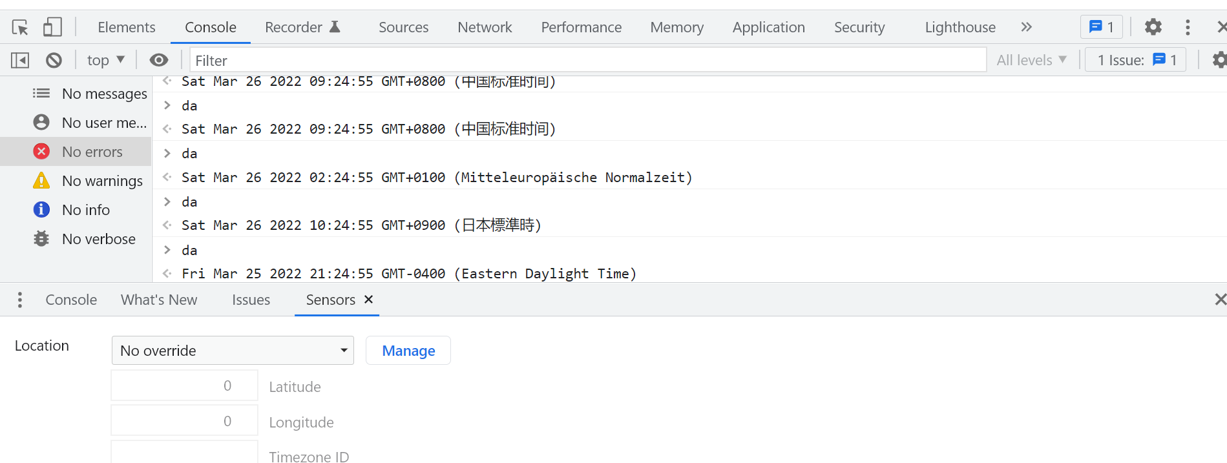
Date Output
const d = new Date();
By default, JavaScript will use the browser's time zone and display a date as a full text string:
Fri Mar 25 2022 21:19:20 GMT-0400 (Eastern Daylight Time)

Slide 7
Create Date Objects
Date objects are created with the new Date() constructor.
There are 4 ways to create a new date object:
new Date() new Date(year, month, day, hours, minutes, seconds, milliseconds) new Date(milliseconds) new Date(date string)

Slide 8
new Date(year, month, ...)
new Date(year, month, ...) - a specified date and time.
7 numbers specify year, month, day, hour, minute, second, and millisecond (in order):
const d = new Date(2018, 11, 24, 10, 33, 30, 0);
Months from 0 to 11: January = 0. December = 11.
Specifying a month higher than 11, will not result in an error but add the overflow to the next year:
const d = new Date(2018, 15, 24, 10, 33, 30);
const d = new Date(2019, 3, 24, 10, 33, 30);

Slide 9
Using 6, 5, 4, 3, or 2 Numbers
6 numbers specify year, month, day, hour, minute, second:
const d = new Date(2018, 11, 24, 10, 33, 30);
5 numbers specify year, month, day, hour, and minute:
const d = new Date(2018, 11, 24, 10, 33);
...

Slide 10
new Date(dateString)
new Date(dateString) creates a new date object from a date string:
const d = new Date("October 13, 2014 11:13:00");

Slide 11
JavaScript Stores Dates as Milliseconds
JavaScript stores dates as number of milliseconds since January 01, 1970, 00:00:00 UTC (Universal Time Coordinated).
Zero time is January 01, 1970 00:00:00 UTC.
Now the time is: 1648257560867 milliseconds past January 01, 1970

Slide 12
new Date(milliseconds)
new Date(milliseconds) creates a new date object as zero time plus milliseconds:
const d = new Date(0);
01 January 1970 plus 100 000 000 000 milliseconds is 03 March 1973:
const d = new Date(100000000000);
January 01 1970 minus 100 000 000 000 milliseconds is approximately October 31 1966:
const d = new Date(-100000000000);
One day (24 hours) is 86 400 000 milliseconds.

Slide 13
Displaying Date
JavaScript will (by default) output dates in full text string format:
Sat Mar 26 2022 16:07:28 GMT-0400 (Eastern Daylight Time)
When displaying a date object in HTML, it is automatically converted to a string, with the toString() method.
const d = new Date(); d.toString();

Slide 14
The toUTCString() method converts a date to a UTC string (a date display standard).
const d = new Date(); d.toUTCString();
The toDateString() method converts a date to a more readable format:
const d = new Date(); d.toDateString();
The toISOString() method converts a Date object to a string, using the ISO standard format:
const d = new Date(); d.toISOString();

Slide 15
3
Javascript Date Format

Slide 16
Date Input
There are generally 3 types of JavaScript date input formats:
The ISO format follows a strict standard in JavaScript.
The other formats are not so well defined and might be browser specific
Type | Example
ISO Date | "2015-03-25" (The International Standard)
Short Date | "03/25/2015"
Long Date | "Mar 25 2015" or "25 Mar 2015"

Slide 17
ISO Input
ISO 8601 is the international standard for the representation of dates and times.
The ISO 8601 syntax (YYYY-MM-DD) is also the preferred JavaScript date format:
const d = new Date("2015-03-25");
The computed date will be relative to your time zone. Depending on your time zone, the result above will vary between March 24 and March 25.

Slide 18
Short Date
Short dates are written with an "MM/DD/YYYY" syntax like this:
const d = new Date("03/25/2015");

Slide 19
Long Date
Long dates are often written with a "MMM DD YYYY" syntax like this:
const d = new Date("Mar 25 2015");
Month and day can be in any order:
const d = new Date("25 Mar 2015");
Month can be written in full (January), or abbreviated (Jan):
const d = new Date("January 25 2015");
const d = new Date("Jan 25 2015");
Commas are ignored. Names are case insensitive:
const d = new Date("JANUARY, 25, 2015");

Slide 20
Parsing Date
If there is a valid date string, it can use the Date.parse() method to convert it to milliseconds.
Date.parse() returns the number of milliseconds between the date and January 1, 1970:
let msec = Date.parse("March 21, 2012");
Above number of milliseconds can be converted to a date object:
let msec = Date.parse("March 21, 2012"); const d = new Date(msec);

Slide 21
Thanks for your attending
Jian Chen

