Slide 1

Web Programming
HTML and CSS
Jian Chen

Slide 2
HTML
Contents
HTML Style
CSS

Slide 3
1
HTML

Slide 4
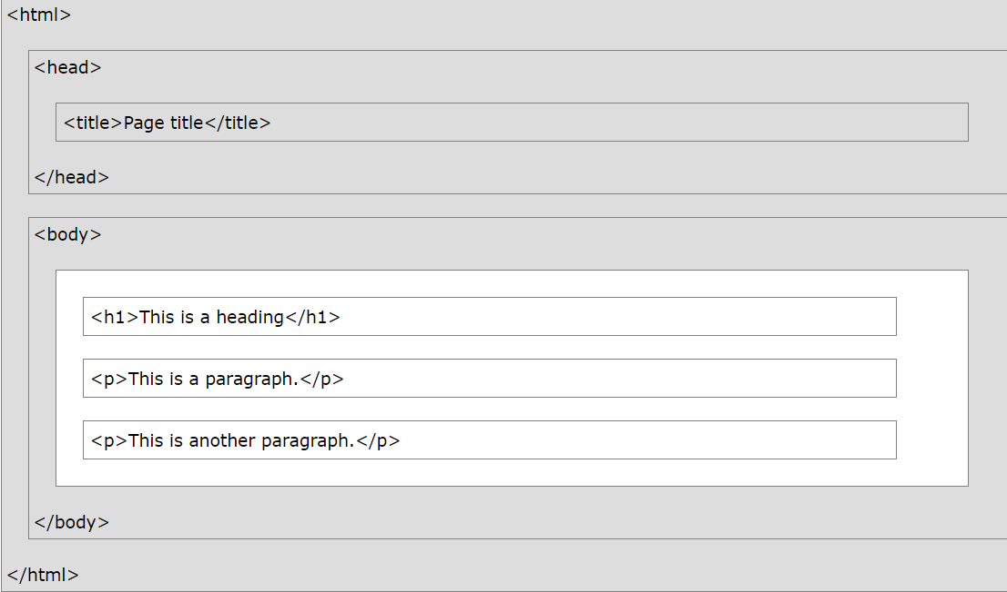
HTML Document and Structure
<!DOCTYPE html> <html lang="en"> <head> <meta charset="UTF-8"> <title>Web Title put here</title> </head> <body> <h1>First level heading</h1> <h2>Second level heading</h2> <p>First paragraph</p> </body> </html>

Slide 5
<!DOCTYPE> Declaration
The <!DOCTYPE> declaration represents the document type, and helps browsers to display web pages correctly.
It must only appear once, at the top of the page (before any HTML tags).
The <!DOCTYPE> declaration is not case sensitive.
The <!DOCTYPE> declaration for HTML5 is:
<!DOCTYPE html>

Slide 6
HTML Headings
HTML headings are defined with the <h1> to <h6> tags.
<h1> defines the most important heading. <h6> defines the least important heading:
Example
<h1>Heading 1</h1> <h2>Heading 2</h2> <h3>Heading 3</h3> <h4>Heading 4</h4> <h5>Heading 5</h5> <h6>Heading 6</h6>

Slide 7
HTML Paragraphs
The HTML <p> element defines a paragraph.
A paragraph always starts on a new line, and browsers automatically add some white space (a margin) before and after a paragraph.
<p> This paragraph contains a lot of lines in the source code, but the browser ignores it. </p>

Slide 8
HTML Links - Hyperlinks
The HTML <a> tag defines a hyperlink. It has the following syntax:
<a href="url">link text</a>
The most important attribute of the <a> element is the href attribute, which indicates the link's destination.
The link text is the part that will be visible to the reader.
Clicking on the link text, will send the reader to the specified URL address.
Example
This example shows how to create a link to W3Schools.com:
<a href="https://goole.com/">Visit Google!</a>

Slide 9
HTML Images Syntax
The HTML <img> tag is used to embed an image in a web page.
Images are not technically inserted into a web page; images are linked to web pages.
The <img> tag creates a holding space for the referenced image.
The <img> tag is empty, it contains attributes only, and does not have a closing tag.
The <img> tag has two required attributes:
src - Specifies the path to the image
alt - Specifies an alternate text for the image
Syntax
<img src="url" alt="alternatetext">

Slide 10
The src Attribute
The required src attribute specifies the path (URL) to the image.
Example
<img src="img_chania.jpg" alt="Flowers in Chania">
The alt Attribute
The required alt attribute provides an alternate text for an image, if the user for some reason cannot view it (because of slow connection, an error in the src attribute, or if the user uses a screen reader).
The value of the alt attribute should describe the image:
Example
<img src="img_chania.jpg" alt="Flowers in Chania">

Slide 11
2
HTML Styles

Slide 12
HTML Styles
.
The HTML style attribute is used to add styles to an element, such as color, font, size, and more
Example
I am Red
I am Blue
I am Big
01
02

Slide 13
HTML Style Attribute
Setting the style of an HTML element, can be done with the style attribute.
The HTML style attribute has the following syntax:
<tagname style="property:value;">
The property is a CSS property. The value is a CSS value.

Slide 14
Background Color
The CSS background-color property defines the background color for an HTML element.
Example
Set the background color for a page to powderblue:
<body style="background-color:powderblue;"> <h1>This is a heading</h1> <p>This is a paragraph.</p> </body>

Slide 15
Text Color
The CSS color property defines the text color for an HTML element:
Example
<h1 style="color:blue;">This is a heading</h1> <p style="color:red;">This is a paragraph.</p>

Slide 16
Fonts
The CSS font-family property defines the font to be used for an HTML element:
Example
<h1 style="font-family:verdana;">This is a heading</h1> <p style="font-family:courier;">This is a paragraph.</p>

Slide 17
Text Size
The CSS font-size property defines the text size for an HTML element:
Example
<h1 style="font-size:300%;">This is a heading</h1> <p style="font-size:160%;">This is a paragraph.</p>

Slide 18
Text Alignment
The CSS font-size property defines the text size for an HTML element:
Example
<h1 style="font-size:300%;">This is a heading</h1> <p style="font-size:160%;">This is a paragraph.</p>

Slide 19
3
CSS

Slide 20
What is CSS?
CSS stands for Cascading Style Sheets (CSS) and is used to format the layout of a webpage.
With CSS, you can control the color, font, the size of text, the spacing between elements, how elements are positioned and laid out, what background images or background colors are to be used, different displays for different devices and screen sizes, and much more!
Tip: The word cascading means that a style applied to a parent element will also apply to all children elements within the parent. So, if you set the color of the body text to "blue", all headings, paragraphs, and other text elements within the body will also get the same color (unless you specify something else)!

Slide 21
CSS Ways
CSS can be added to HTML documents in 3 ways:
Inline - by using the style attribute inside HTML elements
Internal - by using a <style> element in the <head> section
External - by using a <link> element to link to an external CSS file
The most common way to add CSS, is to keep the styles in external CSS files. However, in this tutorial we will use inline and internal styles, because this is easier to demonstrate, and easier for you to try it yourself.

Slide 22
Inline CSS
An inline CSS is used to apply a unique style to a single HTML element.
An inline CSS uses the style attribute of an HTML element.
The following example sets the text color of the <h1> element to blue, and the text color of the <p> element to red:
Example
<h1 style="color:blue;">A Blue Heading</h1> <p style="color:red;">A red paragraph.</p>

Slide 23
Internal CSS
An internal CSS is used to define a style for a single HTML page.
An internal CSS is defined in the <head> section of an HTML page, within a <style> element.
The following example sets the text color of ALL the <h1> elements (on that page) to blue, and the text color of ALL the <p> elements to red. In addition, the page will be displayed with a "powderblue" background color:
Example
<!DOCTYPE html> <html> <head> <style> body {background-color: powderblue;} h1 {color: blue;} p {color: red;} </style> </head> <body> <h1>This is a heading</h1> <p>This is a paragraph.</p> </body> </html>

Slide 24
External CSS
An external style sheet is used to define the style for many HTML pages.
To use an external style sheet, add a link to it in the <head> section of each HTML page:
Example
<!DOCTYPE html> <html> <head> <link rel="stylesheet" href="styles.css"> </head> <body> <h1>This is a heading</h1> <p>This is a paragraph.</p> </body> </html>

Slide 25
4
Project

Slide 26
Design of a static website
https://github.com/jianchentech/WebCamp/blob/main/WebProject/WebStatic.md

Slide 27
Thanks for your attending
Jian Chen

