Slide 1

Web Programming
PHP 3
Jian Chen

Slide 2
1
PHP Loops

Slide 3
PHP While Loop
while loop executes a block of code as long as the specified condition is true.
Example
<?php $x = 1; while($x <= 5) { echo "The number is: $x <br>"; $x++; } ?>
Example Explained
$x = 1; - Initialize the loop counter ($x), and set the start value to 1
$x <= 5 - Continue the loop as long as $x is less than or equal to 5
$x++; - Increase the loop counter value by 1 for each iteration

Slide 4
PHP Do While Loop
The do...while loop will always execute the block of code once, it will then check the condition, and repeat the loop while the specified condition is true.
Firstly sets a variable $x to 1 ($x = 1). Then, the do while loop will write some output, and then increment the variable $x with 1. Then the condition is checked (is $x less than, or equal to 5?), and the loop will continue to run as long as $x is less than, or equal to 5:
Example
<?php $x = 1; do { echo "The number is: $x <br>"; $x++; } while ($x <= 5); ?>

Slide 5
PHP For Loop
The for loop is used when you know in advance how many times the script should run.
Syntax
for (init counter; test counter; increment counter) { code to be executed for each iteration; }
Parameters:
init counter: Initialize the loop counter value
test counter: Evaluated for each loop iteration. If it evaluates to TRUE, the loop continues. If it evaluates to FALSE, the loop ends.
increment counter: Increases the loop counter value

Slide 6
Example
<?php for ($x = 0; $x <= 10; $x++) { echo "The number is: $x <br>"; } ?>
$x = 0; - Initialize the loop counter ($x), and set the start value to 0
$x <= 10; - Continue the loop as long as $x is less than or equal to 10
$x++ - Increase the loop counter value by 1 for each iteration

Slide 7
PHP Foreach Loop
The foreach loop works only on arrays, and is used to loop through each key/value pair in an array.
Syntax
foreach ($array as $value) { code to be executed; }
For every loop iteration, the value of the current array element is assigned to $value and the array pointer is moved by one, until it reaches the last array element.
<?php $colors = array("red", "green", "blue", "yellow"); foreach ($colors as $value) { echo "$value <br>"; } ?>

Slide 8
2
PHP Function

Slide 9
PHP Built-in Functions
PHP has over 1000 built-in functions that can be called directly, from within a script, to perform a specific task.
Please check out our PHP reference for a complete overview of the PHP built-in functions.
PHP User Defined Functions
Besides the built-in PHP functions, it is possible to create your own functions.
A function is a block of statements that can be used repeatedly in a program.
A function will not execute automatically when a page loads.
A function will be executed by a call to the function.

Slide 10
User Defined Function
A user-defined function declaration starts with the word function:
Note: A function name must start with a letter or an underscore. Function names are NOT case-sensitive.
Tip: Give the function a name that reflects what the function does!
In the example below, we create a function named "writeMsg()". The opening curly brace ( { ) indicates the beginning of the function code, and the closing curly brace ( } ) indicates the end of the function. The function outputs "Hello world!". To call the function, just write its name followed by brackets ():
Example
<?php function writeMsg() { echo "Hello world!"; } writeMsg(); // call the function ?>

Slide 11
Function Argument
Information can be passed to functions through arguments. An argument is just like a variable.
Arguments are specified after the function name, inside the parentheses. You can add as many arguments as you want, just separate them with a comma.
The following example has a function with one argument ($fname). When the familyName() function is called, we also pass along a name (e.g. Jani), and the name is used inside the function, which outputs several different first names, but an equal last name:
Example
<?php function familyName($fname, $year) { echo "$fname Refsnes. Born in $year <br>"; } familyName("Hege", "1975"); familyName("Stale", "1978"); ?>

Slide 12
Return Values
To let a function return a value, use the return statement:
Example
<?php declare(strict_types=1); // strict requirement function sum(int $x, int $y) { $z = $x + $y; return $z; } echo "5 + 10 = " . sum(5, 10) . "<br>"; echo "7 + 13 = " . sum(7, 13) . "<br>"; echo "2 + 4 = " . sum(2, 4); ?>

Slide 13
3
PHP Form Handling

Slide 14
A Simple HTML Form
The example below displays a simple HTML form with two input fields and a submit button:
<html> <body> <form action="welcome.php" method="post"> Name: <input type="text" name="name"><br> E-mail: <input type="text" name="email"><br> <input type="submit"> </form> </body> </html>
When the user fills out the form above and clicks the submit button, the form data is sent for processing to a PHP file named "welcome.php". The form data is sent with the HTTP POST method.

Slide 15
PHP Form in back-end
To display the submitted data you could simply echo all the variables. The "welcome.php" looks like this:
<html> <body> Welcome <?php echo $_POST["name"]; ?><br> Your email address is: <?php echo $_POST["email"]; ?> </body> </html>
The output could be something like this:
Welcome John Your email address is john.doe@example.com

Slide 16
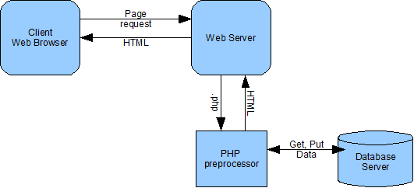
PHP Form in back-end

Slide 17
POST VS GET
Both GET and POST are treated as $_GET and $_POST. These are superglobals, which means that they are always accessible, regardless of scope - and you can access them from any function, class or file without having to do anything special.
$_GET is an array of variables passed to the current script via the URL parameters.
$_POST is an array of variables passed to the current script via the HTTP POST method.
When to use GET?
Information sent from a form with the GET method is visible to everyone (all variable names and values are displayed in the URL). GET also has limits on the amount of information to send. The limitation is about 2000 characters. However, because the variables are displayed in the URL, it is possible to bookmark the page. This can be useful in some cases.
GET may be used for sending non-sensitive data.
Note: GET should NEVER be used for sending passwords or other sensitive information!
When to use POST?
Information sent from a form with the POST method is invisible to others (all names/values are embedded within the body of the HTTP request) and has no limits on the amount of information to send.
However, because the variables are not displayed in the URL, it is not possible to bookmark the page.

Slide 18
4
PHP Form Validation

Slide 19
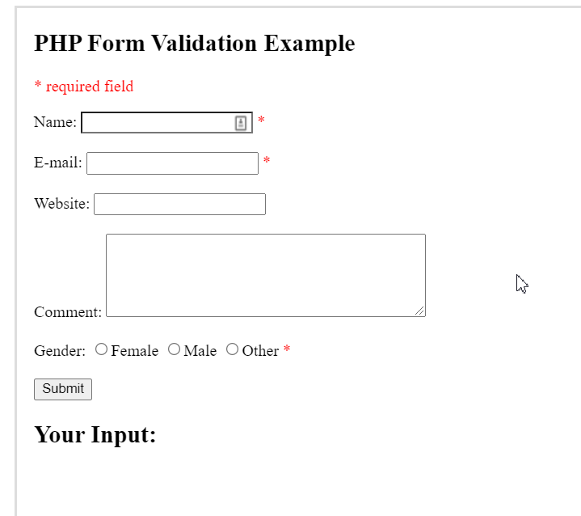
HTML Form for validation
Think SECURITY when processing PHP forms!
it will show how to process PHP forms with security. Proper validation of form data is important to protect your form from hackers and spammers!
The HTML form we will contains various input fields: required and optional text fields, radio buttons, and a submit button:

Slide 20
Validation Rule
The validation rules for the form above are as follows:
Field | Validation Rules
Name | Required. + Must only contain letters and whitespace
E-mail | Required. + Must contain a valid email address (with @ and .)
Website | Optional. If present, it must contain a valid URL
Comment | Optional. Multi-line input field (textarea)
Gender | Required. Must select one

Slide 21
Text Field
The name, email, and website fields are text input elements, and the comment field is a textarea. The HTML code looks like this:
Name: <input type="text" name="name"> E-mail: <input type="text" name="email"> Website: <input type="text" name="website"> Comment: <textarea name="comment" rows="5" cols="40"></textarea>

Slide 22
Radio Button
The gender fields are radio buttons and the HTML code looks like this:
Gender: <input type="radio" name="gender" value="female">Female <input type="radio" name="gender" value="male">Male <input type="radio" name="gender" value="other">Other

Slide 23
Form Element
The HTML code of the form looks like this:
<form method="post">
When the form is submitted, the form data is sent with method="post".

Slide 24
Pass Variable between HTML and PHP
<?php // define variables and set to empty values $name = $email = $gender = $comment = $website = ""; if ($_SERVER["REQUEST_METHOD"] == "POST") { $name = $_POST["name"]; $email = $_POST["email"]; $website = $_POST["website"]; $comment = $_POST["comment"]; $gender = $_POST["gender"]; } ?>
The start of the script, we check whether the form has been submitted using $_SERVER["REQUEST_METHOD"]. If the REQUEST_METHOD is POST, then the form has been submitted - and it should be validated. If it has not been submitted, skip the validation and display a blank form.
In the example above, all input fields are optional. The script works fine even if the user does not enter any data.

Slide 25
Thanks for your attending
Jian Chen

