Slide 1

Web Programming
PHP 1
Jian Chen

Slide 2
1
PHP Introduction

Slide 3
What is PHP?
PHP is an acronym for "PHP: Hypertext Preprocessor"
PHP is a widely-used, open source scripting language
PHP scripts are executed on the server
PHP is free to download and use

Slide 4
What is PHP file?
PHP files can contain text, HTML, CSS, JavaScript, and PHP code
PHP code is executed on the server, and the result is returned to the browser as plain HTML
PHP files have extension ".php"

Slide 5
What PHP can do?
PHP can generate dynamic page content
PHP can create, open, read, write, delete, and close files on the server
PHP can collect form data
PHP can send and receive cookies
PHP can add, delete, modify data in your database
PHP can be used to control user-access
PHP can encrypt data
PHP are not only limited to output HTML. It can output images, PDF files, and even Flash movies. It can also output any text, such as XHTML and XML.

Slide 6
Why PHP?
PHP runs on various platforms (Windows, Linux, Unix, Mac OS X, etc.)
PHP is compatible with almost all servers used today (Apache, IIS, etc.)
PHP supports a wide range of databases
PHP is free. Download it from the official PHP resource: www.php.net
PHP is easy to learn and runs efficiently on the server side

Slide 7
2
PHP Syntax

Slide 8
Basic PHP Syntax
A PHP script can be placed anywhere in the document.
A PHP script starts with <?php and ends with ?>:
<?php // PHP code goes here ?>
The default file extension for PHP files is ".php".
A PHP file normally contains HTML tags, and some PHP scripting code.

Slide 9
An example of a simple PHP file, with a PHP script that uses a built-in PHP function "echo" to output the text "Hello World!" on a web page:
<!DOCTYPE html> <html> <body> <h1>My first PHP page</h1> <?php echo "Hello World!"; ?> </body> </html>

Slide 10
PHP Keywords Case Sensitivity
In PHP, keywords (e.g. if, else, while, echo, etc.), classes, functions, and user-defined functions are not case-sensitive.
In the example below, all three echo statements below are equal and legal:
<!DOCTYPE html> <html> <body> <?php ECHO "Hello World!<br>"; echo "Hello World!<br>"; EcHo "Hello World!<br>"; ?> </body> </html>

Slide 11
PHP Variable Case Sensitivity
All PHP variable names are case-sensitive!
Look at the example below; only the first statement will display the value of the $color variable! This is because $color, $COLOR, and $coLOR are treated as three different variables:
<!DOCTYPE html> <html> <body> <?php $color = "red"; echo "My car is " . $color . "<br>"; echo "My house is " . $COLOR . "<br>"; echo "My boat is " . $coLOR . "<br>"; ?> </body> </html>

Slide 12
3
EasyPHP Installation

Slide 13
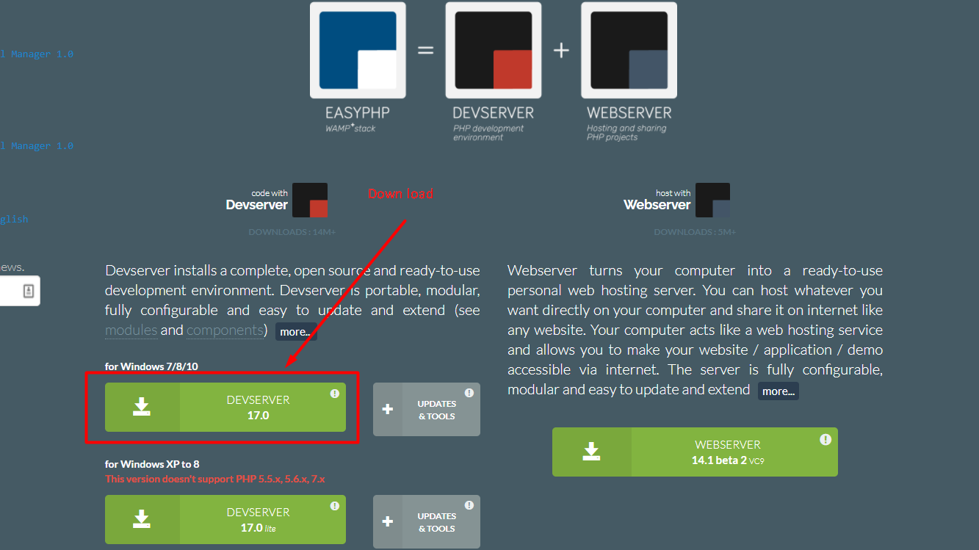
Step 1: Download The Devserver
Go to https://www.easyphp.org/ to download the latest version.
Click Devserver 17.0

Slide 14
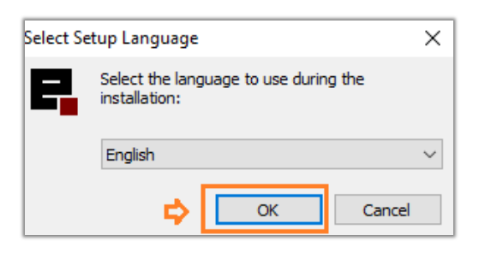
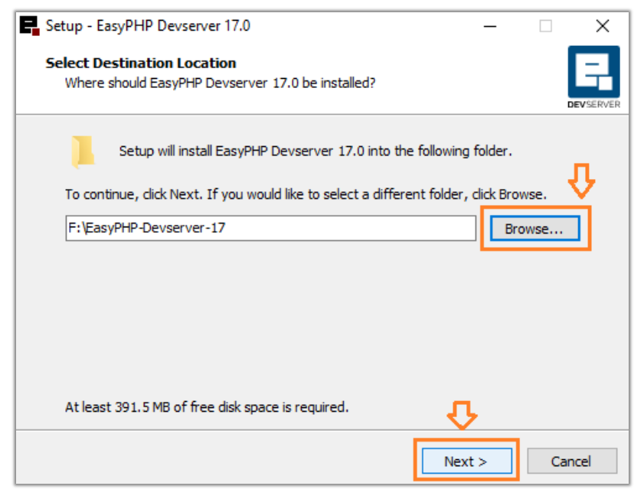
Step 2: Install
Click the downloaded setup.
Select English.
Click OK.
Select the path. By default it suggests C:/Program files, but it is better to choose a location other than C: drive. I have chosen F: drive.
Click Next.

Slide 15
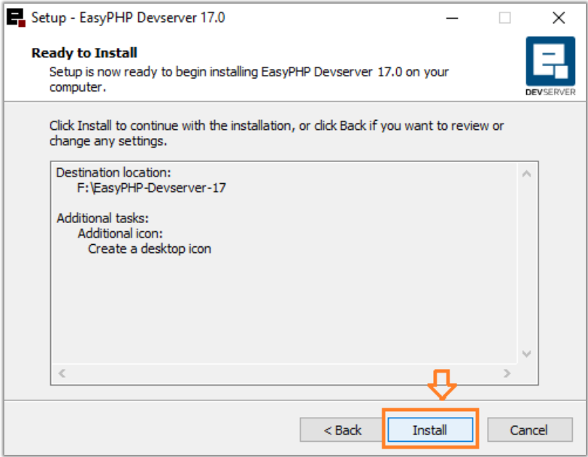
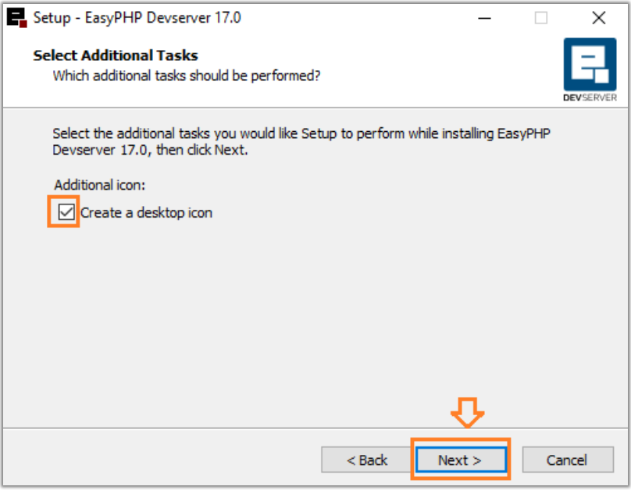
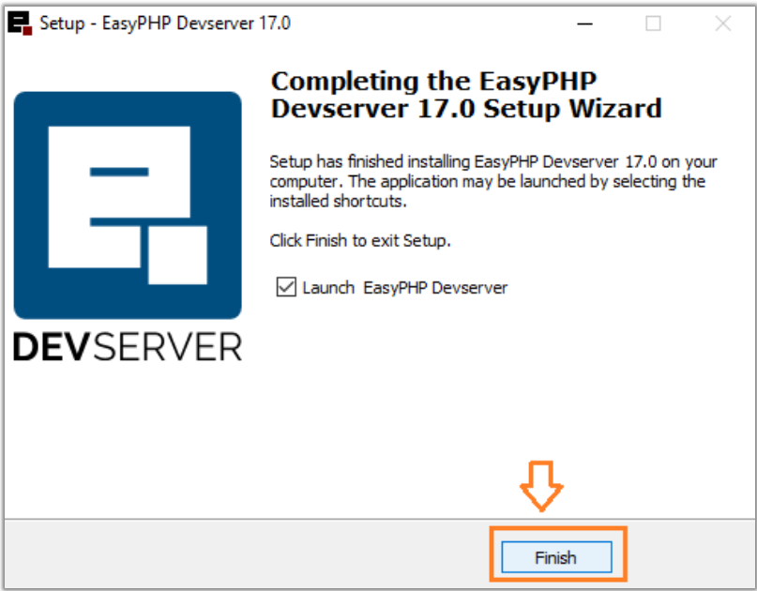
Click Install.
Tick Create a desktop icon.
Click Next.
Click Finish

Slide 16
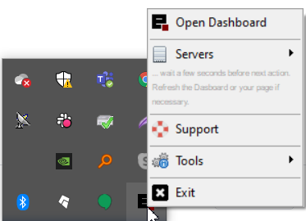
Step 3: Launch
Click hidden icons, located at bottom-right of Desktop.
Right Click on EasyPHP black icon.
Click Open Dashboard.

Slide 17
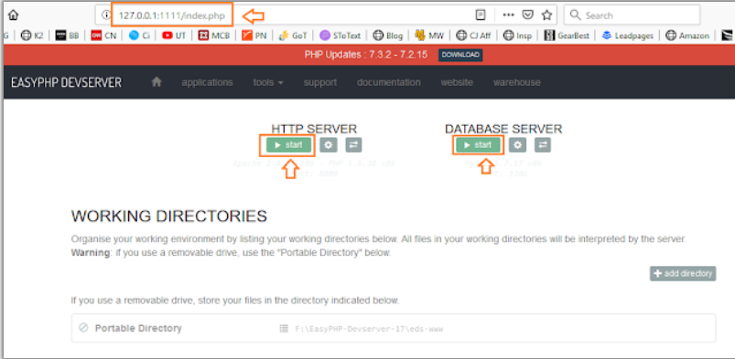
The browser might show you an error message something like this, "Can't establish a connection to the server at 127.0.0.1:8000."
To resolve this issue restart your computer & repeat the above step i.e Open Dashboard.
You can open manually as well, in two ways: 127.0.0.1:1111 or localhost:1111
Start HTTP SERVER & DATABASE SERVER.

Slide 18
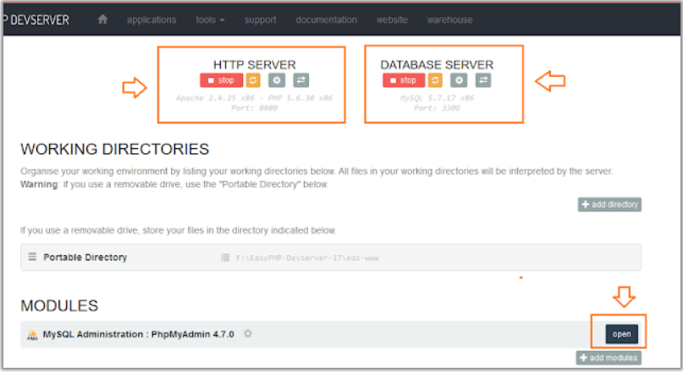
They will look like this, once started.
Click Open, to open phpMyAdmin.

Slide 19
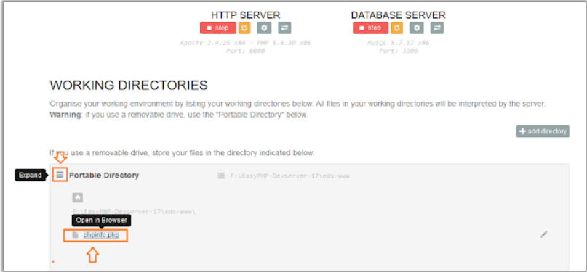
Step 4: Run Code on Server
You can access the front-end by two ways:
First method, Expand the Portable directory by Clicking three lines icon.
Click the folder or file you want to open.
Second method, type http://127.0.0.1:8080/ or localhost:8080/
Note: In my computer, since port 80 was being used by other application, so that's why the port 8080 is added. Normally you can access simply by localhost or 127.0.0.0

Slide 20
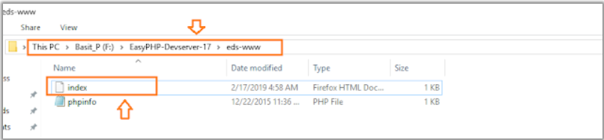
Go to the the Drive where you have installed the EasyPHP.
1
Open PHP-Devserver-17 folder.
2
Open eds-www folder (Root Directory)
3
Since, I had installed on F: drive so, my path is F:\EasyPHP-Devserver-17\eds-www
4
Now create index.php or index.html in root directory.
5
Put some HTML code like, <h1> Thanks Meer's World </h2>
6

Slide 21
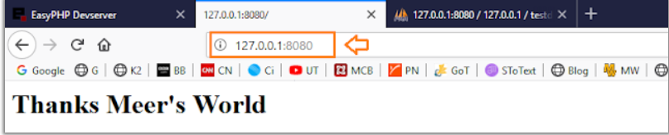
Now open to test.
Type localhost or 127.0.0.1 or localhost:8080 or 127.0.0.1:8080
You can see that, it has been run successfully.

Slide 22
4
Project

Slide 23
Design of a Dynamic website
https://github.com/jianchentech/WebCamp/blob/main/WebProject/WebDynamic.md

Slide 24
Thanks for your attending
Jian Chen

