Slide 1

Web Programming
Javascripts
Jian Chen

Slide 2
1
Javascript Arrays

Slide 3
Why Use Arrays?
An array is a special variable, which can hold more than one value:
const cars = ["Saab", "Volvo"];
If there is a list of items (a list of car names, for example), storing the cars in single variables could look like this:
let car1 = "Saab"; let car2 = "Volvo";
How loop through the cars (like 300) and find a specific one?
An array can hold many values under a single name, and it can access the values by referring to an index number.

Slide 4
Create Array
Using an array literal is the easiest way to create a JavaScript Array.
const array_name = [item1, item2, ...];
It is common to declare arrays with the const keyword.
const cars = ["Saab", "Volvo", "BMW"];
It can also create an array, and then provide the elements:
const cars = []; cars[0]= "Saab"; cars[1]= "Volvo"; cars[2]= "BMW";

Slide 5
Javascript keyword new
The following example also creates an Array, and assigns values to it:
const cars = new Array("Saab", "Volvo", "BMW");
There is no need to use new Array().
For simplicity, readability and execution speed, use the array literal method

Slide 6
Accessing Array Elements
It can access an array element by referring to the index number:
const cars = ["Saab", "Volvo", "BMW"]; let car = cars[0];
Note: Array indexes start with 0.
[0] is the first element. [1] is the second element.

Slide 7
Change Array Element
The following statement will change the value of the elements in cars:
cars[0] = "Opel";
const cars = ["Saab", "Volvo", "BMW"]; cars[0] = "Opel";

Slide 8
Change Array Element
The following statement will change the value of the elements in cars:
cars[0] = "Opel";
const cars = ["Saab", "Volvo", "BMW"]; cars[0] = "Opel";

Slide 9
Property Length
The length property of an array returns the length of an array (the number of array elements).
const fruits = ["Banana", "Orange", "Apple", "Mango"]; let length = fruits.length;
The length property is always one more than the highest array index.

Slide 10
Loop Array Elements
One way to loop through an array, is using a for loop:
const fruits = ["Banana", "Orange", "Apple", "Mango"]; let fLen = fruits.length; let text = "<ul>"; for (let i = 0; i < fLen; i++) { text += "<li>" + fruits[i] + "</li>"; } text += "</ul>";
You can also use the Array.forEach() function:
const fruits = ["Banana", "Orange", "Apple", "Mango"]; let text = "<ul>"; fruits.forEach(myFunction); text += "</ul>"; function myFunction(value) { text += "<li>" + value + "</li>"; }

Slide 11
2
Javascript Array Method

Slide 12
Convert Array into String
The JavaScript method toString() converts an array to a string of (comma separated) array values.
const fruits = ["Banana", "Orange", "Apple", "Mango"]; document.getElementById("demo").innerHTML = fruits.toString();
Banana,Orange,Apple,Mango
The join() method also joins all array elements into a string.
It behaves just like toString(), but in it can specify the separator:
const fruits = ["Banana", "Orange", "Apple", "Mango"]; document.getElementById("demo").innerHTML = fruits.join(" * ");
Banana * Orange * Apple * Mango

Slide 13
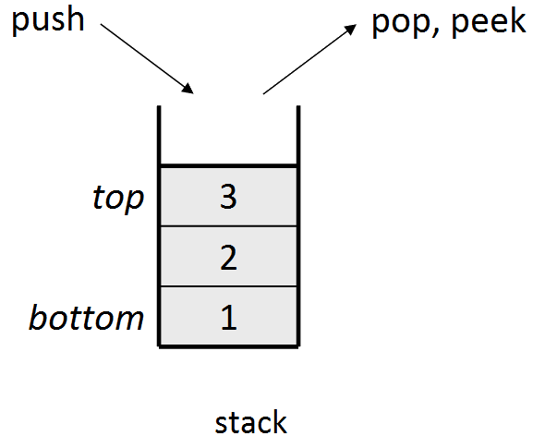
Popping and Pushing
When you work with arrays, it is easy to remove elements and add new elements.
Popping items out of an array, or pushing items into an array.

Slide 14
Array Pop
The pop() method removes the last element from an array:
const fruits = ["Banana", "Orange", "Apple", "Mango"]; fruits.pop();
The pop() method returns the value that was "popped out":
const fruits = ["Banana", "Orange", "Apple", "Mango"]; let fruit = fruits.pop();

Slide 15
Array Push
The push() method adds a new element to an array (at the end):
const fruits = ["Banana", "Orange", "Apple", "Mango"]; fruits.push("Kiwi");
The push() method returns the new array length:
const fruits = ["Banana", "Orange", "Apple", "Mango"]; let length = fruits.push("Kiwi");

Slide 16
Merging Arrays
The concat() method creates a new array by merging (concatenating) existing arrays:
Merging Two Arrays:
const myGirls = ["Cecilie", "Lone"]; const myBoys = ["Emil", "Tobias", "Linus"]; const myChildren = myGirls.concat(myBoys);
The concat() method does not change the existing arrays. It always returns a new array.
Merging an Array with Values:
const arr1 = ["Emil", "Tobias", "Linus"]; const myChildren = arr1.concat("Peter");

Slide 17
Array Splice
The splice() method can be used to add new items to an array:
const fruits = ["Banana", "Orange", "Apple", "Mango"]; fruits.splice(2, 0, "Lemon", "Kiwi");
The first parameter (2) defines the position where new elements should be added (spliced in).
The second parameter (0) defines how many elements should be removed.
The rest of the parameters ("Lemon" , "Kiwi") define the new elements to be added.
The splice() method returns an array with the deleted items:
const fruits = ["Banana", "Orange", "Apple", "Mango"]; fruits.splice(2, 2, "Lemon", "Kiwi");

Slide 18
Array Slice
The slice() method slices out a piece of an array into a new array.
The followed slices out a part of an array starting from array element 1 ("Orange"):
const fruits = ["Banana", "Orange", "Lemon", "Apple", "Mango"]; const citrus = fruits.slice(1);
The slice() method creates a new array.
The slice() method does not remove any elements from the source array.

Slide 19
The slice() method can take two arguments like slice(1, 3).
The method then selects elements from the start argument, and up to (but not including) the end argument.
const fruits = ["Banana", "Orange", "Lemon", "Apple", "Mango"]; const citrus = fruits.slice(1, 3);

Slide 20
3
Install VS Code

Slide 21
Installation Guide Link
https://www.codecademy.com/article/visual-studio-code

Slide 22
Thanks for your attending
Jian Chen

