Slide 1
UNC | McALLISTER HEART INSTITUTE
Building a Functional Heart
From Cellular Neighborhoods
to Gene Function
Coordinating postnatal muscle, vascular and matrix development
Jiandong Liu, Ph.D.
McAllister Heart Institute
Department of Pathology and Laboratory Medicine · UNC–Chapel Hill
Notes:
SLIDE 1 | MAIN TALK | Suggested 25 seconds
SPEAKER SCRIPT
Today I want to ask how a growing heart becomes a functional heart. Making more cardiomyocytes is an important part of cardiac repair, but those cells must also acquire the structure, metabolism and electrical properties needed to contribute to pumping. Our work approaches that problem at two scales. First, we map where different cardiac cells and maturation states occur during postnatal development. Second, we test candidate regulators directly in the intact heart. The central idea is that cardiomyocyte maturation should be understood within the tissue being built around it.
EVIDENCE / SOURCE
Original author affiliation; revised narrative
INTERPRETATION BOUNDARY
Use the stated evidence category; no additional causal or functional claim is implied.

Slide 2
THE BIOLOGICAL PROBLEM
Biological framework
New muscle must become functional myocardium
Produce or preserve muscle
Build durable function
Cell number and growth
Replenish the tissue that has been lost
Contract, conduct and sustain workload
Integrate muscle with vessels and matrix
Postnatal development reveals how growing muscle acquires function within a tissue.
Tzahor & Poss, Science 356, 1035–1039 (2017); Guo & Pu, Circ Res 126, 1086–1106 (2020)
2
Notes:
SLIDE 2 | MAIN TALK | Suggested 60 seconds
SPEAKER SCRIPT
Regeneration raises two connected problems: producing or preserving cardiomyocytes, and making those cells function as part of the heart. A new cardiomyocyte needs more than a favorable transcriptional identity. It needs organized contractile structures, appropriate electrical behavior, adequate energy supply and integration with the surrounding tissue. These goals can overlap in time. Growth and maturation are not opposite ends of a single scale. This is why normal postnatal development is useful: it shows us how muscle growth, vascular development and matrix remodeling are coordinated as the heart takes on increasing work.
EVIDENCE / SOURCE
Tzahor & Poss, Science 356, 1035–1039 (2017); Guo & Pu, Circ Res 126, 1086–1106 (2020)
INTERPRETATION BOUNDARY
Use the stated evidence category; no additional causal or functional claim is implied.

Slide 3
THE BIOLOGICAL PROBLEM
Established biology
Maturation combines several changes in cell function
Structure
Electrical behavior
Sarcomeres, cell growth
and T-tubules
Excitation and
calcium handling
Metabolism
Cell-cycle behavior
Energy supply for
sustained contraction
One developmental feature;
not a complete functional readout
Growth-associated and maturation-associated programs can overlap in the same cell.
Guo & Pu, Circ Res 126, 1086–1106 (2020); original supplied slide 2
3
Notes:
SLIDE 3 | MAIN TALK | Suggested 65 seconds
SPEAKER SCRIPT
I will use maturation to describe several related but distinct processes. Cardiomyocytes enlarge and organize their sarcomeres. Their electrical and calcium-handling machinery changes. Their metabolic capacity adapts to sustained contraction. Cell-cycle behavior also changes, but cell-cycle withdrawal alone does not establish mature function. A cell can retain some cycling-associated RNA while expressing metabolic or contractile programs. We therefore need to distinguish a transcriptional score, which is useful for mapping tissue, from direct functional measurements. That distinction becomes important when we move from the atlas to genetic perturbation.
EVIDENCE / SOURCE
Guo & Pu, Circ Res 126, 1086–1106 (2020); original supplied slide 2
INTERPRETATION BOUNDARY
Use the stated evidence category; no additional causal or functional claim is implied.

Slide 4
THE BIOLOGICAL PROBLEM
Framework informed by prior work
Intrinsic programs and the local environment develop together
Intrinsic competence
Local tissue context
Changing physiology
Chromatin and
transcriptional programs
Prior lab example:
CARM1-dependent regulation
Capillaries and mural cells
Fibroblast matrix
Endocardial environment
Mechanical and paracrine cues
Circulation and workload
Nutrition and hormones
Oxygen demand and supply
Shared developmental inputs
Guo & Pu (2020); Garbutt et al., Circulation (2024), as cited in original deck; Lu et al. Nature Cell Biology 23, 967–977 (2021); doi:10.1038/s41556-021-00747-1
4
Notes:
SLIDE 4 | MAIN TALK | Suggested 55 seconds
SPEAKER SCRIPT
Our earlier work on the epigenetic regulator CARM1 established one intrinsic route into cardiomyocyte maturation. That leads to a broader question: how does a cardiomyocyte coordinate its internal program with its changing environment? During the same period, vessels expand, the myocardial wall remodels, and fibroblasts change the matrix they express. Mechanical demand, endocrine signals and nutrition also change. A complete model has to connect these influences rather than assign the entire process to one gene or one neighboring cell type. The atlas gives us a way to identify where these processes meet.
EVIDENCE / SOURCE
Guo & Pu (2020); Garbutt et al., Circulation (2024), as cited in original deck; Lu et al. Nature Cell Biology 23, 967–977 (2021); doi:10.1038/s41556-021-00747-1
INTERPRETATION BOUNDARY
The CARM1 citation is retained from the author’s original presentation; no new CARM1 experiment is introduced.

Slide 5
THE ROADMAP
Study design
Map the tissue, nominate regulators, then test function
01 MAP
02 CONNECT
03 TEST
Who is present?
Where are they?
How do states vary?
Which vascular and matrix
contexts accompany
CM maturation?
Which candidate genes
are required for
cell and heart function?
Wang et al., Nature Cardiovascular Research (2026)
5
Notes:
SLIDE 5 | MAIN TALK | Suggested 40 seconds
SPEAKER SCRIPT
The story has three parts. First, we build a spatial and temporal atlas to identify the cells and states present in the postnatal heart. Second, we ask how cardiomyocyte transcriptional maturation relates to vascular and fibroblast neighborhoods. These observations nominate hypotheses, but they do not establish a local mechanism. Third, we use an in vivo functional-genomics platform to test candidate regulators, then follow one candidate into structural, cellular and heart-level phenotypes. This sequence lets us move from where a process occurs toward which genes are required for it.
EVIDENCE / SOURCE
Wang, Dong, Song et al. Nature Cardiovascular Research (2026); doi:10.1038/s44161-026-00861-z
INTERPRETATION BOUNDARY
Use the stated evidence category; no additional causal or functional claim is implied.

Slide 6
MAP THE DEVELOPING HEART
Published study + reviewed reference
An atlas connects four developmental stages across two assays
P0
P7
P14
P21
Single-nucleus RNA-seq
Xenium spatial transcriptomics
Broad transcriptomic coverage
2 libraries / 2 animals per age
403 measured gene targets
1 observed section per age
RNA supports cell identities; measured Xenium counts support spatial comparisons.
Wang et al., Nature Cardiovascular Research (2026); GSE290989; Zenodo 14961929/14961942
6
Notes:
SLIDE 6 | MAIN TALK | Suggested 70 seconds
SPEAKER SCRIPT
The atlas covers P0, P7, P14 and P21. Single-nucleus RNA sequencing provides broad transcriptomic coverage, with two libraries from two animals at each age in the reviewed reference. Xenium supplies a spatial section at each age and directly measures 403 gene targets. We use the RNA reference to support cell identities and broader program interpretation, and the measured spatial counts to examine local relationships. These data give complementary views of development. They do not provide repeated spatial hearts at each stage, which limits how strongly we can generalize a section-level association.
EVIDENCE / SOURCE
Wang, Dong, Song et al. Nature Cardiovascular Research (2026); doi:10.1038/s44161-026-00861-z; GSE290989; Zenodo 14961929/14961942
INTERPRETATION BOUNDARY
One observed Xenium section per stage; cells are not independent hearts.

Slide 7
MAP THE DEVELOPING HEART
Measurement framework
Keep measured expression separate from transferred information
Directly measured
Reference-supported / inferred
Xenium target counts
The 21-gene spatial
maturation module
Cell identities and subtypes
Broader RNA programs
placed into spatial context
No missing maturation genes are imputed into the spatial 21-gene outcome.
Wang et al., Nature Cardiovascular Research (2026); current reanalysis methods
7
Notes:
SLIDE 7 | MAIN TALK | Suggested 45 seconds
SPEAKER SCRIPT
There are two kinds of information on these maps. Xenium directly measures the targets on its panel. Reference alignment, including CytoSPACE in the original study, adds RNA-supported identities or inferred transcriptomic information. Those should not be treated as equivalent measurements. For the spatial maturation question, we deliberately use the 21 maturation genes measured in Xenium. We do not project missing maturation genes from the nuclear reference. The reference identifies neighboring populations, while the measured spatial panel supplies the cardiomyocyte outcome. This separation makes the biological question easier to interpret.
EVIDENCE / SOURCE
Wang, Dong, Song et al. Nature Cardiovascular Research (2026); doi:10.1038/s44161-026-00861-z; current reanalysis methods
INTERPRETATION BOUNDARY
PIP-seq later uses broader transcriptional phenotype modules; those are separate readouts from the Xenium 21-gene score.

Slide 8
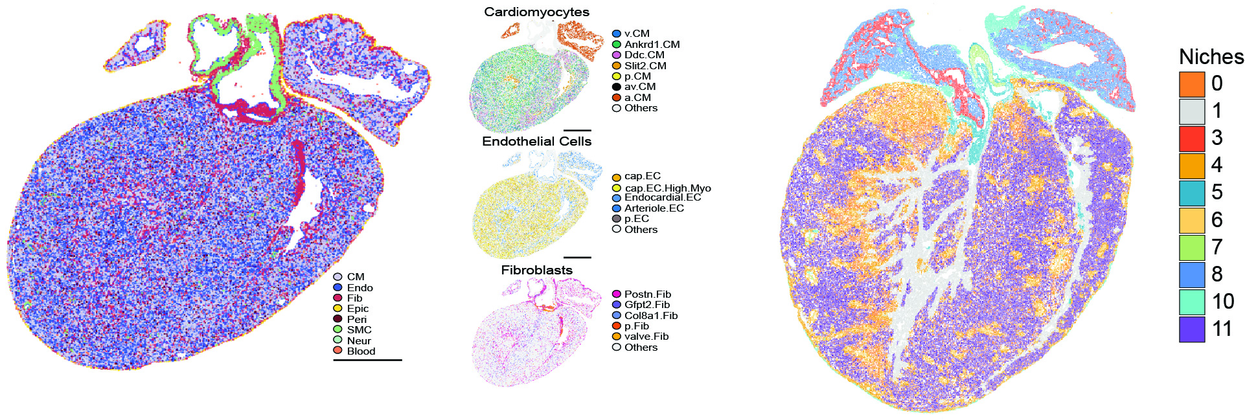
MAP THE DEVELOPING HEART
Published atlas
Cardiac cells occupy organized tissue neighborhoods
Organized neighborhoods provide biological context and a potential source of regional confounding.
Wang et al., Nature Cardiovascular Research (2026); supplied presentation slide 4
8
Notes:
SLIDE 8 | MAIN TALK | Suggested 60 seconds
SPEAKER SCRIPT
The first observation is that the heart is organized at more than one level. Cardiomyocytes, endothelial cells, fibroblasts, mural cells, immune cells and epicardial cells occupy different territories and form recurring local combinations. These combinations reflect anatomy and development, not simply a random mixture of cell types. This gives us a tissue framework for asking about maturation. It also creates an important alternative explanation: if both capillaries and higher-scoring cardiomyocytes concentrate in the same anatomical region, their association may be regional rather than a direct local signaling effect.
EVIDENCE / SOURCE
Wang, Dong, Song et al. Nature Cardiovascular Research (2026); doi:10.1038/s44161-026-00861-z; supplied presentation slide 4
INTERPRETATION BOUNDARY
The published fine niche partition is descriptive. Earlier seed checks supported broader contexts more strongly than every fine boundary; organized tissue does not imply that all fine partitions are stable.

Slide 9
MAP THE DEVELOPING HEART
Published atlas + reviewed annotations
Subtypes make the neighborhood biologically informative
Cardiomyocytes
Endothelial cells
Fibroblasts
Working ventricular
Ankrd1-associated
Regional / cycling
Identity ≠ maturity
Capillary-like
Arterial-like / venous-like
Endocardial-like
Lymphatic-like, if supported
Postn-associated
Gfpt2/Pi16-associated
Col8a1-associated
Other matrix / adhesion families
Wang et al., Nature Cardiovascular Research (2026); reviewed subtype catalogs
9
Notes:
SLIDE 9 | MAIN TALK | Suggested 55 seconds
SPEAKER SCRIPT
Broad lineage labels are a starting point, but they conceal important differences. Endothelial cells include capillary-like, arterial-like, venous-like, endocardial-like and lymphatic-like populations where there is sufficient evidence. Fibroblasts include developmental Postn-associated and later Gfpt2/Pi16-, Col8a1- and other matrix-associated families. Ventricular cardiomyocytes also include different states, including Ankrd1-associated cells. These are not all different positions on a single maturation scale. Keeping identity separate from maturation lets us ask whether the same local environment relates differently to different kinds of cardiomyocytes.
EVIDENCE / SOURCE
Wang, Dong, Song et al. Nature Cardiovascular Research (2026); doi:10.1038/s44161-026-00861-z; reviewed subtype catalogs
INTERPRETATION BOUNDARY
Marker-based and RNA-transfer labels remain provisional; an anatomical identity is not established by one marker.

Slide 10
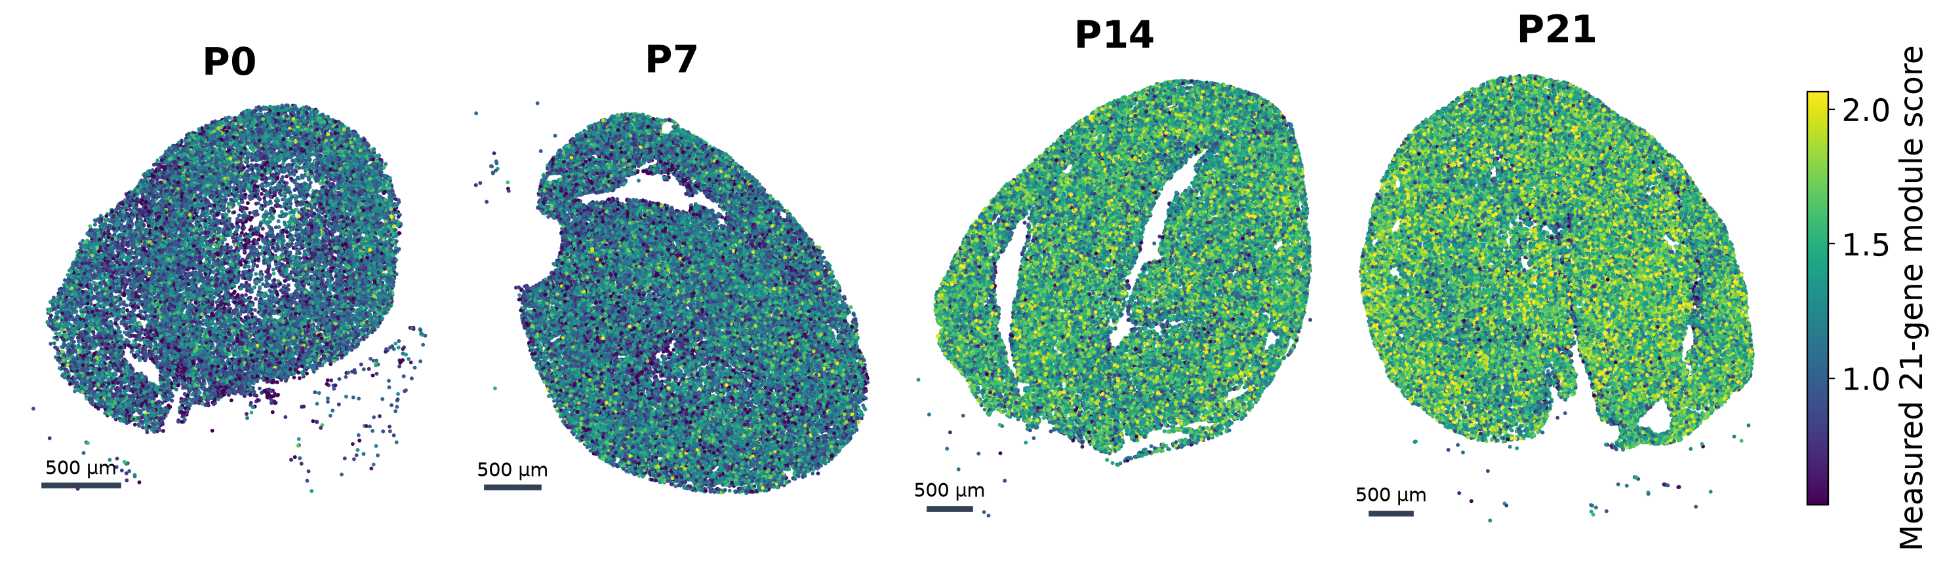
MAP CM MATURATION
Exploratory follow-up
The 21-gene landscape changes with age
The same measured 21-gene module is used across ages; the shared color scale shows the index.
Reviewed 21-gene follow-up (frozen analysis); measured_21gene_panel.tsv; stage_score_summaries.tsv
10
Notes:
SLIDE 10 | MAIN TALK | Suggested 70 seconds
SPEAKER SCRIPT
We next map the same 21 measured maturation genes across the four sections. The maps show an age-related shift in the index, but they also show considerable variation among cells within each age. The color scale is shared across sections. The positive maturation module contains only the published 21 targets, with other measured genes used for normalization and matched background controls. This is a paper-style score reconstruction; the authors’ exact control set and original spatial graph are unavailable. We retain all 131,605 previously QC-eligible ventricular cardiomyocyte profiles rather than restricting the map to selected anatomical patches.
EVIDENCE / SOURCE
Exploratory follow-up: CM21_paperstyle_extension, frozen commit 1179f3cfb4af34fdfeeba4e2fee2ca765bbe8c6e; measured_21gene_panel.tsv; stage_score_summaries.tsv
INTERPRETATION BOUNDARY
A transcriptional index does not directly measure force, perfusion, mitochondrial performance or completed maturation.

Slide 11
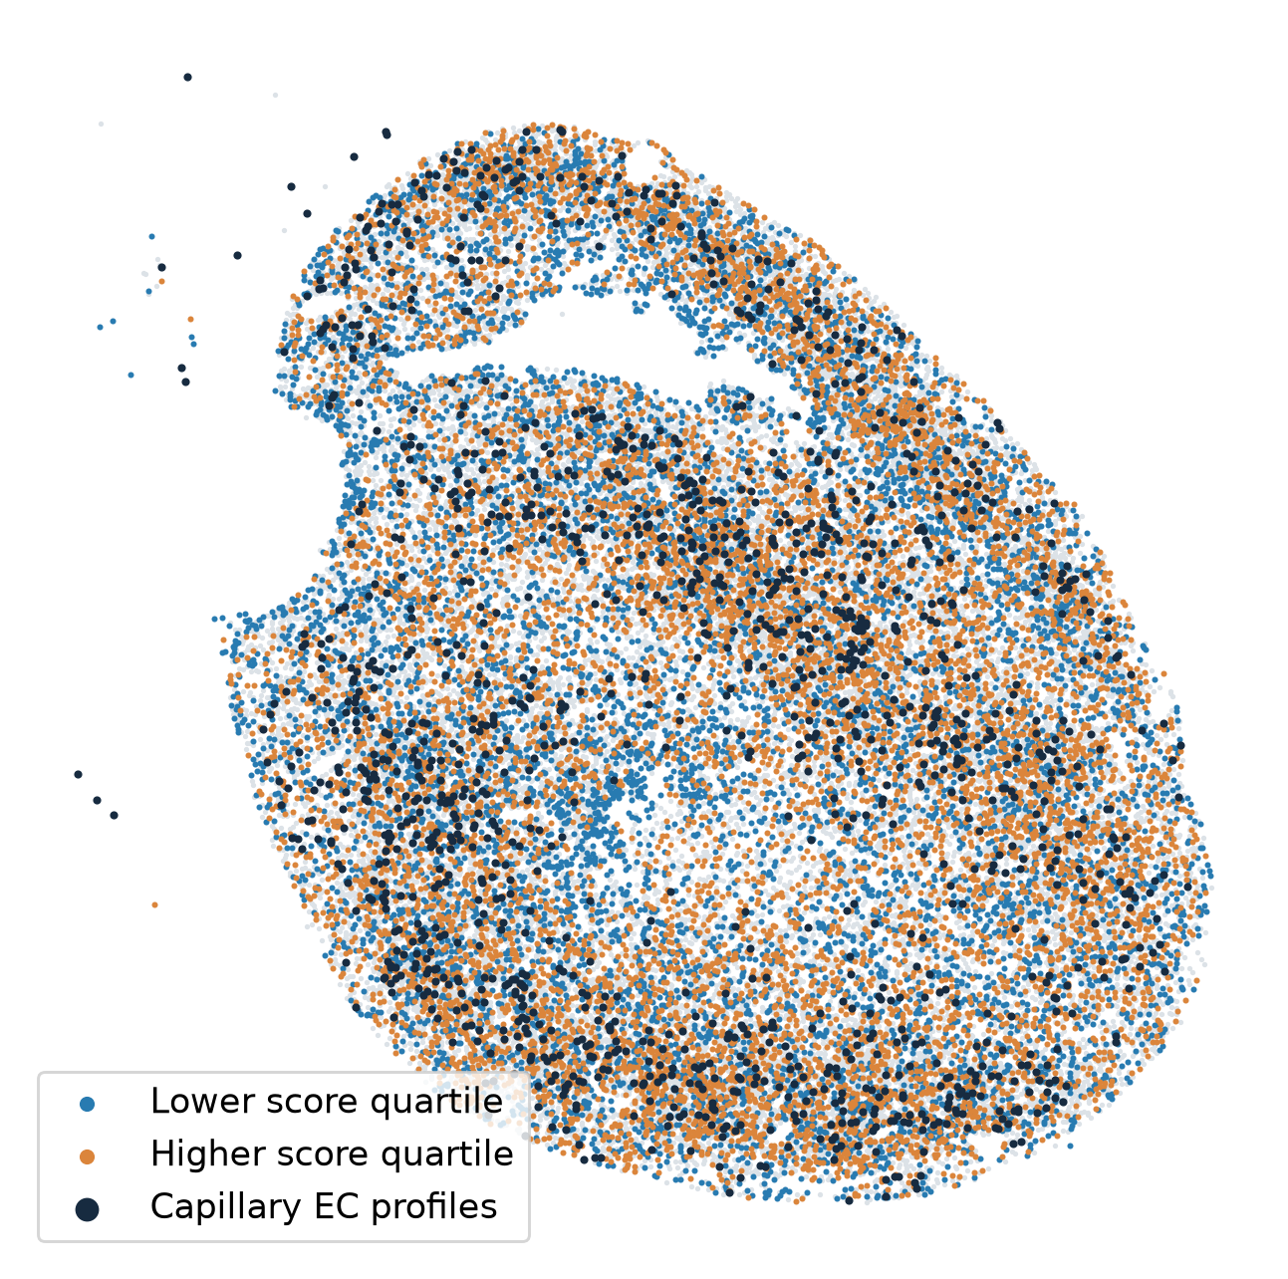
MAP CM MATURATION
Exploratory follow-up
CMs in the same section have different maturation scores
Variation within one age
P7 lower and higher
score quartiles
Relative transcriptional states
within the same section
Reviewed 21-gene follow-up (frozen analysis); P7_CM21_extension_values.tsv.gz
11
Notes:
SLIDE 11 | MAIN TALK | Suggested 60 seconds
SPEAKER SCRIPT
The P7 section makes the within-age variation easier to see. Blue and orange mark lower- and higher-score quartiles within this stage. These are relative groups in the same tissue, not a claim that a higher-scoring P7 cell is fully mature. The next question is what surrounds these cells. Do higher-scoring cells lie closer to capillaries? Does the identity of nearby fibroblasts matter? We also retain CMs without a visible nuclear profile, because a section through a large cardiomyocyte can legitimately miss its nucleus. We do not equate a missing nuclear area with an invalid cell.
EVIDENCE / SOURCE
Exploratory follow-up: CM21_paperstyle_extension, frozen commit 1179f3cfb4af34fdfeeba4e2fee2ca765bbe8c6e; P7_CM21_extension_values.tsv.gz
INTERPRETATION BOUNDARY
Use the stated evidence category; no additional causal or functional claim is implied.

Slide 12
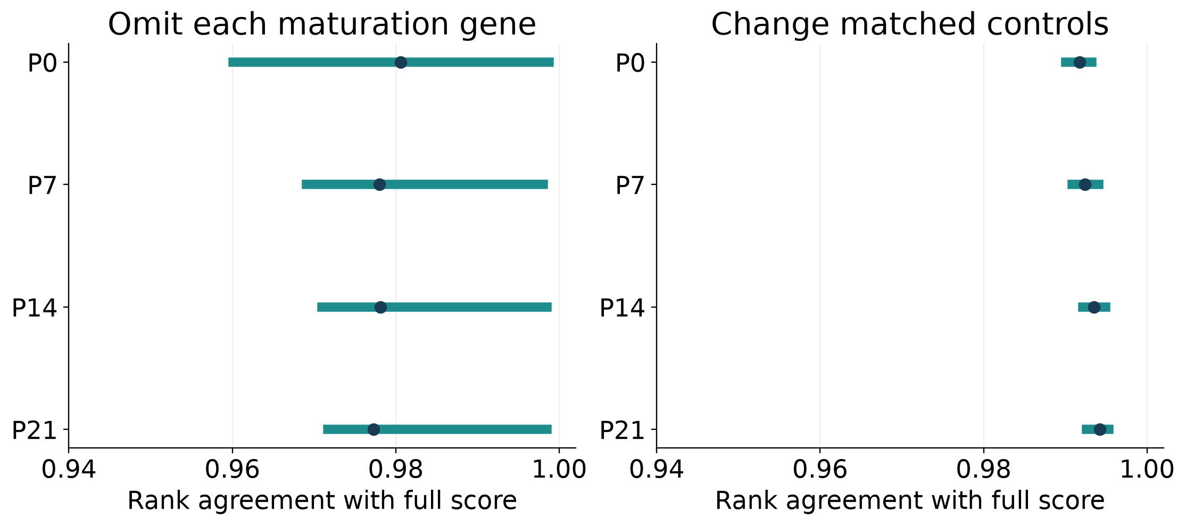
MAP CM MATURATION
Robustness analysis
The score is stable to individual-gene omission
Stable to individual genes and control draws; transcript ownership and source labels remain uncertain.
Reviewed 21-gene follow-up (frozen analysis); score_stability.tsv; source_label_sensitivity.tsv
12
Notes:
SLIDE 12 | MAIN TALK | Suggested 45 seconds
SPEAKER SCRIPT
Before interpreting the map biologically, we challenged the score. Removing any one of the 21 genes leaves the cell rankings strongly similar to the full-panel result. Changing matched background controls also has little effect. This argues against one highly influential naming gene or a favorable random control draw driving the map. That does not make every individual cell assignment certain. Whole-cell and boundary-supported transcript assignments give only moderate agreement in cell rankings, and source labels can affect the spatial association. We therefore distinguish score-component stability from segmentation and annotation uncertainty.
EVIDENCE / SOURCE
Exploratory follow-up: CM21_paperstyle_extension, frozen commit 1179f3cfb4af34fdfeeba4e2fee2ca765bbe8c6e; score_stability.tsv; source_label_sensitivity.tsv
INTERPRETATION BOUNDARY
Minimum one-gene-omission rank agreement ≈0.960; control-draw minimum ≈0.990. Whole-cell/core rank agreement ≈0.77–0.79.

Slide 13
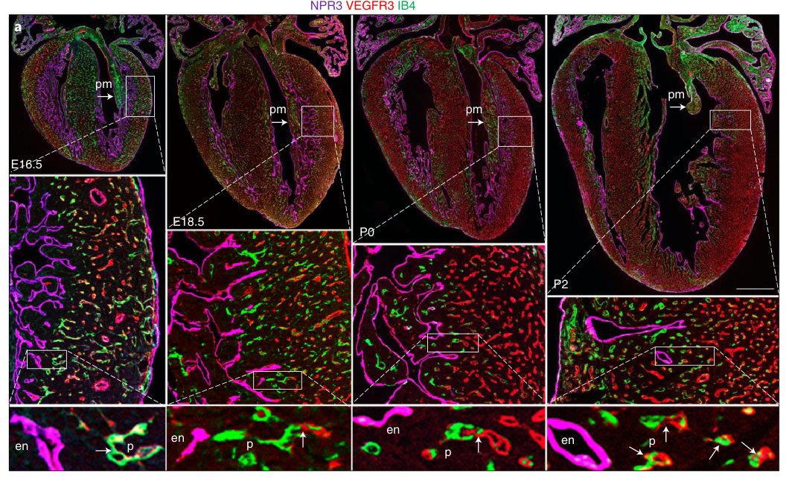
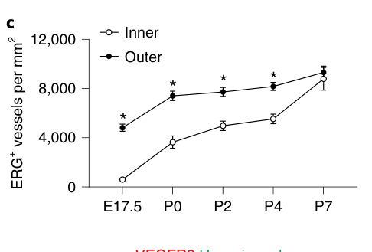
THE VASCULAR CONTEXT
Published literature
Coronary growth is regional and begins before birth
Inner-wall vessel density
approaches outer-wall
density by P7
Pre-existing coronary vessels expand into growing inner myocardium; the process begins before birth.
Lu et al. Nature Cell Biology 23, 967–977 (2021); doi:10.1038/s41556-021-00747-1; Figure 3 and Results
13
Notes:
SLIDE 13 | MAIN TALK | Suggested 85 seconds
SPEAKER SCRIPT
The perinatal vascular study provides a physical context for these maps. Lu and colleagues showed that the pre-existing coronary plexus expands into the developing inner myocardium, beginning before birth around E18.5. Growth is regionally concentrated and associated with endothelial proliferation and local hypoxia. By P7, inner-wall vessel density approaches that in the outer wall. Their lineage experiments distinguish this late expansion from de novo production by the late-fetal or neonatal ventricular endocardium. The biological point for us is that a cardiomyocyte’s vascular surroundings are changing as the myocardial wall thickens and remodels.
EVIDENCE / SOURCE
Lu et al. Nature Cell Biology 23, 967–977 (2021); doi:10.1038/s41556-021-00747-1; Figure 3 and Results
INTERPRETATION BOUNDARY
This study supplies context, not an oxygen measurement in our Xenium sections; the source is the late pre-existing coronary plexus, not a claim about all embryonic coronary origins.

Slide 14
THE VASCULAR CONTEXT
Developmental interpretation
Vascular expansion and CM maturation can overlap
Late fetal → P0
P0 → P7
P7 → P21
Regional coronary
ingrowth is underway
Vascular expansion
and muscle growth overlap
CM specialization continues
as vascular context changes
Schematic developmental framework: vessel growth is not a direct measurement of vascular delivery.
Lu et al. Nature Cell Biology 23, 967–977 (2021); doi:10.1038/s41556-021-00747-1; Wang et al., Nature Cardiovascular Research (2026)
14
Notes:
SLIDE 14 | MAIN TALK | Suggested 50 seconds
SPEAKER SCRIPT
It would be too simple to imagine an early phase of vessel growth followed by a completely separate phase of cardiomyocyte maturation. A growing network can support increasingly active and enlarging muscle while some endothelial cells remain proliferative. The important developmental changes may include network coverage, vessel connectivity, mural association and the proximity of capillaries to cardiomyocytes. More endothelial proliferation is not automatically better perfusion, and fewer cycling cells do not mean that vascular adaptation is complete. This is why we measure the local arrangement of capillary profiles rather than use an endothelial cycling label as a surrogate for oxygen delivery.
EVIDENCE / SOURCE
Lu et al. Nature Cell Biology 23, 967–977 (2021); doi:10.1038/s41556-021-00747-1; Wang, Dong, Song et al. Nature Cardiovascular Research (2026); doi:10.1038/s44161-026-00861-z
INTERPRETATION BOUNDARY
The interval diagram is a schematic interpretation, not newly observed P3/P5/P10 data or a measured developmental trajectory.

Slide 15
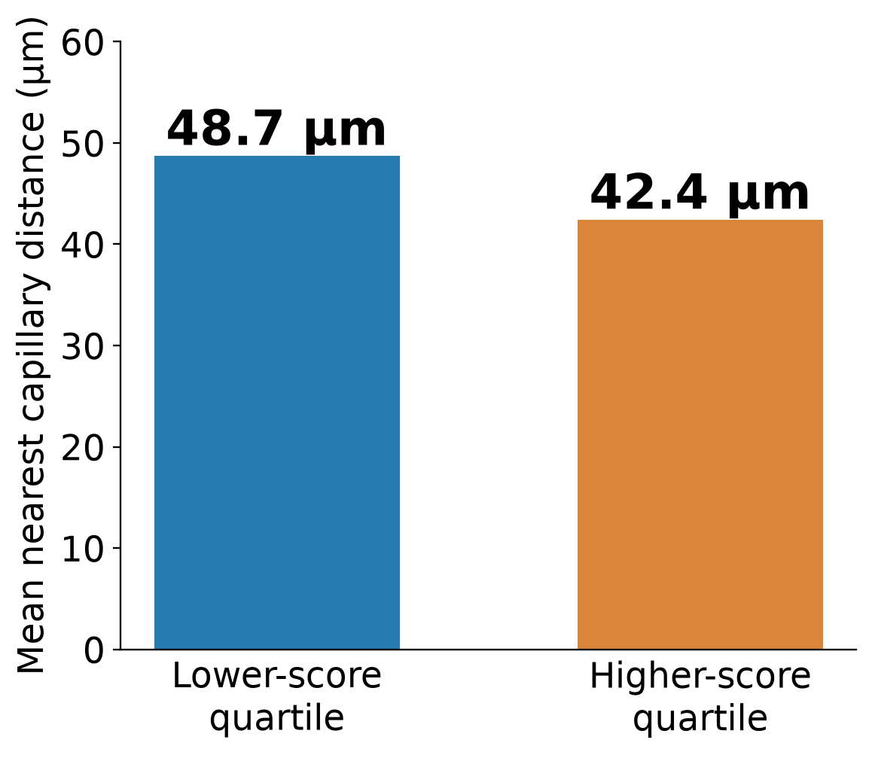
THE VASCULAR CONTEXT
Exploratory association
At P7, higher-scoring CMs are closer to capillary ECs
P7: positive individual-CM and locally adjusted associations; small effects in one observed section.
Reviewed 21-gene follow-up (frozen analysis); raw_vascular_comparisons.tsv; primary_vascular_results.tsv
15
Notes:
SLIDE 15 | MAIN TALK | Suggested 85 seconds
SPEAKER SCRIPT
Using the paper-style 21-gene score, the higher-score P7 quartile lies closer to capillary endothelial profiles than the lower-score quartile: mean distances are 42.4 and 48.7 micrometers. The continuous-score analysis also gives a small positive relationship after local and technical adjustment. This is stronger than relying on a correlation between neighborhood-bin averages because we also inspect the relationship at the individual-CM level. It remains an association in one observed section. The result does not by itself tell us whether capillaries instruct maturation, respond to cardiomyocyte demand, or share a regional developmental environment.
EVIDENCE / SOURCE
Exploratory follow-up: CM21_paperstyle_extension, frozen commit 1179f3cfb4af34fdfeeba4e2fee2ca765bbe8c6e; raw_vascular_comparisons.tsv; primary_vascular_results.tsv
INTERPRETATION BOUNDARY
Adjusted beta≈+0.0246 SD, vascular-family q=0.0012. Paper-style scoring differs from the earlier gene-Z score and from the unavailable exact author score.

Slide 16
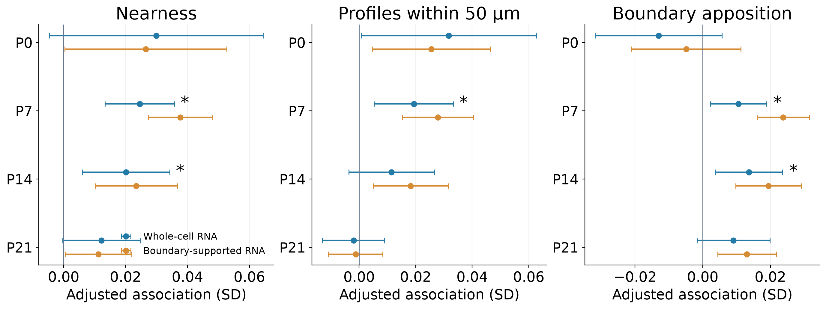
THE VASCULAR CONTEXT
Exploratory geometry comparisons
Nearness and boundary apposition give complementary evidence
P7: all three metrics pass correction. P14: nearness and apposition pass; annotation sensitivity remains.
Reviewed 21-gene follow-up (frozen analysis); primary_vascular_results.tsv; source_label_sensitivity.tsv
16
Notes:
SLIDE 16 | MAIN TALK | Suggested 70 seconds
SPEAKER SCRIPT
We asked the same question using three spatial measurements: nearest-capillary distance, the number of capillary profiles within 50 micrometers, and the fraction of the segmented CM boundary close to capillary profiles. At P7, all three associations pass the same vascular-test correction. At P14, nearness and boundary apposition pass, while the count comparison does not. The count association also weakens when total nearby cell number is included. This suggests that arrangement may be more informative than abundance alone. However, the measurements are related descriptions of the same tissue, not three independent demonstrations of a mechanism.
EVIDENCE / SOURCE
Exploratory follow-up: CM21_paperstyle_extension, frozen commit 1179f3cfb4af34fdfeeba4e2fee2ca765bbe8c6e; primary_vascular_results.tsv; source_label_sensitivity.tsv
INTERPRETATION BOUNDARY
Boundary apposition uses a 2-µm threshold and native polygons; it is not validated membrane contact. Strict source labels attenuate P7; P14 is more source-definition-sensitive.

Slide 17
THE VASCULAR CONTEXT
Analysis design
Local comparisons reduce a shared-anatomy explanation
Comparable CMs
Comparable local tissue
Technical context
Same stage
Same available CM subtype
Within nearby regions
No anatomical exclusion
RNA capture and cell size
Nucleus-free CMs retained
These comparisons reduce regional confounding; exact author anatomical masks remain unavailable.
Reviewed 21-gene follow-up (frozen analysis); analysis_settings.json; spatial_models.tsv
17
Notes:
SLIDE 17 | MAIN TALK | Suggested 60 seconds
SPEAKER SCRIPT
A regional explanation is the main baseline we need to take seriously. We therefore compare CMs at the same age, within nearby tissue regions and the same available CM subtype, while accounting for RNA capture, cell size and missing nuclear area. These comparisons retain a positive P7 relationship under several local grid choices. We also use tissue-screened graph paths and boundary distances. These checks strengthen the description, but they do not recreate the authors’ exact anatomical masks or establish matched compact, trabecular, papillary and chamber identities. Independent morphology and independent hearts remain important next steps.
EVIDENCE / SOURCE
Exploratory follow-up: CM21_paperstyle_extension, frozen commit 1179f3cfb4af34fdfeeba4e2fee2ca765bbe8c6e; analysis_settings.json; spatial_models.tsv
INTERPRETATION BOUNDARY
Existing candidate anatomy is a sensitivity, not expert-validated LV/RV or compact/trabecular ground truth. Statistical uncertainty is within-section.

Slide 18
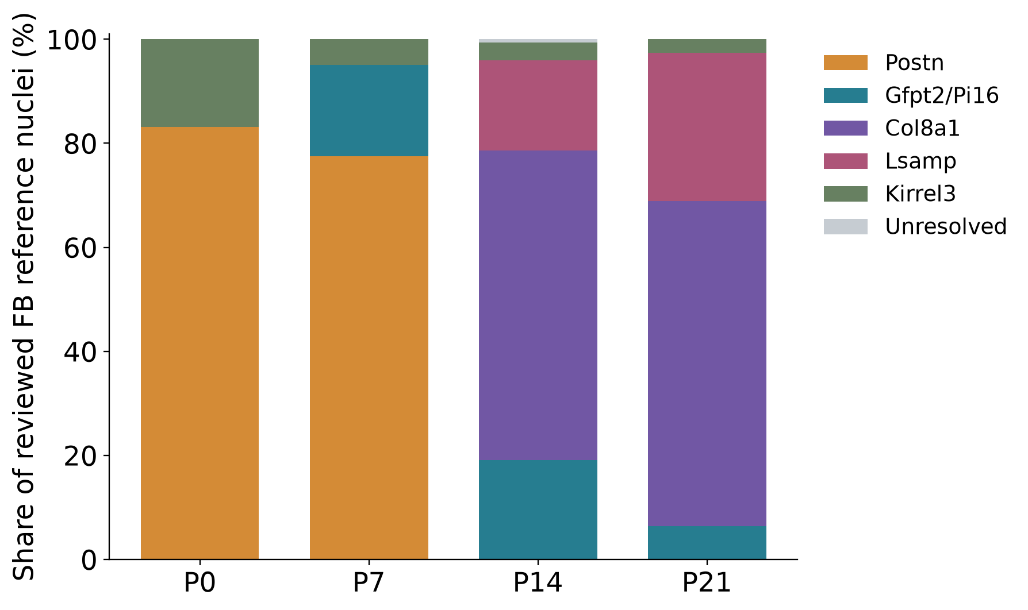
THE MATRIX CONTEXT
Reviewed snRNA-seq reference
Fibroblast families change as the ventricle develops
Early developmental
matrix programs
Later matrix-associated
specialization
Reference-nucleus shares are descriptive; changing family labels do not establish cell fate or disappearance.
fibroblast_subtype_catalog/reviewed_family_nucleus_counts.tsv; Hortells et al. PNAS (2020); doi:10.1073/pnas.2009119117; PMID:32817558
18
Notes:
SLIDE 18 | MAIN TALK | Suggested 70 seconds
SPEAKER SCRIPT
Fibroblasts are also changing during the interval in which CMs mature. In the reviewed RNA reference, early populations are dominated by Postn-associated developmental programs. Later ages contain more distinct Gfpt2/Pi16-, Col8a1- and Lsamp-associated families. These names summarize multi-gene profiles, not mandatory double-positive gates. The bars describe the captured, QC-retained reference nuclei; they are not unbiased tissue abundances or lineage tracing. Importantly, losing a Postn-family label at a later age does not prove that every Postn-expressing cell has disappeared. It may reflect changing expression and reference classification.
EVIDENCE / SOURCE
fibroblast_subtype_catalog/reviewed_family_nucleus_counts.tsv; Hortells et al. PNAS (2020); doi:10.1073/pnas.2009119117; PMID:32817558
INTERPRETATION BOUNDARY
Early Postn-cell interventions in Hortells implicate developmental support but do not isolate a direct FB→CM signal from matrix, nerve or other effects.

Slide 19
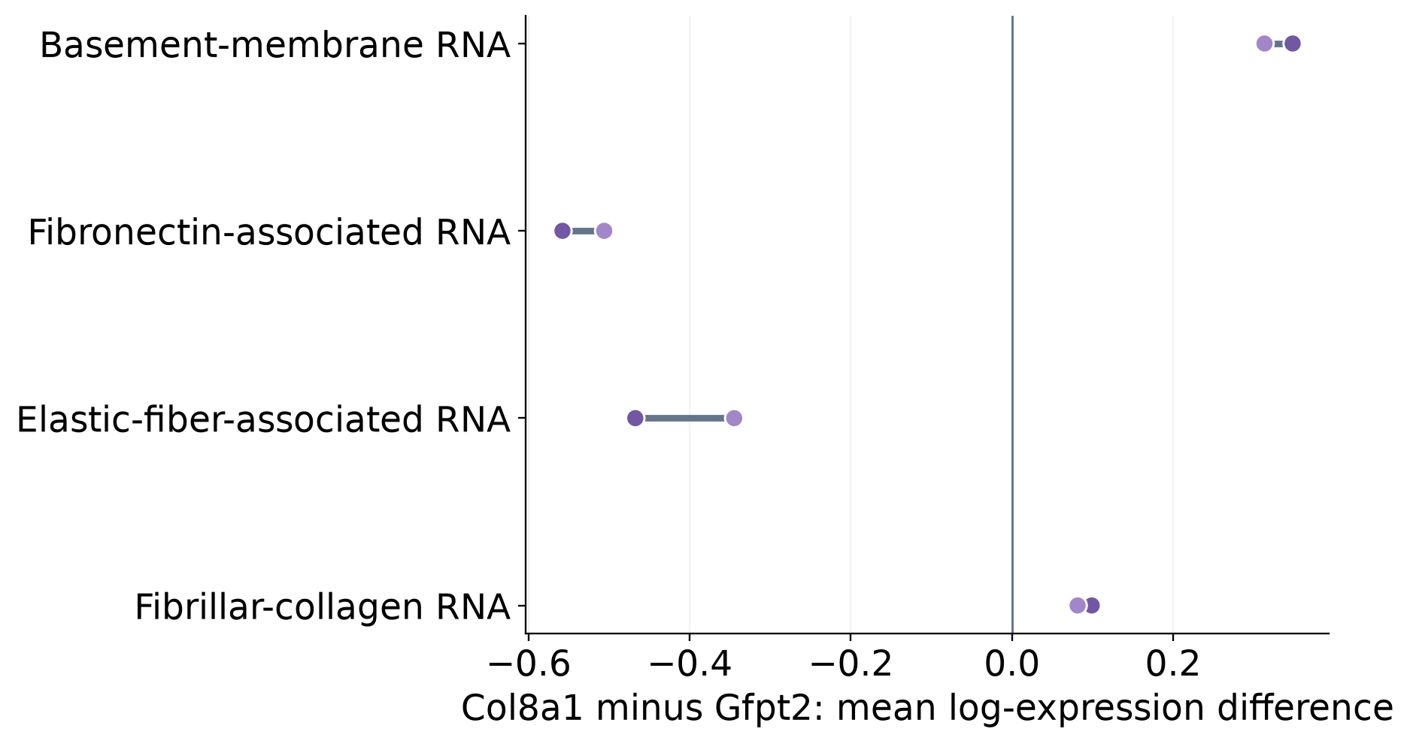
THE MATRIX CONTEXT
RNA-supported specialization
Late fibroblast families emphasize different matrix programs
Col8a1 family
Basement-membrane
RNA relatively higher
Gfpt2/Pi16 family
Fibronectin / elastic
programs relatively higher
P14 paired libraries: RNA specialization suggests matrix roles; deposited matrix and mechanics are unmeasured.
fibroblast_states/RNA_matrix_direct_family_pairs.tsv; P14 corrected comparisons
19
Notes:
SLIDE 19 | MAIN TALK | Suggested 65 seconds
SPEAKER SCRIPT
The later fibroblast families are not simply interchangeable collagen-producing cells. At P14, the Col8a1 family has relatively higher basement-membrane-associated RNA than Gfpt2/Pi16 fibroblasts, while the Gfpt2 family has relatively higher fibronectin- and elastic-fiber-associated programs. The points show the two RNA libraries, so we can see whether the directions agree between animals. These differences suggest distinct ways of organizing the local matrix. They do not establish the amount, stiffness or architecture of deposited extracellular matrix. Those are testable tissue properties, and they may matter for vascular organization and mechanical communication with CMs.
EVIDENCE / SOURCE
fibroblast_states/RNA_matrix_direct_family_pairs.tsv; P14 corrected comparisons
INTERPRETATION BOUNDARY
Relative RNA programs are not direct measurements of collagen deposition, hyaluronan synthesis, matrix elasticity or force transmission. P14 shown to avoid mixing earlier P21 group definitions.

Slide 20
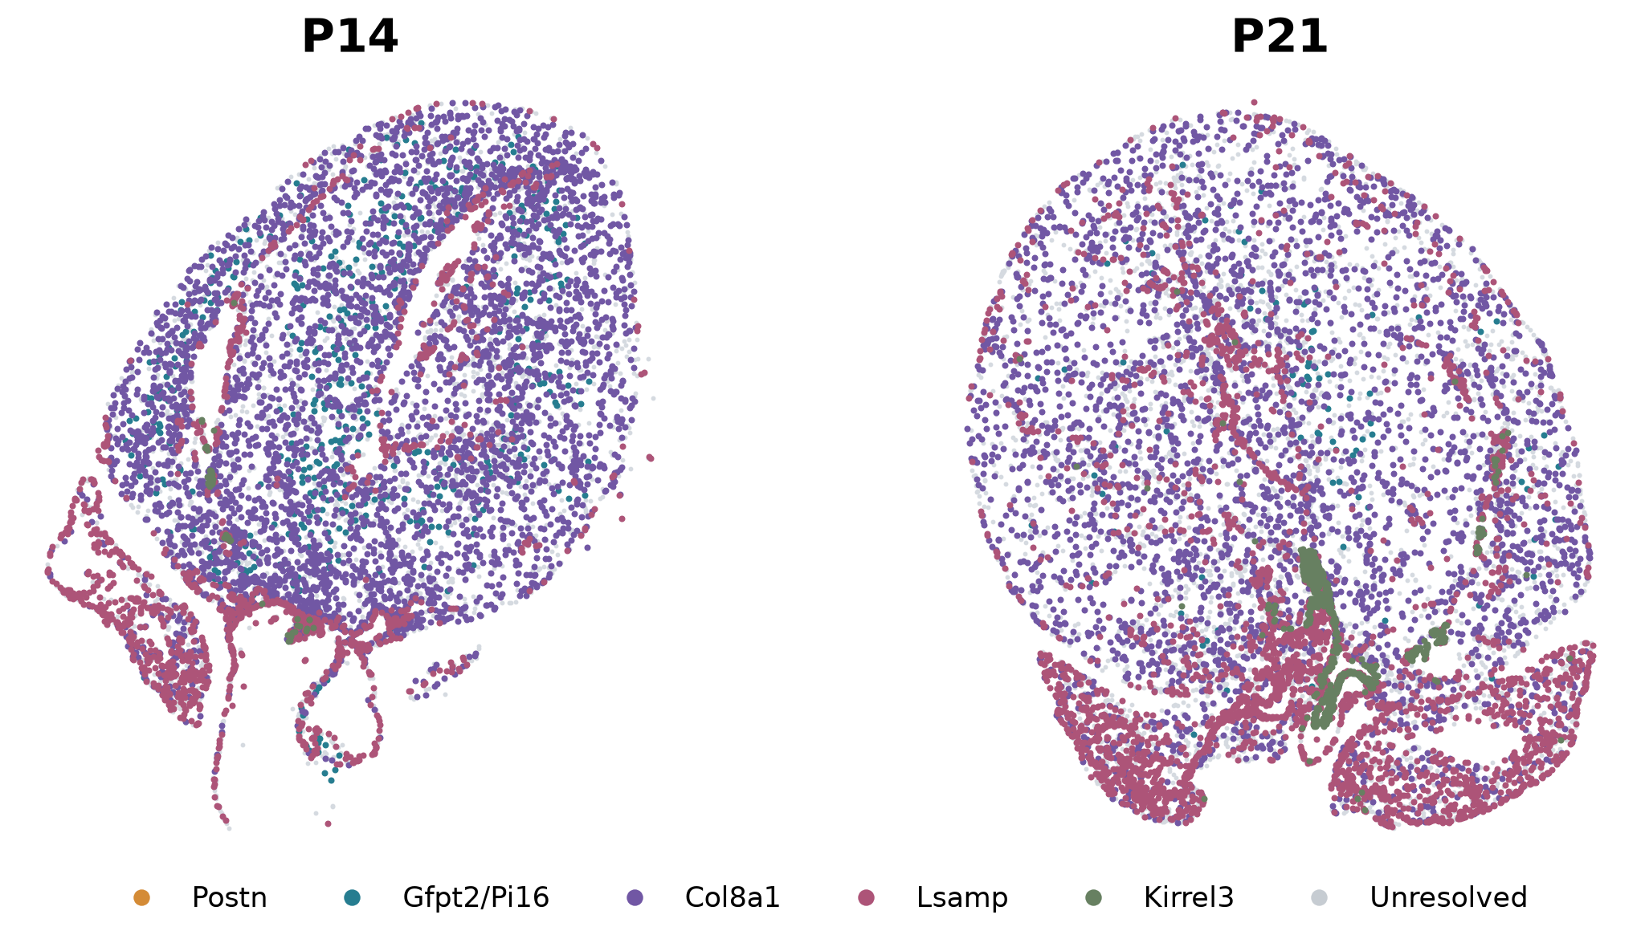
THE MATRIX CONTEXT
Candidate spatial assignments
Fibroblast families occupy different spatial territories
Candidate labels; unresolved profiles remain visible. P21 Gfpt2 placement is particularly incomplete.
fibroblast_multimethod_identity/P14 and P21 recommended_candidate layers
20
Notes:
SLIDE 20 | MAIN TALK | Suggested 70 seconds
SPEAKER SCRIPT
The spatial maps suggest that these fibroblast programs are organized rather than uniformly mixed. They also show why finer labels matter: a broad fibroblast map hides differences among Col8a1-, Gfpt2/Pi16-, Lsamp- and other supported families. We keep unresolved profiles visible. Late Gfpt2 placement remains particularly uncertain, so sparse calls should not be interpreted as biological rarity. The sections are not anatomically registered across ages, and the myocardial wall is growing. A shift in position therefore cannot establish migration or a particular state transition. The reliable conclusion is spatially patterned specialization with incomplete fine assignment.
EVIDENCE / SOURCE
fibroblast_multimethod_identity/P14 and P21 recommended_candidate layers
INTERPRETATION BOUNDARY
No exclusive peri-arterial Col8a1, valve Kirrel3 or outflow-tract Lsamp identity is claimed. P21 Gfpt2 coverage remains incomplete.

Slide 21
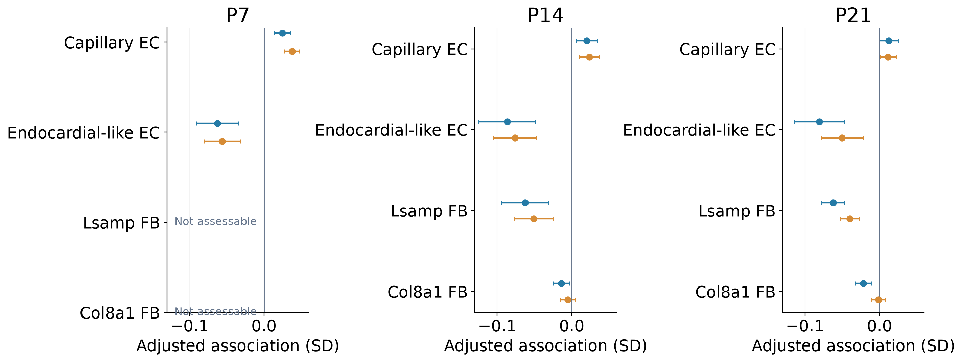
THE MATRIX CONTEXT
Exploratory 21-gene associations
The maturation relationship depends on the neighboring subtype
Whole-cell (blue) and boundary-supported RNA (gold): associations do not establish promotion or inhibition.
Reviewed 21-gene follow-up (frozen analysis); primary_nonCM_results.tsv; nonCM_score_and_segmentation_robustness.tsv
21
Notes:
SLIDE 21 | MAIN TALK | Suggested 75 seconds
SPEAKER SCRIPT
When we keep the same 21-gene CM outcome but distinguish neighboring subtypes, different patterns emerge. Capillary EC nearness is positively associated at P7 and P14, whereas endocardial-like EC nearness is negatively associated in the paper-style whole-cell analysis. Lsamp-associated fibroblast nearness accompanies lower scores at P14 and P21, with a consistent direction across transcript-assignment and fibroblast-label layers. Col8a1 results are less stable between whole-cell and boundary-supported RNA. These differences are useful for generating more specific biological questions. They do not establish that one cell type promotes maturation and another inhibits it; regional anatomy and mechanics can contribute.
EVIDENCE / SOURCE
Exploratory follow-up: CM21_paperstyle_extension, frozen commit 1179f3cfb4af34fdfeeba4e2fee2ca765bbe8c6e; primary_nonCM_results.tsv; nonCM_score_and_segmentation_robustness.tsv
INTERPRETATION BOUNDARY
Source-screen q values are within-section. Do not infer functional inhibition or acceleration from a coefficient; subtype calls are provisional.

Slide 22
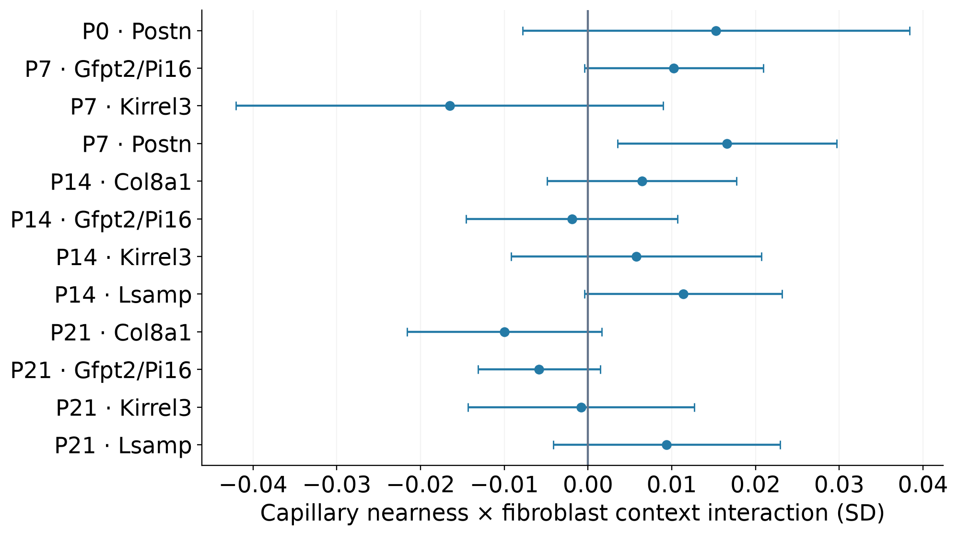
THE MATRIX CONTEXT
Exploratory test; inconclusive interaction
A vascular–matrix interaction remains a hypothesis to test
No corrected interaction
12 assessable tests
A combined vascular–matrix
effect remains unresolved
Reviewed 21-gene follow-up (frozen analysis); primary_fibroblast_context_results.tsv
22
Notes:
SLIDE 22 | MAIN TALK | Suggested 50 seconds
SPEAKER SCRIPT
A natural next hypothesis is that the matrix environment changes how CMs relate to capillaries. We tested this directly by including capillary nearness, the local count of a fibroblast family, and their interaction in the same model. None of the twelve assessable interactions passes correction for multiple comparisons. This is an important boundary on the story: the data support some subtype-specific associations, but they do not yet establish a combined Postn-, Gfpt2/Pi16- or Col8a1-dependent vascular effect. We should use this result to design the next experiment rather than turn a plausible niche model into a positive finding.
EVIDENCE / SOURCE
Exploratory follow-up: CM21_paperstyle_extension, frozen commit 1179f3cfb4af34fdfeeba4e2fee2ca765bbe8c6e; primary_fibroblast_context_results.tsv
INTERPRETATION BOUNDARY
All unsuccessful interaction tests are retained. An inconclusive interaction does not prove biological independence.

Slide 23
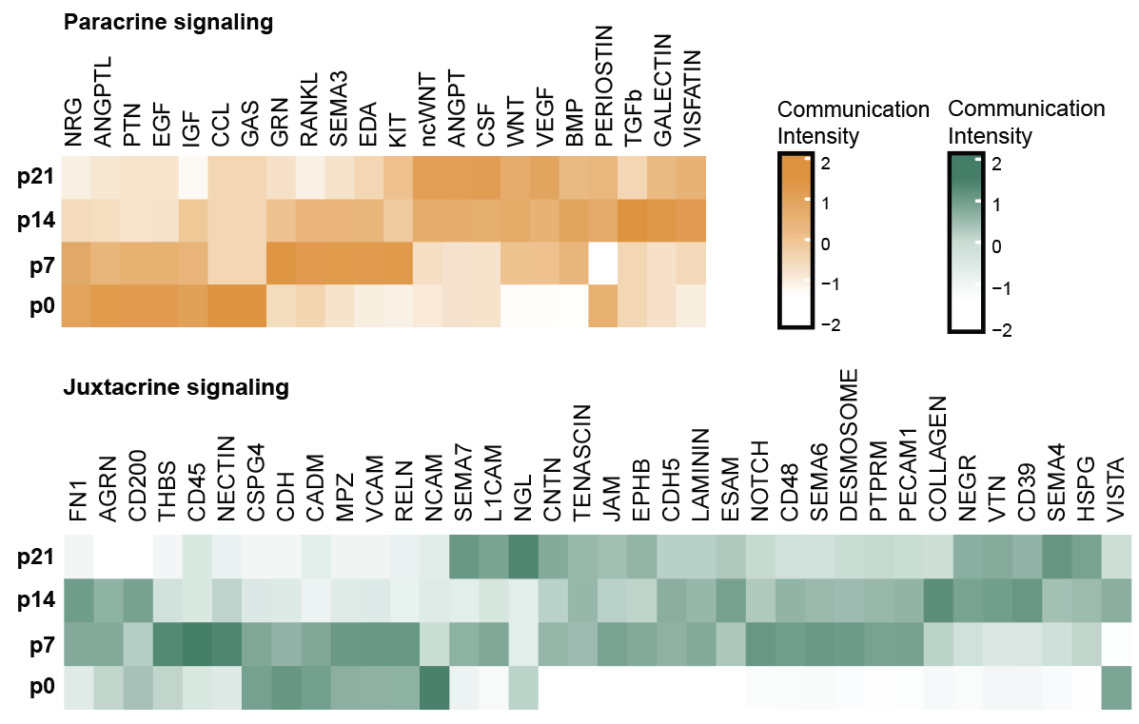
FROM MAPS TO REGULATORS
Published inference framework
Spatial observations nominate signals for functional testing
What the model asks
Who can send?
Who can receive?
Are they nearby?
Which CM response
covaries with the signal?
Spatial and regulatory models nominate experiments; intervention tests a different level of evidence.
Wang et al., Nature Cardiovascular Research (2026); supplied slide 7; COMMOT, SCENIC and SigNET analyses
23
Notes:
SLIDE 23 | MAIN TALK | Suggested 55 seconds
SPEAKER SCRIPT
The atlas becomes most useful when it narrows the next experiment. The heatmaps summarize inferred paracrine and juxtacrine activities across stages; the important point is that candidate signaling programs change with development. Spatial proximity identifies compatible neighborhoods, and ligand–receptor expression nominates possible communication routes. Regulatory-network inference suggests how a CM might respond. Each step contributes information, but all remain partly dependent on expression data. A predictive model or a high correlation is not a causal experiment. We next test whether a candidate is required, and ask which neighboring cell supplies the relevant signal. This connects the tissue map to functional genetics.
EVIDENCE / SOURCE
Wang, Dong, Song et al. Nature Cardiovascular Research (2026); doi:10.1038/s44161-026-00861-z; supplied slide 7; COMMOT, SCENIC and SigNET analyses
INTERPRETATION BOUNDARY
Random-cell predictive validation does not establish generalization to independent spatial regions or animals. COMMOT does not directly measure ligand transport or receptor activation.

Slide 24
FROM MAPS TO REGULATORS
Published observations + working mechanism
A contact-associated candidate links the niche to CM regulation
Spatial evidence
Perturbation evidence
Working link
PTPRM-compatible
EC–CM interfaces
Protein detected at
boundaries
Ptprm perturbation
changes cell-cycle and
maturation-associated RNA
at P8
MEIS1-associated
cell-cycle exit
Sender-specific mechanism
and mediation remain open
A contact-associated candidate is supported; a complete EC → CM → mediator causal chain is not established.
Wang et al., Nature Cardiovascular Research (2026); Fig.4 and Extended Data Fig.7
24
Notes:
SLIDE 24 | MAIN TALK | Suggested 80 seconds
SPEAKER SCRIPT
One example is PTPRM, a contact-associated membrane protein. The paper nominates PTPRM-compatible interactions between capillary ECs and adjacent CMs, and detects protein at EC–CM interfaces. Perturbing Ptprm in the postnatal heart changes cell-cycle and maturation-associated RNA. MEIS1, a regulator of postnatal cell-cycle exit, is nominated as a downstream link. Together, these results support a functional role for the candidate. They do not establish the complete chain from a particular EC sender through a homophilic contact to MEIS1-dependent functional maturation. Cell-type-specific perturbation and a downstream rescue would make that model more precise.
EVIDENCE / SOURCE
Wang, Dong, Song et al. Nature Cardiovascular Research (2026); doi:10.1038/s44161-026-00861-z; Fig.4 and Extended Data Fig.7
INTERPRETATION BOUNDARY
The spatial association, protein localization and gene perturbation are different evidence layers. EC-specific necessity, CM–CM alternatives and MEIS1 mediation remain incompletely tested.

Slide 25
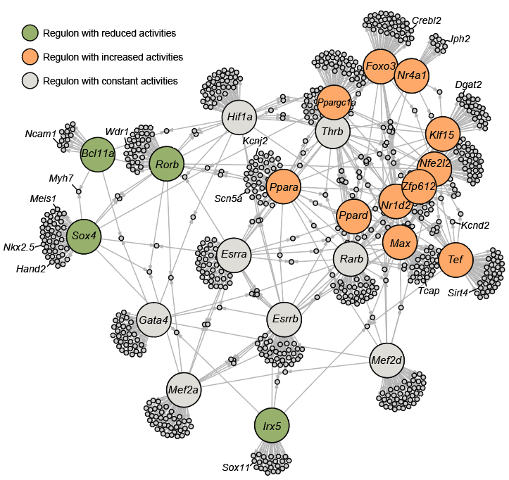
FROM MAPS TO REGULATORS
Published regulon inference
Intrinsic regulatory networks provide another set of candidates
32
CM-specific regulons
7
25
Previously linked
Candidates
Temporal regulon inference generates a testable candidate set, not a validated binding network.
Wang et al., Nature Cardiovascular Research (2026); Fig.5d; original supplied slide 9
25
Notes:
SLIDE 25 | MAIN TALK | Suggested 60 seconds
SPEAKER SCRIPT
The spatial environment is only one side of the problem. We also used temporal RNA profiles and SCENIC to identify intrinsic transcriptional programs. Here, a regulon means a candidate transcription factor together with the genes predicted to respond to it. The study reports thirty-two CM-specific regulons, including seven with previous links to maturation and twenty-five not previously characterized in this context. The network is a candidate map, not a catalogue of experimentally confirmed binding events. It connects changing CM states to a manageable set of regulators. The next question is which of them actually changes maturation when perturbed in the postnatal heart.
EVIDENCE / SOURCE
Wang, Dong, Song et al. Nature Cardiovascular Research (2026); doi:10.1038/s44161-026-00861-z; Fig.5d; original supplied slide 9
INTERPRETATION BOUNDARY
SCENIC uses expression and motif evidence; inferred edges and regulon activity are not direct binding or necessity tests.

Slide 26
FUNCTIONAL GENOMICS
Published study design
The next step is to test candidates in the intact heart
Atlas-nominated candidates
One scalable in vivo test
Intrinsic transcriptional
regulators
Intercellular signaling
components
Perturb candidates
in the postnatal heart
Read the RNA phenotype
from identified CM nuclei
Wang et al., Nature Cardiovascular Research (2026); Fig.6; 37 intracellular and 13 intercellular candidate targets
26
Notes:
SLIDE 26 | MAIN TALK | Suggested 40 seconds
SPEAKER SCRIPT
The atlas produced more candidates than could be tested one at a time efficiently. We therefore built a pooled strategy to connect a perturbation to a transcriptomic phenotype within the intact postnatal heart. The selected target set included intracellular regulators and genes associated with intercellular signaling. For genes perturbed in CMs, the screen tests their requirement in those cells within a native tissue context. It does not by itself establish which non-CM population supplied an upstream cue. This distinction lets us use the niche to prioritize candidates while keeping the experiment’s causal scope clear.
EVIDENCE / SOURCE
Wang, Dong, Song et al. Nature Cardiovascular Research (2026); doi:10.1038/s44161-026-00861-z; Fig.6; 37 intracellular and 13 intercellular candidate targets
INTERPRETATION BOUNDARY
Candidate selection is not proof of a niche-specific mechanism; pooled screening nominates targets for independent functional validation.

Slide 27
FUNCTIONAL GENOMICS
Published platform
PIP-seq connects an in vivo perturbation to its RNA phenotype
P0
IN VIVO
P14
READOUT
AAV9: dual guides
+ CM-directed Cre
Cas9 perturbation
+ nuclear GFP label
Enrich GFP+
CM nuclei
Guide identity
+ RNA phenotype
PIP-seq: probe-based, indel-detectable Perturb-seq in the native postnatal heart.
Wang et al., Nature Cardiovascular Research (2026); Fig.6a–c; PIP-seq Methods
27
Notes:
SLIDE 27 | MAIN TALK | Suggested 85 seconds
SPEAKER SCRIPT
Cardiomyocytes are large and difficult to recover reliably as intact single cells. PIP-seq works through nuclei while preserving an in vivo perturbation context. At P0, AAV9 delivers dual guides and CM-directed Cre to mice carrying Cas9 and a Cre-dependent nuclear-envelope GFP reporter. At P14, GFP-positive CM nuclei are enriched and profiled with a probe-based single-nucleus assay. Custom probes recover guide identity and provide evidence at the targeted transcript site. We can then connect candidate perturbations to changes in broader transcriptional programs. The native environment is retained during the perturbation, even though the final readout is performed on isolated nuclei.
EVIDENCE / SOURCE
Wang, Dong, Song et al. Nature Cardiovascular Research (2026); doi:10.1038/s44161-026-00861-z; Fig.6a–c; PIP-seq Methods
INTERPRETATION BOUNDARY
SUN1-GFP marks the targeted/infected CM-nuclear population; it is not itself proof of biallelic editing.

Slide 28
FUNCTIONAL GENOMICS
Published platform logic
Two probe readouts strengthen perturbation assignment
Guide-detection probes
Perturbation-detection probes
Guide transcript
WT site
Guide-specific region
Constant region
Indel
×
Probe pairing recovers
perturbation identity
Reduced target-probe signal
adds RNA-based editing evidence
Guide identity and target-probe reduction are complementary; neither alone proves biallelic editing.
Wang et al., Nature Cardiovascular Research (2026); Fig.6c; Supplementary Fig.24
28
Notes:
SLIDE 28 | MAIN TALK | Suggested 75 seconds
SPEAKER SCRIPT
PIP-seq uses two complementary probe strategies. One captures the guide transcript so we can identify the perturbation associated with a nucleus. The other targets a wild-type transcript sequence across the expected editing region; an indel can reduce probe hybridization at that site. This provides additional target-site evidence beyond guide detection alone. It is still an RNA-based proxy. Reduced target-probe signal can also be influenced by transcript abundance and RNA stability, and guide assignment does not guarantee that every allele is edited. The platform improves screening, while independent target and phenotype validation remain essential.
EVIDENCE / SOURCE
Wang, Dong, Song et al. Nature Cardiovascular Research (2026); doi:10.1038/s44161-026-00861-z; Fig.6c; Supplementary Fig.24
INTERPRETATION BOUNDARY
Do not describe target-probe reduction as a measured whole-population biallelic knockout rate.

Slide 29
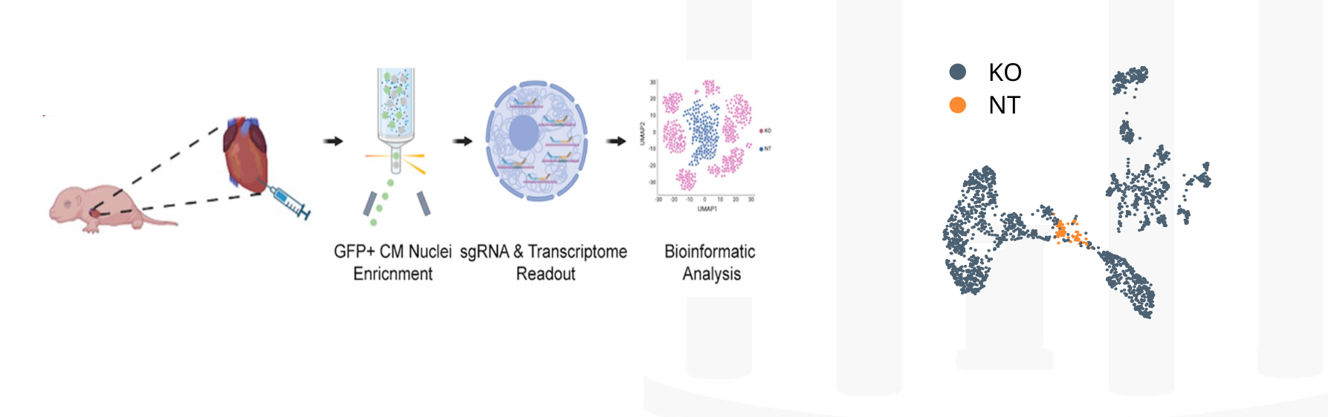
FUNCTIONAL GENOMICS
Published pooled screen
The screen recovers known regulators and nominates new ones
50
Candidate regulators
5,706
Guide-assigned nuclei
23 RNA-program hits
(2 known controls)
Wang et al., Nature Cardiovascular Research (2026); Fig.6; 5,706 guide-assigned nuclei; 23 genes affect ≥1 RNA program
29
Notes:
SLIDE 29 | MAIN TALK | Suggested 65 seconds
SPEAKER SCRIPT
The screen recovered 5,706 nuclei with at least one assigned guide and evaluated the candidate set using transcriptional maturation programs. Twenty-three genes, including the two established positive-control regulators, affected at least one tested program. Thus the study nominates twenty-one additional candidates rather than demonstrating twenty-one fully validated functional mechanisms. Recovering known regulators provides a useful benchmark. The UMAP is descriptive; separation alone is not an editing-efficiency assay. These screen readouts use broader RNA program sets and should not be confused with the separate 21-gene Xenium index used in our spatial comparisons.
EVIDENCE / SOURCE
Wang, Dong, Song et al. Nature Cardiovascular Research (2026); doi:10.1038/s44161-026-00861-z; Fig.6; 5,706 guide-assigned nuclei; 23 genes affect ≥1 RNA program
INTERPRETATION BOUNDARY
Screen-level comparisons are nucleus-level; the later targeted experiments add biological and functional validation. Do not equate 23 RNA hits with 23 proven therapies.

Slide 30
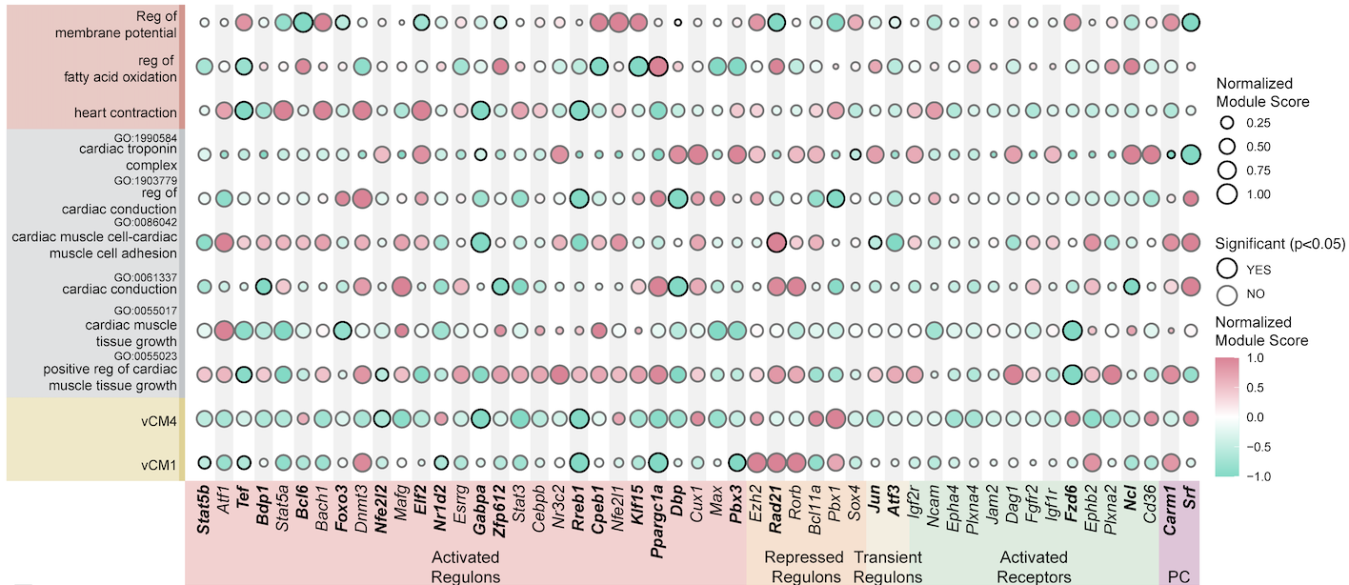
FUNCTIONAL GENOMICS
Published transcriptional screen
Different perturbations affect different maturation programs
PIP-seq phenotype modules are broader RNA programs, distinct from the spatial 21-gene Xenium score.
Wang et al., Nature Cardiovascular Research (2026); Fig.6e–g; original supplied slide 14
30
Notes:
SLIDE 30 | MAIN TALK | Suggested 65 seconds
SPEAKER SCRIPT
The perturbation matrix shows why a single maturity label is not enough. Some candidates affect several programs, whereas others have a more selective pattern. The positive controls recover expected aspects of maturation, and new candidates include regulators of transcription, chromatin organization and metabolism. This helps us choose what to validate and which functional measurements to use. A candidate with a broad RNA phenotype should be followed across structural, electrical and metabolic outcomes. A selective RNA phenotype should motivate a focused functional test. The matrix is therefore a prioritization tool, not the final mechanistic conclusion.
EVIDENCE / SOURCE
Wang, Dong, Song et al. Nature Cardiovascular Research (2026); doi:10.1038/s44161-026-00861-z; Fig.6e–g; original supplied slide 14
INTERPRETATION BOUNDARY
These RNA program sets differ from the spatial 21-gene panel. The exact number of screen hits depends on the published significance and module definitions.

Slide 31
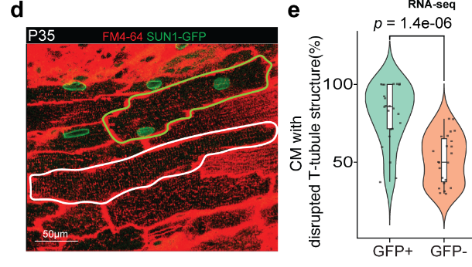
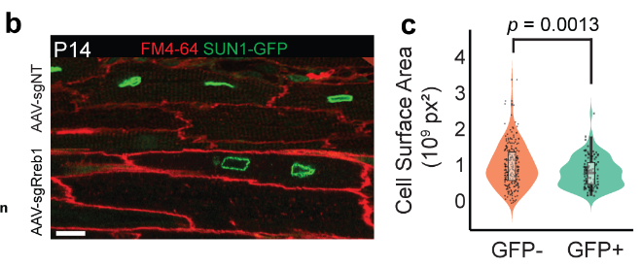
VALIDATE FUNCTION
Published targeted perturbation
Rreb1 supports CM growth and T-tubule organization
P14 · Cardiomyocyte growth
P35 · T-tubule organization
Targeted postnatal perturbation links a screen candidate to structural CM phenotypes.
Wang et al., Nature Cardiovascular Research (2026); Fig.7b–e; author-supplied manuscript panels
31
Notes:
SLIDE 31 | MAIN TALK | Suggested 80 seconds
SPEAKER SCRIPT
We followed Rreb1, a transcriptional regulator, because conventional loss of the gene is embryonically lethal and does not directly answer its postnatal role. Postnatal AAV perturbation allows us to examine that later interval. At P14, GFP-positive, sgRreb1-targeted CMs are smaller than GFP-negative CMs within the same heart. At P35, targeted CMs show more disorganized T-tubule structure. These results move beyond the RNA screen and support a role in postnatal structural development. Cell size alone would be an incomplete maturation phenotype, so the next question is whether electrical, metabolic and organ-level function also change.
EVIDENCE / SOURCE
Wang, Dong, Song et al. Nature Cardiovascular Research (2026); doi:10.1038/s44161-026-00861-z; Fig.7b–e; author-supplied manuscript panels
INTERPRETATION BOUNDARY
Morphology points are cells/FOVs nested within mice; do not present them as independent animal counts. Supplied draft panel layout is interpreted against final published legend.

Slide 32
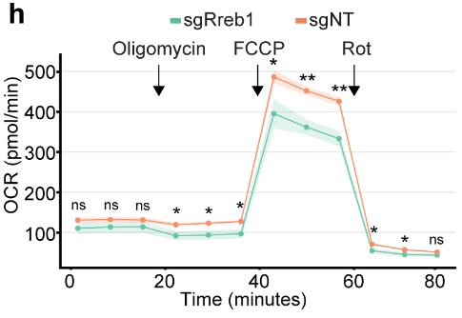
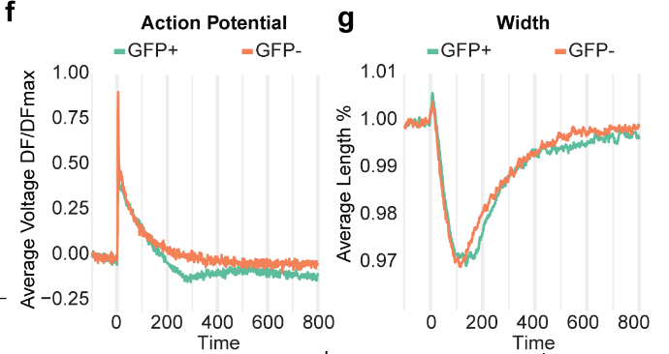
VALIDATE FUNCTION
Published targeted perturbation
Electrical and metabolic measurements extend the phenotype
Electrical and contraction readouts
Mitochondrial respiration
Independent assay types extend the RNA-screen phenotype; fluorescence and contraction are not direct force measurements.
Wang et al., Nature Cardiovascular Research (2026); Fig.7f–h
32
Notes:
SLIDE 32 | MAIN TALK | Suggested 80 seconds
SPEAKER SCRIPT
Rreb1 perturbation also changes voltage-sensitive fluorescence and contraction behavior, and reduces maximal mitochondrial respiratory capacity in the reported assay. These readouts address different aspects of cardiomyocyte performance, which is important because transcriptional scores alone cannot establish function. The electrical trace is a fluorescence-based measurement, not a calibrated membrane-voltage recording. The contraction trace describes behavior rather than directly measuring generated force. The agreement across these assays nevertheless makes the phenotype substantially more informative than an isolated gene-expression change. It suggests that the transcriptional regulator contributes to several linked parts of postnatal CM development.
EVIDENCE / SOURCE
Wang, Dong, Song et al. Nature Cardiovascular Research (2026); doi:10.1038/s44161-026-00861-z; Fig.7f–h
INTERPRETATION BOUNDARY
Avoid claiming a specific action-potential-duration change or direct force measurement that was not established by these panels.

Slide 33
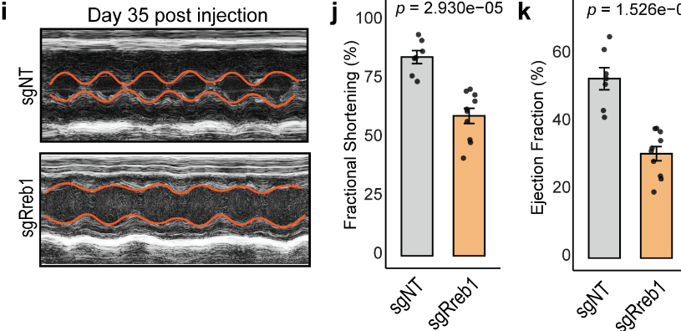
VALIDATE FUNCTION
Published targeted perturbation
Rreb1 perturbation also reduces heart-level performance
Heart-level outcome
Fractional shortening ↓
Ejection fraction ↓
7 control mice
10 sgRreb1 mice
A thyroid-hormone-associated downstream program is nominated; causal mediation still requires testing.
Wang et al., Nature Cardiovascular Research (2026); Fig.7i–o
33
Notes:
SLIDE 33 | MAIN TALK | Suggested 75 seconds
SPEAKER SCRIPT
At the organ level, hearts receiving the Rreb1-targeting treatment show reduced fractional shortening and ejection fraction at the later assessment. The final paper reports seven control and ten sgRreb1 mice for these echocardiographic comparisons. Together with structural, electrical and metabolic findings, this supports a requirement for Rreb1 in normal postnatal cardiac development. RNA sequencing and regulatory-network overlap also nominate thyroid-hormone-associated transcription as a possible downstream component. That proposed mediator remains a working mechanism rather than a completed rescue or epistasis result. The functional phenotype is stronger evidence than the inferred intermediate pathway.
EVIDENCE / SOURCE
Wang, Dong, Song et al. Nature Cardiovascular Research (2026); doi:10.1038/s44161-026-00861-z; Fig.7i–o
INTERPRETATION BOUNDARY
The higher-dose heart-function experiment differs from the mosaic within-heart morphology comparison. A Thra-mediated causal chain is not fully established.

Slide 34
INTEGRATE THE STORY
Working biological model
Mature muscle emerges within a developing tissue system
Vascular context
CM competence
Matrix context
Access, coverage
and local interactions
Intrinsic gene regulation
Rreb1 perturbation
affects function
Family-specific programs
and tissue organization
CM and heart performance
Solid: tested perturbation outcome. Dashed: proposed reciprocal niche relationships.
Wang et al., Nature Cardiovascular Research (2026); Lu et al. Nature Cell Biology 23, 967–977 (2021); doi:10.1038/s41556-021-00747-1; Reviewed 21-gene follow-up (frozen analysis)
34
Notes:
SLIDE 34 | MAIN TALK | Suggested 60 seconds
SPEAKER SCRIPT
The emerging model is that intrinsic competence and tissue context develop together. Genetic perturbation demonstrates that particular CM regulators are required for normal development and function. Spatial observations associate transcriptional maturation with the identity and organization of nearby cells. CMs are also potential senders: changing muscle demand and CM-derived signals may help organize the surrounding vasculature and matrix. The vascular literature and fibroblast programs provide context for this reciprocal model. These evidence layers are complementary but not interchangeable. Which local interactions are instructive, permissive or responses to muscle development remains an experimental question.
EVIDENCE / SOURCE
Wang, Dong, Song et al. Nature Cardiovascular Research (2026); doi:10.1038/s44161-026-00861-z; Lu et al. Nature Cell Biology 23, 967–977 (2021); doi:10.1038/s41556-021-00747-1; Exploratory follow-up: CM21_paperstyle_extension, frozen commit 1179f3cfb4af34fdfeeba4e2fee2ca765bbe8c6e
INTERPRETATION BOUNDARY
Solid relationships in the diagram denote tested gene-perturbation effects; dashed relationships denote unproven reciprocal niche mechanisms or inferred mediators.

Slide 35
IMPLICATIONS
Translational hypothesis
Development suggests goals for regenerative strategies
Generate muscle
Build the environment
Consolidate function
Cell production and survival
Vascular access and matrix
Structure, electrical behavior
and metabolic capacity
Overlapping developmental goals guide a regenerative hypothesis; no treatment efficacy is claimed.
Guo & Pu (2020); Tzahor & Poss (2017); Wang et al., Nature Cardiovascular Research (2026)
35
Notes:
SLIDE 35 | MAIN TALK | Suggested 50 seconds
SPEAKER SCRIPT
For regeneration, the implication is that generating new muscle should be paired with building the conditions that let it function. A strategy may need to support cell production, vascular access, matrix organization and the acquisition of appropriate contractile and electrical properties. These goals can overlap; we should not assume that all maturation must be suppressed before growth or that cell-cycle exit is the only desired endpoint. The current work identifies measurements and candidate regulators for designing such experiments. It does not demonstrate a regenerative treatment or establish that inhibiting a maturation regulator would improve repair.
EVIDENCE / SOURCE
Guo & Pu (2020); Tzahor & Poss (2017); Wang, Dong, Song et al. Nature Cardiovascular Research (2026); doi:10.1038/s44161-026-00861-z
INTERPRETATION BOUNDARY
This is a proposed experimental framework, not a demonstrated regenerative therapy.

Slide 36
IMPLICATIONS
Proposed experiments
Three experiments can distinguish the remaining explanations
1 Vascular support
2 Contact signaling
3 Matrix organization
Independent hearts
Matched ventricular regions
Perfused-capillary measures
21-gene score + CM function
EC- versus CM-specific
perturbation
Downstream rescue
Separate source and receiver
Defined FB state / matrix
Regional anatomy controls
Vascular and CM readouts
Intermediate P3/P5/P10 stages
Reviewed 21-gene follow-up (frozen analysis); inference boundaries from Wang et al., Nature Cardiovascular Research (2026)
36
Notes:
SLIDE 36 | MAIN TALK | Suggested 130 seconds
SPEAKER SCRIPT
The next experiments should separate explanations rather than simply add another computational method. First, repeat the regional vascular comparisons in independent hearts while measuring perfused capillaries and CM function alongside the same 21-gene score. Second, compare EC-specific and CM-specific perturbation of a contact candidate, with a downstream rescue where feasible. Third, test whether a defined fibroblast state or matrix property changes vascular organization and CM performance, rather than interpreting broad cell depletion as a single direct signal. Earlier P3/P5 and intermediate P10 samples would clarify timing between the existing stages. These experiments would turn the spatial associations into a more precise developmental model.
EVIDENCE / SOURCE
Exploratory follow-up: CM21_paperstyle_extension, frozen commit 1179f3cfb4af34fdfeeba4e2fee2ca765bbe8c6e; inference boundaries from Wang, Dong, Song et al. Nature Cardiovascular Research (2026); doi:10.1038/s44161-026-00861-z
INTERPRETATION BOUNDARY
Keep shared anatomy, general tissue injury and matrix/nerve-mediated effects as alternative explanations.

Slide 37
TAKE-HOME MESSAGES
Synthesis
A functional heart requires both a tissue map and gene tests
01
Maturation has a spatial landscape
Age and CM identity do not explain all within-section variation.
02
Neighbor identity sharpens the biological question
Capillary organization is associated; finer matrix mechanisms remain hypotheses.
03
Functional genetics moves the story forward
Targeted validation connects a candidate gene to cell and heart performance.
Wang et al., Nature Cardiovascular Research (2026); Lu et al. Nature Cell Biology 23, 967–977 (2021); doi:10.1038/s41556-021-00747-1; reviewed exploratory follow-up
37
Notes:
SLIDE 37 | MAIN TALK | Suggested 50 seconds
SPEAKER SCRIPT
There are three main messages. First, postnatal maturation is spatially heterogeneous, and CM identity should be separated from maturation state. Second, the identity and arrangement of vascular and fibroblast neighbors help define biologically specific hypotheses; the strongest new spatial support concerns capillary organization at P7, while several finer relationships remain uncertain. Third, in vivo functional genomics turns those hypotheses into testable gene requirements, and targeted validation shows that a screen-nominated regulator can affect structure, cellular performance and heart function. Together, these approaches connect a developmental tissue landscape to experimentally testable mechanisms.
EVIDENCE / SOURCE
Wang, Dong, Song et al. Nature Cardiovascular Research (2026); doi:10.1038/s44161-026-00861-z; Lu et al. Nature Cell Biology 23, 967–977 (2021); doi:10.1038/s41556-021-00747-1; reviewed exploratory follow-up
INTERPRETATION BOUNDARY
Use the stated evidence category; no additional causal or functional claim is implied.

Slide 38

Notes:
SLIDE 38 | MAIN TALK | Suggested 20 seconds
SPEAKER SCRIPT
I would like to thank the members of the Liu and Qian laboratories, the collaborators and colleagues who contributed to this work, and our funding organizations. The original acknowledgment slide is preserved here so that the names, photographs and funder logos remain intact. Thank you, and I welcome your questions.
EVIDENCE / SOURCE
Original presentation slide 16, names/photos/funder logos preserved
INTERPRETATION BOUNDARY
Use the stated evidence category; no additional causal or functional claim is implied.

Slide 39
METHODS
Measured Xenium panel
Backup | The exact 21-gene spatial outcome
Measured targets
Measured targets
Measured targets
Rxrg
Ppargc1a
Ppargc1b
Cebpa
Cebpb
Esrra
Esrrb
Esrrg
Mitf
Myh6
Tnni3
Myl2
Kcnq1
Jph1
Jph2
Bin1
Lpin1
Pln
Ppara
Ppard
Cpt1b
Module score = mean expression of 21 genes − expression-matched background
Reconstruction: 8 bins, 20 controls/gene, 50 draws; fixed cross-stage reference within each RNA view.
Reviewed 21-gene follow-up (frozen analysis); measured_21gene_panel.tsv; analysis_settings.json
39
Notes:
SLIDE 39 | BACKUP | Suggested 0 seconds
SPEAKER SCRIPT
The spatial outcome is the published 21-gene positive module measured by Xenium. Counts are normalized over the 403 measured targets. The paper-style reconstruction subtracts matched control expression, with fixed pooled expression bins and an ensemble of 50 control draws. We also retain the earlier gene-Z score and alternative control settings as sensitivities. These are different numerical definitions using the same positive maturation panel. No missing maturation targets are imputed from snRNA-seq.
EVIDENCE / SOURCE
Exploratory follow-up: CM21_paperstyle_extension, frozen commit 1179f3cfb4af34fdfeeba4e2fee2ca765bbe8c6e; measured_21gene_panel.tsv; analysis_settings.json
INTERPRETATION BOUNDARY
The original author control genes, exact graph and masks are unavailable; this is not exact replication.

Slide 40
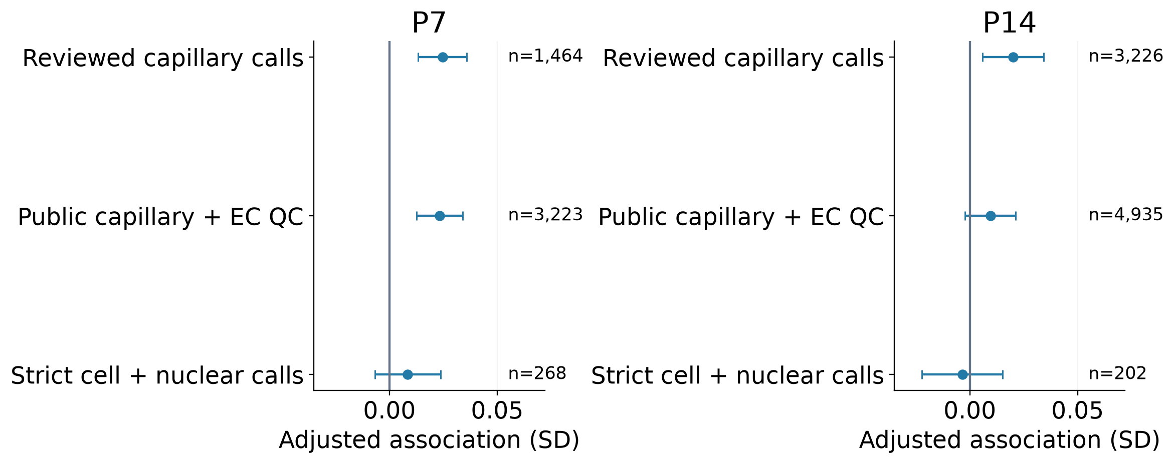
METHODS
Source-label sensitivity
Backup | Capillary labels limit the spatial conclusion
The strict source sets are sparse; neither annotation layer is established biological ground truth.
Reviewed 21-gene follow-up (frozen analysis); source_label_sensitivity.tsv
40
Notes:
SLIDE 40 | BACKUP | Suggested 0 seconds
SPEAKER SCRIPT
The P7 association remains positive with reviewed capillary calls and broader public capillary labels passing EC QC. Requiring strict cell-and-nucleus agreement leaves 268 P7 source profiles and weakens the estimate. At P14, broader-label support is weaker and the strict 202-profile set is inconclusive. A highly selected sparse source set is not ground truth for the whole capillary network. Source definitions should therefore be shown alongside the main result rather than hidden as a technical footnote.
EVIDENCE / SOURCE
Exploratory follow-up: CM21_paperstyle_extension, frozen commit 1179f3cfb4af34fdfeeba4e2fee2ca765bbe8c6e; source_label_sensitivity.tsv
INTERPRETATION BOUNDARY
No favorable source definition is selected post hoc as the sole truth.

Slide 41
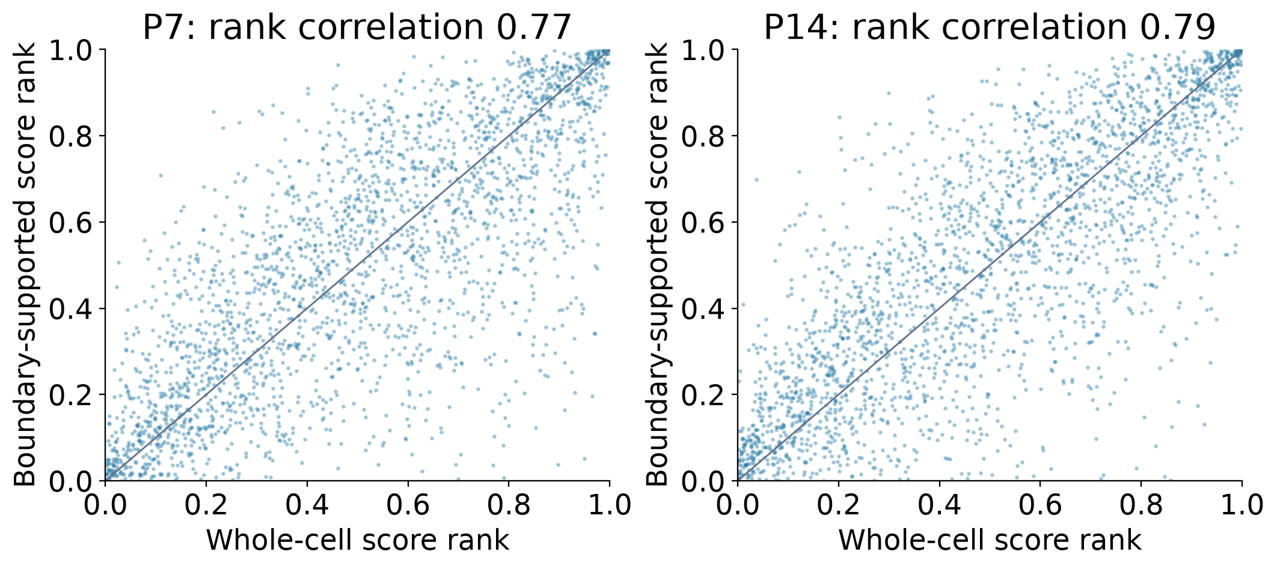
METHODS
QC and sensitivity
Backup | Segmentation affects transcript ownership and geometry
Keep valid
nucleus-free
CM profiles.
Core counts
are not
nuclear-only
truth.
Reviewed 21-gene follow-up (frozen analysis); core_native_score_agreement.tsv; original boundary validation
41
Notes:
SLIDE 41 | BACKUP | Suggested 0 seconds
SPEAKER SCRIPT
A valid section through a large cardiomyocyte can miss its nucleus. We therefore retain nucleus-free CM profiles and compare whole-cell with confidence-supported transcript assignments. The core layer is not nuclear-only truth. Individual CM score rankings agree only moderately between these views, even when some spatial association directions agree. Native polygon apposition is also only an operational two-dimensional measurement. Protein-defined boundaries, transcript-level inspection and boundary perturbations should support, rather than be replaced by, a single label or score.
EVIDENCE / SOURCE
Exploratory follow-up: CM21_paperstyle_extension, frozen commit 1179f3cfb4af34fdfeeba4e2fee2ca765bbe8c6e; core_native_score_agreement.tsv; original boundary validation
INTERPRETATION BOUNDARY
96 sampled original boundaries and eight stage/view count reconstructions were independently checked; these audits do not establish universal segmentation accuracy.

Slide 42
DEVELOPMENTAL QUESTIONS
Hypotheses from cross-sectional data
Backup | Fibroblast state change is not lineage tracing
Observed
Possible explanations
Discriminating evidence
Different expression families
at different ages
Growing tissue geometry
State switching
Differential growth / survival
Sampling / label changes
Migration
Timed lineage tracing
Intermediate ages
Registered anatomy
Coherent marker panels
Reviewed fibroblast reference and spatial annotations; Hortells et al. PNAS (2020); doi:10.1073/pnas.2009119117; PMID:32817558
42
Notes:
SLIDE 42 | BACKUP | Suggested 0 seconds
SPEAKER SCRIPT
The decline of one expression family and the appearance of another can reflect state switching, differential proliferation or survival, sampling, and changes in classification. Growing myocardial geometry can also alter a cell’s relative distance to the endocardium without requiring active outward migration. RNA trajectories and optimal-transport correspondences can nominate transitions but cannot distinguish these possibilities conclusively. A Postn-associated to Gfpt2/Pi16- or Col8a1-associated transition remains a hypothesis. Timed lineage tracing with intermediate stages and coherent marker panels is needed, especially before claiming that anatomically distinct valve- or outflow-associated groups share the same transition.
EVIDENCE / SOURCE
Reviewed fibroblast reference and spatial annotations; Hortells et al. PNAS (2020); doi:10.1073/pnas.2009119117; PMID:32817558
INTERPRETATION BOUNDARY
Postn-family label absence is not proof of absent Postn RNA; Gfpt2/Pi16 is a descriptive multi-gene family, and Col8a1 remains one broad family.

Slide 43
METHODS
Method interpretation
Backup | Communication models organize hypotheses
CytoSPACE
COMMOT
SCENIC / SigNET
Validation
RNA-to-spatial alignment
Spatially compatible
communication proposals
Candidate regulatory links
Spatial / animal holdouts
Cell-specific intervention
Wang et al., Nature Cardiovascular Research (2026); released COMMOT/SCENIC/SigNET and maturation-model code
43
Notes:
SLIDE 43 | BACKUP | Suggested 0 seconds
SPEAKER SCRIPT
CytoSPACE aligns an RNA reference to the spatial dataset. COMMOT nominates expression-compatible spatial communication. SCENIC and SigNET nominate regulatory relationships and possible mediators. Predictive modeling evaluates associations under the chosen validation split. These methods address different questions and their agreement can be useful, but overlapping RNA features are not independent experimental confirmation. For prediction, spatially held-out regions and independent animals are stronger tests than a random cell split. For mechanism, receiver perturbation alone does not identify the sender, contact route or mediator.
EVIDENCE / SOURCE
Wang, Dong, Song et al. Nature Cardiovascular Research (2026); doi:10.1038/s44161-026-00861-z; released COMMOT/SCENIC/SigNET and maturation-model code
INTERPRETATION BOUNDARY
Do not treat SHAP importance, random-cell predictive accuracy or a transport solution as proof of a biological mechanism.

Slide 44
METHODS
Published platform checks
Backup | Screen assignment and target validation are different
37 / 43
What the readout supports
Detectable target probes decreased ≥50%
Target-site RNA evidence
Guide detection ≠ every allele edited
Independent target and phenotype
validation remain essential
Probe-signal reduction is an editing proxy, not a measured biallelic knockout percentage.
Wang et al., Nature Cardiovascular Research (2026); Supplementary Fig.24; Methods
44
Notes:
SLIDE 44 | BACKUP | Suggested 0 seconds
SPEAKER SCRIPT
Among 43 targets with detectable perturbation-detection probes, 37 showed at least a 50% reduction in the reported comparison. This is a target-probe signal result, not an absolute biallelic-editing percentage. Guide detection and probe reduction provide complementary assignment evidence. The screen also includes non-targeting controls and established maturation regulators. Nucleus-level module-score changes nominate hits, whereas independent target verification, biological replication and functional measurements establish the stronger follow-up conclusions. The Rreb1 studies supply several of those additional evidence layers.
EVIDENCE / SOURCE
Wang, Dong, Song et al. Nature Cardiovascular Research (2026); doi:10.1038/s44161-026-00861-z; Supplementary Fig.24; Methods
INTERPRETATION BOUNDARY
Use 37/43 probe reductions rather than the original slide note’s unqualified 88% knockout efficiency.

Slide 45
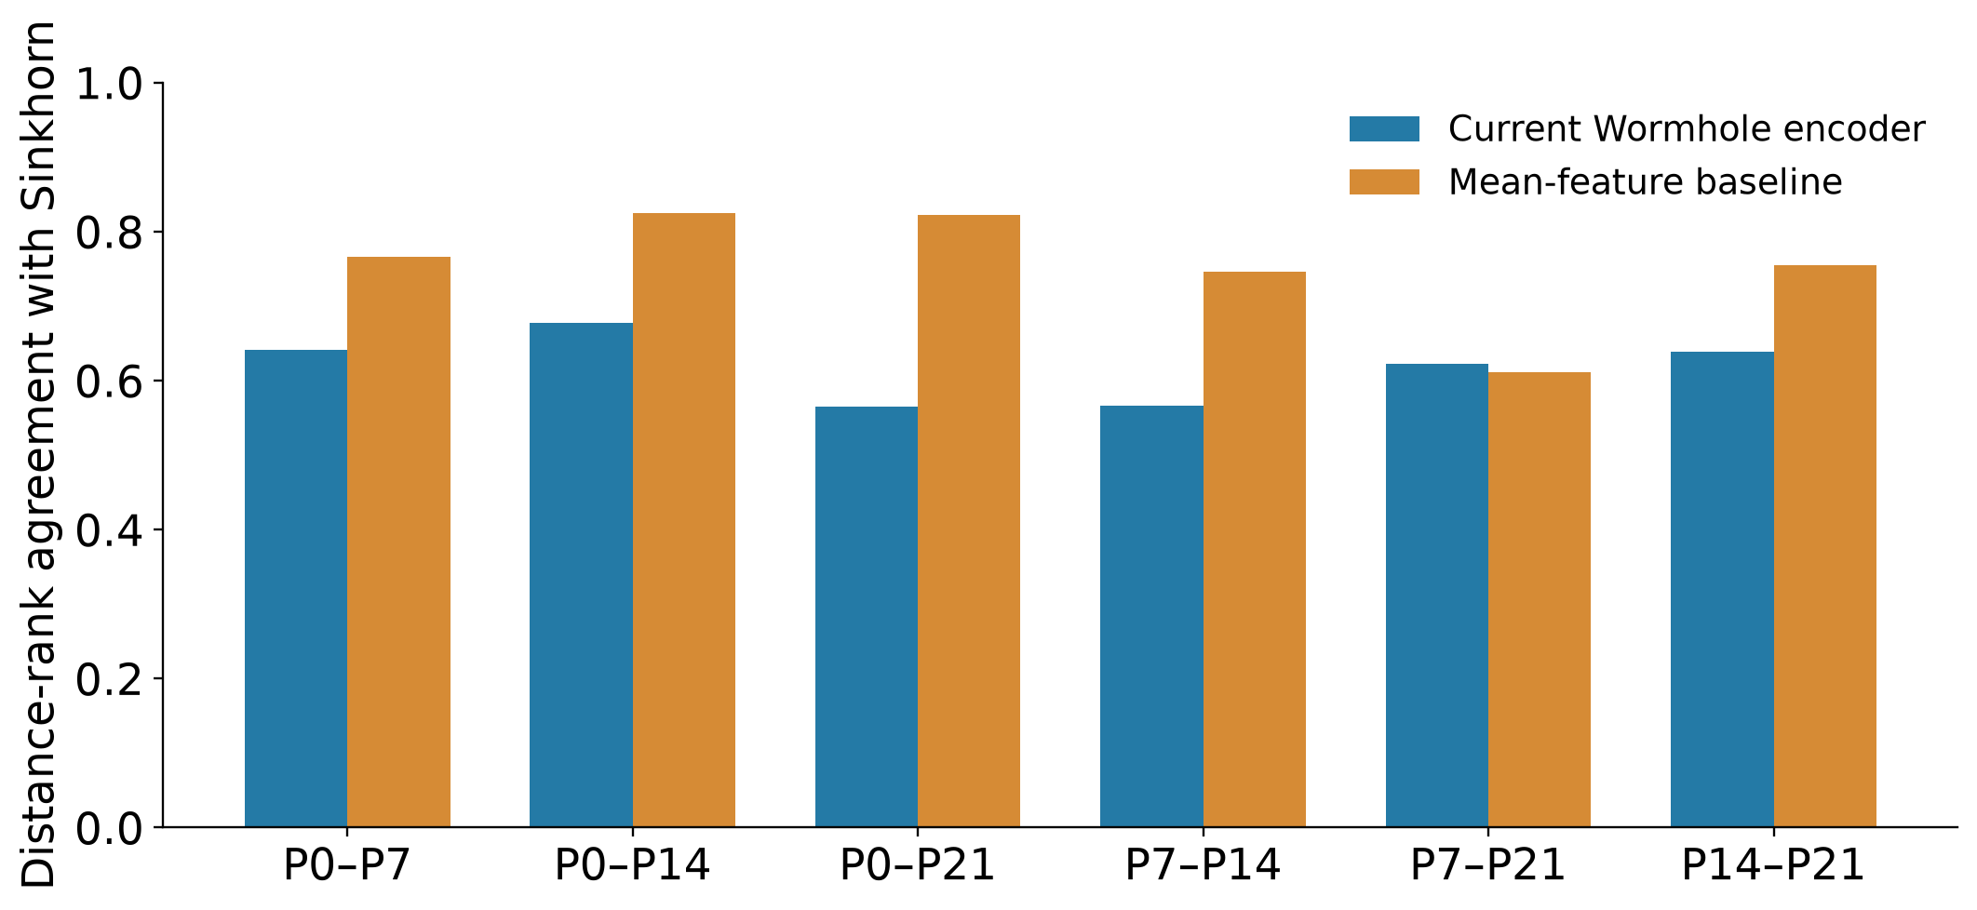
FUTURE ANALYSIS
Benchmark and limits
Backup | Transport can nominate developmental correspondence
Distributional correspondence is not fate tracing; the current encoder does not establish dynamic cardiac niches.
cardiac_developmental_synthesis/cross_stage_metric_assessment.tsv; prior held-out Wormhole assessment
45
Notes:
SLIDE 45 | BACKUP | Suggested 0 seconds
SPEAKER SCRIPT
Optimal transport compares distributions and can help ask whether developmental neighborhoods change composition, internal state or both. It does not track cells or establish fate. In our existing cross-stage benchmark, the current Wormhole encoder was less convincing for composition-matched changes, where simple mean-feature comparisons usually matched or outperformed it. We therefore keep transport-generated developmental correspondences outside the core conclusions. A useful extension would preserve anatomy and absolute vascular abundance separately, compare with exact or regularized transport, and test any proposed trajectory with intermediate stages and independent biological evidence.
EVIDENCE / SOURCE
cardiac_developmental_synthesis/cross_stage_metric_assessment.tsv; prior held-out Wormhole assessment
INTERPRETATION BOUNDARY
The benchmark is calibration of distances, not a validated dynamic cardiac niche reconstruction.

Slide 46
REFERENCES
Sources
Selected references and source material
Heart atlas / functional genomics
Wang, Dong, Song et al. Spatially guided in vivo single-cell functional genomics of postnatal heart. Nature Cardiovascular Research (2026). DOI: 10.1038/s44161-026-00861-z.
Perinatal coronary expansion
Lu et al. Perinatal angiogenesis from pre-existing coronary vessels via DLL4–NOTCH1 signalling. Nature Cell Biology 23, 967–977 (2021). DOI: 10.1038/s41556-021-00747-1.
CM maturation and regeneration
Guo & Pu. Circulation Research 126, 1086–1106 (2020). Tzahor & Poss. Science 356, 1035–1039 (2017).
Fibroblast developmental context
Hortells et al. A specialized population of Periostin-expressing cardiac fibroblasts contributes to postnatal cardiomyocyte maturation and innervation. PNAS (2020). DOI: 10.1073/pnas.2009119117.
Supplied manuscript panels are credited; exploratory follow-up is kept distinct from published experiments.
Bibliography and figure provenance
46
Notes:
SLIDE 46 | BACKUP | Suggested 0 seconds
SPEAKER SCRIPT
The main sources are the final 2026 heart-atlas article, the full Lu et al. perinatal angiogenesis paper supplied by the author, the cardiomyocyte-maturation review cited in the original presentation, and the existing reviewed analysis outputs. The Hortells intervention is discussed with its mechanistic limitations; that earlier review checked the indexed abstract rather than performing a new full-paper audit. Figure panels from the supplied manuscript are credited as supplied draft panels and interpreted against the final article’s results and legends. Original acknowledgment names and photographs are preserved. The original PowerPoint remains unchanged.
EVIDENCE / SOURCE
Bibliography and figure provenance
INTERPRETATION BOUNDARY
Use the stated evidence category; no additional causal or functional claim is implied.

