Slide 1
Basic plan
Partition so that, for some j
- entry a[j] is in place
- no larger entry to the left of j
- no smaller entry to the right of j
Sort each piece recursively
54 | 26 | 93 | 17 | 77 | 31 | 44 | 55 | 20 | 20
lo
i
j

Slide 2
Partition
Phase I. Repeat until i and j pointers cross
Scan i from left to right so long as (a[i] < a[lo])
Scan j from right to left so long as (a[j] > a[lo])
Exchange a[i] with a[j]
54 | 26 | 93 | 17 | 77 | 31 | 44 | 55 | 20 | 20
lo
i
j

Slide 3
Partition
Phase I. Repeat until i and j pointers cross
Scan i from left to right so long as (a[i] < a[lo])
Scan j from right to left so long as (a[j] > a[lo])
Exchange a[i] with a[j]
54 | 26 | 93 | 17 | 77 | 31 | 44 | 55 | 20 | 20
lo
i
j
Stop i scan because a[i] >= a[lo]

Slide 4
Partition
Phase I. Repeat until i and j pointers cross
Scan i from left to right so long as (a[i] < a[lo])
Scan j from right to left so long as (a[j] > a[lo])
Exchange a[i] with a[j]
54 | 26 | 93 | 17 | 77 | 31 | 44 | 55 | 20 | 20
lo
i
j
Stop j scan and exchange a[i] with a[j]

Slide 5
Partition
Phase I. Repeat until i and j pointers cross
Scan i from left to right so long as (a[i] < a[lo])
Scan j from right to left so long as (a[j] > a[lo])
Exchange a[i] with a[j]
54 | 26 | 20 | 17 | 77 | 31 | 44 | 55 | 20 | 93
lo
i
j

Slide 6
Partition
Phase I. Repeat until i and j pointers cross
Scan i from left to right so long as (a[i] < a[lo])
Scan j from right to left so long as (a[j] > a[lo])
Exchange a[i] with a[j]
54 | 26 | 20 | 17 | 77 | 31 | 44 | 55 | 20 | 93
lo
i
j

Slide 7
Partition
Phase I. Repeat until i and j pointers cross
Scan i from left to right so long as (a[i] < a[lo])
Scan j from right to left so long as (a[j] > a[lo])
Exchange a[i] with a[j]
54 | 26 | 20 | 17 | 77 | 31 | 44 | 55 | 20 | 93
lo
i
j
Stop i scan because a[i] >= a[lo]

Slide 8
Partition
Phase I. Repeat until i and j pointers cross
Scan i from left to right so long as (a[i] < a[lo])
Scan j from right to left so long as (a[j] > a[lo])
Exchange a[i] with a[j]
54 | 26 | 20 | 17 | 77 | 31 | 44 | 55 | 20 | 93
lo
i
j
Stop j scan and exchange a[i] with a[j]

Slide 9
Partition
Phase I. Repeat until i and j pointers cross
Scan i from left to right so long as (a[i] < a[lo])
Scan j from right to left so long as (a[j] > a[lo])
Exchange a[i] with a[j]
54 | 26 | 20 | 17 | 20 | 31 | 44 | 55 | 77 | 93
lo
i
j

Slide 10
Partition
Phase I. Repeat until i and j pointers cross
Scan i from left to right so long as (a[i] < a[lo])
Scan j from right to left so long as (a[j] > a[lo])
Exchange a[i] with a[j]
54 | 26 | 20 | 17 | 20 | 31 | 44 | 55 | 77 | 93
lo
i
j

Slide 11
Partition
Phase I. Repeat until i and j pointers cross
Scan i from left to right so long as (a[i] < a[lo])
Scan j from right to left so long as (a[j] > a[lo])
Exchange a[i] with a[j]
54 | 26 | 20 | 17 | 20 | 31 | 44 | 55 | 77 | 93
lo
i
j

Slide 12
Partition
Phase I. Repeat until i and j pointers cross
Scan i from left to right so long as (a[i] < a[lo])
Scan j from right to left so long as (a[j] > a[lo])
Exchange a[i] with a[j]
54 | 26 | 20 | 17 | 20 | 31 | 44 | 55 | 77 | 93
lo
i
j

Slide 13
Partition
Phase I. Repeat until i and j pointers cross
Scan i from left to right so long as (a[i] < a[lo])
Scan j from right to left so long as (a[j] > a[lo])
Exchange a[i] with a[j]
54 | 26 | 20 | 17 | 20 | 31 | 44 | 55 | 77 | 93
lo
i
j

Slide 14
Partition
Phase I. Repeat until i and j pointers cross
Scan i from left to right so long as (a[i] < a[lo])
Scan j from right to left so long as (a[j] > a[lo])
Exchange a[i] with a[j]
54 | 26 | 20 | 17 | 20 | 31 | 44 | 55 | 77 | 93
lo
j
i

Slide 15
Partition
Phase I. Repeat until i and j pointers cross
Scan i from left to right so long as (a[i] < a[lo])
Scan j from right to left so long as (a[j] > a[lo])
Exchange a[i] with a[j]
Phase II.
Exchange a[lo] with a[j]
54 | 26 | 20 | 17 | 20 | 31 | 44 | 55 | 77 | 93
lo
j
i

Slide 16
Partition
Phase I. Repeat until i and j pointers cross
Scan i from left to right so long as (a[i] < a[lo])
Scan j from right to left so long as (a[j] > a[lo])
Exchange a[i] with a[j]
Phase II.
Exchange a[lo] with a[j]
44 | 26 | 20 | 17 | 20 | 31 | 54 | 55 | 77 | 93
lo
j
i

Slide 17
Quick sort: average-case analysis
Proposition.
The average number of compares C_{N} to quicksort an array of N distinct keys is ~ 2N ln N.

Slide 18
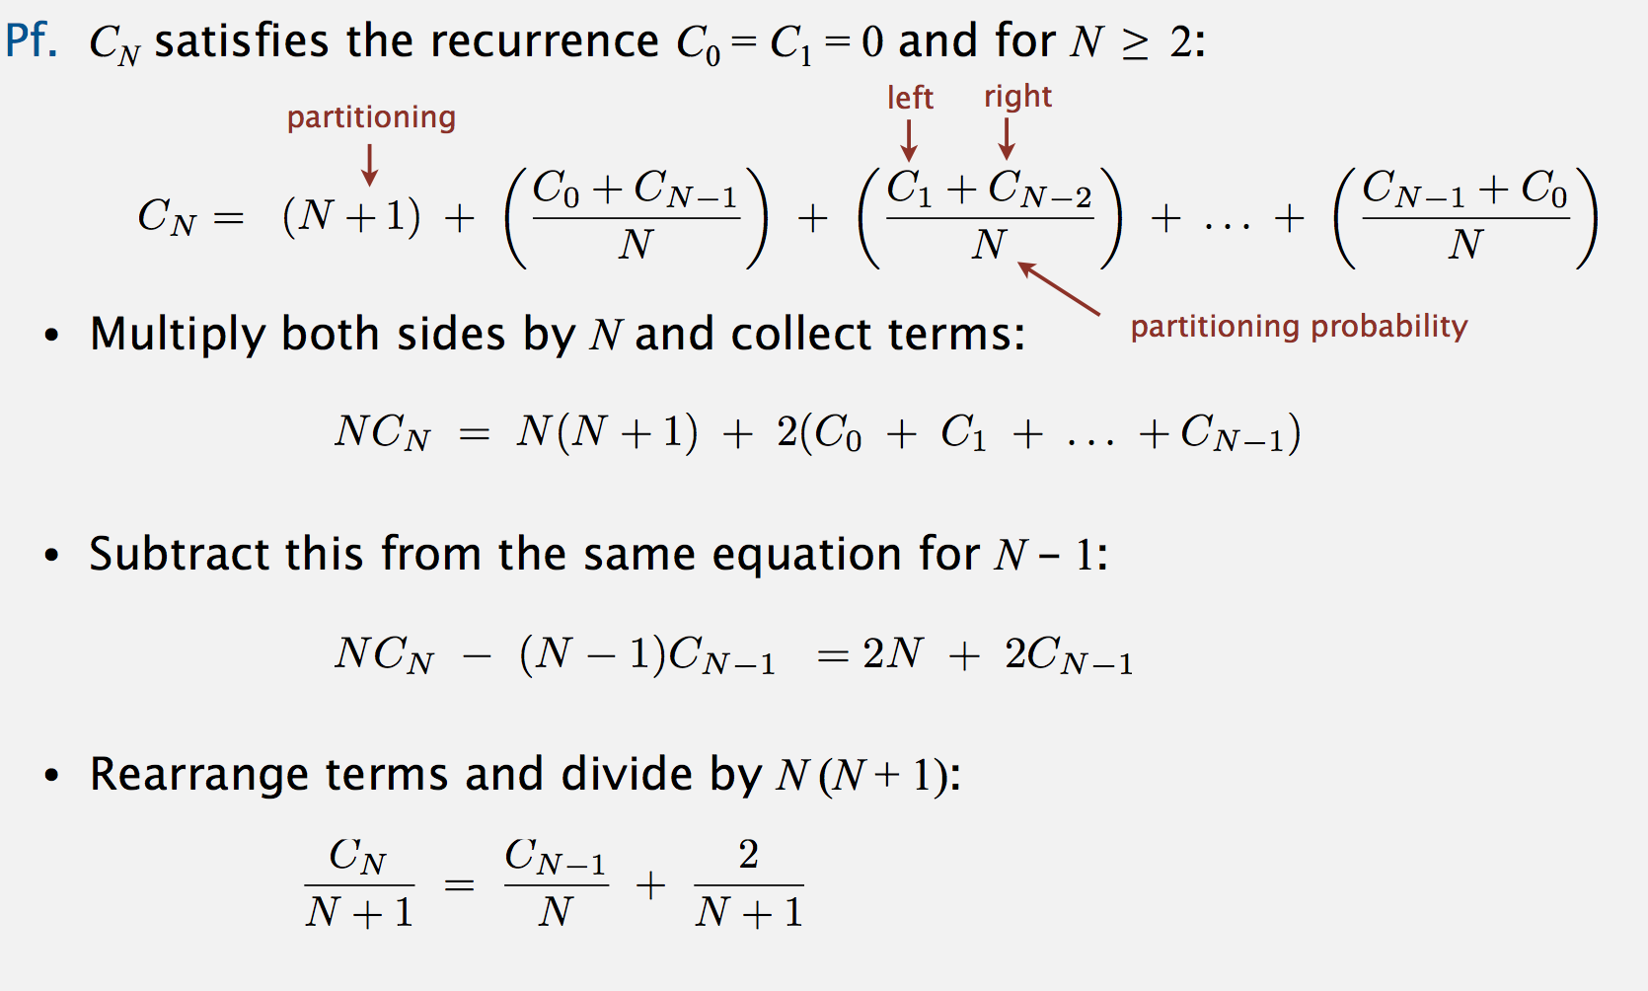

Slide 19
