Slide 1
Connectivity Overview
Jianfson Jun 6 2017

Slide 2
What is Bluetooth?
Bluetooth is a telecommunications industry specification that describes how mobile devices, computers and other devices can easily communicate with each other using a short-range wireless connection.
The global wireless standard for simple, secure connectivity.
The radio frequency for Bluetooth is between 2.400 GHZ and 2.4835 GHZ.

Slide 3
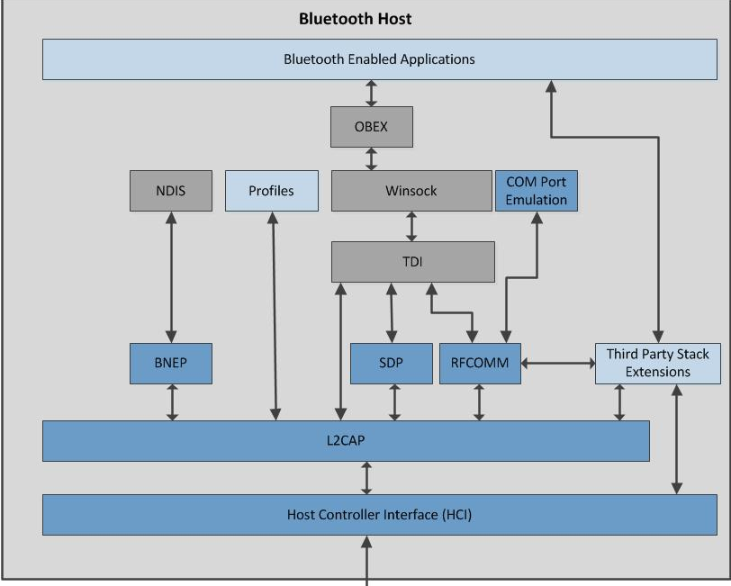
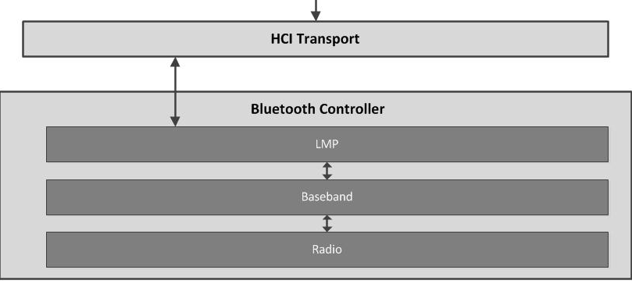
Bluetooth Architecture

Slide 4
Bluetooth Capability Map
BT Player
GoogleCast Player
FireCast Player
Audio Interface
AVRCP
HFP
HSP
A2DP
Other Profiles
Bluetooth Application profile
RFCOMM
OBEX
SDP
L2CAP
Bluetooth Stack
Host Controller Interface （HCI）
LMP
BaseBand
Bluetooth Controller
RADIO

