Slide 1
search后的

Slide 2
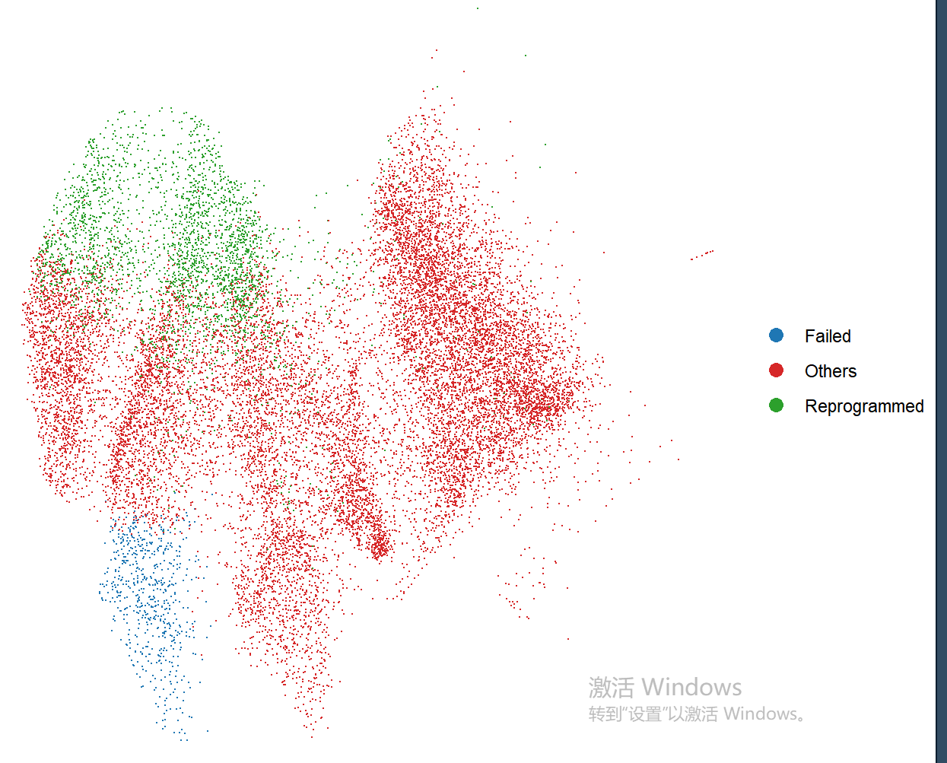
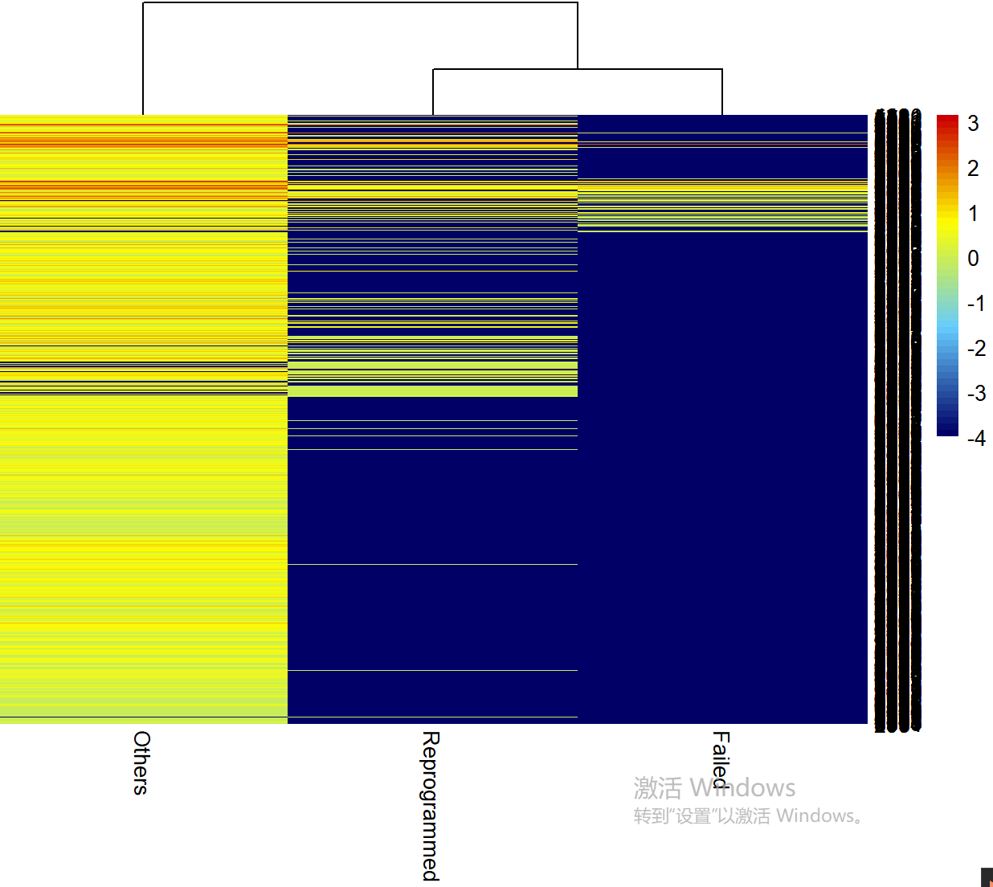
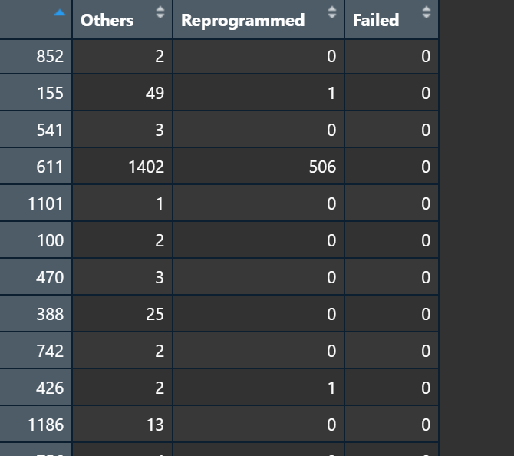
barcode count, cell type similarity, fate bias
search barcode: 1

Slide 3
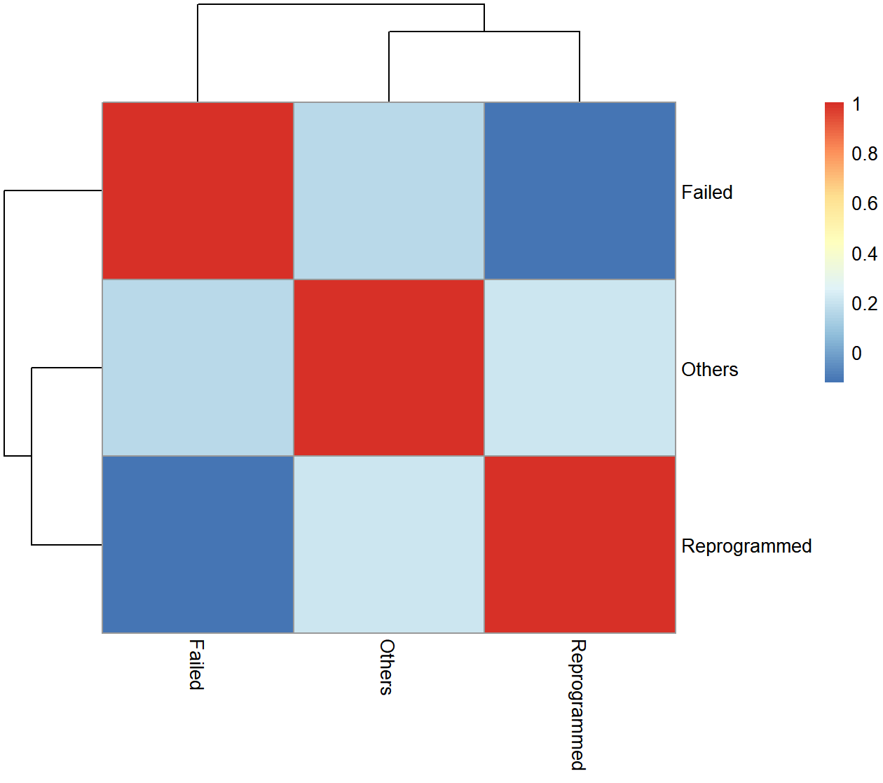
barcode count, cell type similarity, fate bias
search barcode: 1

Slide 4
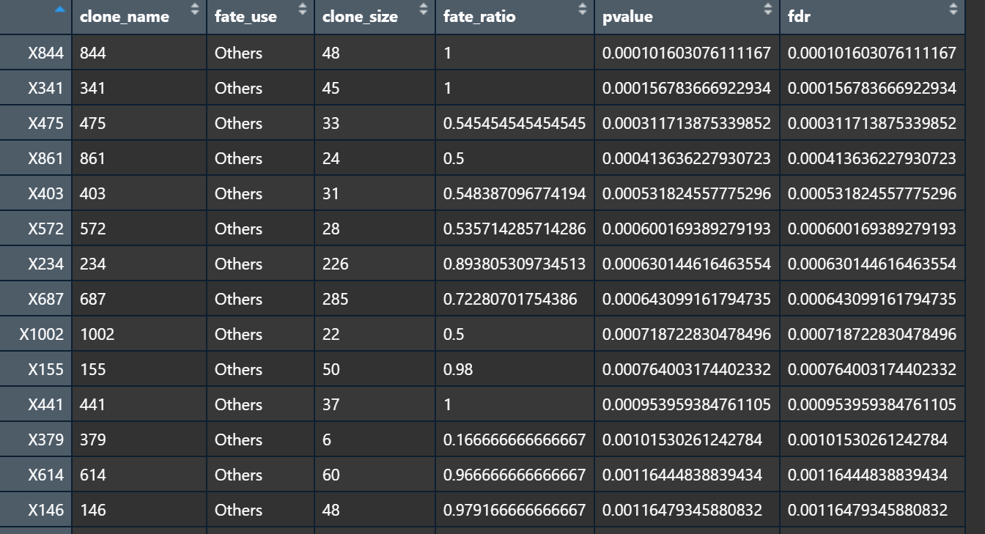
barcode count, cell type similarity, fate bias,marker
search barcode: celltype
select ct/fate: Failed, Others, Reprogrammed

Slide 5
online tool

Slide 6
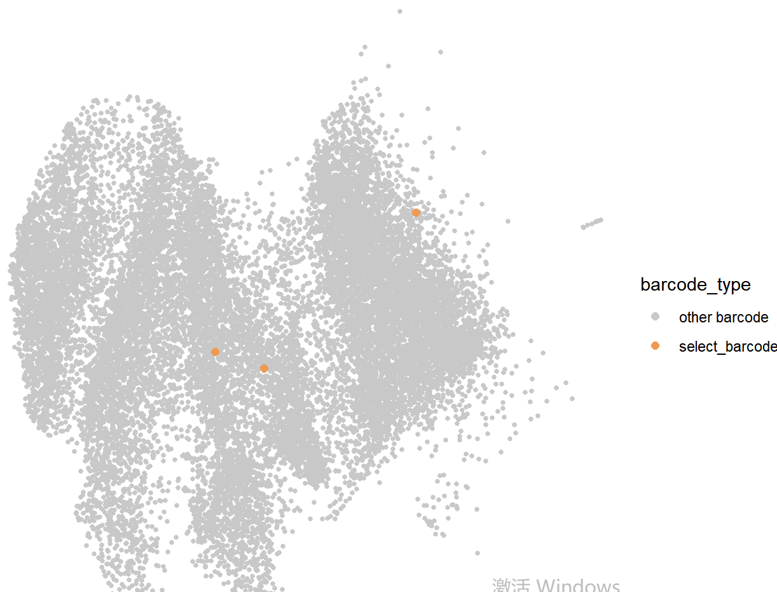
### input data
上传一个东西
1.XXX analysis
选 parameter
保存图片(pdf)
2.XXX analysis
这个分析代表啥意思
3.XXX analysis

