Slide 1
A Study of Female Board Directors Correlation With the Board Decision-Making Efficiency—Based in Automobile Manufacturing Industry List Companies’ Empirical Evidence
——Dandan Dong, and Aimin Li

Slide 2
Introduction
Problem statement
The correlation between the female board directors and board decision-making behavior

Slide 3
Research Design
Study samples
This paper selects listed companies in Shanghai and Shenzhen A-share automobile manufacturing industry
2006-2014
No ST companies
No companies without complete data
42 companies
Data are from Guotai’an database and calculated by Minitab

Slide 4
Research Design
The selection of Interpreted variables
In this paper, the Board of Directors annual meeting frequency( BMF) is choosed to measure the efficiency of board decision-making.
The higher the frequency, the lower the efficiency.

Slide 5
Research Design
The selection of Explanatory variables
The number of female directors( FD)
Female director Percentage( FADPER)
The average lever of education female directors( EDU)

Slide 6
Research Design
The selection of control variables
The size of board of directors( BS)
The proportion of independent directors( IDR)
The size of the company( SIZE)
The equity checks and balances( SHS)
The assets-liability ratio( DAR)

Slide 7
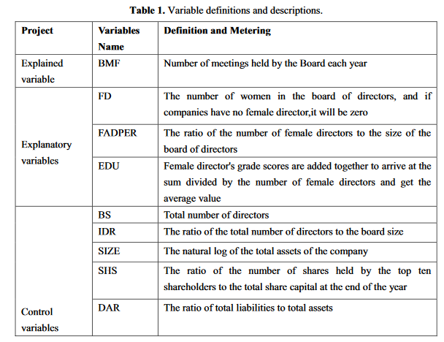
Research Design
The selection of control variables
The size of board of directors( BS)
The proportion of independent directors( IDR)
The size of the company( SIZE)
The equity checks and balances( SHS)
The assets-liability ratio( DAR)

Slide 8
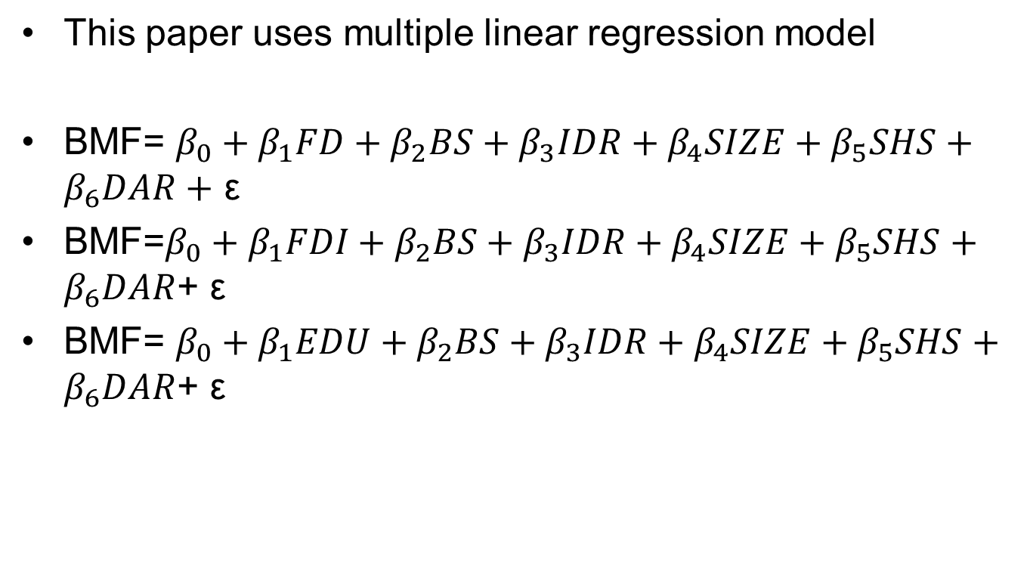
Research Design
Model design

Slide 9
Empirical analysis
Steps
Descriptive statistical analysis of variables
Correlation analysis of variables
Regression analysis

Slide 10
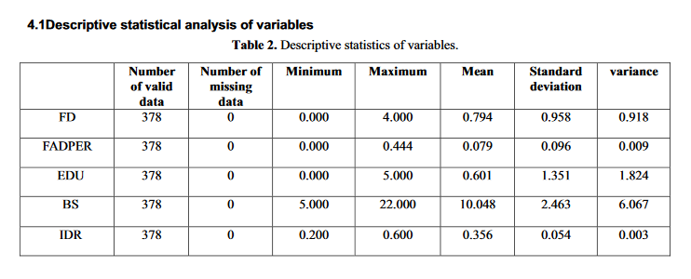
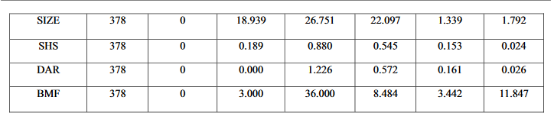
Empirical analysis
Steps
Descriptive statistical analysis of variables
Correlation analysis of variables
Regression analysis

Slide 11
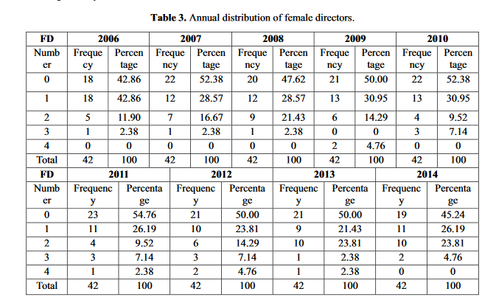
Empirical analysis
Steps
Descriptive statistical analysis of variables
Correlation analysis of variables
Regression analysis

Slide 12
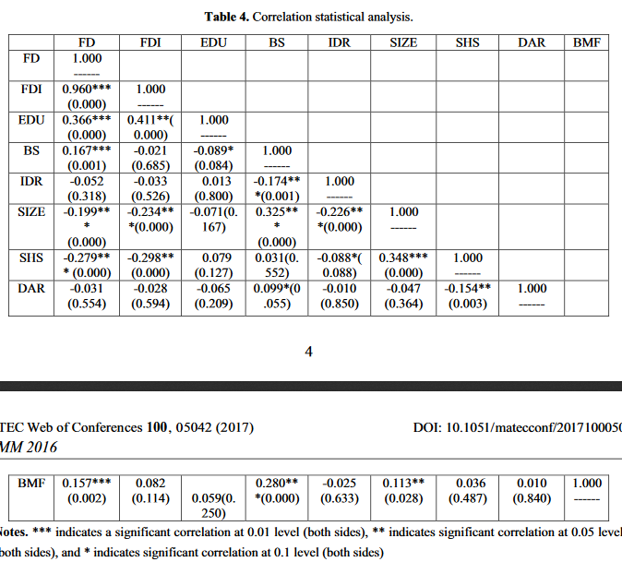
Empirical analysis
Steps

Slide 13
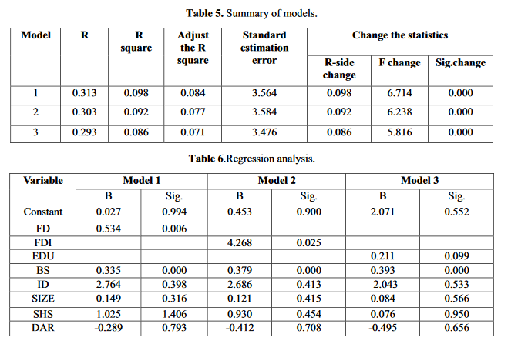
Empirical analysis
Steps

Slide 14
Conclusion
This paper find that the number of female directors, the proportion of female directors and the average educational background of female directors are negatively related to board decision-making efficiency.
Although, according to the individual cognitive limitation theory, the participation of female directors can help the company to make a comprehensive scientific decision-making.

Slide 15
Shortages
The scope of the sample
Survey interval
Other factors

Slide 16
Should we make some policies to make sure that the board has enough female directors?

Slide 17
Introduction
Problem statement
In recent years, the relevance between board gender diversity and corporate governance has caused extensive concern of governments, media and academic organizations.
Some European countries made laws.
Do we need?

Slide 18
Research Design
Study samples
This paper selects listed companies in Shanghai and Shenzhen A-share
2006-2010
No Listed companies in the financial sector
No companies without complete data

Slide 19
Research Design
The selection of Interpreted variables
Performance( Perf)
This paper uses ROA, ROE, EBIT/TA, TobinQ to measure the Perf.

Slide 20
Research Design
The selection of Explanatory variables
EBIT/TA
ROA
ROE
TobinQ

Slide 21
Research Design
The selection of control variables
The size of board ( Board)
The proportion of independent directors( Ind)
The size of the company( Size）
The assets-liability ratio( Dar)
The nature of equity( Nsh）
The proportion of the biggest shareholder’ share( Bigsh)

Slide 22
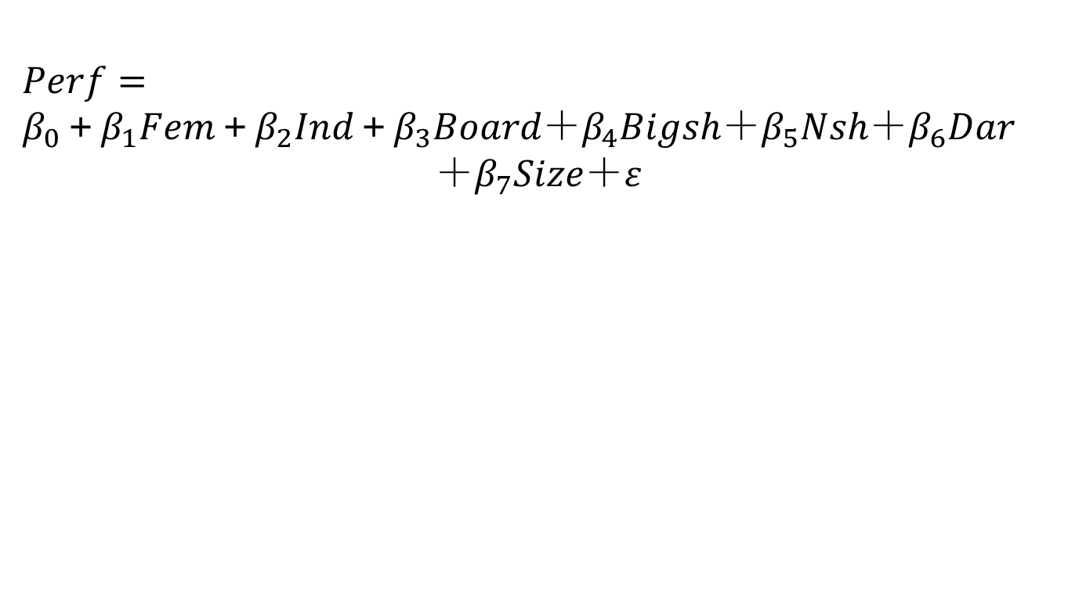
Research Design
Model design

Slide 23
Empirical analysis
Steps
Descriptive statistical analysis of variables
Correlation analysis of variables
Regression analysis

Slide 24
Conclusion
There is a negative correlation between the proportion of female directors and the company's financial performance.
We should not make some policies to make sure that the board has enough female directors.

Slide 25
·
Thanks!

