Slide 1
How do Companies Invest in Corporate Social Responsibility? An Ordonomic Contribution for Empirical CSR Research
Matthias Georg Will * and Stefan Hielscher
AI: Administrative Science Quarterly
Published: 21 July 2014
Designed by Liu Mengying
16720796 刘梦颖

Slide 2
Abstract:
This paper takes both a conceptual and an empirical approach to answer the question as to how Corporate Social Responsibility (CSR) can be connected to the company‘s role as an agent of social value creation when it operates within an imperfect institutional framework of market competition. To develop a functional design for an empirical study, we draw on the concept of ordonomics, which provides a heuristics for responsible business activities in society. Drawing on ordonomics,
we devise three questions: Referring to action responsibility we ask in which CSR activities companies do invest in their day-to-day business. Referring to governance responsibility we ask as to how companies realize win-win solutions through strategic commitments. In addition, with regard to discourse responsibility we ask in which stakeholder dialogues companies engage in order to discuss and find functional rules for organizing win-win solutions. In our empirical study, we reveal insights into the micro-level analysis of the CSP-CFP link and generate several new questions to be the subject of future research.

Slide 3
The Current State of Empirical CSR Research
During the last 35 years, more than 170 empirical studies have been published that analyze the market return of firm investment in corporate social responsibility (CSR)
The good news is that many of these empirical CSR studies find a significant relationship between corporate social performance (CSP) and corporate financial performance (CFP).
The bad news is that the literature still lacks a clear understanding as to how CSR can positively influence a firm‘s processes of value creation.
In this section, we review the extant empirical research and present its results in the two categories of (1) macro-level and (2) micro-level CSR research. There is a long tradition in empirical research of analyzing the direct impact of CSP on CFP. By now, many of these studies‘ results have been scrutinized by using the tools of statistical meta-analysis.
In particular, three prominent meta-studies estimate the overall impact of CSP on CFP.

Slide 4
Three prominent meta-studies estimate the overall impact of CSP on CFP
One meta-study analyzes 52 empirical studies concludes
the causal link between CSP and CFP is likely to be reciprocal and simultaneous.
the reputation the company gains from CSR activity greatly influences the strength of the CSP-CSF-link.
Another meta-study analyzes 82 empirical studies
CSP has a positive impact on CSF, and this effect is stronger in the United Kingdom than in the United States.
Parameters such as size of firm, industry or company-specific risk, and R&D expenditure have no effect on the CSP-CFP relationship.
Tests suggest that CSR has a bigger influence on subjective measures and market indicators like stock market returns than on accounting-based parameters.
The most recent meta-study examines 167 empirical studies
(a) Capital markets do not punish companies that invest in CSR.
The returns of pro-active CSR activities are lower than investments in innovation, capital goods, or mergers.
CSR is profitable if it helps minimize business scandals or if it is used to prevent negative reputation effects caused by company scandals.
Companies with strong financial fundamentals in the past are more likely to spend money for philanthropic activities.
the reliability and validity of the CSP indicators are doubtful.

Slide 5
As a consequence
empirical studies that use aggregated macro data to evaluate the CSP-CFP link encounter difficulty in finding causal interdependencies. As a matter of fact, in many cases the link between CSR and profitability is neither linear nor mono causal.
Thus, empirical research needs a theoretical framework to handle the complex CSP-CFP link before the link can be evaluated effectively.
A more systematic approach to empirical CSR research focuses on other aspects of the CSP-CFP relationship and pays attention to the organizational micro-level of the firm‘s value creation activities.
These micro-level studies ask as to how different CSR functions can influence the present or future profit and even the market value of the firm. The underlying assumption is that CSR activities that affect the future value also raise present equity prices because of a higher cash value.

Slide 6
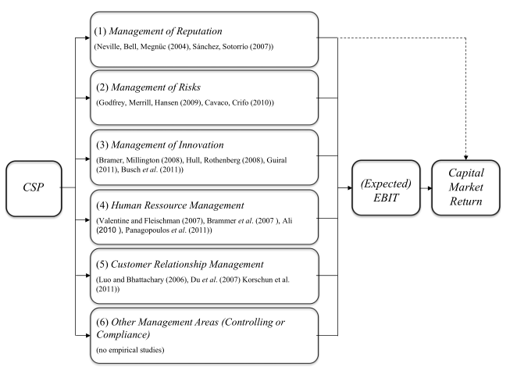
Micro-level
CSP-CFP relationship
(author’s illustration)
how CSR impacts specific business functions is a big step forward in the attempt to better understand the CSP-CFP relationship in detail.

Slide 7
An Ordonomic Conceptualization of CSR: Morality as a Factor of Production
We develop this ordonomic concept in four steps.
Step (1) argues that, in an ideal world, competitive markets are socially beneficial institutions.
Step (2) presents any societal role of business must be compatible with real-world markets
Step (3) develops that CSR can reinforce this role of business in society.
Step (4) clarifies the ordonomic understanding of win-win oriented CSR.
generates new ideas for studying an detail the CSP-CFP relationship.

Slide 8
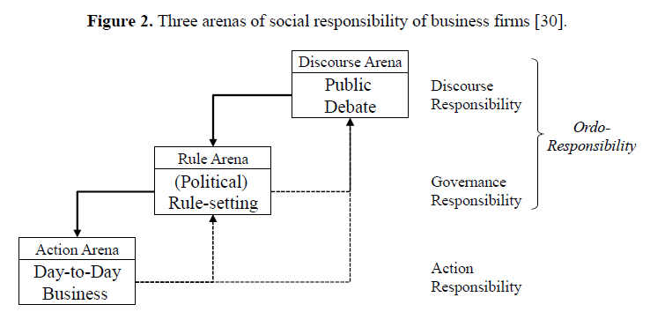
includes creating both a shared understanding of the underlying social dilemma and a common
appreciation of suitable moral commitments as a solution to it
e.g
by saving natural resources in production or reducing the carbon footprint of their business activities,
by building trust with suppliers and employees,
by circumventing the negative effects of child labor.
underlying idea is that companies need to change the business as usual way of doing things‘ inside the firm or with their partners by changing the incentives for action in order to reduce the waste of resources or to build up trust.

Slide 9
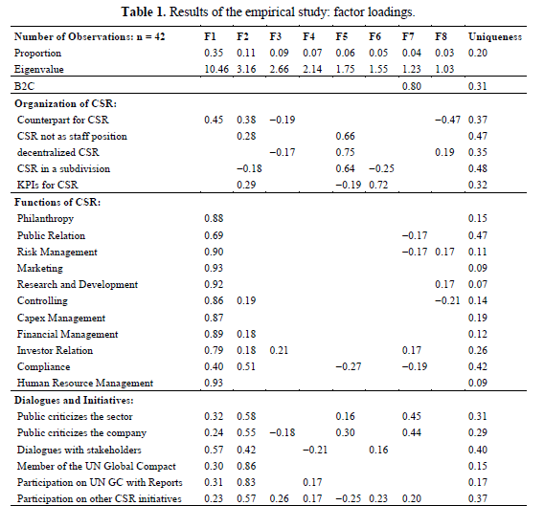
Developing a Design for Empirical CSR Research
We present the result of our study in two steps: Step (1) explains the results of the factor analysis. Using the measured correlations, analyzed 42 companies active in the German capital goods industry.
The factors listed in the table were extracted by the non-iterative principal-factor approach.
Besides clarifying some empirical links, the aim of this study is generating new questions for further empirical research.

Slide 10
Step (2) This ordonomically-inspired factor analysis derives new and interesting hypotheses about the CSP-CFP link. Yet further research is required to test some hypotheses that result from our factor analysis.
Further research options inspired by factor…….
factor 4. Some companies do not invest in CSR because other investments yield higher returns. These companies might be under strong pressure from investors to pay high dividends. Alternative research options inspired by factor 4. Certain companies are so successful that they can afford not to engage in CSR activity. These firms seem to buy their ―license to operate‖ with high capital costs.
factor 7. Companies operating in the business-to-consumer industry seem to use CSR to strengthen the relationship to their shareholders or even to attract new investors.
factor 8. Companies that use CSR decentralized in risk management and in innovation management (and hence improve their current business model or develop new business models) also yield higher returns on
invested capital.
I choose several factors I am interested in……

Slide 11
Conclusions and Implications for Future Research
paper inquired into the question as to how CSR can be connected to the company‘s role as an agent of
social value creation. We believe that our approach generates interesting conceptual insights into how
companies can use CSR to create value. Our analysis suggests how future CSR research can measure
and estimate particularly important parameters. More specifically, we suggest the following directions
for future research in the field of empirical CSR:
An important insight is that not all CSR is functional. From an ordonomic perspective,
it is not at all surprising that CSR shows a negative return in empirical studies if CSR
activities are completely unconnected to the corporate processes of value creation, i.e.,
when CSR is exclusively designed as an instrument of giving back to society.‘
· Another important insight is that CSR can be functional if companies use moral commitments
as a factor of production. This type of CSR is be strongly connected to corporate processes of
Value creation and, hence, also to important management functions such as, for example, risk
management and innovation management. This effect should show up in the data.

Slide 12
Conclusions and Implications for Future Research
From an ordonomic perspective, the CSP-CFP literature would be well advised to distinguish not just two levels of social interaction, but three.
In addition to the arena of business and the arena of rule-setting, the ordonomic perspective emphasizes that social cooperation also needs a common understanding of the win-win potential of social cooperation. Discourse, sometimes also public discourse, can create such a common awareness and is thus an important prerequisite for mutually beneficial value creation with stakeholders.

Slide 13
Thank you !
Designed by Liu Mengying
16720796 刘梦颖

