Slide 1
Agency costs and efficiency of business
capital investment: evidence from quarterly
capital expenditures
17720955
贺川

Slide 2

Introduction
Contents
Literature Review
Methods
Summary and conclusion
References

Slide 3
1
Introduction
Using the quarterly Compustat files, we present empirical findings that business capital investment is significantly higher in the fourth quarter than in other quarters. Even after controlling for business capital investment determinants, we find that the fourth quarter capital investment is significantly larger but less sensitive to investment opportunities than other quarters' capital investment. This phenomenon is more evident for firms with larger cash holdings than for firms with smaller cash holdings, for larger firms than for smaller firms, and for diversified firms than for stand-alone firms. Our findings suggest a high level of agency costs in corporate investment decisions.

Slide 4
2
Literature Review
Hubbard (1998) points out that there is very little empirical evidence on the effect of agency costs on the corporate investment, while a large body of literature examines the effect of asymmetric information on business fixed investments.
Jensen(1986)and Stulz(1990) argue that firms with large cash holdings may invest more than they should.
Brealey and Myers (2000) list empire building as an agency problem in capital budgeting. Empire building is that other things being equal, managers prefer to run large businesses rather than small ones.
Jensen and Meckling (1976) also argue that budget restrictions are used as a way to control the behavior of the owner-manager when the owner-manager has a partial ownership and an incentive to expend resources in order to capture non-pecuniary benefits.

Slide 5
Scharfstein(1997)reports that divisions with good investment opportunities invest less than their single segment stand-alone industry peers, while divisions with poor investment opportunities invest more than their stand-alone industry peers.
Lamont(1997)also finds that industry-adjusted levels of profitability and cash flow of non-oil subsidiaries of oil conglomerates are significantly lower than their industry peers, but their investment is not significantly different from industry levels.
Shin and Stulz(1998) report that small divisions' capital expenditures are affected by cash flows from other divisions within the diversified firms.
Furthermore, Shin and Stulz(1998) and Rajan et al.(1997) find inefficient internal allocation of funds for diversified firms.

Slide 6
3
Methods
The sample is obtained from Quarterly Compustat tapes for manufacturing companies between 1984 and 1994. Observations with any missing or excess values were deleted from the sample and all variables are winsorized at the 1% tails. The final sample consists of 69,955 firm-quarter observations. Real assets and real sales are normalized to 1994 dollars using the“Monthly Consumer Price Index for all Urban”of the Bureau of Labor Statistics. Capital expenditure (Compustat quarterly data item number 90) and other variables are normalized by total assets (44). Cash flow is the sum of net income (69) and the depreciation(5). Cash holdings are the cash and short-term investments (36). Market to book ratio is the ratio of the sum of market value of equity (closing price (14) times shares outstanding (61)) and total book assets (44)minus book value of equity (59) to the book value of assets (44). Market to book ratio is the measure of growth opportunities at the beginning of the quarter. Sales grow this the change in sales from the same quarter of the previous fiscal year.

Slide 7
For all firms and quarters, the mean and median real-total assets are 1385 million and 80 million dollars, respectively. The mean and median sales also show the same wide variation: mean sales are about 14 times the median sales.
On average, firms make quarterly investments of 1.64% of total assets. The median capital expenditure is 1. 17%. When we turn to the investment for each quarter, we find a steady increase in investment from the first quarter to the fourth quarter. The mean and median capital expenditures in the first quarter are 1.41% and 1.01%, respectively, while those in the fourth quarter are 2.01% and 1. 44%, respectively.
We look at the cash flows in each quarter to see whether the high capital expenditures in later quarters are due to greater cash flows in those quarters.In contrast to one’s conjecture, the median cash flows are about 2.3% of total assets and do not increase towards the fourth quarter.

Slide 8
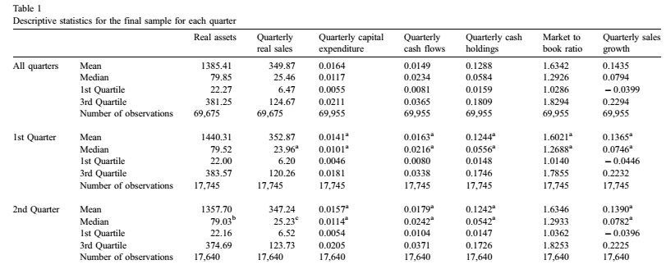
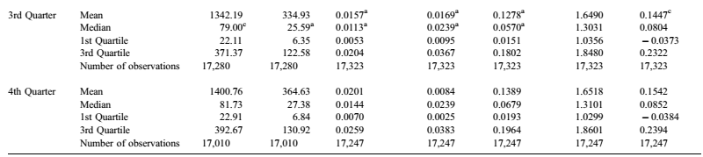

Slide 9
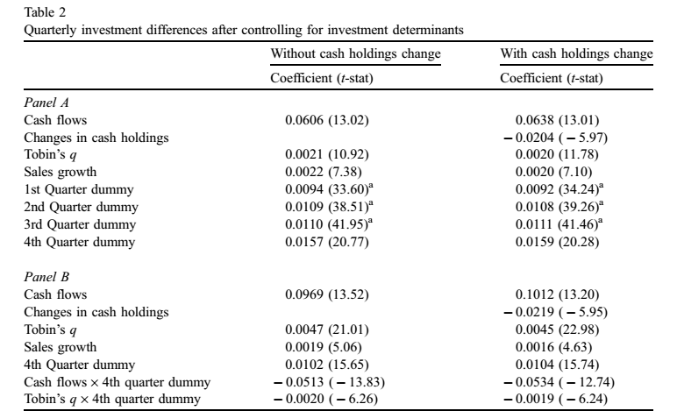
In this section, we investigate whether a large investment in the fourth quarter is found even after we control for business fixed investment determi-nants.

Slide 10
The coefficient of the interactive term of cash flow and the fourth quarter dummy is negative and significant. This is inconsistent with the view that the large investment in the fourth quarter is driven by large cash flows in that quarter. One of the questions we really want to answer is whether the larger fourth quarter capital expenditure is justified by larger investment opportunities. The interactive term of Tobin'sq and the fourth quarter dummy is negative and significant. This means that the fourth quarter investment is significantly less sensitive to investment opportunities.

Slide 11
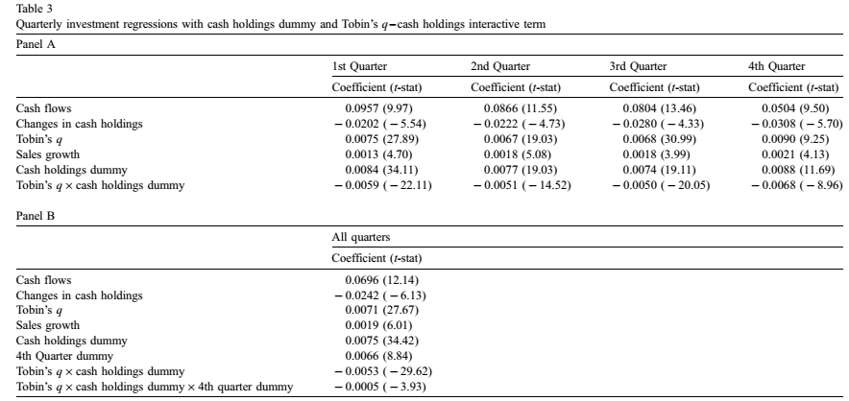
Next, we examine whether the investment in the fourth quarter is driven by factors other than investment opportunities or financial constraints. Does the level of cash holdings affect the firms' investment decision?

Slide 12
The coefficient of the interactive term of cash flow and the fourth quarter dummy is negative and significant. This is inconsistent with the view that the large investment in the fourth quarter is driven by large cash flows in that quarter. One of the questions we really want to answer is whether the larger fourth quarter capital expenditure is justified by larger investment opportunities. The interactive term of Tobin'sq and the fourth quarter dummy is negative and significant. This means that the fourth quarter investment is significantly less sensitive to investment opportunities.

Slide 13
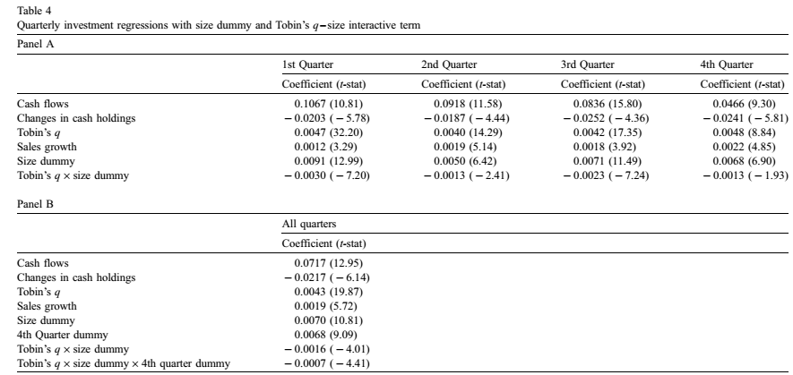
The coefficient of the size dummy is positive but the interactive term in Table 4 is negative and significant, suggesting that capital expenditures are greater for large firms than small firms and large-firm capital expenditures are less efficient than small-firm capital expenditures

Slide 14
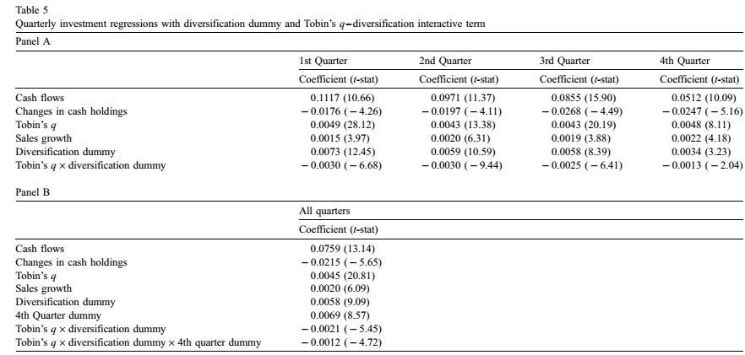

Slide 15
Panel A of Table 5 shows the result of investment regressions with diversification dummy and interactive term of Tobin's q and diversification dummy. The positive coefficient of the diversification dummy indicates that diversified firms invest more than stand-alone firms, even after controlling for other investment determinants. The coefficient of the interactive term is negative, consistent with the view that diversified firms make less efficient allocation of internal capital, so their investment is less sensitive to the investment opportunities.
Panel B of Table 5 includes two more variables to investigate the investment efficiency in the fourth quarter for diversified firms. As we expected, the coefficient of the interactive term of Tobin's q, diversification dummy and the fourth quarter dummy is negative and significant, suggesting that the fourth quarter investment tends to be less efficient for diversified firms than stand-alone firms.

Slide 16
4
Summary and conclusion
We find larger capital expenditures in the fourth quarter. We propose agency theory to explain the phenomenon and then document that investments by firms with large cash holdings are less responsive to their growth opportunities than investments by firms with little cash holdings. We also report that, after adjusting for size differences, large firms invest more than small firms and this difference is even greater in the fourth quarter. In addition, we show that diversified firms invest more but less efficiently than stand-alone firms in all quarters, and this is more pronounced in the fourth quarter. To the extent that cash holdings proxy for free cash flows, and that firm size and diversification proxy for inefficient allocation of internal capital.
Overall, we find a support for the idea that quarterly capital expenditures are inefficiently allocated and the degree of inefficiency is explained by agency costs. Our main empirical contribution to the literature is to demonstrate that agency costs do affect the efficiency of quarterly investment behavior of the firm.

Slide 17
555
References
· Das, S., Shroff, P.K., 1988. Fourth quarter reversals in carmings changes: motivations and consequences, Working paper, University of Ilinois at Chicago.
· Erickson, T., Whited, T.M, 2000. Measurement error and the relationship between investment and q. Journal ofPolitical Economy 108， 1027- 1057.
· Fama, E.F., French, K.R., 1998. Taxes, financing decisions, and firm value. Journal of Finance 53, 819- 844.Fama, E.F, MacBeth, J.D., 1973. Risk, retum, and equilibrium: empirical tests. Jourmal of Political Economy 81,607- 636.
· Fazzari, S.M, Petersen, B.C, 1993. Working capital and fixed investment: new evidence on financing con-straints. Rand Journal of Economics 23, 328- 342.
· Fazzari, S.M., Hubbard, R.G, Petersen, B, 1988. Financing constraints and corporate investment. Brookings Papers on Economic Activity 19, 141- 195.

Slide 18
· Gertner, R, Powers, E., Scharfistein, D., 1999. Learning about intemal capital markets from corporate spinoffs,Working paper, Massachusetts Institute of Technology.
· Gomes, J., 2001. Financing investment. In press American Economic Review.
· Gu, Z., Lee, C.J, 1999. How Widespread Is Earmnings Management? The Intra-Year Timing Evidence, Working paper, Carnegie Mellon University.
· Harford, J, 1997. Corporate cash reserves and acquisitions, Unpublished working pap per, William E. Simon Graduate School of Business Administration, University of Rochester, Rochester, NY 14627.
· Harris, M., Raviv, A., 1996. The capital budgeting process: incentives and information. Journal of Finance 51,1139-1174.
· Harris, M., Raviv, A., 1998. Capital budgeting and delegation. Journal of Financial Economics 50, 259- 289.

Slide 19
· Hoshi, T., Kashyap, A., Scharfstein, D., 1991. Corporate structure liquidity, and investment: evidence from Japanese industrial groups. Quarterly Journal of Economics, 33- 59.
· Hubbard, R.G., 1998. Capital-market imperfections and investment. Journal of Economic Literature 36, 193- 225.Hubbard, R.G., Palia, D., 1998. A re-examination of the conglomerate merger wave in the 1 960s: an internal capital markets view. Journal of Finance 54, 1131-1152.
· Jensen, M.C, 1986. Agency costs of free cash flow, corporate finance, and takeovers. American Economic Review 76, 323 - 329.
· Jensen, M.C., Meckling, W.H., 1976. Theory of the fim: managerial behavior, agency costs and ownership structure. Journal of Financial Economics 3, 305 - 360.
· John, T.A., 1993. Accounting measurcs of corporate liquidity, leverage, and costs of financial distress. Financial Management 22, 91- 100.

Slide 20
Thanks for your attention
谢谢观看

