Slide 1
Compensation Goals and Firm Performance
Benjamin Bennett, J. Carr Bettisb, Radhakrishnan Gopalan, Todd Milbourn,2017

Slide 2
Part One
Introduction
Part Two
Research method
Directory
Part Three
Empirical process
Part One
Conclusion

Slide 3
Part One
Introduction

Slide 4
Abstract
Using a large data set of performance goals employed in executive incentive contracts, we find that a disproportionately large number of firms exceed their goals by a small margin as compared to the number that fall short of the goal by a similar margin. This asymmetry is particularly acute for earnings goals, when compensation is contingent on a single goal, when the pay-performance relationship around the goal is concave-shaped, and for grants with non-equity-based payouts. Firms that exceed their compensation target by a small margin are more likely to beat the target the next period and CEOs of firms that miss their targets are more likely to experience a forced turnover. Firms that just exceed their Earnings Per Share (EPS) goals have higher abnormal accruals and lower Research and Development (R&D) expenditures, and firms that just exceed their profit goals have lower Selling, General and Administrative (SG&A) expenditures. Overall, our results high- light some of the costs of linking managerial compensation to specific compensation targets.

Slide 5
Research background
In their ongoing effort to link managerial pay to performance, firms are increasingly tying non-equity and equity grants to achieving explicit performance goals. Rewarding managers for achieving explicit performance goals certainly has a bright side. It makes pay more transparent and offers strong incentives, especially when the goal is challenging. On the other hand, identifying explicit performance goals and having “jumps and kinks” in the PPR at the goals may also have a dark side. If there is a jump in managerial pay for achieving a performance goal, and if actual performance is close to but short of the goal, managers may be tempted to take actions – with possible negative long-term consequences – to push reported performance to (or past) the goal. In other words, managerial myopia may be exacerbated around “jump points” in the PPR. The effect of kinks on managerial behavior is more nuanced. If the kink is concave, it may reduce the man- ager’s incentives to improve firm performance much be- yond the kink. On the other hand if the kink is convex, it will not only incentivize managers to push performance beyond the kink, but may also affect their incentives to take risk.

Slide 6
Research content
The content of the paper is to use data to understand how goals in the incentive contracts influence reported performance. Specifically, they studies the distribution of reported performance around the incentive goals and tests to see if performance clusters around the goals. they also conducts tests to explore the possible reasons for such clustering.

Slide 7
Research significance
The paper is the first to show that they manage performance to meet compensation plan goals. Paper results highlight the costs of having explicit performance goals when executives exercise power over the reported performance. Furthermore, the paper not only knows the monetary penalty managers face for not meeting a performance goal, thereby being able to design sharper cross-sectional tests, but their analysis also helps highlight the important role performance goals can play in predicting actual firm performance.
In addition to the intended contribution to the literature, the paper may also adds to the already active, policy- oriented, executive compensation debate.

Slide 8
Empirical methodology
In this section, they describes the tests that they performs to identify manipulation of firm performance to meet goals. All the tests look for discrepancies in the distribution of reported performance.
The first test they implements is the one described in McCrary (2008) that is designed to test for the presence of a discontinuity at a point in a density.
The second test that they conducts to detect performance manipulation is from Bollen and Pool (2009). This test not only serves as a robustness check on the test in McCrary (2008), but also allows they to test for discontinuities all through the density.

Slide 9
Part Two
Research design

Slide 10
Hypothesized
The paper expects the reported performance of a disproportionate number of firms to exceed the goal by a small margin as compared to fall short by a small margin.
The paper expects a larger discontinuity in the density of underlying performance for executives that obtain grants that depend on a single metric as compared to executives that obtain grants contingent on multiple metrics.
The slope of the PPR at the performance goal may also affect the extent of performance clustering. To the extent pay increases at a slower rate when performance exceeds a kink that is concave, The paper expects performance to cluster around concave kinks and not around convex kinks.
the board evaluates managers relative to the target and punishes underperformance, then The paper expects CEOs who fail to meet their target to be more likely to experience forced turnover.

Slide 11
Data
Data on the metrics used to design stock and bonus awards are from Incentive Lab (hereafter IL). Similar to Standard and Poor’s (S&P) (the provider of ExecuComp), IL collects grant data from firms’ proxy statements.
They obtains data on other components of executive pay, such as salary and bonus, from ExecuComp.
They complements the compensation data with stock returns from CRSP and firm and segment financial data from Compustat.

Slide 12
Regression sample
To statistically compare the size of the discontinuities and also to accommodate for discontinuities at multiple points in the density, we perform a regression analysis es- timating the following model:
Number of firms = α + β0Metric × Mid − point+ β1Metric × Mid − point2 + β2Metric× Mid − point3 + β3Metric × Mid − point4+ β4Number of goals + Y
The dependent variable, Number of firms is the log- arithm of one plus the number of firms whose reported performance falls in a particular bin.
main independent variable is Number of goals, which is the logarithm of one plus the number of firms whose target or threshold performance is in a particular bin.
yi = α + β0 x Exceed EPS/Sales/Profit + β1 x Size+β2 x Markettobook+Y +γj +εi
The dependent variable is one of Accruals, R&D/TA, SG&A/Sales, or Repurchase. The main independent variable is one of Exceed EPS, Exceed sales, or Exceed profit.

Slide 13
Part
Three
Empirical process

Slide 14
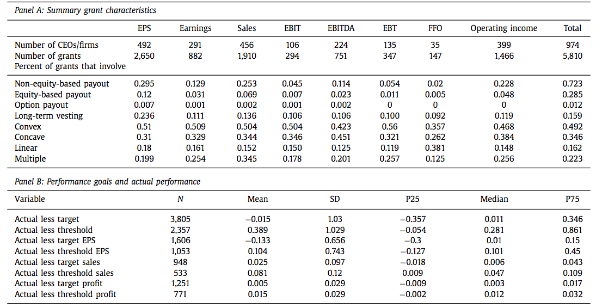
Empirical process
Table 1 Summary characteristics. This table reports the summary statistics of the key variables used in our analysis. Panel A reports the summary characteristics of grants broken down based on the metric employed. Panel B reports the summary statistics of the variables that compare actual performance outcomes to corresponding performance goals in the compensation contract. All variables are defined in detail in Appendix A. The data covers the period
2006–2012. The compensation data are from Incentive Lab (IL), Compustat, CRSP, and ExecuComp.

Slide 15
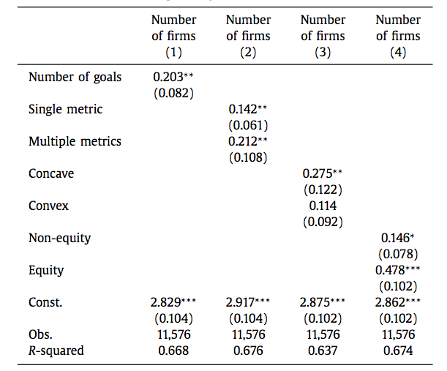
Empirical process
Table 2

Slide 16
Empirical process
Table 2 reports the results of an ordinary least squares (OLS) regression
relating number of firms whose performance (earnings, sales, or profit) falls within a bin to the bin mid-point and the number of firms with a performance goal in the same bin. Standard errors reported in parentheses are robust to heteroskedasticity and are clustered at the bin level. All variables are defined in detail in Appendix A. The data cover the period 2006–2012. The compensation data are from Incentive Lab (IL), Compustat, CRSP, and ExecuComp. (∗ ∗ ∗ ); (∗ ∗ ); (∗ ) denote 1%, 5%, and 10%, levels respectively.

Slide 17
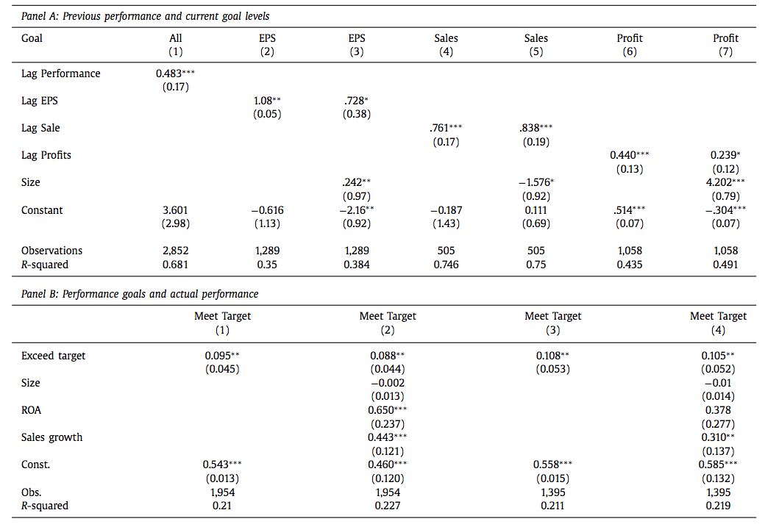
Empirical process
Table 3

Slide 18
Empirical Process
Table 3 Evidence for target ratcheting effect. Panel A reports the results of multivariate tests for correlation in performance targets. The dependent variable EPS/Sales/Profit goal, is equal to the EPS/Sales/Profit goal in the current period. The main independent variable is
Lag EPS/Sales/Profit and is equal to the previous period’s firm EPS/Sales/Profit. Panel B reports the results of multivariate tests that relate the probability of a firm meeting its performance target to the performance relative to
target the previous year. The dependent variable is Meet target, a dummy variable that identifies firms that meet their performance target in the next period. The main independent variable is Exceed target (CEOs who meet the
performance target in the current period). This variable takes a value one for firms whose performance is in the two bins just above the performance goal and zero otherwise. Details on the definition of the variables in this table are provided in Appendix A. Standard errors reported in parentheses are robust to heteroskedasticity and are clustered at the two-digit SIC industry level, except in Specification 1 of Panel A, which includes firm fixed effects and standard errors clustered at the firm level. The data cover the period 2006–2012. The compensation data are from Incentive Lab (IL), Compustat, CRSP, and ExecuComp. (∗∗∗); (∗∗); (∗) denote statistical significance at 1%, 5%, and 10%, levels respectively.

Slide 19
Part
Four
Conclusion

Slide 20
Conclusion
The paper finds evidence consistent with executives managing reported accounting performance to achieve compensation goals. A disproportionately large number of firms just exceed the goals as compared to the number of firms that just fail to meet the goals. This effect is present for earnings-based goals, and is stronger among executives who receive grants contingent on a single metric as opposed to grants contingent on multiple metrics. This effect is strong for grants with a concave kink at the target and those with non-equity payouts. We do not find a corresponding tendency for firms to beat relative performance goals. Consistent with firms understating performance to influence subsequent targets, firms that just beat performance targets are more likely to meet their subsequent targets. CEOs of firms that fail to meet performance targets are more likely to experience forced turnover. Firms that just exceed their EPS goal have higher abnormal accruals and lower R&D expenditures as compared to firms that just miss their EPS goal. Firms that just exceed their profit goal have lower SG&A expenses as compared to firms that miss their goal.
Their results indicates less performance management if goals are specified either relative to other firms or in terms of sales or profit targets. On the other hand, there appears to be greater performance management in the case of EPS-based goals. They also find that grants that involve a concavity in the PPR and grants that use cash payouts are more likely to result in performance management by CEOs. We believe that compensation committees and consultants should consider structuring performance-pay contracts that are relative versus ab- solute to minimize performance management.

Slide 21
Thanks

