Slide 1
dividend, liquidity and firm valuation: Evidence from China
《Applied Financial Economics》2014 , 24 (9) :587-603
Reporter：秦裕玮 16720812

Slide 2
Contents
Contents
0. Abstract
1. Introduction
2. Economic Model
3. Research hypotheses
4. Data & Variables
5. Methodology
6. Empirical Results
7. Robustness test for the dynamic panel analysis
8. Conclusion
3.

Slide 3
0.Abstract
This paper examines the relevance of cash dividend from the theoretical and empirical perspectives by taking market liquidity into account.
The paper construct an economic model which demonstrates that the effect of cash dividend on firm valuation depends on the status of market liquidity.
The results from the dynamic panel regression indicates that the price premium of B-share relative to A-share is positively correlated to the level of cash dividend, and this relationship even becomes stronger when the relative liquidity of B-share is low. In addition, the price premium is positively affected by the relative liquidity and firm profitability.
Using the event study approach, the paper observed a more positive (negative) response to the announcement of cash dividend initiation (omission) in the B-share market. In particular, this positive response on the initiation is negatively correlated with the relative liquidity.
Notes:
在于：
首先，本文涉及“法律与金融”，总结了前人研究；
其次，在确定投资者保护对金融市场发展的影响外，还探讨了法律如何影响公司所有权结构；
最后，本文阐述了关于公司所有权结构对估值的影响。

Slide 4
1. Introduction
MM theory——Miller and Modigliani （1961）
irrelevance theory
perfect market liquidity
(1) exogenous transaction costs, such as brokerage commissions;
(2) demand pressure and inventory risk;
(3) information asymmetry among investors;
(4) search and delay costs.
The underlying reason for liquidity to affects prices ——Amihud （2008）：liquidity cost adds incremental burden to an investor when he trades a security.
liquidity hypothesis of dividend——Banerjee et al. （2007）： investors prefer cash dividend payers when markets liquidity is low
Notes:
在于：
首先，本文涉及“法律与金融”，总结了前人研究；
其次，在确定投资者保护对金融市场发展的影响外，还探讨了法律如何影响公司所有权结构；
最后，本文阐述了关于公司所有权结构对估值的影响。

Slide 5
1. Introduction
A brief history of Chinese stock markets.
Shanghai Stock Exchange (Nov.1990)
Shenzhen Stock Exchange (Apr.1991)
SHARES
tradable shares
A-shares
legal person shares
employee shares
B-shares
non-tradable shares
H-shares
other foreign shares
state shares
China B- share discount puzzle：B-shares always traded at a large discount relative to A-shares—— Bailey (1994)
The illiquidity of B-share market
(Chen et al., 2001);
Differential demand elasticity
(Sun and Tong, 2000
Information asymmetry
(Chan et al., 2008);
Speculative trading of domestic investors
(Mei et al., 2009);
Political risk arising from state ownership
(Karolyi et al., 2009);
Differential attitudes to the corporate governance
(Tong and Yu, 2012).
Notes:
在于：
首先，本文涉及“法律与金融”，总结了前人研究；
其次，在确定投资者保护对金融市场发展的影响外，还探讨了法律如何影响公司所有权结构；
最后，本文阐述了关于公司所有权结构对估值的影响。

Slide 6
1. Introduction
Innovation points：
（1）This paper considered the preference of the investors to the cash dividend payers in different status of liquidity.
（2） This paper make use of a distinctive and promising setting (the Chinese AB-markets) to test the liquidity hypothesis of dividend
Research purposes： This paper construct an economic model which provides further insights into the importance of cash dividend in different status of market liquidity.
Notes:
在于：
首先，本文涉及“法律与金融”，总结了前人研究；
其次，在确定投资者保护对金融市场发展的影响外，还探讨了法律如何影响公司所有权结构；
最后，本文阐述了关于公司所有权结构对估值的影响。

Slide 7
2. Economic Model
The model is based on a setting similar to Domowitz et al (1997) but the paper extend the model by incorporating the dividend policy and the profitability of a firm into the model setting.
Assumptions
(1)There is a representative all-equity firm in an economy without tax and the firm issues two classes of shares, A-share and B-share.
(2) Both shares have identical cash flow right and voting right.
(3) Each type of shares is traded in its corresponding market separately.
(4)The two classes of shares are prohibited from converting to each other.

Slide 8


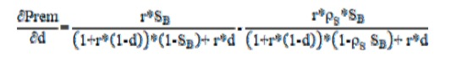
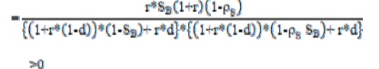
2. A Simple Model
Proposition I : If B-share market is less liquid than A-share market, then B-share sell at a discount to its counterpart in the A share market.
Proposition II : The price premium is an increasing function of the relative liquidity.
Proposition III: The price premium is an increasing function of dividend payout ratio if B-shares are less liquid than A-shares.

Slide 9

2. A Simple Model
Proposition IV: Ceteris paribus, the marginal effect of dividend payout ratio on the price premium decreases with the improvement in relative liquidity.
Proposition V: Ceteris paribus, the price premium is an increasing function of the profitability if B-shares are less liquid than A-shares.
This model highlights the effects of the change in liquidity and dividend policy on the valuation of a firm.
More importantly, the model emphasizes that the significance of dividend policy on firm valuation depends on the status of market liquidity.

Slide 10
3. Research hypotheses
H1: Ceteris paribus, as the B-share market is less liquid than the A-share market, the B-share should trade at a discount relative to its counterpart in the A share market.
H2: Ceteris paribus, the higher the relative liquidity of B-shares, the higher the price premium traded on A-share counterpart.
H3a: Ceteris paribus, the price premium is higher for the companies who distribute the cash dividend than for those without any dividend payment.
H3b: Ceteris paribus, B-share market reacts more positively (negatively) to announcements of the dividend initiations (omissions) than A-share market.
H4: Ceteris paribus, B-share market reacts more positively (negatively) to announcements of the dividend initiations (omissions) than A-share market.
H5: Ceteris paribus, the more profitable the firm, the higher the price premium.
Notes:
在于：
首先，本文涉及“法律与金融”，总结了前人研究；
其次，在确定投资者保护对金融市场发展的影响外，还探讨了法律如何影响公司所有权结构；
最后，本文阐述了关于公司所有权结构对估值的影响。

Slide 11
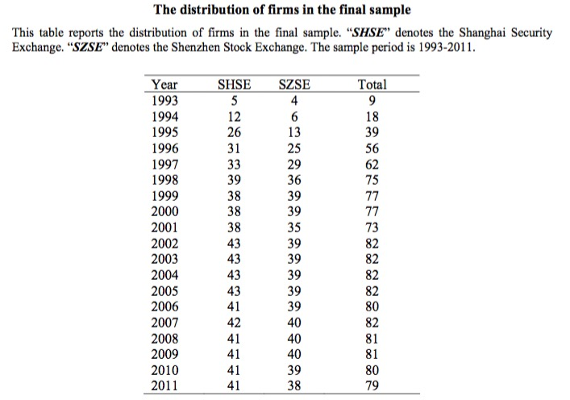
4. Data & Variables
Data elimination:
The firms are required to list on the A- and B-share markets for at least 12 months;
Stock price are in between 0.50-500.00 RMB.
The annual number of trading days should be at least 100 days.
Remove the firms with negative book value of shareholders’ equity.

Slide 12
4. Data & Variables
Variables
Variables definition
Price premium | Prem=(PB-PA)/PA | PA and PB are daily close prices of A-share and B-share respectively
Liquidity | Rliq=ILLIQA/ILLIQB | ILLIQ is defined as the annual average of daily ratio of absolute stock return to its dollar volume. It can be interpreted as the average daily price response associated with one dollar of trading volume.
Cash dividend | Payout Ratio = total cash dividend /the net incomes
Profitability | EBIT

Slide 13
4. Data & Variables
Variables
Control Variables definition
Differential risk | StdB/StdA | The ratio of the return volatility of A and B shares
Relative share supply | NoB/NoA | The ratio of the return volatility of A and B shares
Information factor | Size | The logarithm of sales
Currency risk | Inflation | The inflation rate
Currency risk | Reserves | The total reserves
Governance concern | Tradable | The ratio of tradable shares
Stock dividend | DivStk | Stock dividend per share

Slide 14
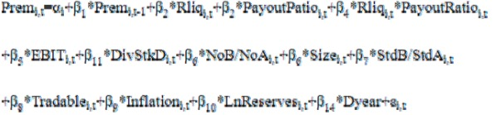
5. Methodology
Dynamic panel data model
The above equation is the full model need to be estimated.
Price premium is regressed on its own lag and other independent variables and interaction terms.

Slide 15
5. Methodology
A event study approach
The paper may omit some variables that may compound our results in the dynamic panel analysis.
The paper further conduct an event study to investigate whether A- and B-share markets react differently to the announcements of dividend policy and whether the differential reaction is due to the relative liquidity.
Based on the event study approach, The paper may reasonably assume other factors held constant in a short time period.

Slide 16
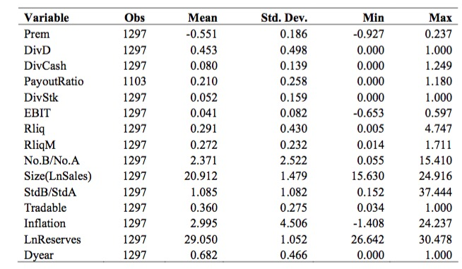
6. Empirical Results
Summary statistics
The table presents the summary statistics of the main variables in this study.

Slide 17
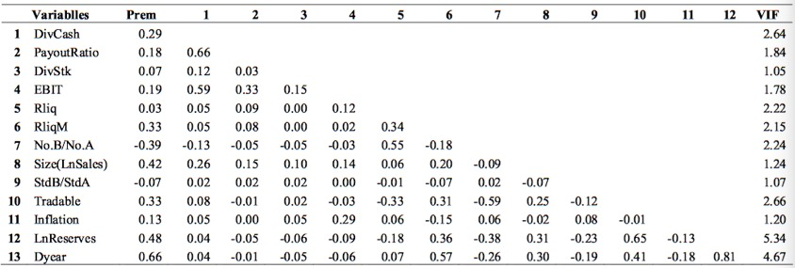
6. Empirical Results
Summary statistics
The correlation matrix among variables is reported in the Table below
The price premium is positively correlated with the level of dividend payments, relative liquidity, profitability, firm size and the ratio of tradable shares.

Slide 18
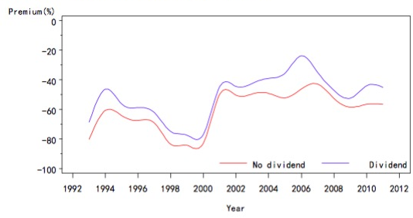
6. Empirical Results
Sub-sample analysis
The paper divided our sample into two groups: firms which issue and not issue cash dividend.
The annual B-share price premium for dividend and non-dividend issued groups
B-share sells at a discount in both groups and the price discount for cash dividend issued firms are significantly lower than the corresponding non-issued counterpart.

Slide 19
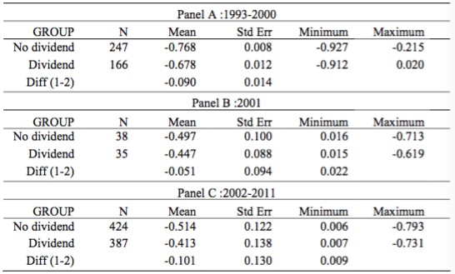
6. Empirical Results
Sub-sample analysis
The sample is further divided into three sub-samples of 1993-2000, 2001 and 2002 -2010.
Two sample t-tests on the dividend and non-dividend issued cross-listed firms
The paper conducted a two sample t test for the firms which issue and not issue cash dividend in these three time periods.

Slide 20
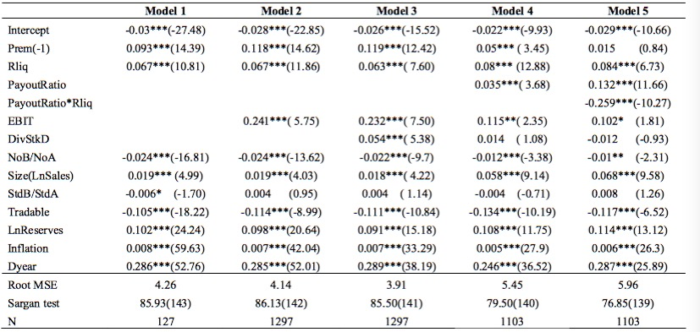
6. Empirical Results
Dynamic panel data analysis : The Table shows the results of the dynamic panel regression
Model 1 examines the effect of relative liquidity on the A- and B-share price disparity.
Model 2 are constructed to test hypothesis 5.
Model 3 show that stock dividend positively affects the B-share price premium.
Model 4 examines the effect of cash dividend on the price premium
Model 5 shows that the signs and the significances of the key variables in this study are not sensitive to the inclusion or exclusion of other variables.

Slide 21
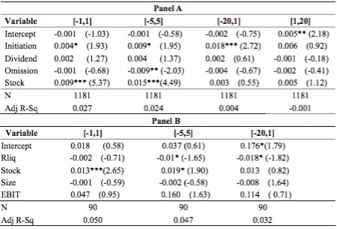
6. Empirical Results
Event study approach analysis :The table presents the results of the multiple regressions.
The results indicate that the illiquid B-share market reacts more positively (negatively) to the announcements of cash dividend initiation (omission).
These results are generally consistent with those results obtained in the dynamic panel analysis.

Slide 22
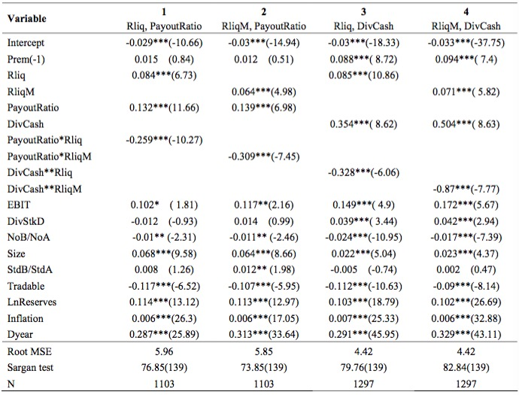
7. Robustness test for the dynamic panel analysis
The paper use the alternative for the proxies of the liquidity and cash dividend measures.
Variables | Alternative Variables
Liquidity | IlliqM | the daily ratio of absolute stock return to its turnover and then takes averaged over the year
Cash Dividend | cash dividend per share
The results in robustness tests are strongly consistent with those obtained in the dynamic panel analysis.

Slide 23
8. Conclusion
The study relax the assumption of perfect market liquidity on MM dividend irrelevance theory and investigate how the firm value and the level of cash dividend are affected by the market liquidity.
In the dynamic panel regression, the results show that there is a positive relationship between the price premium and the level of cash dividend payments. The paper also notice that the price premium is positively correlated to both the relative liquidity and the profitability of a company.
Using the event study approach, The paper find that the illiquid B-share market react positively (negatively) to the dividend initiation (omission).

Slide 24
Thank You
For Watching
THE END

