Slide 1

Underwriter–Auditor Relationship and Pre-IPO Earnings Management
Evidence from China
Xingqiang Du¹ •Xu Li² •Xuejiao Liu³ •Shaojuan Lai ⁴

Slide 2
1
Introduction
2
Hypotheses Development
CONTENTS
3
Empirical Design
4
Conclusions

Slide 3

Abstract

Slide 4
This study examines the influence of underwriter–auditor relationship (UAR) on pre-initial public offering (IPO) earnings management. Using a sample of Chinese to-be-listed firms, we find that a close UAR, as reflected in repeated collaborations between an underwriter and an audit firm in IPOs, is positively associated with pre-IPO earnings management. This association is more pronounced for firms with politically connected auditors/underwriters, firms with less reputable auditors/underwriters, firms located in provinces with weak legal environment, firms to-be-listed on boards with lax listing requirements, and firms whose auditors are with low industry specialization, and legal liability exposures. We provide further evidence that UAR is associated with greater likelihood of irregular activities in post-IPO period and poorer post-IPO financial performance. To the extent that we control for alternative explanations and potential endogeneity, our results suggest that the collusion incentive is likely to drive repeated collaborations between underwriters and auditors in the Chinese IPO market. Our findings provide interesting implications for auditors, investors, and regulators seeking to understand the Chinese IPO market.

Slide 5
Introduction
IPO prospectuses and auditing in China
During a typical IPO underwriting in China, underwriters assemble a restructuring team that consists of an auditor, an attorney, and an asset appraiser (Chen et al. 2013). This process empowers underwriters to select auditors or affect the clients’ auditor choice through ‘‘tacit approval of the firm’s current auditor or by requesting auditor change’’
(Balvers et al. 1988).
Moreover, the Chinese audit market is highly competitive and dispersed (Du and Lai 2015), and thus Big 4 audit firms do not dominate the Chinese audit market as do they in other markets (Chu et al. 2011).

Slide 6
Introduction
Two different incentives underlying UAR formation
On the one hand, an underwriter may opt to team up with a specific audit firm to increase efficiency (the efficiency incentive). A close UAR helps auditors gain underwriter specific expertise, lowers the start-up costs in each IPO underwriting process, and facilitates timely communication between the underwriter and auditor, leading to a more efficient and effective collaboration to detect and deter any pre-IPO earnings management in IPO firm.
On the other hand, the large profits from successful IPOs can motivate underwriters to select auditors who are willing to succumb to their pressure to issue favorable opinions or even aid managers in ‘‘pushing the boundaries’’ of Generally Accepted Accounting Principles, Such a collusion incentive in turn jeopardizes auditor independence and leads to a deterioration in financial reporting quality.

Slide 7
Hypotheses Development
Hypothesis 1: Ceteris paribus, the underwriter–auditor relationships (UAR) are significantly associated with pre-IPO earnings management.
Hypothesis 2a: Ceteris paribus, the positive (negative) relation between a UAR and pre-IPO earnings management becomes stronger (weaker) when the audit firm or under-
writer is politically connected.
Hypothesis 2b: Ceteris paribus, the positive (negative) link between UAR and pre-IPO earnings management becomes weaker (stronger) when the reputation of the auditor/underwriter increases.
Hypothesis 2c :Ceteris paribus, the positive (negative) relation between a UAR and earnings management becomes weaker (stronger) when the legal environment is
strong.

Slide 8
Empirical Design
Sample:
Our initial sample consists of 1543 to-be-listed firms that filed for IPOs in the Chinese A-share market during 2006–2012. To count for all of the collaborations between an underwriter and an audit firm, we include to-be-listed firms regardless of whether their IPO applications were approved or denied by the CSRC.
We obtain the list of to-be-listed companies from the Wind database and hand-
collect financial information from their prospectuses. We further collect information about auditor and underwriter reputation from the websites of the Chinese Institute of
Certified Public Accountants (http://www.cicpa.org.cn) and the Securities Association of China (http://www.sac.net.cn), respectively.

Slide 9
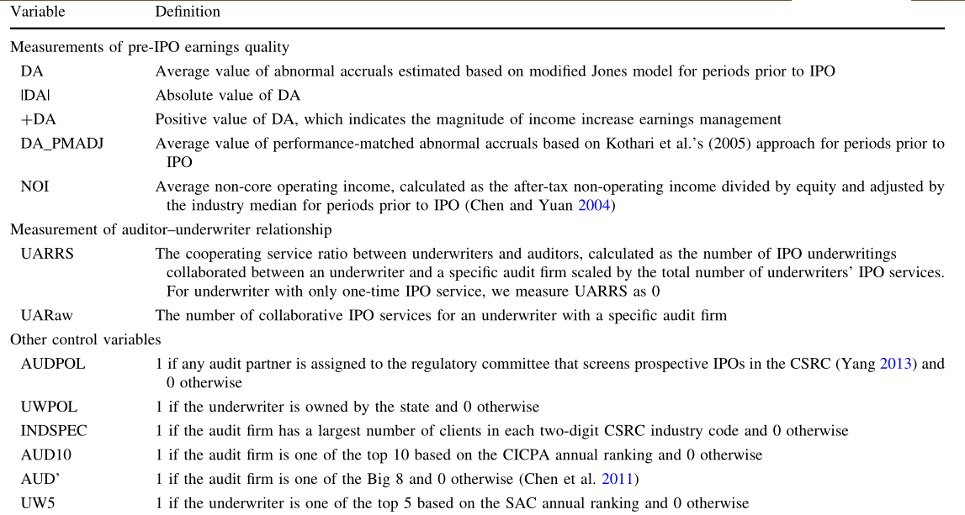
Empirical Design

Slide 10
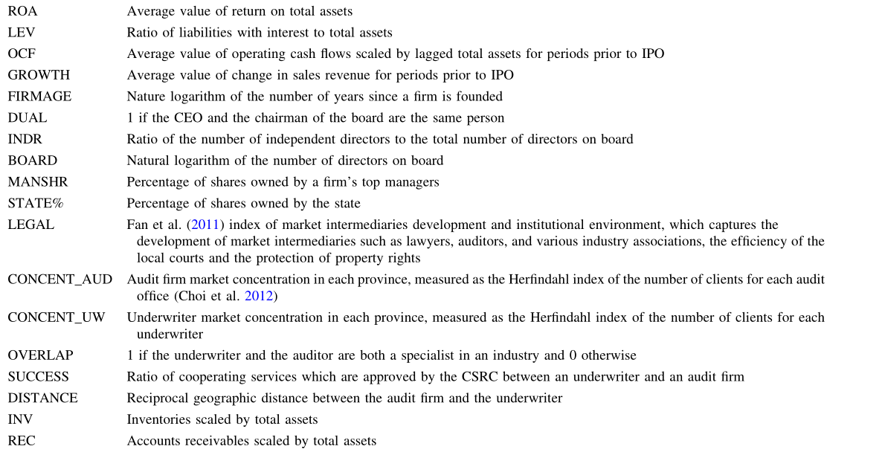
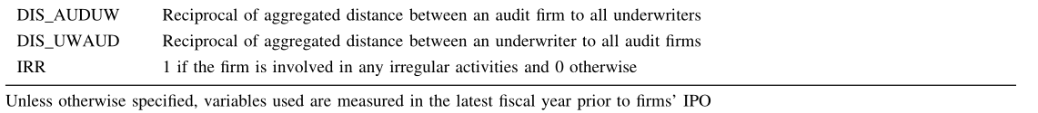
Empirical Design

Slide 11
Empirical Model
DA = a ₀ +a ₁ UARRS + a ₂ AUDPOL + a ₃ UWPOL+a ₄ INDSPEC + a ₅ AUD10 +a ₆ UW5 + a ₇ SIZE+a ₈ ROA + a ₉ LEV + a ₁₀ OCF + a ₁₁ GROWTH+a ₁₂ FIRMAGE + a ₁₃ FIRST + a ₁₄ DUAL+a ₁₅ INDR + a ₁₆ BOARD + a ₁₇ MANSHR+a ₁₈ STATE% + a ₁₉ LEGAL+ year indicator + industry indicator +e

Slide 12
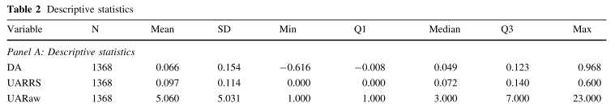
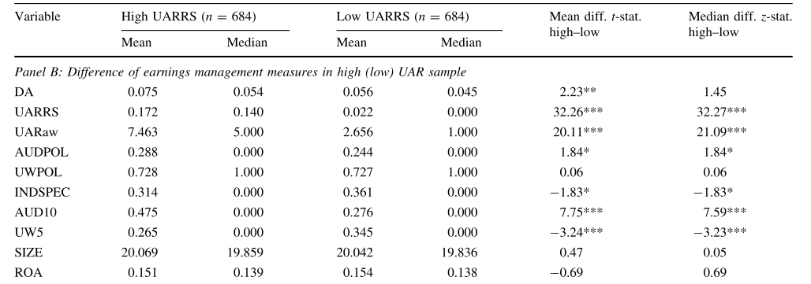
Empirical Results

Slide 13
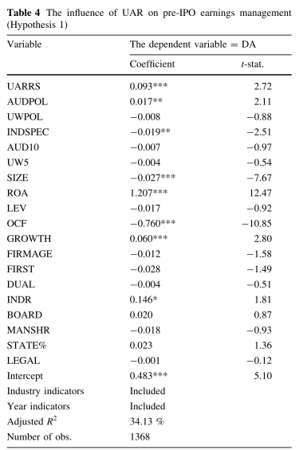
Empirical Results

Slide 14
Empirical Design
Hypothesis 2a
Hypothesis 2b
Hypothesis 2c
We first perform the modified regression Model with indicator variable UWPOL excluded on subsamples whose underwriters are with and without political connections. Similarly, we run modified Model with AUDPOL excluded on subsamples whose auditors are with and without political connections.
we test Hypothesis 2c using the modified Model with the variable LEGAL excluded. We partition the sample into subsamples with strong and weak legal environments based on the sample median value of LEGAL.
We then examine Hypothesis 2b, by regressing modified Model with the indicator variables AUD10 and UW5 excluded on three different subsamples classified based on auditor and underwriter reputation. In particular, we categorize more reputable auditors and underwriters (AUD10 = 1 and UW5 = 1) as subsample H–H, less reputable auditors and underwriters (AUD10 = 0 and UW5 = 0) as subsample L–L, and mixed combinations with more (less) reputable auditors and less (more) reputable underwriters as subsample H–L.

Slide 15
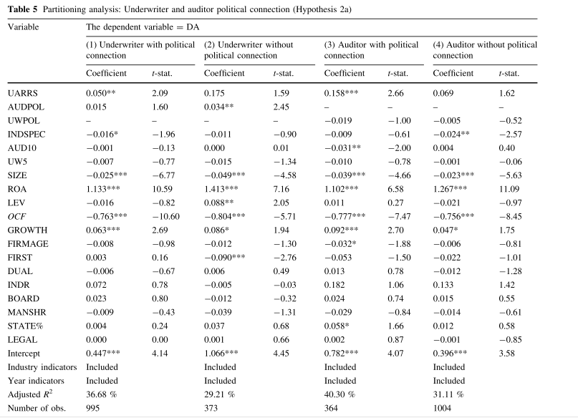
Empirical Results

Slide 16
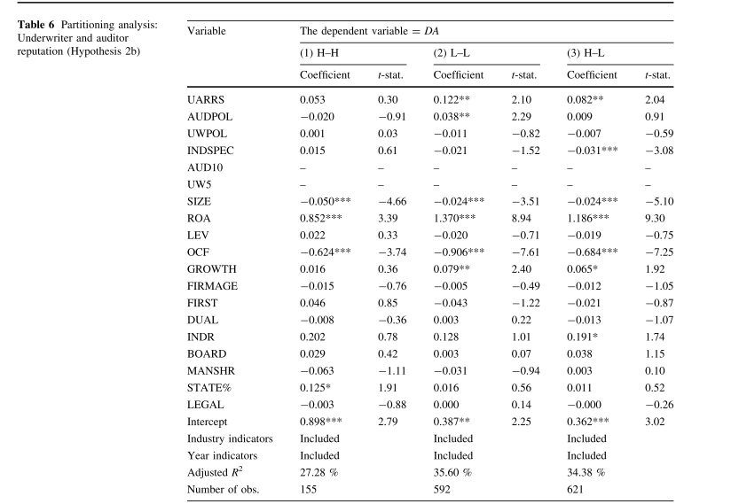
Empirical Results

Slide 17
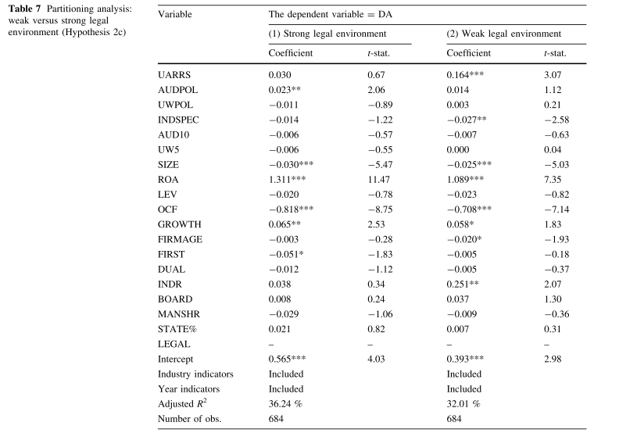
Empirical Results

Slide 18
Further Analysis
1
2
3
4
Listing on the Main, SME, or Venture Boards
Alternative Measurement of UAR, Pre-IPO Earnings
Management
Audit Firm Industry Specialization
Audit Firm Organizational Reform

Slide 19
Endogeneity
With respect to the propensity
score matching (PSM) method, in the first stage, we include a set of variables to estimate the propensity of a
high UAR (based on the sample median).
we use two instruments unlikely to exert an effect on pre-IPO earnings management, but should have an indirect relationship through their effects on UAR. The instruments are AUDDIS and UWDIS, which capture the average distance between an audit firm to all underwriters and vice versa.

Slide 20
Conclusion

Slide 21
First
Second
Third
This study provides very first evidence of a positive association between UAR and pre-IPO earnings management, suggesting that the collusion incentive
embedded in UAR dominates the efficiency incentive and leads to deteriorated earnings quality.
The undesirable effect of UAR on earnings quality is more pronounced for firms whose auditor/underwriter is politically connected, firms with less reputable auditor (underwriter), firms located in provinces
with weak legal environment, firms facing lax listing
requirements, and firms whose auditors have low industry specialization or liability exposure.
The current approval-based system over Chinese IPOs is criticized for distorting the IPO market and encouraging official corruption and collusion. Our study suggests a new form of collusion, i.e., through repeated collaborations between market intermediaries, and thereby heightens the necessity of considering UAR in IPO resource allocation, equity evaluation, and supervision.

Slide 22
THANKS!

