Slide 1
Accounting conservatism and firm investment efficiency
16720803
樊粉芬

Slide 2

Contents
1、Basic information of the article
2、 Research Questions
3、Significance of research
4、The research hypothesis
5、Main empirical results
6、Conclusion
7、References

Slide 3
1、Basic information of the article
Topic: Accounting conservatism and firm investment efficiency
Author: Juan Manuel García Lara , Beatriz García Osma , Fernando Penalva
Literature sources: Journal of Accounting and Economics

Slide 4
2、 Research Questions
We argue that conservatism improves investment efficiency. In particular, we predict that it resolves debt-equity conflicts, facilitating a firm's access to debt financing and limiting underinvestment. This permits the financing of prudent investments that otherwise might not be pursued. Our empirical results confirm these predictions. We find that more conservative firms invest more and issue more debt in settings prone to underinvestment and that these effects are more pronounced in firms characterized by greater information asymmetries. We also find that conservatism is associated with reduced overinvestment, even for opaque investments such as research and development.

Slide 5
3、Significance of research
Our results contribute to the literature in several ways. First, we extend the growing literature on the links between accounting quality and investment efficiency. We show that, among firms prone to underinvest, those with more conservative accounting invest more (in less profitable but more prudent projects) and issue more debt. This suggests that conservatism encourages low-risk, positive-NPV investments and that these new investments are financed with new debt. This is consistent with conservatism limiting debt-equity conflicts. Our finding that conservatism mitigates underinvestment in financially constrained firms is novel, as prior research focuses only on the role of conservatism in reducing overinvestment (Francis and Martin, 2010; Bushman et al., 2011).
We also contribute to the stream of literature on the links between accounting quality and financing (e.g., Balakrishnan et al., 2014). Prior work shows that conservatism can lead to a lower cost of debt (Ahmed et al., 2002; Zhang 2008; Wittenberg-Moerman, 2008). We provide evidence of an association between conservatism and new debt issuances for financially constrained firms. This finding complements the related analytical evidence provided by Göx and Wagenhofer (2009), who show that conditional conservatism is the optimal accounting policy for financially constrained firms seeking to issue debt. Our evidence also complements the work of Beatty et al. (2010). Their work on the role accounting quality in facilitating investment focuses on access to private versus public debt. We examine debt versus equity.
We also expand the evidence on the role of conservatism in mitigating the overinvestment problems documented in Francis and Martin (2010). We show that conservatism, in overinvestment scenarios, is also associated with reduced investment in more opaque investments, such as R&D and capital expenditures, where outsider monitoring is less likely to affect investment outcomes. We also add to their findings by showing that the investment-related effects of conservatism affect performance differently depending on whether the firm is over- or underinvesting. While prior research finds that the investment effects of improved accounting quality lead to greater profitability (Hope and Thomas, 2008; Francis and Martin, 2010), we find that this is true only in settings prone to overinvestment. In settings prone to underinvestment, conservatism is associated with investment in prudent projects and therefore does not lead to a higher ROA.

Slide 6
4、The research hypothesis
H1a. Among firms prone to underinvestment, more conservative firms invest more.
H1b. Among firms prone to overinvestment, more conservative firms invest less.
H2. The effects of conservatism on investment are more pronounced among firms characterized by greater information asymmetry.
H3a. Among firms prone to underinvestment, accounting conservatism is associated with future debt issuances.
H3b. Among firms prone to underinvestment, accounting conservatism is not associated with future equity issuances.

Slide 7
5、Main empirical results Sample and data
We use Compustat for accounting data and CRSP for stock market data. Analyst data come from IBES, ownership data from Thomson Financial, and governance data from Gompers et al. (2003). To increase the power of our tests, we employ as many observations as possible from the available data sources. Our sample covers 18 years—1990 to 2007. The sample spans these years because this is when some of the governance variables are available. Financial firms are excluded because their accounting differs and because they invest differently. To mitigate the influence of outliers, all continuous variables are winsorized annually at the first and 99th percentiles. These selection procedures result in a maximum of 41,626 firm-year observations, although the number of observations varies depending on the type of test conducted. Table 1 presents descriptive statistics of the main variables. The reported values for the conservatism proxy are in line with those in Khan and Watts (2009), and the values of the control variables are also similar to those in Biddle et al. (2009). Table 1 also contains descriptive statistics for the full sample and the underinvestment and overinvestment subsamples. The under- and overinvestment subsamples correspond to observations in the first and third tercile, respectively, of the distribution of UnderInvest.

Slide 8
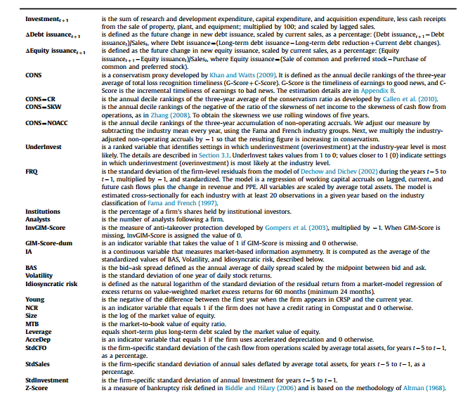
Definitions of variables

Slide 9
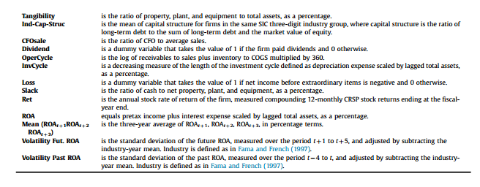

Slide 10
H1：Investment_{t+1}=β_{t}+δ₁ CONS_{t}+δ₂ CONS_{t}*UnderInvest_{t}+δ₃ UnderInvest_{t} +δ₄ FRQ_{t}+δ₅ FRQ_{t}*UnderInvest_{t}+δ₆ GOV_{t}+δ7 GOV_{t}*UnderInvest_{t} +γ Controls_{t}+ε_{t}+1
H2：Investment_{t+1}=β_{t}+δ₁ CONS_{t}+δ₂ CONS_{t}*InfoAsym_{t}+δ₃CONSt*UnderInvest_{t}+δ4 CONS_{t}*UnderInvest_{t}*InfoAsym_{t} +γ Controls_{t} +ε_{t}+1
H3: ΔDebt issuance_{t +1}= β_{t}+δ₁ CONS_{t}+δ₂ CONS_{t}*UnderInvest_{t}+δ₃ UnderInvest_{t} +δ₄ FRQ_{t}+δ₅ FRQ_{t}*UnderInvest_{t}+δ₆ GOV_{t}+δ7 GOV_{t}*UnderInvest_{t} +γ Controls_{t}+ε_{t}+1

Slide 11
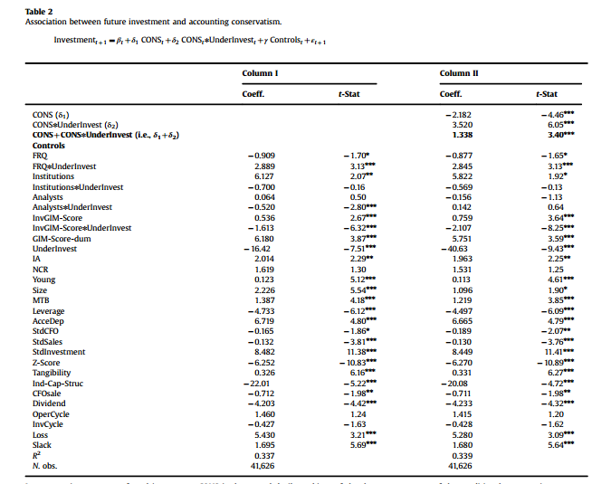
In our first analysis, we study the association between conservatism and investment efficiency. Table 2 reports the results of estimating Eq. (1). In Column I, we replicate the results in Biddle et al. (2009) on the effects of financial reporting quality on over- and underinvestment. Consistent with their results, we find that financial reporting quality (FRQ) mitigates both overinvestment and underinvestment. The results on conservatism are reported in Column II. We find evidence that conservatism is positively associated with investment in firm-year observations with a greater likelihood of underinvestment.In particular, the sum of coefficients δ1 and δ2 (1.338, t-stat=3.40) is positive and significant at conventional levels, confirming that more conservative firms invest more in settings prone to underinvestment (i.e., UnderInvest¼1). The negative and significant δ1 coefficient (2.182, t-stat= 4.46) also confirms that conservatism constrains investment in firms that are likely to overinvest (i.e., UnderInvest=0). The economic significance is such that a one decile change in CONS translates into an increase (decrease) in investment, relative to its mean, of 5.3% (8.6%). These results confirm hypotheses H1a and H1b.

Slide 12
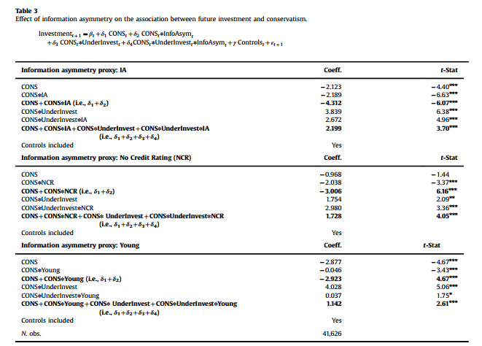
Under H2, we predict that information asymmetries contribute to the investment effects of conservatism. Table 3 contains the results of estimating Eq. (3) for each of our three information asymmetry proxies. For parsimony, we report only the coefficients of interest. In settings prone to underinvestment, the coefficient δ4 on the three-way interaction among CONS, UnderInvest, and InfoAsym is positive and significant for all three, which confirms that, in under-investment settings, the contribution of conservatism to increase investment is greater when information asymmetry is high. In overinvestment settings with high information asymmetry, conservatism also plays a greater role in decreasing investment: the coefficient δ2 is significantly negative in all cases. Overall, these findings suggest that the investment benefits of conservatism are greater for firms subject to larger information asymmetries, as expected.

Slide 13
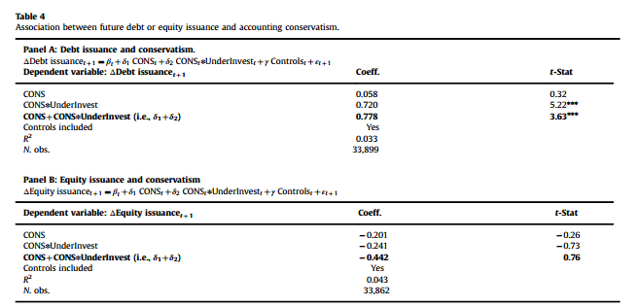
In our third analysis, we study whether more conservative firms, in settings where underinvestment is likely, issue more debt than less conservative ones, as predicted by hypothesis H3a. Table 4, Panel A, displays the results of estimating Eq. (4). We observe that the sum of δ1 and δ2 is positive and significant (δ1+δ2=0.778, t-stat=3.63). This indicates a positive association between conservatism and future change in debt issuance in settings prone to underinvestment (i.e.,UnderInvest=1), consistent with our predictions. In terms of economic significance, a one-decile change in conservatism results in an increase in future debt issuance of 2.6%, relative to average total debt, among firms that are underinvesting. In settings where overinvestment is likely (i.e., UnderInvest=0), there is no association between conservatism and future change in debt issuance (δ1 is not significant at conventional levels). This is consistent with our expectation that the role of conservatism in debt financing is less important for healthy firms.
We also analyze the effect of conservatism on equity issuance. Table 4, Panel B, contains the results. Under H3b, we do not expect an association between conservatism and the issuance of equity. Consistent with our hypothesis, the sum of δ1 and δ2 is not significant at conventional levels. Overall, the evidence reported in Table 4 confirms that the additional funding obtained by conservative firms comes from new debt, not equity.

Slide 14
6、Conclusion
We study the association between conservatism and the investment efficiency of firms. We find that, in settings where firms are prone to underinvest, more conservative firms invest more and raise more debt than less conservative ones. These effects of conservatism on investment and financing are more pronounced in the presence of information asymmetries. Our empirical evidence is consistent with prior analytical work showing that conservatism facilitates access to debt (Göx and Wagenhofer, 2009). This comports with prior research that indicates that debtholders demand conservative accounting because it facilitates their monitoring. We also find that, in settings prone to overinvestment, conservatism reduces investment not only for acquisitions, as documented by Francis and Martin (2010), but also for other harder-to-monitor types of investments.
Overall, our evidence strongly suggests that conservatism can lead to a direct benefit to investors in the form of more efficient investments. Therefore we add to a growing number of studies that demonstrate that accounting conservatism, through the timelier recognition of losses in the income statement, generates positive economic outcomes (Ahmed et al., 2002; Guay and Verrecchia, 2007; LaFond and Watts, 2008; Suijs, 2008; Wittenberg-Moerman, 2008; Zhang, 2008; Khan and Watts, 2009; Göx and Wagenhofer, 2009; Francis and Martin, 2010; García Lara et al., 2011; Gormley et al., 2012; Ettredge et al., 2012; Jayaraman and Shivakumar, 2013). One interpretation of our evidence is that the elimination of conservatism from accounting regulatory frameworks may lead to undesired economic consequences.

Slide 15
7、Reference
Aboody, D., Lev, B., 2000. Information asymmetry, R&D, and insider gains. Journal of Finance 55 (6), 2747–2766.
Ahmed, A.S., Billings, B.K., Morton, R.M., Stanford-Harris, M., 2002. The role of accounting conservatism in mitigating bondholder-shareholder conflicts over dividend policy and in reducing debt costs. Accounting Review 77 (4), 867–890.
Ahmed, A.S., Duellman, S., 2007. Accounting conservatism and board of director characteristics: an empirical analysis. Journal of Accounting and Economics 43, 411–437.
Altman, E., 1968. Discriminant analysis and the prediction of corporate bankruptcy. Journal of Finance 23 (4), 589–609.
Balakrishnan, K., Core, J.E., Verdi, R.S., 2014. The relation between reporting quality and financing and investment: evidence from changes in financing capacity. Journal of Accounting Research 52 (1), 1–36.
Ball, R., 2001. Infrastructure requirements for an economically efficient system of public financial reporting and disclosure. Brookings-Wharton Papers on Financial Services, pp. 127–182.
Ball, R., Kothari, S.P., Nikolaev, V.A., 2013a. Econometrics of the Basu asymmetric timeliness coefficient and accounting conservatism. Journal of Accounting Research 51 (5), 1071–1097.
Ball, R., Kothari, S.P., Nikolaev, V.A., 2013b. On estimating conditional conservatism. Accounting Review 88 (3), 755–788.

Slide 16
Ball, R., Lev, B., Watts, R.L., 1976. Income variation and balance sheet compositions. Journal of Accounting Research 14 (1), 1–9.
Ball, R., Shivakumar, L., 2005. Earnings quality in UK private firms: comparative loss recognition timeliness. Journal of Accounting and Economics 39,83–128.
Barclay, M., Smith Jr., C.W., 1999. The capital structure puzzle: another look at the evidence. Journal of Applied Corporate Finance 12, 8–20.
Bargeron, L.L., Lehn, K.M., Zutter, C.J., 2010. Sarbanes-Oxley and corporate risk-taking. Journal of Accounting and Economics 49 (1–2), 34–52.
Basu, S., 1997. The conservatism principle and the asymmetric timeliness of earnings. Journal of Accounting and Economics 24, 3–37.
Beatty, A., Liao, W.S., Weber, J., 2010. The effect of private information and monitoring on the role of accounting quality in investment decisions. Contemporary Accounting Research 27, 17–47.
Becker, B., Strömberg, P., 2012. Fiduciary duties and equity-debtholder conflicts. Review of Financial Studies 25 (6), 1931–1969.
Bens, D., Monahan, S., 2004. Disclosure quality and the excess value of diversification. Journal of Accounting Research 42 (4), 691–730.
Biddle, G.C., Hilary, G., 2006. Accounting quality and firm-level capital investment. Accounting Review 81 (5), 963–982.
Biddle, G.C., Hilary, G., Verdi, R.S., 2009. How does financial reporting quality improve investment efficiency? Journal of Accounting and Economics 48,112–131.
Bushman, R.M., Piotroski, J.D., Smith, A.J., 2011. Capital allocation and timely accounting recognition of economic losses. Journal of Business Finance & Accounting 38, 1–33.
Callen, J.L., Segal, D., Hope, O.-K., 2010. The pricing of conservative accounting and the measurement of conservatism at the firm-year level. Review of Accounting Studies 15, 145–178.
Chang, X., Dasgupta, S., Hilary, G.C., 2006. Analyst coverage and financing decisions. Journal of Finance 61 (6), 3009–3048.
Chang, X., Dasgupta, S., Hilary, G.C., 2009. The effect of auditor quality on financing decisions. Accounting Review 84 (4), 1085–1117.
Chen, Q., Hemmer, T., Zhang, Y., 2007. On the relation between conservatism in accounting standards and incentives for earnings management. Journal of Accounting Research 45 (3), 541–565.
Cheng, M., Dhaliwal, D., Zhang, Y., 2013. Does investment efficiency improve after the disclosure of material weaknesses in internal control over financial reporting? Journal of Accounting and Economics 56 (1), 1–18.
Childs, P.D., Mauer, D.C., Ott, S.H., 2005. Interactions of corporate financing and investment decisions: the effects of agency conflicts. Journal of Financial Economics 76, 667–690.

Slide 17
Dechow, P., 1994. Accounting earnings and cash flows as measures of firm performance: the role of accounting accruals. Journal of Accounting andEconomics 18, 3–42.
Dechow, P., Dichev, I., 2002. The quality of accruals and earnings: the role of accrual estimation errors. Accounting Review 77, 35–59.
Dechow, P., Kothari, S.P., Watts, R.L., 1998. The relation between earnings and cash flows. Journal of Accounting and Economics 25, 133–168.
Dietrich, D., Muller, K., Riedl, E., 2007. Asymmetric timeliness tests of accounting conservatism. Review of Accounting Studies 12, 95–124.
Ettredge, M., Huang, Y., Zhang, W., 2012. Earnings restatements and differential timeliness of accounting conservatism. Journal of Accounting and Economics 53, 489–503.
Fama, E., French, K., 1997. Industry costs of equity. Journal of Financial Economics 43, 153–193.
Fama, E., French, K., 2002. Testing trade-off and pecking order predictions about dividends and debt. Review of Financial Studies 15, 1–33.
Faulkender, M., Petersen, M., 2006. Does the source of capital affect capital structure? Review of Financial Studies 19, 45–79.
Francis, J., Martin, X., 2010. Acquisition profitability and timely loss recognition. Journal of Accounting and Economics 49 (1-2), 161–178.
Frank, M., Goyal, V., 2003. Testing the pecking order theory of capital structure. Journal of Financial Economics 67, 217–248.
Frank, M., Goyal, V., 2009. Capital structure decisions: which factors are reliably important? Financial Management 38, 1–37.
Gao, P., 2013. A measurement approach to conservatism and earnings management. Journal of Accounting and Economics 55, 251–268.
García Lara, J.M., García Osma, B., Penalva, F., 2011. Conditional conservatism and cost of capital. Review of Accounting Studies 16 (2), 247–271.
Givoly, D., Hayn, C., 2000. The changing time-series properties of earnings, cash flows and accruals: has financial reporting become more conservative? Journal of Accounting and Economics 29, 287–320.
Givoly, D., Hayn, C., Natarajan, A., 2007. Measuring reporting conservatism. Accounting Review 82, 65–106.
Gompers, P., Ishii, J., Metrick, A., 2003. Corporate governance and equity prices. Quarterly Journal of Economics 118 (1), 107–155.
Gormley, T.A., Kim, B.H., Martin, X., 2012. Do firms adjust their timely loss recognition in response to changes in the banking industry? Journal of Accounting Research 50, 159–196.

Slide 18
Göx, R., Wagenhofer, A., 2009. Optimal impairment rules. Journal of Accounting and Economics 48, 2–16.
Guay, W., Verrecchia, R., 2007. Conservative disclosure. Working paper. University of Pennsylvania.
Harris, M., Raviv, A., 1991. The theory of capital structure. Journal of Finance 46, 297–355.
Hope, O.-K., Thomas, W.B., 2008. Managerial empire building and firm disclosure. Journal of Accounting Research 46 (3), 591–626.
Hovakimian, A., 2004. The role of target leverage in security issues and repurchases. Journal of Business 77, 1041–1071.
Hovakimian, A., Opler, T., Titman, S., 2001. The debt-equity choice. Journal of Financial Quantitative Analysis 36, 1–24.
Jackson, S.B., 2008. The effect of firms' depreciation method choice on managers' capital investment decisions. Accounting Review 83 (2), 351–376.
Jackson, S.B., Liu, X., Cecchini, M., 2009. Economic consequences of firms' depreciation method choice: evidence from capital investments. Journal of Accounting and Economics 48 (1), 54–68.
Jayaraman, S., 2012. The effect of enforcement on timely loss recognition: evidence from insider trading laws. Journal of Accounting and Economics 53, 77–97.
Jayaraman, S., Shivakumar, L., 2013. Agency-based demand for conservatism: evidence from state adoption of antitakeover laws. Review of Accounting Studies 18, 95–134.
Jensen, M., Meckling, W., 1976. Theory of the firm: managerial behavior, agency costs and ownership structure. Journal of Financial Economics 3 (4), 305–360.
Khan, M., Watts, R.L., 2009. Estimation and empirical properties of a firm-year measure of accounting conservatism. Journal of Accounting and Economics 48, 132–150.
Kim, Y., Li, S., Pan, C., Zuo, L., 2013. The role of accounting conservatism in the equity market: evidence from seasoned equity offerings. Accounting Review 88 (4), 1327–1356.
Krishnaswami, S., Spindt, P.A., Subramaniam, V., 1999. Information asymmetry, monitoring, and the placement structure of corporate debt. Journal of Financial Economics 51, 407–434.
LaFond, R., Watts, R.L., 2008. The information role of conservatism. Accounting Review 83 (2), 447–478.
Leland, H., 1994. Corporate debt value, debt covenants, and optimal capital structure. Journal of Finance 49, 1213–1252.
Leuz, C., 2001. Comment on: Ball, R., Infrastructure requirements for an economically efficient system of public financial reporting and disclosure. Brookings-Wharton Papers on Financial Services.

Slide 19
Liu, M., Wysocki, P., 2007. Cross-sectional determinants of information quality proxies and cost of capital measures.Working paper. MIT.
Lucas, D.J., McDonald, R., 1990. Equity issues and stock price dynamics. Journal of Finance 45, 1019–1043.
McNichols, M.F., Stubben, S.R., 2008. Does earnings management affect firms' investment decisions? Accounting Review 83 (6), 1571–1603.
Modigliani, F., Miller, M.H., 1958. The cost of capital, corporation finance and the theory of investment. American Economic Review 48 (3), 261–297.
Myers, S.C., 1977. Determinants of corporate borrowing. Journal of Financial Economics 5, 147–176.
Myers, S.C., 1984. The capital structure puzzle. Journal of Finance 39 (3), 575–592.
Myers, S.C., 2003. Financing of corporations. In: Constantinides, G.M., Harris, M., Stulz, R. (Eds.), Handbook of the Economics of Finance, Elsevier, Amsterdam. Nikolaev, V., 2010. Debt covenants and accounting conservatism. Journal of Accounting Research 48 (1), 137–175.
Patatoukas, P.N., Thomas, J.K., 2011. More evidence of bias in differential timeliness estimates of conditional conservatism. Accounting Review 86 (5), 1765–1794.
Petersen, M.A., 2009. Estimating standard errors in finance panel data sets: comparing approaches. Review of Financial Studies 22, 435–480.
Pinnuck, M., Lillis, A.M., 2007. Profits versus losses: does reporting an accounting loss act as a heuristic trigger to exercise the abandonment option and divest employees? Accounting Review 82 (4), 1031–1053.
Rajan, R., Zingales, L., 1995. What do we know about capital structure? Some evidence from international data. Journal of Finance 50, 1421–1460.
Rauh, J.D., Sufi, A., 2010. Capital structure and debt structure. Review of Financial Studies 23, 4242–4280.
Roychowdhury, S., 2010. Discussion of: Francis, J., Martin, X., Acquisition profitability and timely loss recognition. Journal of Accounting and Economics 49, 179–183.
Sufi, A., 2007. Information asymmetry and financing arrangements: evidence from syndicated loans. Journal of Finance 62, 629–668.
Sufi, A., 2009. Bank lines of credit in corporate finance: an empirical analysis. Review of Financial Studies 22, 1057–1088.
Suijs, J., 2008. On the value relevance of asymmetric financial reporting policies. Journal of Accounting Research 46 (5), 1297–1321.
Titman, S., Wessels, R., 1988. The determinants of capital structure choice. Journal of Finance 43, 1–19.
Vuolteenaho, T., 2002. What drives firm-level stock returns? Journal of Finance 57, 233–264.
Watts, R.L., 2003. Conservatism in accounting – part I: Explanations and implications. Accounting Horizons 17 (3), 207–221.
Wittenberg-Moerman, R., 2008. The role of information asymmetry and financial reporting quality in debt trading: evidence from the secondary loan market. Journal of Accounting and Economics 46, 240–260.
Zhang, J., 2008. The contracting benefits of accounting conservatism to lenders and borrowers. Journal of Accounting and Economics 45, 27–54.

Slide 20
Thanks!

