Slide 1




Institutional investors, corporate governance, and earnings management around merger: evidence from French absorbing firms
2
0
1
4
Mouna Njaha, Anis Jarbouib
Journal of Economics, Finance and Administrative Science 18 (2013) 89-96
张柳
16720776

Slide 2

1
Hypothesis development
Context
2
Research methodology
3
Main empirical results
4
Conclusions

Slide 3
Abstract
This paper examines the association between institutional ownership and the earnings management behavior of some French absorbing firms.
Using a sample of 76 French mergers and absorptions concluded over the period ranging from 2000 to 2010, we undertake to present some empirical evidence highlighting that absorbing-firms manipulate earnings relevant to the year preceding the merger-offer in the presence of institutional cross-holding.
However, the presence of active institutions turns out to limit the managerial accruals discretion. The monitoring role exerted by the active-institutional investors does restrict the opportunities of earnings management around mergers and acquisitions. Further analyses suggest that the average value of discretionary accruals with regards to the absorbing firms proves to be influenced by the nature of merger deal (takeover vs. restructuring).

Slide 4
1 Hypothesis development
1.1 The absorbent company’s accounting politics: earnings anagement hypothesis
Erickson and Wang（1999）predict that the acquiring firms manage their earnings during the period prior to the merger offer.
Jiraporn, Miller, Yoon and Kim (2008) suggest that earnings management may seem beneficial as it potentially enhances the informative-value of earnings.
An opportunistic earnings management undertaken by acquirer may have two major explanations：
1. it serves to conceal the managerial entrenchment strategy；
2. it tend to reduce the exchange ratio

Slide 5
1 Hypothesis development
1.2 Institutional ownership and earnings management incentives
① Transient institutional investors ——passive
Transient institutions are institutional investors who buy and sell their investments very frequently and exhibit strong preference for short-term earnings、a high portfolio turnover；
not directly involved in corporate management decisions；
Lipson et al (2006) report that institutional ownership is highly associated with income increasing accruals。
Firstly, these transactions favor the primary objective of maximizing the shareholder’s value further to achieving positive abnormal returns when announcing the absorption offer (Comblé & Heldenbergh, 2002).
Secondly, such a specific accounting strategy complies with near-term earnings preference adopted by transient institutional investors.
H1：Absorbent firms are more incited to manage earnings upwards during the year preceding a merger in presence of transient institutional ownership.

Slide 6
1 Hypothesis development
1.2 Institutional ownership and earnings management incentives
②Dedicated institutional investors —— active
Long-term oriented investors with a desire to invest in a firm which creates a long-run value.
Bethel, Hu & Wang (2009) have provided some evidence highlighting that institutional shareholders with concentrated-bidder stakes may vote against merger proposals once they feel they are misguided.
Dedicated-institutional investors are likely to constrain the accruals discretion available to and exercised by acquirer managers. The presence of these institutional investors has also been discovered to mitigate managerial incentives to manipulate earnings.
Djerbi & Jarboui（2012）support the competing view that institutional investors play an active role in monitoring and disciplining managers and their presence reduces, as well, managerial incentives to adopt aggressive earnings-management strategies.
H2：Absorbent firms are less incited to manage earnings upwards during the year preceding a merger in presence of dedicated-institutional ownership.

Slide 7
1 Hypothesis development
1.2 Institutional ownership and earnings management incentives
③Institutional cross-holding —— zero-sum game
institutional investors can hold equity stakes in both the bidder and target companies.
zero-sum game：a simple transfer of wealth from the acquiring-companies’ shareholders to the target-companies’shareholders.
Bethel et al. (2009) suggest that institutional investors holding equity stakes in both bidders and targets may try to maximize their overall holdings’value around the agreement dates of mergers.if they fail to realize abnormal returns during the merger offer，earnings management represent a means of maximizing the profitability of their portfolio.So：
H3：Absorbent firms are more incited to manage earnings upwards in the period preceding a merger with the presence of institutional cross-ownership.

Slide 8
1 Hypothesis development
1.3 Earnings management major determinants
①The pre-bid ownership in the target companies
Boutant (2011) confirms that the absorbing firms’ upwards earnings management is influenced by certain contextual factors related to the characterizing features of French mergers characteristics such as nature of the mergers deals (common control vs. control absence) . She finds that the incentives for earnings management turn out to be less (more) pronounced when the mergers are undertaken among entities under common control (absence of control).
So,the absorbent firms are more (less) incited to manage earnings upwards in the period preceding a merger if the operation is led between entities under different control (common control).

Slide 9
1 Hypothesis development
1.3 Earnings management major determinants
②Merger’s auditing quality
Krishnan (2003) finds that discretionary accruals in firms audited by Big-X have a higher positive relationship with future profitability than those of firms audited by non-Big X auditors.
Djama and Boutant (2006) have highlighted the presence of a negative association between discretionary accruals and the presence of a well-qualified merger auditor.
Hence, the absorbent firms are less motivated to manage earnings upwards in the period preceding a merger in the presence of a high-quality merger auditor.

Slide 10
1 Hypothesis development
1.3 Earnings management major determinants
③Merger-payment method
bidder has three methods:
cash payments
mixed payments
stock payments
Myers and Majluf (1984) suggest that bidders usually use their stock to finance takeovers once they are overvalued in the financial market.
Fishman (1989), Sudarsaman (1995) and Henry (2004) have concluded that cash-based bids prove to have a more highly significant probability of success than do bids involving a pure-equity or part-equity consideration.
Based on these developments, the absorbent firms are more incited to manage earnings upwards in the pre-merger period once equity is used as a payment method.

Slide 11
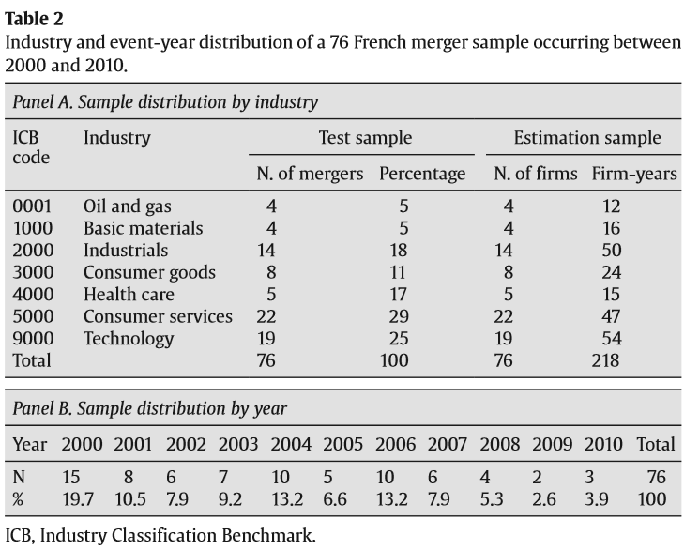
Research methodology
Sample：
（1）transactions contemplated by the Paris stock-exchange operations’ commission COB prior to the year 2004, as well as the financial-markets’ authorities AMF following that same year.
（2）the targets become totally absorbed in the acquirers
（3）exclude 35 transactions completed by financial companies
（4）28 transactions have been rejected due to the lack of data necessary to evaluate the merger-related earnings management
Hence, our final sample turns out to include 76 French mergers.（72% absorbent companies : the Industrial, Consumer Services and Technology sectors.）

Slide 12
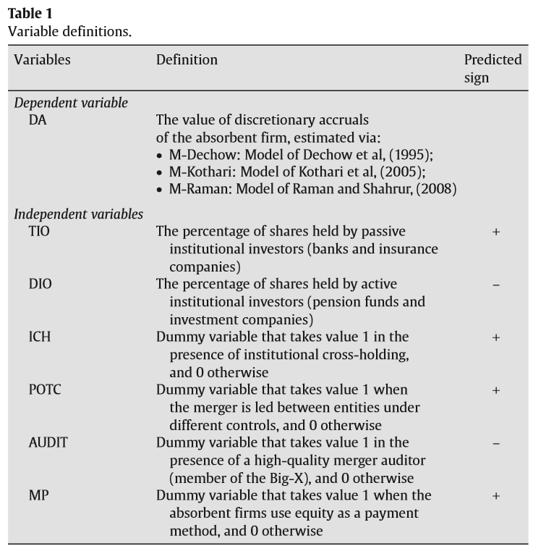
Research methodology

Slide 13
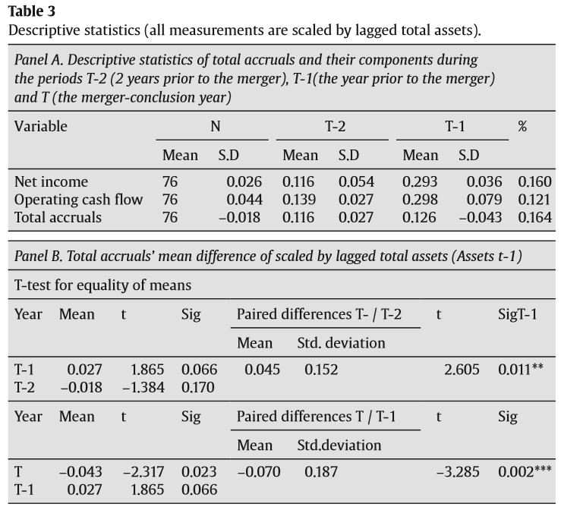
Main empirical results
These preliminary results do support the hypothesis of earnings management by acquirers with respect to the specific context of merger.

Slide 14
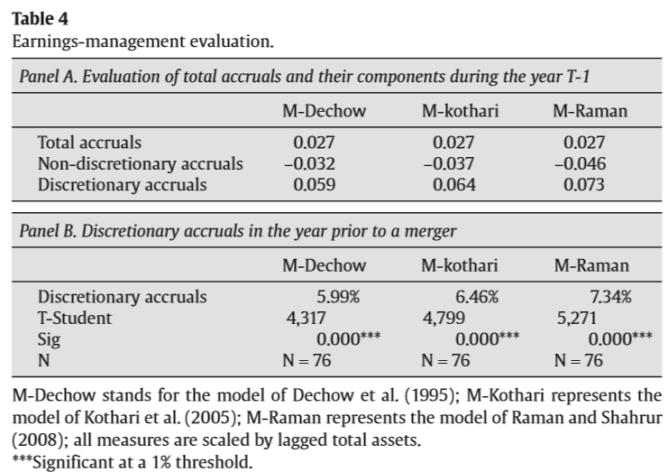
Main empirical results
These empirical findings prove to validate the earnings management hypothesis pertaining to merger and absorption

Slide 15
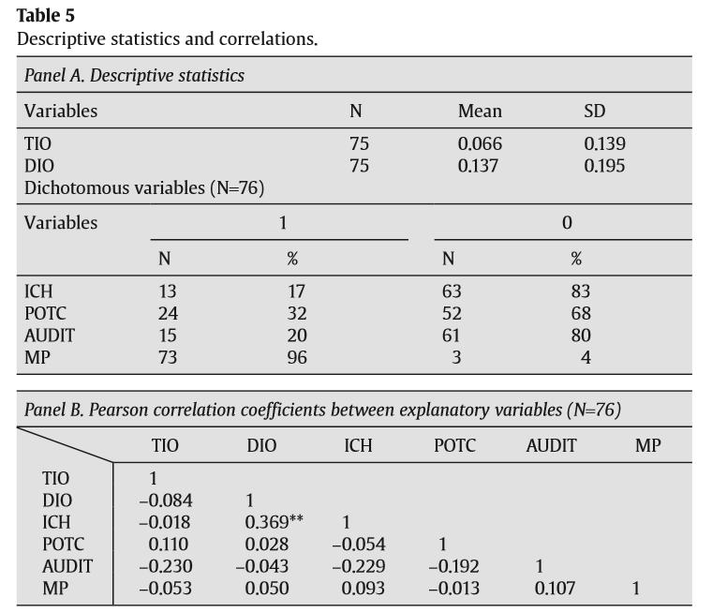
Main empirical results

Slide 16
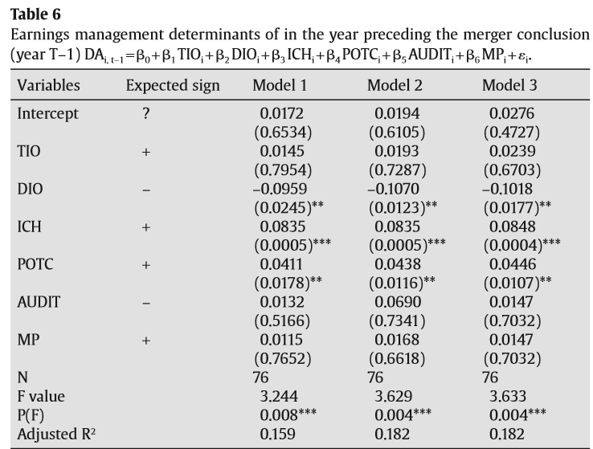
Main empirical results
Major determinants of earnings management in regard to merger:
（1）dedicated institutional ownership (DIO),
（2）institutional cross-holding (ICH),
（3） pre-bid ownership positions in target companies (POTC).

Slide 17
Conclusion
Objectives:
（1）testing the validity of the earnings management hypothesis around merger;
（2）identifying the earnings-management determinants as undertaken by the acquiring firms
Findings:
（1）the absorbing firms usually most often undertake to manipulate earnings in the year preceding the merger offer.
（2）The monitoring role exerted by the dedicated-institutional investors does restrict the opportunities of earnings management around mergers and acquisitions。（consistent with the active-monitoring hypothesis）
（3）earnings-management incentives undertaken by the acquiring firms in the year prior to a merger are more important with the presence of institutional cross-holding and the existence of a pre-bid toehold shareholding by the bidding companies
Limits:
size of our sample is reduced; measures relevant to some variables

Slide 18
Thanks

