Slide 1
Methodology for accounting
Wu Jiangang

Slide 2
Why is this course useful to you?
Methodology is very useful to help you find right answers to interesting research questions
Without a solid understanding of methodology and econometrics, it will be difficult for you to:
  find the correct answer to the research question
  convince others that your answer is correct

Slide 3
This course is very practical
  By the end of the course you will know how to do your own data analysis
This course is very practical for applied researchers (many courses in statistics and econometrics emphasize theory rather than practice)

Slide 4
Classification from method
Normative Research
  Deductive method
  Analytical: Valuation model, Auditing model, Disclosure model, Compensation mechanism model, etc.
Empirical Research
  Inductive method
  Experimental research, field research, questionnaires, archival research, case studies, etc.

Slide 5
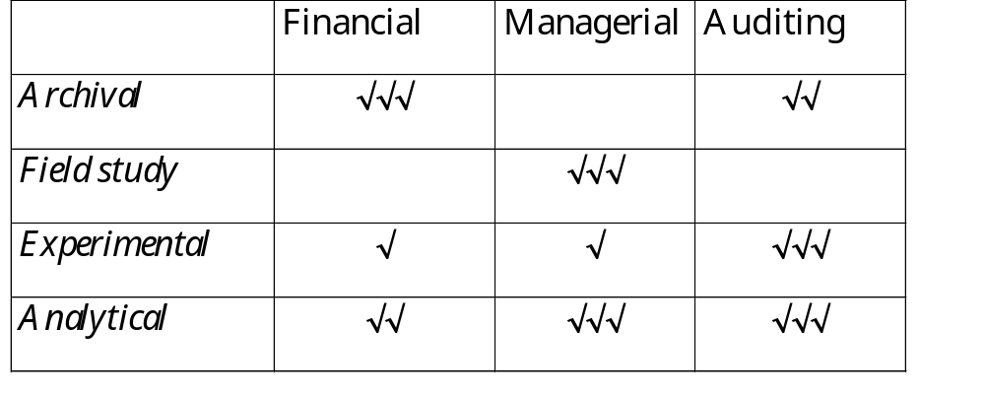

Slide 6
Positive research on Vs normative research
An empirical study is to seek arguments based on assumptions, from realistic information and data to confirm or falsify the assumptions
  To answer: what, why
  To seek facts.
An normative research: Use axioms, laws, rules or doctrines to do a logical reasoning (including mathematical calculations) to get the results of support or negative assumptions
  To answer: what should, how
  To seek solvation

Slide 7
Positive research
Theory
Question
Factors
Assumption

Slide 8
Normative Research
Concepts
Question
Laws
Deduction
Theory
Conclustion

Slide 9
Classification from contents
  Management accounting: EVA, ABC, B-Cards, ERP, JIT, etc.
  Corporate finance: CG, EM, EMH, Asset-Pricing, earnings response coefficient, Fundamental Analysis, Valuation model, Disclosure model, etc.
  Auditing: the selection of CPA firms, Auditing fees, the changes of CPA firms, Auditing model, Auditor qualification and EM, etc.
  Tax: Tax and Dividend Policy, Tax and Accounting Choices, Tax and Capital Structure, Tax and Compensation (option), etc.

Slide 10
Assumption test:
Fama-MecBeth (1973) (cross-section, then time-series):
  t-Statistics=mean of the coefficients/standard error of the coefficients.
Firm-specific time-series regressions:
  t-Statistics=mean of the coefficients/standard error of the coefficients.
White (1984) (cross-section, then time-series):
  Z-Statistics=mean of t-Statistics/standard error of t-Statistics.

Slide 11
R2
Incremental Explanatory Power (IEP,增量解释力) and Relative Explanatory Power (REP ,相关的解释力):
RET(I,J,T)=a1+a2*MKTRET(T)+a3*INDRET(J,T)+E(I,J,T) (1)
RET(I,J,T)=a1+a2*MKTRET(T)+E(I,J, T) (2)
RET(I,J,T)=a1+a2*INDRET(J,T)+E(I,J, T) (3)
REP of MKTRET= adjusted R2 of model 2 / adjusted R2 of model 1;
IEP of MKTRET= (adjusted R2 of model 1 - adjusted R2 of model 3) /
adjusted R2 of model 1;
REP of INDRET= adjusted R2 of model 3 / adjusted R2 of model 1;
IEP of INDRET= (adjusted R2 of model 1 - adjusted R2 of model 2) /
adjusted R2 of model 1;

Slide 12
OLS
Logit regressions；Probit regressions; Rank regressions;
Event count: Poisson/binomial;
Simultaneous equations (联立方程，endogenesis): 2sls, 3sls;
Mishkin tests（会计盈余对股价影响的持续性）: Sloan (1996), Xie (2001);
Lead-Lag Analysis:
Mean and non-parameter median tests;
Principal Component Analysis:

Slide 13
Software
Excel
SAS: Data Process
STATA: regressions, tests and robustness checks.
R
Python

Slide 14
Objectives of Empirical Research
1) Describe: “what is”, just Y
  Example: Performance of listed companies in HK
2) Explain: Because X, so Y
  Example: Performance of companies (Y) after merger (X)
3) Predict: Next time, if X occurs, Y will follow
  Now two companies merge, will they perform better in the future as one single company?
Empirical research usually do (1) and (2), and leave (3) as possible implications
  Direct predictive research: earnings and bankruptcy predications

Slide 15
Steps:
1. Identification of research questions
2. Development of hypotheses
3. Research design
4. Collection of sample and data
5. Statistical analysis
6. Interpretation of results
(1) and (2) are theory construction, and (3)~(6) are theory verification

Slide 16
Step 1. Research Questions
Ask: what is the relationship between two or more variables? Examples:
  Is accounting information useful for stock market investors?
  Is performance improved after merger?

Slide 17
General vs. specific questions:
  Some terms are general, such as
    Does “performance” improve after merger?
    Is the market in HK “efficient”
  These terms have to be narrowed to become testable
  Some terms are specific, such as
    The trading volume of firms disclosing more information is higher than those disclosing less
  These terms need to link to a more general term to be meaningful
  So, interesting questions are usually based on specific meaning of a general term.

Slide 18
Multivariate and conditional nature of research questions
Question: If X, then Y
But there are other variables (can become conditions): A, B, C, D, E…
The question is usually conditional:
  If X, and A, B, C, D, ... then Y
  Example: merger (X) improves performance (Y) only when two companies in the same industry merged (A), and/or merger did not increase debt burden (B)
  Conditional variables allow deeper understanding of the issue
  Sometimes conditional variables are more interesting than X, so can be elevated as the main variables

Slide 19
Step 2. Hypotheses
Conjectural statement of the relation between two or more variables, examples:
  Stock returns are correlated with accounting income
  Accounting income increases after merger
Criteria of good hypothesis:
  Should state relation between two or more variables (in statistical terms, e.g., equal to, correlated, etc.)
  Should be empirically testable (variables should be measurable)
  Should be based on a theory or careful logical deduction

Slide 20
Difference between questions and hypotheses
Hypotheses are testable. questions are not. We test hypotheses, not questions.
Questions don’t need to have a theoretical basis, but hypotheses do.
All research starts from asking questions. If a question cannot be transformed into a hypothesis, then, it is not a worthwhile empirical research question.

Slide 21
Importance of theory in empirical research
What is a theory
  Systematically organized knowledge applicable in a variety of circumstances
A theory can
  Structure the study
  Suggest hypotheses
  Allow knowledge to accumulate

Slide 22
Theory can be either mathematical or logical
  Math theories
    Agency theory
    Valuation model
  Non-math theories
    EMH
    Positive theory of accounting
    Corporate governance

Slide 23
Skills needed to do empirical accounting research
Understand the institutional background:
Understand major lines of accounting or finance research
Computer programming skills/databases
Knowledge of statistical/econometric methods.

Slide 24
Healy, Palepu, and Ruback (1992)
Motivation of the study:
  Why merger should improve performance?
Research question:
Does performance improve after merger?
H1 :
post-merger performance > per-merger performance

Slide 25
2.1 Sample:
The largest 50 acquisitions between 1979 and 1984
  Not random? Why is it okay?
2.2. Performance measure:
  Operating cash flows (sales - COGS + depreciation & amortization) divided by (market value of equity + book value of liabilities), call it CR (cash flow return)
  Why not net income/total assets?

Slide 26
2.3. Performance benchmark (control group)
  (CR_{i} - CR_{med})_{post} = α + β (CR_{i} - CR_{med})_{pre}
  CR_{med} industry/year median
    Control for:
    Industry definition: ? (1980-1982: Recession)
  premerger CR = acquirer CR + target CR

Slide 27
To choose a research question
The importance of the topic: the topic determines the value of the paper and the success or failure of the study, the topic establish a clear goal for the study.
The range of topics: Bachelor, Master, PhD.
Types of topics:
  Pioneering research topics, developmental research topics.
  Deepen and add to the existing point of view.
  Refute and revise the existing point of view.
  Giving the existing theory a new meaning.
The principle of selecting topics:
  choose objective and meaningful topics
  choose topics that belong to academic issues.
  Choose a topic that you have the ability to complete
  Choose a topic that you are interested in.
How to find a topic:
  To find a topic from current phenomena.
  To do a good job of the literature review work.

Slide 28
What is accounting research
Areas of accounting research

Slide 29
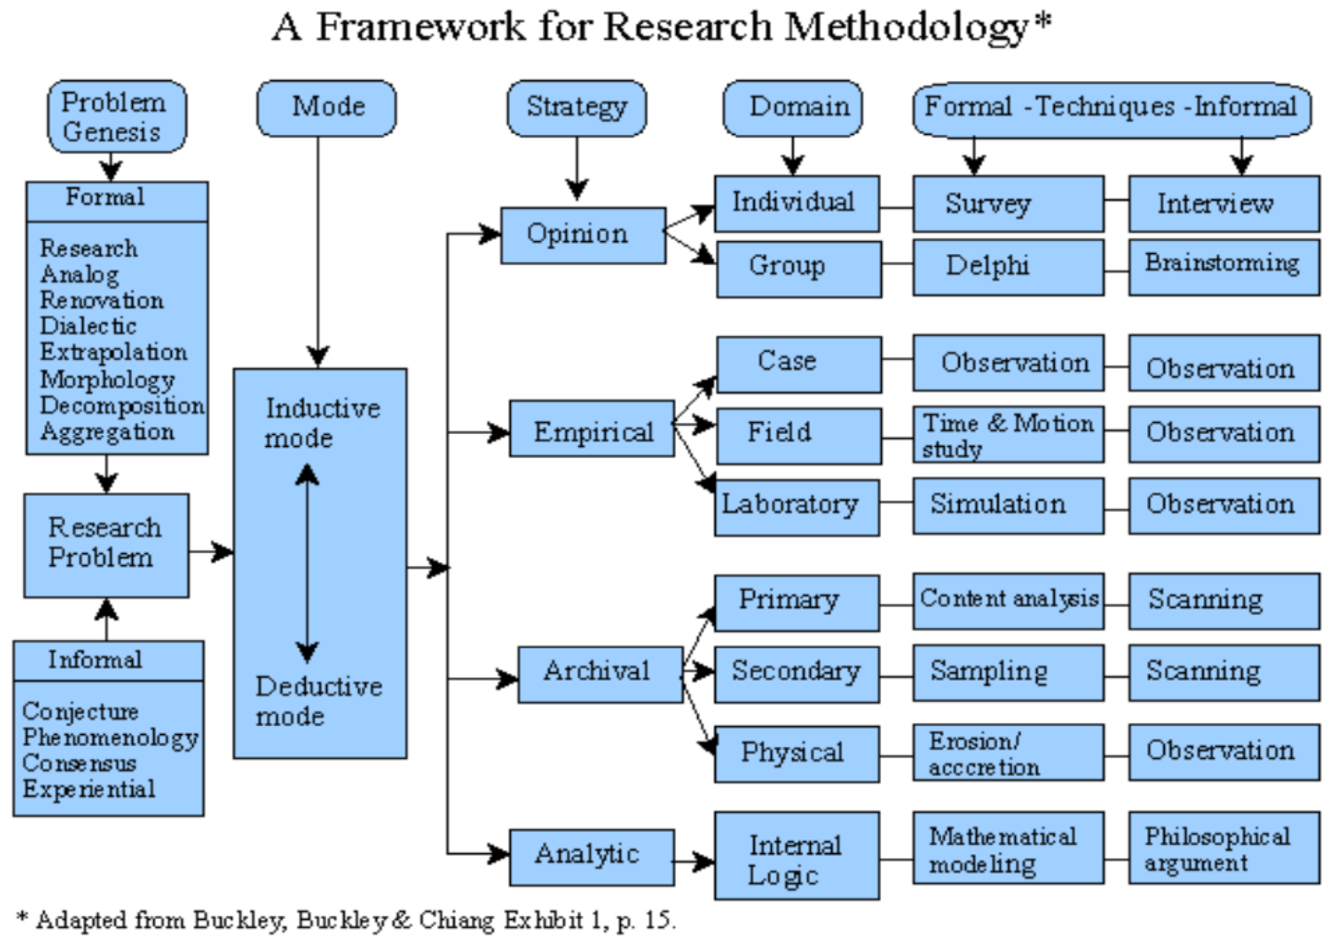

Slide 30
Schedule
Chapter | Topic | % | Word | Time (Month)
1 | Preface | 5 | 2,500 | 1
2 | Literature and assumption | 30 | 15,000 | 1
3 | Research design | 20 | 10,000 | 2
4 | Statistic analysis | 30 | 15,000 | 1
5 | Conclusion | 15 | 7,500 | 1
 | Total | 100 | 50,000 | 8

