Slide 1
Methodology of Accounting Research
Event Study

Slide 2
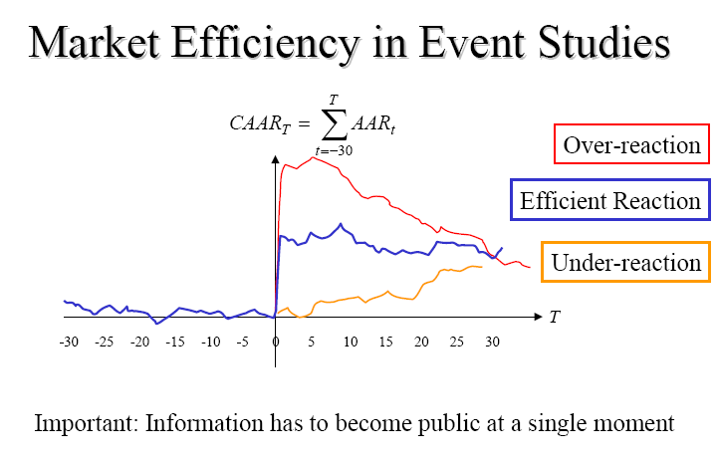

Slide 3
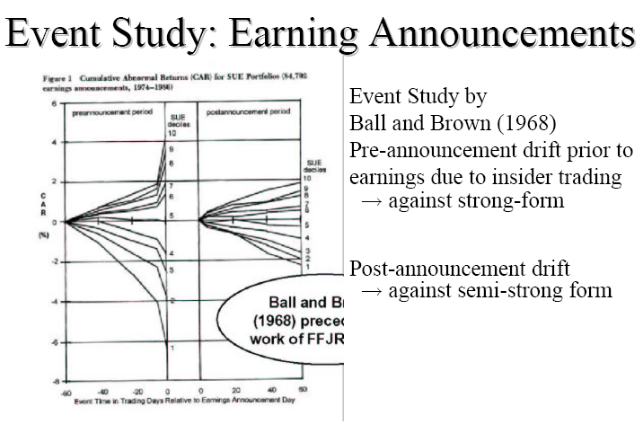

Slide 4
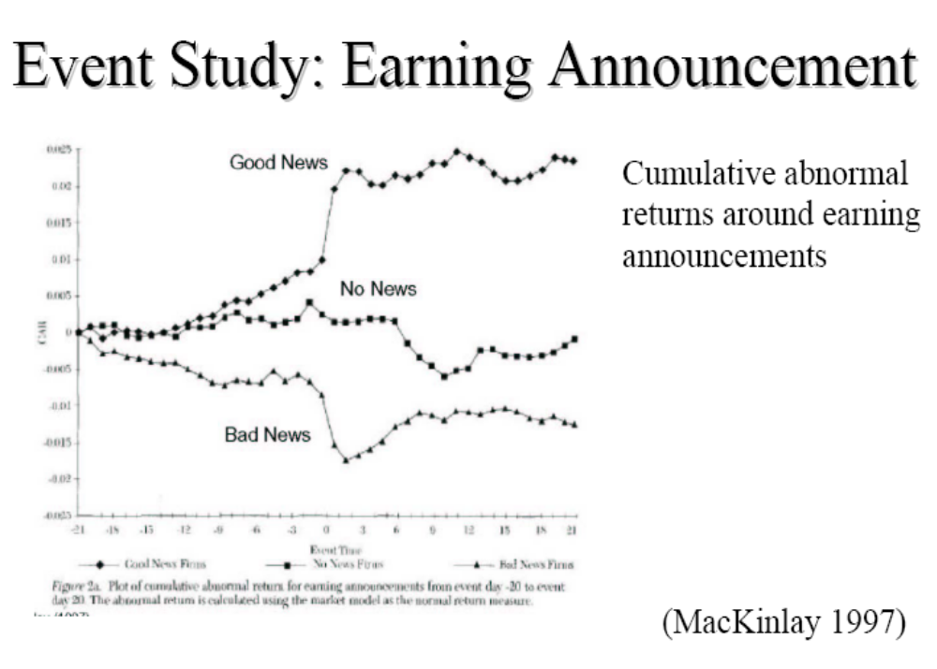

Slide 5
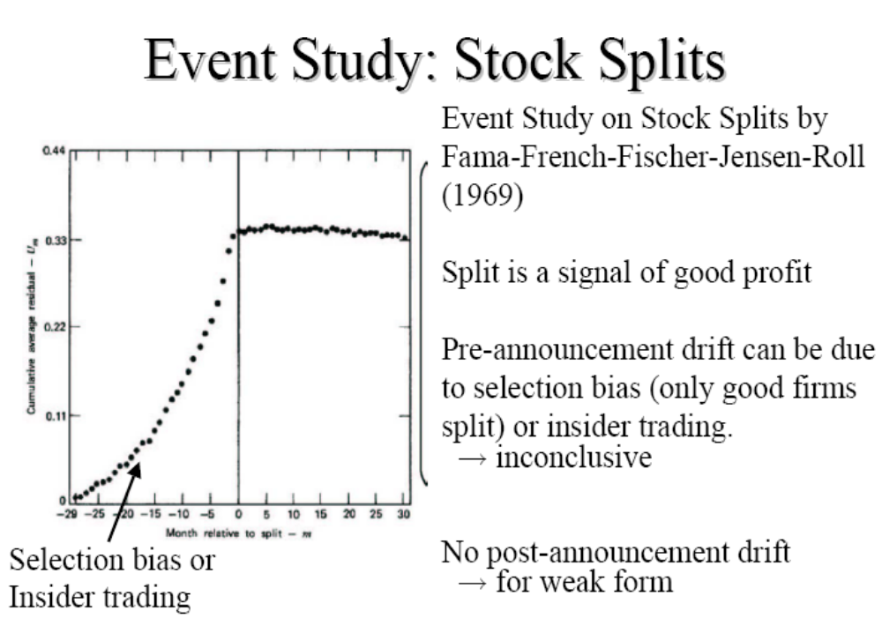

Slide 6
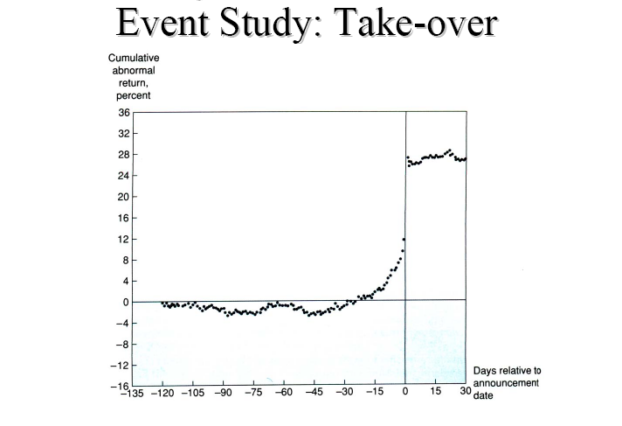

Slide 7
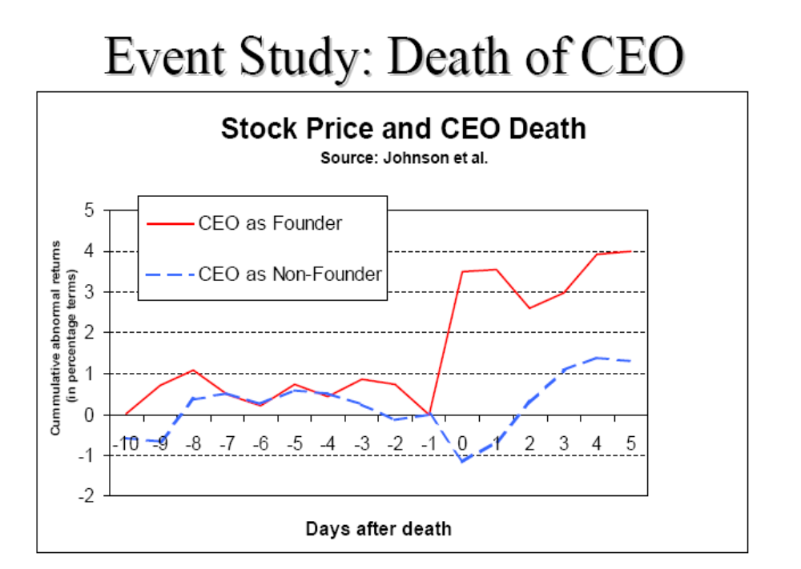

Slide 8
2 outliers:
  Atlas Air Inc: Stock price drops after CEO's death
  McDonald's Reacts To CEO's Death
  Therefore, the studies of Johnson et al (JAE, 1985) , based on 53 sudden CEO deaths (1971-1982) should be examined further.
  Other factors related with the reactions of investors: e.g. talent, entrenchment (CG), take-over candidates, etc.

Slide 9
References
Brown and Warner (1980), JFE, 205-258.
Brown and Warner (1985), JFE, 3-31.
Kothari and Warner (2004), WP.
Boehmer, et al (1991), JFE, 253-272.
Patell (1976), JAR, 246-276.
Kothari (2001), JAE, 105-231.

Slide 10
Fama et al.(1969) conducted the first event study in financial economics. Event studies are joint tests of market efficiency and the model of expected rates of return used in estimating abnormal returns. Fama et al.’s research design innovation permits researchers to align sample firms in event time and to then examine their security price performance before, during, and after economic events such as stock splits (Fama et al., 1969) and earnings announcements (Ball and Brown, 1968; Beaver, 1968).

Slide 11
Publications
According to the census of event studies published in 8 leading journals (1969-2005): Journal of Business (JB), Journal of Finance (JF), Journal of Financial Economics (JFE), Review of Financial Studies (RFS), Accounting Review (AR), Journal of Accounting & Economics (JAE), Journal of Accounting Research (JAR), and Review of Accounting Studies (RAS), the number of published event studies exceeds 800, and the literature continues to grow. Since many academic and practitioner-oriented journals are excluded, these figures provide a lower bound on the size of the literature.

Slide 12
What’s Event Study
A study of the relationship between a particular event or class of events and the response of a variable of interest. For example, a researcher may be interested in the relationship between company stock repurchases and stock returns. The researcher measures the returns in the period prior to and after the day a stock repurchase is announced for a sample of securities. Although the dates of the stock repurchase announcements differ across time, the pre-event and post-event periods are uniform in relation to the event. The researcher tests to see if the average returns in the pre-event and post-event periods are significantly different from each other.

Slide 13
Fundamental:
  If we assume that market is rational, the impact of a related event will be immediately reflected in the price of the securities.
  Thus, the economic impact of an event can be measured using a relatively short-term observed stock price.

Slide 14
Steps:
1. Event definition
Identify the events to be studied
Identify the period of the event - the event window.

Slide 15
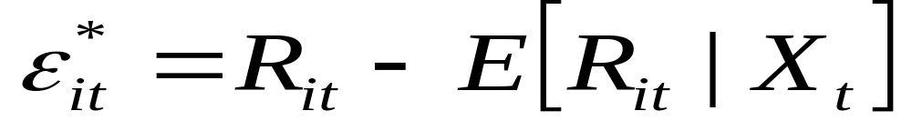
2. Define normal and abnormal returns
  Normal income refers to the expected return that does not occur under the condition of the event.
  Abnormal income is the difference between the actual income of the securities prior to or after the event and the normal return of the same period during the event.

Slide 16




3. Estimation procedure
  Define estimation window
(estimation window] (event window]
0
  The normal return model is used to estimate the parameters

Slide 17
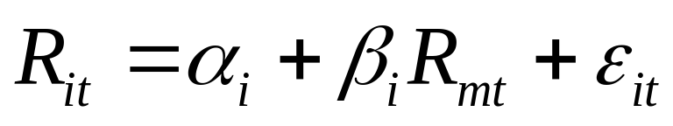
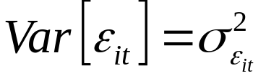
Common normal return models
Market model
  It is assumed that there is a stable linear relationship between market returns and securities returns.
  Advantages: Eliminate the portion of the revenue that is related to the volatility of the market, thereby it reduces the estimated error.

Slide 18
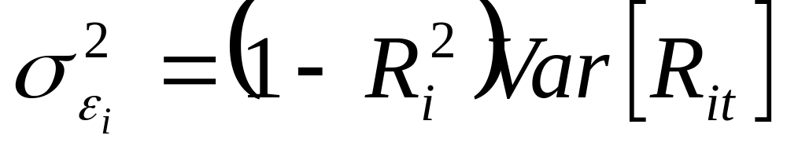
In the market model:

Slide 19
2. Mean-adjusted return model
  The normal return is the average yield of the stock before the period.

Slide 20
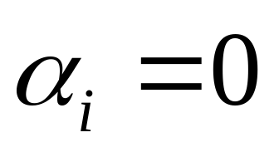
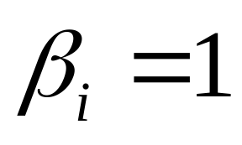
3. market-adjusted return model
  To use the market rate of return as the normal rate of return stocks, that is, in the market model, so that
  The model is applied to situations where the model parameters can not be estimated in advance.

Slide 21
4. Factor model
  One-factor model (e.g. market model)
  Multifactor model
    Fama-French 3 factor: beta, size, BM;
    Carhart 4 factor: beta, size, BM, and Momentum

Slide 22
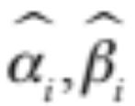
（三 ）Example (Market model)
1. Calculate normal income:
Use OLS from the estimation window
We get:

Slide 23
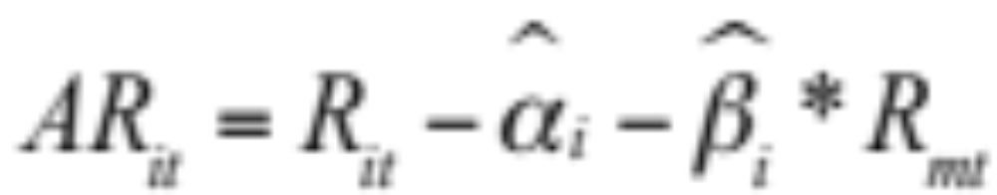
2. Put into the event window, we get the abnormal return (AR):

Slide 24
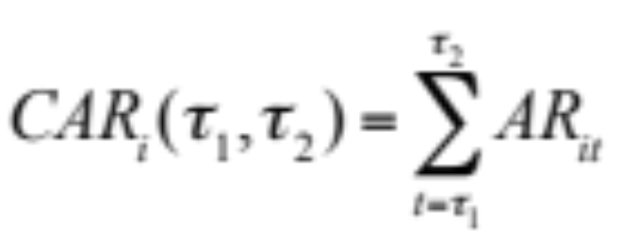
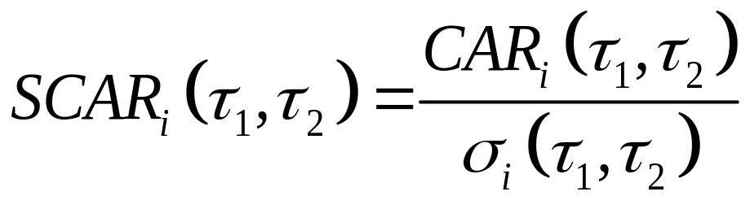
3. Calculate the cumulative abnormal rate of return (CAR) and the normalized rate of abnormal return (SCAR):

Slide 25
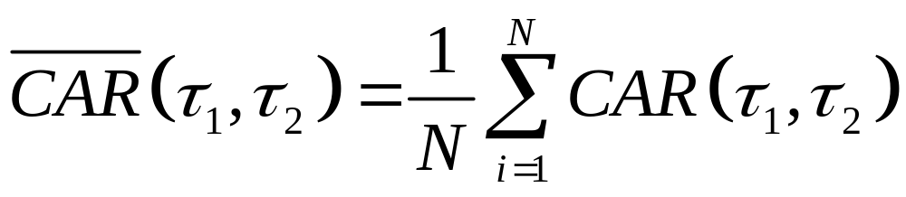

4. _x0016_Calculate the average cumulative abnormal rate of return:

Slide 26
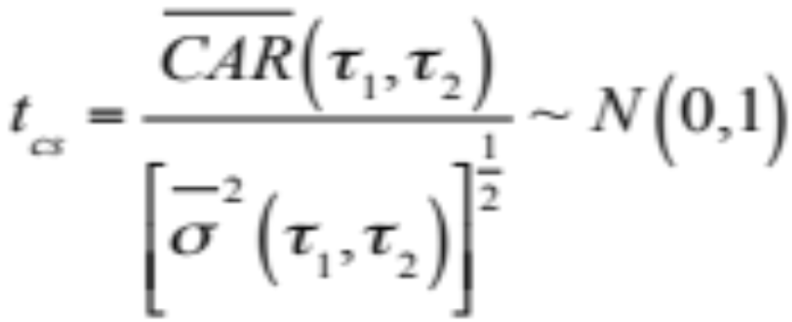
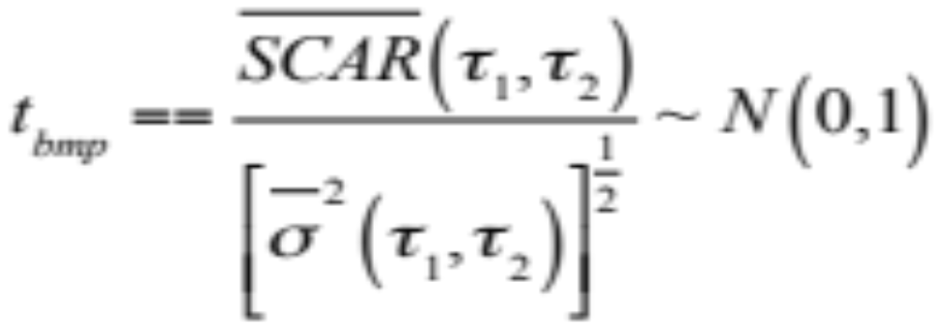
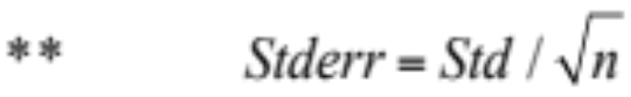
5 Statistics:

Slide 27
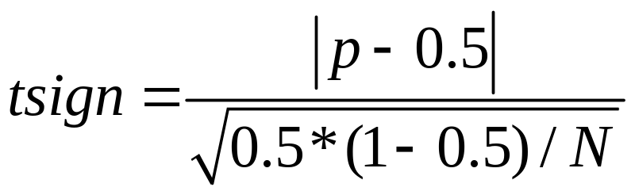
The sign test is a simple binomial test of whether the frequency of positive abnormal residuals equals 50%. The advantage of the sign test is that it takes into account the evidence of skewness in security returns.
The following statistic has an approximate unit normal distribution:
where p is the observed fraction of positive returns computed across stocks in one particular event window.

Slide 28
The choice of statistics
(1) Cross-sectional test: There is no significant difference in the variance that depends on the abnormal returns during the forecast period and during the event window.
(2) Boehmer et al，1991: The variance that allows abnormal returns is different during the forecast period and during the event.
(3) The sign test (Cowan,1992)：Nonparametric test method, independent of the assumption of normal distribution.

Slide 29
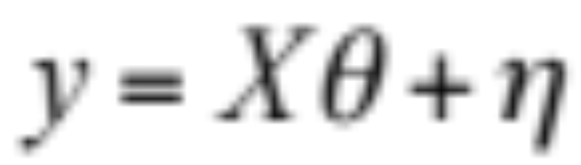
4. Cross-Sectional Models
Cross-sectional analysis is a more detailed study of abnormal returns, that is, through regression analysis of the specific characteristics of each company variables (such as size, profitability, etc.) and the relationship between abnormal income.

Slide 30
Asquith and Mullins (1986) use the abnormal earnings of the additional issuance to do a regression with to the size of the additional issuance (expressed in terms of the ratio of its total additional issuance to the company's total assets) and the accumulated abnormal return with a window of 11 months before the announcement and find that:
  The larger the size of the additional issuance, the greater the negative earnings;
  The greater CAR for the 11 months before the announcement, the smaller the negative abnormal income.

Slide 31
5. Insider trading
Bhattacharya, Daouk, Jorgenson, Kehr (2000) find that four possible causes of event failure:
1. The securities market may be inefficient, or non-semi-strong effective market.
2. The announcement information of the company is irrelevant to the value of the company.
3. Event information has been fully expected.
4. insider trading, the information will only affect the ordinary investors and will not affect the insiders.

Slide 32
Through the analysis of incident on the company's announcement in the Mexican securities market, it found that the securities prices in the A-share market failed to respond to the company's announcement information, but the B-share market is not. It may mean that the internal transactions on the A-share market has reflected the information in the securities before the announcement and because of the existence of transaction costs, A shares and B-share market can not arbitrage the differences.

Slide 33
Comments:
  The analysis of the article rejected the first three reasons, but because there may be other reasons for the failure of the event study, so the article is not satisfactory.
  Since the internal transaction reflected the announcement information in the securities price before the announcement date, the event date should be shifted to an earlier date to analyze the price fluctuations caused by internal transactions, but the article did not analyze this.

Slide 34
6. The Application of Event Study
The application areas of event research include:
1. The financial aspects of the company: such as the wealth effect of mergers and acquisitions, the price effect of corporate finance decision-making, and the information effect of earnings announcement.
2. Economic and legal areas: as the principle of professional judgment of the the United States High Court accepted in the insider trading case, and as reference method to determine the level of compensation in a securities fraud.
3. Macroeconomic regulation and control: such as the impact of changes in the regulatory environment on the value of the company.

Slide 35
Related literature:
1. Halpern (1983):
  This paper studies the event study method used in the study of acquisition.
2. El-Gazzar (1998):
  The results show that the higher the proportion of institutional investors, the more financial analysts follow up, the weaker the information effect of earnings announcement.

Slide 36
3.El-Gazzar, et al (2003) examine the information content of earnings releases under two economic conditions facing the airline industry: regulation and deregulation (i.e., competition). They hypothesize that in a deregulated environment, there is greater competition, causing more risk and uncertainty for the investor in setting security prices. Therefore, earnings’ releases provide more useful information in resolving uncertainties and in formulating and revising the investor’s beliefs regarding future earnings in deregulated than in regulated markets.
Three critical event periods are examined: the regulation period (1973 - 1975), the transition period (1976 - 1978), and the deregulation period (1979 - 1981). The results indicate that earnings announcements have information contents in both conditions. However, the market revaluation to earnings releases is greater in a deregulated (competitive) period than in a regulated one. The findings have direct implications for the level of disclosure in a given market structure. Since financial reporting is a costly process, it becomes important to identify the circumstances under which the level of financial disclosure should be expanded or reduced.

Slide 37
4.Steiner，Volker(2001)：Studied the relationship between changes in European bond prices and Standard & Poor's announcement on credit ratings, and found that:
(1) When the credit rating drops, the bond price will be significantly changed; and credit rating rose, there is no significant effect of the announcement.
(2) In particular, when the credit rating drops to a speculative grade, the price change is particularly pronounced.

Slide 38
5. Manuel, Pilotte(1996)：This paper analyzes the impact of the previous stock segmentation on the yield, and predicts the impact of the stock segmentation on the yield.
  The results show that the impact of the previous event on the yield can be used to predict the similar event again.
  The forecast of changes of return should not only consider the stock segmentation itself, but also consider the change of return after the previous stock split.
  In addition to stock segmentation, the methods used in this article can also be applied to analyze the effects of events such as dividend, stock repurchase, or right claims announcement.

