Slide 1
Corporate governance, chief executive officer compensation, and firm performance
刘铭锋 17721004

Slide 2
Abstract
The purpose of this paper is to examine whether there is an association between the level of CEO compensation and the quality of firms’ corporate governance, and whether firms with weaker governance structures have poorer future performance.

Slide 3
Contents
1
Literature review
2
Methodological approach, sample, and variable descriptions
3
Results – the level of CEO compensation
4
Excess CEO compensation and subsequent firm performance
5
Sensitivity tests
6
Conclusions

Slide 4
1
Literature review
1.Some literatures about structure of boards of directors
①Board members may be unwilling to take positions adversarial to the CEO, especially concerning the CEO’s compensation
②Boards usually rely on the compensation consultants hired by the CEO, and this may lead to compensation contracts that have been optimized not for the firm, but for the CEO.
2. There have been relatively few studies of the relation between ownership structure and the level of CEO compensation
3. Other studies have examined the association between ownership structure and firm performance and value.

Slide 5
1
Literature review
Overall, the impact of board and ownership structure on executive pay and firm performance is unclear given the mixed nature of the empirical results. So the author examines the association between executive pay and a comprehensive set of board and ownership structure variables. More importantly, the article estimate the association between subsequent firm performance and the predicted component of compensation arising from the board and ownership structure variables.

Slide 6
2
Methodological approach, sample, and variable descriptions
2.1 Methodological approach
The null hypothesis of this paper is that observed board and ownership structures induce optimal CEO contracting and firm performance.The author use CEO compensation as a metric for assessing the effectiveness of corporate governance because it is a frequent and observable board decision, and has been the subject of much of the debate regarding the effectiveness of boards of directors.
2.2 Sample
The sample consists of 495 observations over a three-year period for 205 publicly traded U.S. firms. And the compensation data were obtained from a major compensation consulting firm. In this study, survey compensation data for CEO will be used.

Slide 7
2
Methodological approach, sample, and variable descriptions
2.3Measurement of the level of CEO compensation
The empirical analysis of CEO compensation is based on three different measures of compensation: total compensation, cash compensation, and salary.

Slide 8
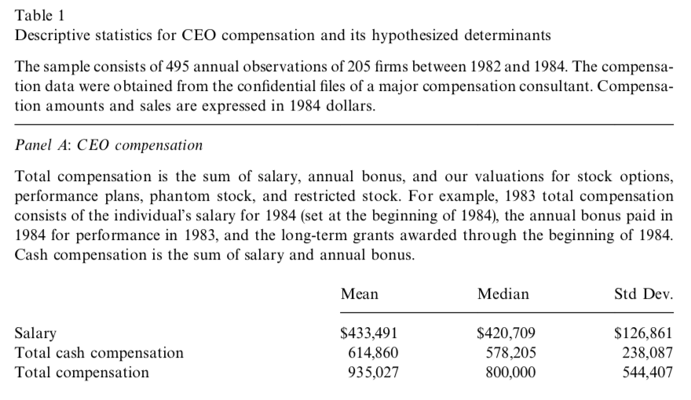
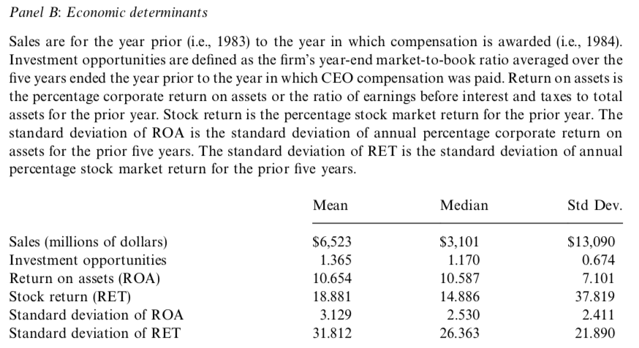

Slide 9
2
Methodological approach, sample, and variable descriptions
2.4Economic determinants of the level of CEO compensation
Author expect that larger firms with greater growth opportunities and more complex operations will demand higher-quality managers with higher equilibrium wages. And they proxy for firm size and complexity with firm sales.
The results of standard agency models suggest that the level of pay is an increasing function of firm performance.

Slide 10
2
Methodological approach, sample, and variable descriptions
2.5 Board of director and ownership variables
Article proxies for the effectiveness of monitoring by the board of directors by using eight measures that characterize the composition of the board.
We expect that outside directors who have been appointed by the CEO, who are `gray', or who are interlocked are less independent of the CEO and less effective monitors.
Outside directors may become less effective as they grow older or serve on `too many' boards.

Slide 11
3
Results – the level of CEO compensation
The association between the level of CEO compensation and the firm's demand for a high-quality CEO, prior firm performance, firm risk, and the board and ownership structure, is examined using a cross-sectional multiple regression. The regression equation includes as a dependent variable one of the three measures of CEO compensation.

Slide 12
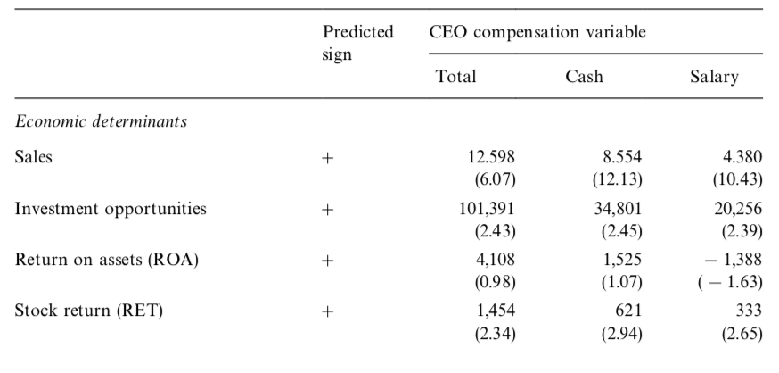
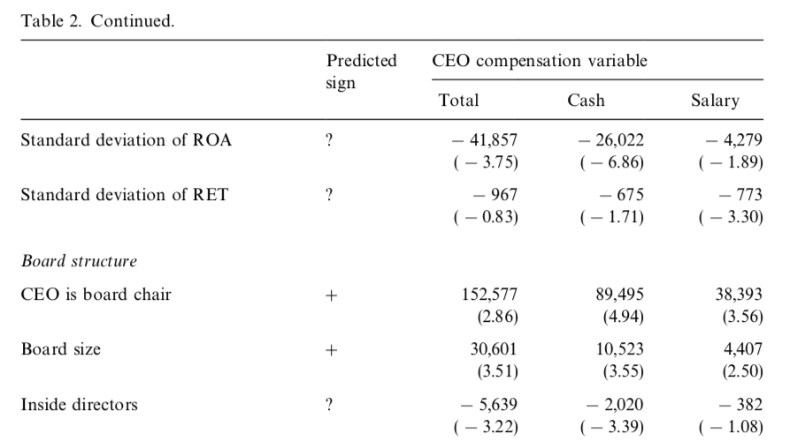
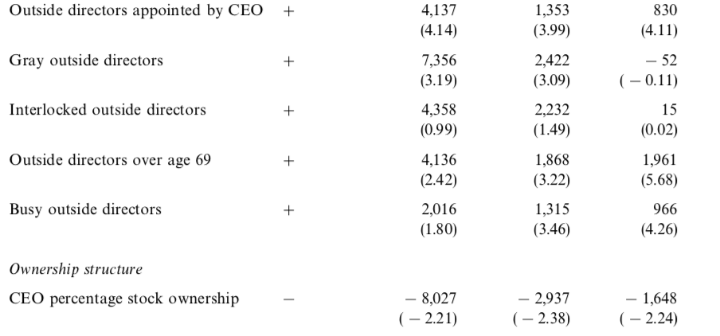
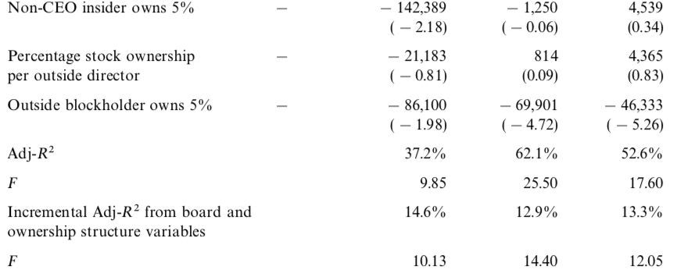

Slide 13
3
Results – the level of CEO compensation
CEO compensation is cross sectionally related to firm size, investment opportunities, prior performance, and firm risk. Larger firms and firms with higher investment opportunities pay higher CEO compensation, which we interpret as reflecting their demand for higher-quality managerial talent.

Slide 14
3
Results – the level of CEO compensation
1.Total compensation has a significant negative association with the percentage of inside directors on the board.
2.Less independent outside directors are associated with greater CEO compensation.
3.Support the reform advocates' arguments for mandatory retirement ages or term limits, and the argument that directors are less effective when they serve on too many other boards.
4.The signs of the coefficients on the ownership structure variables are also consistent with the interpretation that less effective governance structures are associated with increases in CEO compensation.

Slide 15
4
Excess CEO compensation and subsequent firm performance
Compute the following linear combination for each CEO:
Overall, the predictable component of compensation due to board and ownership structure variables exhibits a significant negative association with subsequent firm operating and stock market performance.

Slide 16
5
Sensitivity tests
Test the sensitivity of the results to a number of alternative specifications:
inclusion of mix of compensation as an economic determinant of CEO pay;
averaging individual firm observations;
using log-transformed CEO compensation and sales.
These sensitivity results, which are obtained by observing Averaging individual firm and Using log-transformed CEO compensation and sales, reinforce the findings that the board and ownership variables measure managerial entrenchment. Given uncertainty about whether the performance effects of the governance structure would be fully impounded in the level of stock price, it is not surprising that predictions of subsequent stock market performance with board and ownership structure are less robust to alternative specifications.

Slide 17
5
Conclusions
Firms with weaker governance structures have greater agency problems; that CEOs at firms with greater agency problems extract greater compensation; and that firms with greater agency problems perform worse

