Slide 1
Corporate social responsibility and cost stickiness
陈耿飞
16720821

Slide 2
Basic Information
Title: “Corporate social responsibility and cost stickiness”
Author: Ahsan Habib, Mostafa Monzur Hasan
Publisher: Business & Society
Year: 2016

Slide 3
CONTENT
01
02
03
Abstract
Introduction
Literature review and hypotheses development
04
05
06
Research design
Multiple regression results
Conclusion

Slide 4

Part1
Abstract

Slide 5
Part One Abstract
Abstract
This paper examines the effects on cost stickiness of firms⁵ involvement in corporate social responsibility (CSR) activities. Cost stickiness represents asymmetric cost behavior whereby the magnitude of cost increases in response to an increase in activity level is greater than the magnitude of cost decreases with a decrease in activity level. They hypothesize that CSR involvement requires ongoing investments in value-creating activities that may involve significant downward adjustment costs during periods of revenue shocks, giving rise to cost stickiness. They use two different CSR proxies and find support for our hypothesis. They further decompose CSR into strategic and tactical CSR and find that cost stickiness is more pronounced for strategic CSR. Finally, they examine the CSR-related cost behavior pattern during economic recession and find that costs stickiness is associated with strategic CSR decrease.

Slide 6
Part2
Introduction

Slide 7
Part Two Introduction
1
They examine the effect of firms’ CSR involvement on cost stickiness, where “…costs are sticky if the magnitude of the increase in costs associated with an increase in volume is greater than the magnitude of the decrease in costs associated with an equivalent decrease in volume” (Anderson, Banker, & Janakiraman, 2003, p. 48).
2
They examine a hitherto unexplored determinant of cost stickiness: firms’involvement in CSR activities. They argue that investment in CSR is costly, owing to the managerial resource commitment decisions arising from stakeholder demand for CSR activities.

Slide 8
Part Two Introduction
3
They use firm-level CSR scores from Kinder, Lydenberg, Domin Research & Analytics (KLD) database. Although KLD does not provide the actual dollar investments associated with CSR activities, KLD derive their scoring after careful evaluation of firm-level CSR activities.
They use a number of CSR proxies including strategic and tactical CSR (Bansal et al. 2015), and find that CSR investments, on average, exhibit cost stickiness that is more pronounced for strategic CSR than for tactical CSR. They also evidence variation in cost stickiness related to CSR investments across environmentally sensitive versus other industries. They then include economic recession as a contextual variable and fail to find cost stickiness across CSR proxies, suggesting that economic recession has a profound effect on managerial deliberate resource adjustment decisions for CSR activities, including strategic CSRs.
3

Slide 9
Part3
Literature review and hypotheses development

Slide 10
Part Three Literature review and hypotheses development
The conventional model of cost accounting, as well as activity-based costing, posits that costs are proportional to the cost drivers (Noreen, 1991). However, subsequent research has found a more complex relationship between cost and activities, whereby some costs rise more when activity increases but do not fall proportionately with a decrease in activity (Cooper & Kaplan, 1998). The theoretical perspective on cost stickiness relies on the notion that many costs, including investments on CSR-related activities，arise from managers’ deliberate resource commitment decisions, whereby the adjustment costs associated with changing resource commitments in response to a decline in activity make costs ‘sticky’ (e.g.，Anderson et al.， 2003).

Slide 11
Part Three Literature review and hypotheses development
Therefore, to the extent that managers recognize the tradeoffs that arise because of adjustment costs, they will reduce CSR investments to a lesser extent when activity decreases than they will expand CSR investments when activity increases, generating cost stickiness (Anderson et al., 2003; Banker et al., 2013). The following hypothesis tests this proposition:
H1: Costs-related to CSR activities are sticky in nature.

Slide 12
Part Three Literature review and hypotheses development
They expect the above hypothesis to be more pronounced for companies demonstrating socially responsible behavior (positive CSR involvement). The rationale for this stems from the fact that firms that demonstrate socially responsible behaviour also invest more on CSR activities, e.g., ongoing investments in R&D for pollution reduction, investments in carbon emissions, investment in products that promote the efficient use of energy, and maintenance of property, plant, and equipment with above average environmental performance for the particular industry. All these initiatives reflect managers5 deliberate resource adjustment decisions, and entail long-term committed costs that and cannot be adjusted downwards easily in the event of revenue shocks.

Slide 13
Part Three Literature review and hypotheses development
However, recent studies have observed that both positive and negative CSR activities sometimes occur simultaneously (Muller & Kraussl, 2011). Tang, Qian, Chen, & Shen (2015, p.1342) observe that “A firm that engages more in socially responsible activities does not necessarily participate in fewer socially irresponsible ones, despite the fact that engagement in socially irresponsible activities is more likely to attract the attention of observers”. The positive aspect of CSR increases corporate investments and associated expenses (e.g., increased training costs; expenses on R&D for developing environment-friendly equipment), giving rise to cost stickiness. The negative CSR, on the other hand, can be considered as a cost-saving strategy at the cost of reduced stakeholder value (Kotchen & Moon, 2012), and gives rise to cost anti¬stickiness, (e.g., exploitative labor practices to lower costs). Therefore, they hypothesize the following:
H2: Firms with positive CSR involvement (CSR_STR) will display cost stickiness, but firms with negative CSR involvement (CSR_CON) will exhibit cost anti-stickiness.

Slide 14
Part Three Literature review and hypotheses development
They also examine H2 for the CSR components. Following Bansal et al. (2015), thet categorize CSR into strategic and tactical CSR, whereby strategic CSR is defined as “corporate social activities that require long time horizons, large resource commitments, and significant adjustments to organizational structures” Strategic actions are more difficult to implement and often non-reversible. Tactical CSR, on the other hand, often require fewer resources and shorter implementation times, and are often reversible. Since strategic CSR requires resource commitments and is non-reversible in nature, the concept of cost stickiness is more appropriately linked to this category of CSR rather than to tactical CSR.
They further expect this effect to be more pronounced for firms operating in environmentally sensitive industries (e.g., automobiles, pharmaceuticals, oil & gas).
H2A: Strategic (tactical) CSR will exhibit more (less) cost stickiness.
H2B: Cost stickiness would vary across environmentally sensitive versus other industries.

Slide 15
Part Three Literature review and hypotheses development
Bansal et al. (2015) provides empirical support for this proposition by documenting that managers reduced both tactical and strategic CSR during the recent crisis, but the magnitude was greater for tactical than for strategic CSR. A direct implication of the Bansal et al. (2015) study for cost stickiness is that stickiness will decrease for strategic CSR during economic recession (implying that downward resource adjustment as a response to a decline in sales during recession will be higher compared to a sales decline during expansion periods). Tactical CSR, on the other hand, may be reduced disproportionately more than the corresponding decline in sales during a recessionary period (cost anti stickiness behaviour). The following hypothesis tests this proposition:
H3: Cost stickiness associated with strategic CSR will decrease during recession and tactical CSR exhibits cost anti stickiness.

Slide 16
Part4
Research design

Slide 17
Part Four Research design
Measurement of CSR
They use information from one of the most widely adopted CSR scoring standards, that is, the Kinder, Lydenberg, and Domini Research & Analytics, Inc. (hereby KLD). KLD captures over 94 measurement items along seven social dimensions: community, diversity, employee relations, environment, corporate governance, human rights, and product safety.

Slide 18
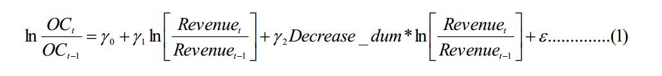
Part Four Research design
Measurement of sticky costs
The following model proposed by Anderson et al. (2003) is used to capture asymmetric cost behaviour:

Slide 19
Part Four Research design
where OC is operating costs. They use two versions of OC. OC1 is operating costs defined as sales revenue minus income before extraordinary items. OC2 is defined as sales revenue minus operating income after depreciation for firm i in year t. Given the qualitatively similar results, they report results based on OC1 only. Decrease_dumt takes the value of one when sales revenues in year t are less than those in year t-1 and zero otherwise. Coefficient γ1 measures the percentage increase in OC costs with a 1 percent increase in sales revenue. The sum of the coefficient (γ1+ γ2) measures the percentage decrease in OC, with a 1 percent decrease in sales revenue. A significantly positive coefficient on γ1 and a significantly negative coefficient on γ2 would confirm cost stickiness.

Slide 20
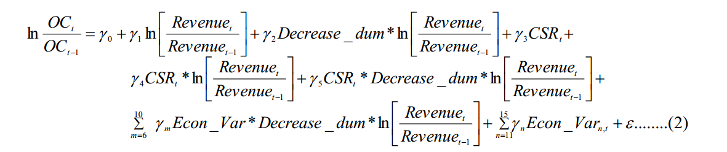
Part Four Research design
Empirical model
They estimate the following comprehensive model that incorporates cost stickiness, CSR effects on cost stickiness, and other determinants unrelated to CSR on cost stickiness (Anderson et al., 2003; Chen, Lu, & Sougiannis, 2012).

Slide 21
Part Four Research design
In the above regression the coefficient on γ2 is our proxy for cost stickiness; CSR is our main variable of interest. They use four different specifications of CSR, net CSR (CSR_NET), industry-adjusted CSR (CSR_IND); CSR strengths (CSR_STR), and CSR concerns (CSR_CON). They also use strategic and tactical CSR scores (defined in 3.1 above). ECON_VAR are economic variables, and include: asset intensity (ASST_INTEN) measured as total assets divided by sales revenue for year t; employee intensity (EMP) is the ratio of total number of employees over sales; successive decrease (SUC_DEC) which is an indicator variable that is equal to 1 if revenue in year t-1 is less than revenue in t-2, and 0 otherwise; stock performance (RETURN) measured as the raw stock return (from Centere for Research in Security Prices (CRSP); and free cash flow (FCF) measured as cash flow from operating activities less common and preferred dividends, scaled by total assets. All these standalone economic variables are interacted with γ2.

Slide 22
Part5
Multiple regression results

Slide 23
Part Five Multiple regression results
CSR involvement and cost stickiness

Slide 24
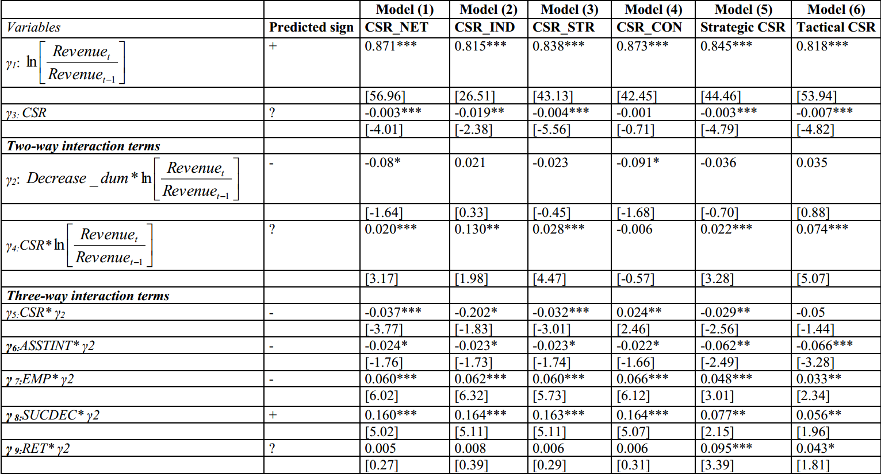

Slide 25
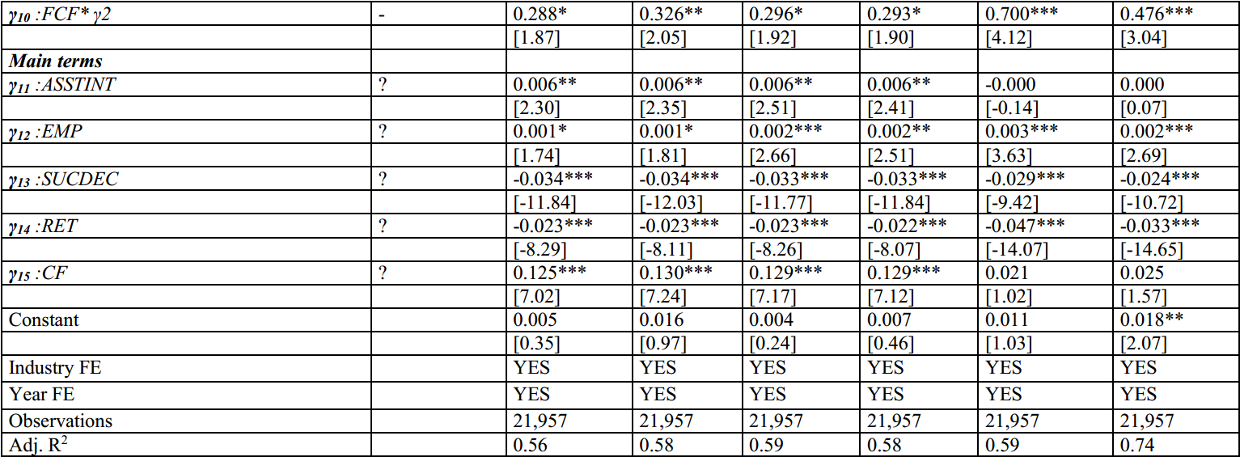

Slide 26
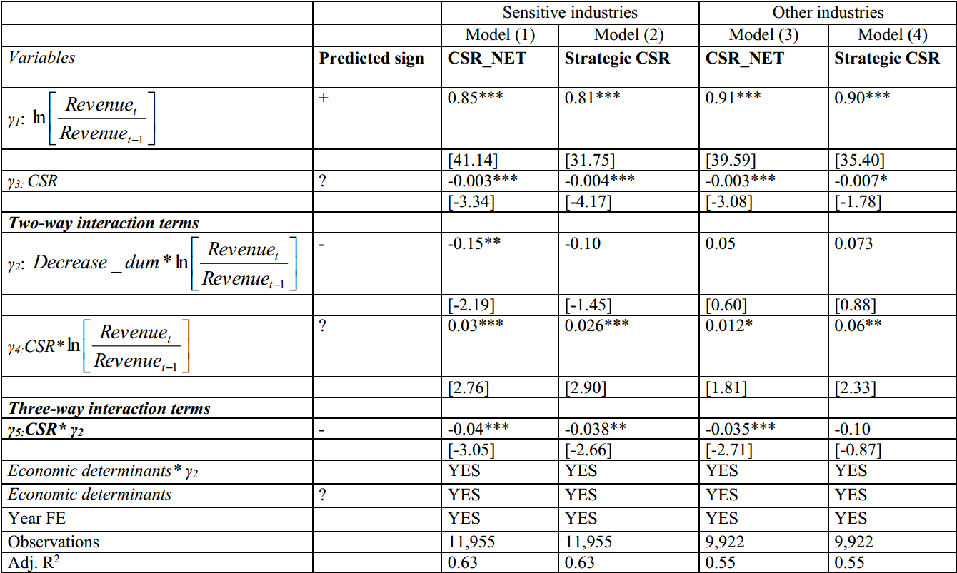

Slide 27
Part6
Conclusion

Slide 28
Part Six Conclusion
A
This paper explores the cost behaviour of CSR activities, and investigates whether firm’s CSR involvement gives rise to cost stickiness.
Their results reveal that firms do not reduce their investment in CSR, even when their activity levels decrease. However, during economic recession, managers need to adjust their trade-off decision and reduce both strategic and tactical CSR, albeit more so for the later than the former type of CSR.
Conclusion
They decompose the CSR scores into strategic versus tactical CSR and find that cost stickiness is more pronounced for the strategic as opposed to tactical CSR.
B
C

Slide 29
THANKS

