Slide 1
The influence of internal corporate governance on bank performance - an empirical analysis for Romania
Vasile Dedu, Gheorghe Chitan
刘颖
16720806

Slide 2
目 录 Contents
1
Introduction
2
Hypothesis
3
Data and the variables
4
Methodology and results
5
Conclusions

Slide 3

1.Introduction
Problems
In the context of banks being essential for a proper functioning of the economic activities, a special attention is allocated to ensuring the stability of the banking system. A major role for ensuring the banks stability is played by the corporative governance (CG).

Slide 4
Contributions
Firstly, the cumulative influence of internal governance framework on bank performance is analyzed, including an internal corporate governance index (ICGI) in this regard.
Secondly, the study completes other studies examining governance over a longer period of time, by adding other variables such as frequency of changes and longevity on positions of the Management body (MB) members MB within the Romanian banking
Thirdly，the study also completes the characteristics of corporate governance which influence risk-taking of banks. Considering that banks within the sample have the same regulator, the results illustrate the effects of regulations at a bank level, our methodology and our findings being indicative in the analysis and the adoption of regulations or for the measures to address the internal governance weaknesses.

Slide 5
2.Hypothesis
Hypothesis 1:
Hypothesis 2:
Hypothesis 3:
ICGI influences negatively ROA, ROE and Z-score.
MB characteristics influences the performance of banks.
Ownership structure influences negatively ROA and Z-score.
Z-score:insolvency risk

Slide 6
3. Data and the variables 3.1. Specification of data and variables
To express the ICG variables, we considered three groups
First group:
express the corporate structure and adopted measures to mitigate risks
Second group:
express the general characteristics of the MB
Third group:
express the ownership structure
Data were collected quarterly from the websites of Romanian banking institutions listed at Bucharest Stock Exchange, for the period 2004-2011, from the financial statements, independent auditor's reports, annual reports, corporate governance codes and reports, reports on transparency and disclosure requirements.

Slide 7
The first group consists of 6 components
1.CSO: its value being the sum of the scoring applying for the three dummy variables used in its determination, respectively: (1) is the organizational structure clear and transparent?; (2) are loans approved at the centralized level?; (3) don't they perform non-standard or non-transparent activities, namely complex derivative activities or under jurisdictions that impede transparency of operations - offshore -?.
2. the committee structure (CS):its value is the sum of the scoring for the next six dummy variables: (1) is there an audit committee?; (2) the members of the audit committee are independent?; (3) is there a remuneration committee?; (4) are members of the remuneration committee independent?; (5) is there a risk committee?; (6) has external auditor been replaced after a maximum of 5 years period?
3. the risk management framework (RM), whose value is determined by summing the scores awarded to the following five dummy variables: (1) are exposure limits on loans established?;(2) are capital requirements for credit risk established?; (3) are capital requirements according to the internal procedures for risk assessment established?; (4) are remuneration policies based on risks established?; (5) are tests for highlighting the extreme conditions (stress tests) performed?.

Slide 8
4.the internal control framework (IC):It includes three dummy variables: (1) an internal control function; (2) a compliance function; (3) an internal audit function.
5.the institutional transparency (T), determined by summing up the scores awarded to the five dummy variables : (1) the financial statements, (2) the capital structure, the MB members and committees, (3) the structure of incentives/remuneration, (4) the risk management policies and (5) the internal governance policy.
6.the internal corporate governance index (ICGI), which expresses the corporative structure and the measures adopted in order to mitigate risks.

Slide 9
The second group includes nine variables indicating the characteristics of the MB.
1. BS:represents the number of members of the MB.
2. BI:expresses the proportion of independent members in the total number of MB members.
3.PRV:signifies the proportion of members of other nationality than Romanian in the total number of the MB members.
4.GEN:represents the number of men within MB.
5.DwFB:represents the proportion of members with experience in the banking and insurance sectors including the academic economical environment in the total number of MB members.
6.OUT:means the proportion of the non-executive members in the total number of the MB members.
7.DwHS:represents the proportion of members holding shares in the total number of the MB members.
8.DUR: represents the average length in service of the MB members expressed in years of service at the end of each period, calculated as simple arithmetic average between the cumulative length in service of all the existing members and their number.
9.CNG:a dummy variable that illustrates if the MB members were not removed from their service to periods of 1 year length or function have not been occupied all through the period observed (CNG).

Slide 10
The third group includes two variables indicating the characteristics of the MB.
1.FRGN:represented by the foreign ownership proportion , calculated as the ratio of foreign capital in the total capital
2.MS:major shareholder share (MS), which indicates the proportion of the capital held by the main shareholder.

Slide 11
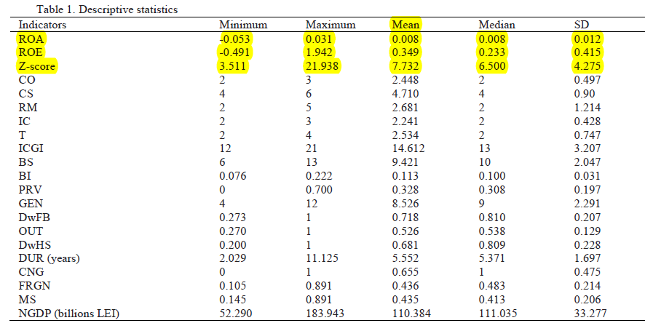
3.2 Descriptive statistics
The descriptive statistics of the value of the variables used are presented in table 1.
For all the variables, the values of the mean and of the median are relatively close, revealing the decrease of sample heterogeneity. The average value of ROA is 0.8%, ROE is 34.9% and Z-score is 7.73. Value of standard deviation (SD) of the variable Z-score indicates mainly a higher dynamic of assets than that of capital,respectively due to debts.

Slide 12
4.Methodology and results
Our empirical approach uses a mixture of time series and cross-sectional data for this research.
To emphasize the dependence between the variables expressing Bank Performance (dependent variables) and those expressing the internal corporate governance (independent variables), we used multiple regression models presented below:
Yijt=αj+β*ICGIjt+θk*Fjt+γn*Ojt+m*ln(NGDP)+aj+ujt

Slide 13
Yijt is the vector of dependent variables, i being in turn, ROA, ROE and ln(Z-score);
αj is the intercept term;
β is the coefficient of the ICGI
θk is the coefficient of the characteristics of the MB
variable (Fjt); γn is the coefficient of the the ownership structure variable (Ojt); m is the coefficient of the NGDP variable;
aj is the unnoticed effect of unit j; ujt is the error term;
t = is the time period and j is cross-sectional observation unit

Slide 14
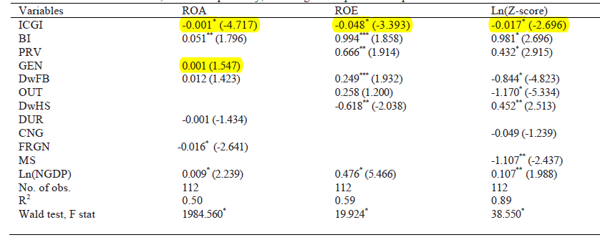
Table 2 reports the results from regressions of ROA, ROE and ln(Z-score).

Slide 15
5. Conclusions
The results of the study illustrates that the aggregate influence of internal corporate governance components is negative as regards to ROA, ROE and Z-score, highlighting the need for relaxation duringthe economic recession periods and tightening during the economic growths.
Regarding the characteristics of the board members, the findings support the idea of increasing the number of members of other nationalities (PRV) and those independents (BI), which should be allowed to make independent and objective decisions. DwHS has also a cautious influence on risk taking. Negative influence on the performance of CNG and DUR support EBA recommendation regarding the existence of a clear policy on the appointment, retention and succession of the MB members. DwFB positive influence on financial performance supports the requirement to include more financial experts in the constituency of the MB, but conditioned to remedy the business behaviour regarding the risks exposure. This recommendation also applies to OUT and to ownership.
Overall, the results illustrate the importance of the internal corporate governance within banks, whose quality influences the normal course of operations and the financial stability.

Slide 16



