Slide 1
Specialist CEOs and IPO survival
From Dimitrios Gounopoulos, Hang Pham, 2017, Journal of Corporate Finance
16720773 徐显丽

Slide 2
Abstract
Research content: it examines the influence of specialist CEOs on the probability of failure and survivability of initial public offering (IPO) firms.
Generalist skills index based on CEOs’ past employment history
Specialist CEOs: pursue a career in particular functional roles, firms and industry sectors
Generalist CEOs: who accumulate their work experience through various positions, firms and industries
Findings: IPO firms with a specialist CEO have a lower probability of failure and a longer time to survive in subsequent periods following the offering

Slide 3
Specialist managerial ability has significant implications for post-issue performance of newly listed firms. Additionally, specialist CEOs may have incentives that are more aligned with those of the firm and its shareholders; thus, they are more likely to enhance the viability of IPO firms for a longer period of time.

Slide 4
Introduction
The extant empirical evidence: although IPO firms often offer substantial initial returns, they show poor long-run performance with around 30% of firms either failing or being acquired in five years subsequent to the offering. (Ritter (2003), Ritter and Welch (2002), Jenkinson and Ljungqvist (2001), Loughran et al. (1994))
Prior studies : underwriter prestige (Schultz 1993), firm age, firm size, underpricing, IPO activity level, insider ownership, risk factors (Hensler et al. 1997), audit quality (Jain and Martin 2005; Demers and Joos 2007), venture backing (Jain and Kini 2000), board effectiveness (Charitou et al. 2007), and earnings management (Alhadab et al. 2014).
However, little has been known about CEO-level determinants of IPO survival.

Slide 5
Review of Related Literatures
Hambrick & Mason (1984) postulates that managerial background characteristics and experiences can exert an impact on managers’ decisionmaking, and thereby influencing organisational outcomes. Particularly, work experience represents an important background factor and its significant impact on firms’ strategy adoption has been supported by various empirical evidence.
General managerial skills which are more readily transferable across firms and industries, as opposed to specialist managerial skills which are more specific to particular firms and industries, tend to be more desirable in the executive labor market. Firms are more willing to offer higher pay packages to generalist CEOs who acquired general managerial skills through various positions, firms and industries than specialist ones whose career experience is more focused in particular functional roles, firms and industries (Custódio et al. 2013).

Slide 6
Given the growing significance of CEOs in the organisational context, and especially, the increasing preference for CEOs with more general managerial ability, the author question whether there is heterogeneity in the survival profiles following the offering between IPO firms having a generalist CEO and those having a specialist CEO.
They argue that different incentives between generalist and specialist CEOs may explain the differences in their course of actions and decision-making, thereby influencing the failure risk and survivability of issuing firms.

Slide 7
Differences between generalist CEO and specialist CEO
Generalist CEOs: more likely to engage in job-hopping (Giannetti 2011) and more easily get hired due to their prominent presence in executive search databases (Dasgupta and Ding 2010). The higher employability makes their wealth less contingent on the future of the firm that they manage. Moreover, prior studies show the tendency of CEOs with varied career experiences to deviate from current firm strategies (Hambrick et al. 1993), have different risk propensity (Vardaman et al. 2008; Nicholson et al. 2005) and openness to experiences (Zimmerman 2008; Boudreau et al. 2001), and favour experimentation and change (Crossland et al. 2014). Generalist CEOs may also be more inclined to undertake riskier strategies to show the market that they have superior ability. Therefore, generalist CEOs may have more incentives to pursue risky projects without much concern about the consequences of such strategies on long-term viability of the firm.

Slide 8
Specialist CEOs: their future wealth tends to be dependent on the long-term performance of the firm, making them more incentivised to ensure the firm’s longevity. Moreover, Crossland et al. (2014) argue that CEOs with lower career variety tend to prefer stability in strategic decisions. In addition, considerable industry expertise, thorough understanding of the firm, and long-standing relationships with customers and suppliers allow specialist CEOs to develop proper strategic corporate decisions to ensure the survivability of IPO firms.
Therefore, the author expect that firms having a specialist CEO will have a lower probability of failure and a higher survival rate.

Slide 9
Aim: investigate CEOs’ career experience in a wide array of roles, firms, and industry sectors to capture the differences among diverse institutional and occupational contexts.
Following Custódio et al. (2013), construct a generalist skills index : summarizes five features of a CEO’s employment history: the number of positions that the CEO held, the number of firms where the CEO was employed, the number of industries where the CEO worked, whether the CEO used to
be a CEO in a different firm, and whether the CEO had experience in a conglomerate.
If a CEO’s generalist skills index is equal to or above the median of the overall sample, the CEO is categorised as a generalist CEO. Otherwise, the CEO is classified as a specialist CEO.

Slide 10
Sample : U.S. common share IPOs from 1999 to 2009
Findings: IPO firms with a specialist CEO have a lower probability of failure and survive longer in subsequent periods after the offering. Particularly, the failure risk of IPO firms with a specialist CEO is 35% that of firms with a generalist CEO. They also find that professional expertise accumulated from experiences outside the firm is of significant importance for specialist CEOs to be able to enhance the future survivability of IPO firms.

Slide 11
Contributions:
contributes to the financial literature that emphasizes the influence of managerial characteristics on corporate decisions and outcomes, this is the first study to directly investigate the influence of CEOs’ managerial ability on IPO firms' survival profiles.
results suggest that generalist CEOs are not only more costly than specialist CEOs but also associated with a higher probability of failure and a lower survival rate in subsequent periods following the offering.
the study has important implications for IPO firm’s decisions on CEO appointment. Our findings emphasize the importance of CEOs’ specialist managerial experience in ensuring the survivability of IPO issuers.

Slide 12
CEOs’ managerial ability and IPO survival
Upper echelons theory (Hambrick and Mason 1984; Hambrick 2007):
Managerial background characteristics and experiences can influence organisational outcomes.
Along with cognitive abilities, personal traits, and observable demographic backgrounds, functional experience represents an important factor suggested by the upper echelons theory as having crucial implications for managerial decision-making.

Slide 13
Generalist CEOs’ long-term wealth is less dependent on the firm’s future prospects, and may also attempt to signal to the market that they have superior ability by adopting risky strategies. Therefore, generalist CEOs may have more incentives to pursue risky projects without much concern about the consequences of such strategies on long-term viability of the firm.
The lower job mobility across firms and industries makes the future prosperity of specialist CEOs crucially depend on the firm’s performance and viability. Thus, specialist CEOs may have stronger incentives to ensure that the firm remains viable in the longterm as their long-term interests tend to be more closely tied to the firm’s future prospects. Moreover, the long-lasting and on-going involvement in a specific industry and firm equips specialist CEOs with considerable industry expertise, thorough understanding of the firm’s business environment, and established relationships with customers and suppliers.

Slide 14
Therefore, specialist CEOs can make more suitable resource allocation decisions that are best suited for the market conditions of a particular IPO firm and help the firm adjust to various structural changes resulting from going public.
Hypothesis: as opposed to generalist CEOs - will significantly make positive contributions to the survivability of IPO firms, specifically IPO firms with a specialist CEO are more likely to have a lower probability of failure and a longer time to survive in subsequent periods following the offering.

Slide 15
Sample and Data
Sample construction: U.S. common share IPOs from 1st January 1999 to 31st December 2009 from the Securities Data Corporation’s (SDC) New Issues database .
Some restrictions : (1) The offer price is at least five dollars a share,
(2) The IPO is not a spin-off, a privatisation, an American depositary receipt (ADR), a leveraged buyout (LBO), a real estate investment trust (REIT), a unit offering, a rights issue, a limited partnership, a closed-end fund, and a financial institution;
(3) For each firm, data are available on Compustat and the Center for Research in Security Prices (CRSP).

Slide 16
Obtain financial data from :Compustat, stock prices and delisting information from CRSP, gather biographical profiles of CEOs from BoardEx in order to extract CEO characteristics and work experience. They also complement dataset with information on share ownership and executive compensation manually collected from S-1 filings available on Securities and Exchange Commission (SEC)’s EDGAR database. After merging the databases and eliminating observations with missing values, final sample consists of 722 IPO firms.

Slide 17
Based on the CRSP delisting codes, they categorize IPO firms into three groups: survived, acquired, and failed firms. All firms that are still trading (i.e., code of 100) at the end of 2014 are classified as survived firms. Acquired firms are those having the delisting code from 200 to 299, which indicates that the
firm was acquired in mergers. Thus, failed firms include those whose delisting code is greater than or equal 300. Our sample of 722 IPOs is comprised of 462 survived firms, 206 acquired firms, and 54 failed firms.

Slide 18
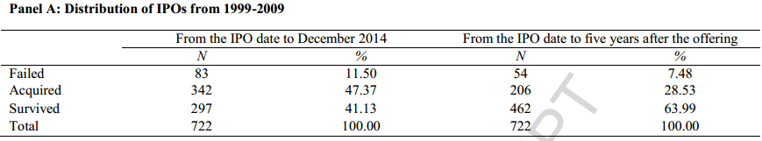
Data description
41% of the firms survived, 47% were acquired, and 12 % failed. Tracking for five years after the issue date, 64% of the firms survived, 29% were acquired, and 7% failed. Consistent with prior literature, the author find that approximately 36% of IPOs either fail or are acquired within five years after the offering.

Slide 19
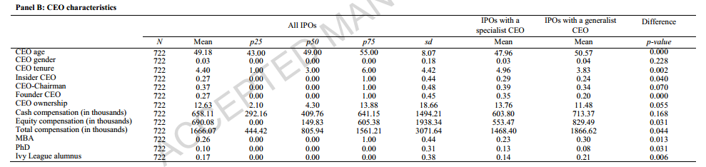
Specialist CEOs are significantly different from generalist CEOs in all the characteristics examined except for gender and cash compensation.

Slide 20
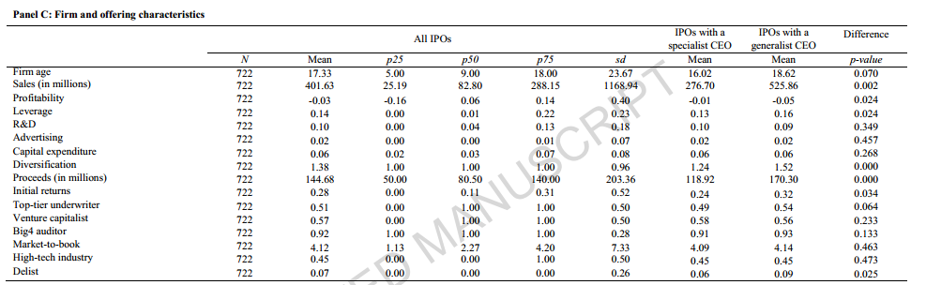
IPO firms are generally young and small with the mean firm age of 17 years and the mean total sales of 402 million dollars. Around half of the IPOs are underwritten by top-tier investment banks, 57% are venture backed, and 92% are audited by big four auditors. Moreover, 45% of firms are in a high-tech industry. With regard to delisting events, on average, 7% of IPO firms are delisted due to negative reasons within 5 years after the offering.

Slide 21
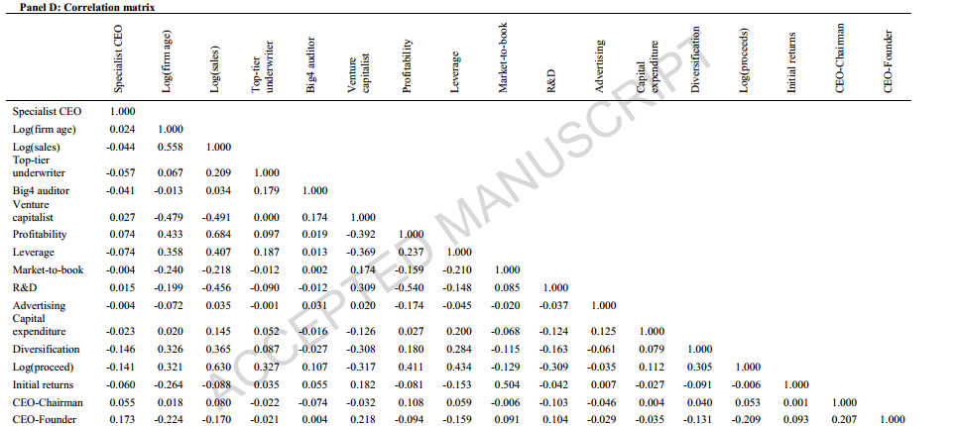
Notably, IPO firms with a specialist CEO is less underpriced than those
with a generalist CEO. This implies that generalist CEOs may have different risk-taking incentives, resulting in a higher agency problem;

Slide 22


Empirical analysis of the impact of specialist CEOs on IPO survival
Survival analysis methodology
If specialist CEOs can reduce the failure risk, the hazard function for IPO firms with a specialist CEO will remain below that of firms with a generalist CEO Estimate the hazard functions for the two groups of IPO firms using the Nelson-Aalen estimator, which is defined as:
If specialist CEOs can enhance the survivability of issuing firms, the survival function curve of firms with a specialist CEO will be above that of firms with a generalist CEO. Estimate the survival functions of the two groups of IPO firms using the Kaplan-Meier estimator, which is defined as:

Slide 23

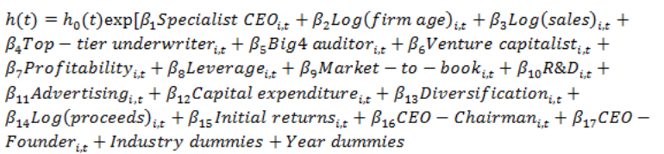
Estimate the survival functions of the two groups of IPO firms using the Kaplan-Meier estimator, which is defined as:
Estimate the model as follow:
The dependent variable indicates the failure risk; The main variable of interest is specialist CEO, which indicates whether the CEO has specialist managerial ability. Besides the indicator variable specialist CEO, for robustness check, we also run the regressions on generalist skills index, and the individual five proxies employed to construct the index, namely, number of roles, number of firms, number of industries, CEO experience dummy and conglomerate experience dummy.

Slide 24
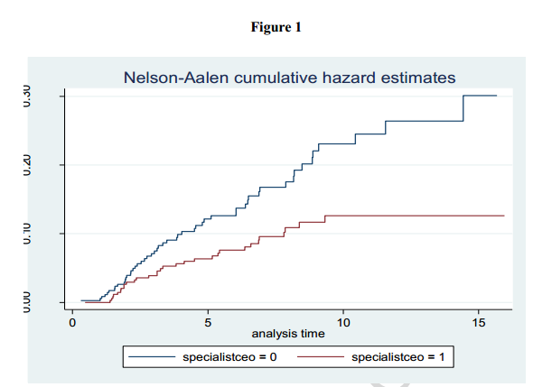
Empirical results
Analysis of the hazard and survival curves:

Slide 25
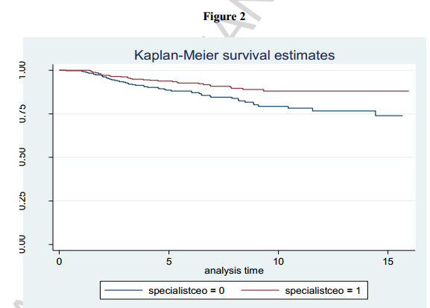

Slide 26
Overall, the plots of hazard and survival functions demonstrate that IPO firms with a specialist CEO have a lower risk profile and a higher survival profile compared to firms with a generalist CEO. The nonparametric approach of the survival analysis provides evidence suggesting that specialist CEOs tend to improve the survival profiles of IPO issuers.

Slide 27
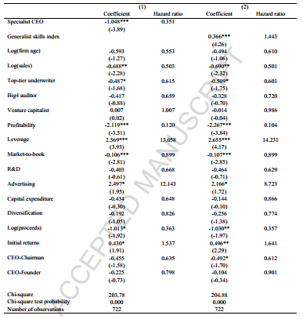
Estimation of the Cox proportional hazards model :
Table 4

Slide 28
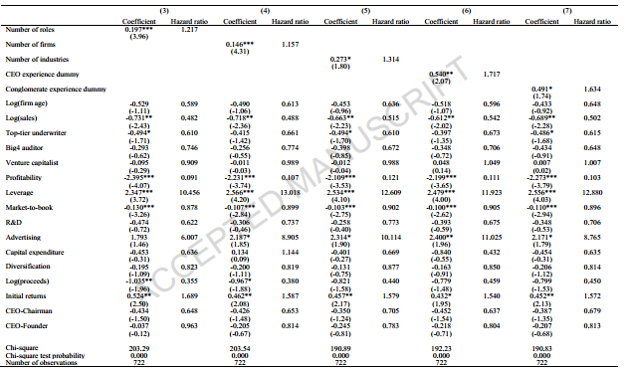

Slide 29
Overall, the results from the Cox proportional hazards model support our hypothesis that IPO firms with a specialist CEO have a lower probability of failure and a longer time to survive in subsequent periods following the offering.

Slide 30
Robustness checks
Controlling for high-tech industries and crisis periods:
The influence of specialist CEOs on IPO survival is not significantly different when the firm is in a high-tech industry.
Controlling for CEO power: The result is still valid
Controlling for endogeneity problem :
Check whether the influence of specialist CEOs on IPO survival is driven by CEO characteristics other than past work experience. specialisOs significantly reduce IPO failure risks after controlling for the impact of observabt CEle CEO characteristics.

Slide 31
Conclusion
Based on the generalist skills index, we categorize CEOs into specialists and generalists. Specialist CEOs possess focused experience in a particular functional area, firm, and industry. Thorough understanding of the firm and its market environment, as well as more aligned incentives with those of the firm make specialist CEOs more capable and motivated to enhance the viability of IPO firms for longer in the future.
Employing the survival analysis, we find that IPO firms with a specialist CEO have a lower probability of failure and a longer time to survive. Particularly, the failure risk of IPO firms with a specialist CEO is 35% that of firms with a generalist CEO.

Slide 32
Furthermore, We also examine the impacts of CEOs possessing specialist-generalist versus founder-professional attributes and those having specialist-generalist versus insider-outsider attributes on the future survivability of IPO firms. The findings indicate that CEOs who possess a combination of specialist and professional skills and a combination of specialist and outside experiences can significantly enhance the survival profiles of IPO firms.

Slide 33
My Comments
There is no doubt that the research Angle of the paper is new, but the research is too one-sided. Not only the CEOs characteristics can affect the company's financial decision-making, but the actual controllers background may also affect the company's financial decision. Therefore, study the CEOs characteristics influence on IPO companies under the different background of actual controllers would be better.

