Slide 1
Do Earnings Targets and Managerial
Incentives Affect Sticky Costs?
杨炳昕
16720820

Slide 2
Papers brief introduction
1. topic
Do Earnings Targets and ManagerialIncentives Affect Sticky Costs?
添文本
2. Author
Itaykama、Dan .Weyiss
添加文本
3. source
添加文本
添加文本
Journal of Accounting Research

Slide 3
Abstract

Slide 4
Abstract
This study explores motivations underlying managers’ resource adjustments.It focus on the impact of incentives to meet earnings targets on resource ad-justments and the ensuing cost structures. they find that, when managers faceincentives to avoid losses or earnings decreases, or to meet financial analysts’earnings forecasts, they expedite downward adjustment of slack resources forsales decreases. These deliberate decisions lessen the degree of cost stickinessrather than induce cost stickiness.
The results suggest that efforts to under-stand determinants of firms’ cost structures should be made in light of themanagers’ motivations, particularly agency-driven incentives underlying re-source adjustment decisions.

Slide 5
Introduction

Slide 6
Introduction
This study is part of a recently emerging stream of research aiming to ex-pand our understanding of how managerial choices in adjusting resourcesinfluence firms’ cost. It follows Anderson, Banker, and Janaki-
raman, who termed costs as sticky if they de-crease less when sales fall than they increase when sales rise by an equivalentamount, arguing that sticky costs occur “because managers deliberately adjustthe resources committed to activities.” Focusing on deliberate decisions made by self-interested managers, they investigate how resource adjustments made
intentionally to meet earnings targets affect the degree of cost stickiness.

Slide 7
Introduction
they note that any effort to infer the sources of sticky costs should be made
in light of the motivations underlying managers’ resource adjustments. Ignoring the impact of agency considerations on documentations of stickycost behavior may bias the inferences due to an omitted correlated variable problem.
The findings extend the real earnings management literature by documenting how managers adjust resources to meet earnings targets.Therefore, the implications are likely to expand the audience of the cost structure literature beyond management accounting scholars and attractthe attention of financial accountants.

Slide 8
Introduction
In sum, the paper integrates a typical management accounting research topic, cost structures, with animportant financial accounting topic, real earnings management. The importance of integrating these two streams of research has long beenrecognized .
The paper proceeds as follows. The hypotheses are developed in the nextsection. Sections 3 and 4 discuss the sample selection and research design,respectively. Sections 5 and 6 present the empirical results, and section 7summarizes.

Slide 9
Hypothesis Development

Slide 10
Hypothesis Development
Understanding how incentives to meet earnings targets shape firms’ coststructures is of primary interest to accounting researchers. In particular,
choices to cut resources made by self-interested managers have recently
drawn much attention. Banker, Huang, and Natarajan [2011] show a posi-
tive association between grants of equity incentives and increases in input resource spending when input resource expenditures create high future
value.
Their findings suggest that equity incentives influence managers’ de-cisions to adjust resources, but they do not explore the potential impact
of equity incentives on the extent of cost asymmetry

Slide 11
Hypothesis Development
Focusing on agency aspects, Chen, Lu, and Sougiannis [2012] document how empire-buildingincentives affect managers’ cost decisions made in response to exogenousdemand shocks. They show that empire-building managers increase selling,general, and administrative (SG&A) costs rapidly when sales rise and de-crease these costs slowly when sales fall.
That is, empire-building incentivesgenerate cost asymmetry, implying a positive relation between an agencyproblem and the degree of SG&A cost asymmetry.

Slide 12
Hypothesis Development
A vast body of evidence indicates that agency considerations lead man-agers to reduce costs to meet various benchmarks (Dechow and Sloan[1991], Baber, Fairfield, and Haggard [1991], Bushee [1998]). In particu-lar, Graham, Harvey, and Rajgopal [2005], Roychowdhury [2006], Cohen,Dey, and Lys [2008], and Keung, Lin, and Shia [2010] report that managers reduce costs to avoid losses and earnings decreases, or to meet analysts’ forecasts.
However, the influence of cost reductions made intentionally to meet earnings targets on the degree of cost asymmetry has not yet been investigated.When sales fall, unutilized resources are not eliminated unless managers make a deliberate decision to remove them.

Slide 13
Hypothesis Development
Since future demand is stochas-tic, managers evaluate the likelihood that a drop in sales is temporary when deciding whether to cut resources. Cutting slack resources when sales fall is likely to result in the incurring of extra costs to adjust resources down-ward (e.g., costs of firing employees) and to replace those resources if sales are restored in the future (e.g., costs of rehiring new employees).
Therefore, value-maximizing considerations based on the future sales expecta-tions lead managers to maintain unutilized resources when they expect a sales drop to be temporary. Retaining unutilized resources when sales de-cline results in costs that decrease less when sales fall than they increase when sales rise by an equivalent amount; that is, sticky costs (ABJ).

Slide 14
Hypothesis Development
In this paper, they investigate the relationship between resource adjust-ments made intentionally to meet earnings targets and the degree of coststickiness. ABJ argue that, in addition to value-maximizing considerations,managers’ choices to maintain unutilized resources may also be caused by personal interests. These choices result in the form of agency costs, which,in turn, contribute to cost stickiness. Focusing on resources adjustments,they assert that incentives to meet earnings targets lead managers to accel-erate resource cuts to achieve cost savings.
These accelerated cuts of slackresources when sales fall lead to greater cost decreases in the presence ofincentives to meet earnings targets than absent these incentives. For thisreason, they hypothesize that cost stickiness is lessened in the presence of incentives to meet earnings targets.

Slide 15
Hypothesis Development
H1: Resource adjustments made intentionally to meet earnings targets di-
minish cost stickiness.
H2: For a given decrease in sales, managers cut costs more aggressively in
the presence of incentives to meet earnings targets than absent these
incentives.

Slide 16
Research Design

Slide 17
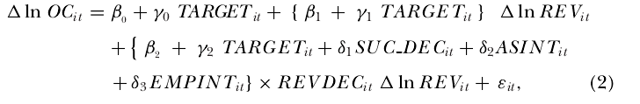
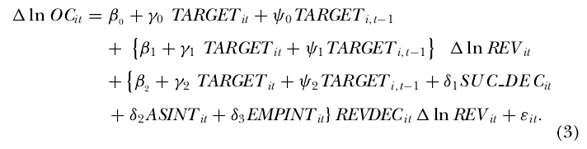
Research Design

Slide 18
Research Design
Indirect Costs
Fees, expenses. personnel
Direct Costs
Consolidated Total Production Cost
Maintenance
Outsoutrcing
…
添文本
Decision Tree
Activity Groups
地位领先，盈利能力下降
产品和服务多样
validation
audits
…
添加文本
NPV Analysis
Work Activities
添加文本
ProductA
ProductB
…
复杂性显著上升
添加文本

Slide 19
Research Design
ACTIVITIES | DISCRETE TASKS | FTE HOURS PER TASK | EXPENSES/FEES | FUNCTION
Technical Maintenance | Annual validation including reports | IFTE x 3 days |  | Manufacturing Science & Technology
 | Troubleshooting onsite | 5 FTEs x 2 days |  | Manufacturing Science & Technology
 | Annual stability testing | 0 | Cost of stability test | Analytical
 | Supplier relations team support | 3 FTEs x 4 days |  | External Supply Operations
Annual audits | cGMP / quality audit | 2 FTEs x 5 days | Travel expenses and fines | Quality Assurance
 | HS&E technical audit and visit | 1 FTE x 5 days | Travel expenses and fines | HS&E
 | Follow up and resolution | 3 FTEs x 2 days |  | Quality Compliance
添文本
地位领先，盈利能力下降
产品和服务多样
添加文本
添加文本
产品结构中不受专利保护的比例较高
复杂性显著上升
添加文本

Slide 20
Sample Selection and Descriptive Statistics

Slide 21
Sample Selection and Descriptive Statistics
The sample includes all public firms covered by Compustat during1979–2006. They use annual data for our tests and our sample choices follow Burgstahler and Dichev [1997], ABJ, Roychowdhury [2006], and Banker,Byzalov, and Plehn-Dujowich [2011]. They exclude financial institutions and public utilities (four-digit SIC codes 6000–6999 and 4900–4999) becausethe structure of their financial statements is incompatible with those ofother companies. The sample includes firm-year observations with positivevalues for sales revenue, total assets, book value, and market value. they alsorequire share price at fiscal year end to be greater than $1 and delete firm-year observations with missing data on two preceding years (t−1, t−2).

Slide 22
Results

Slide 23
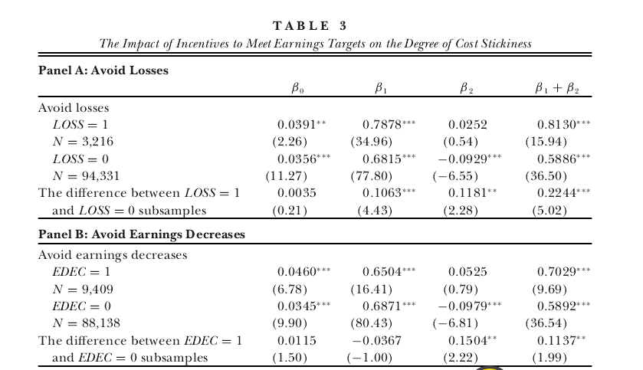
Empirical Results

Slide 24
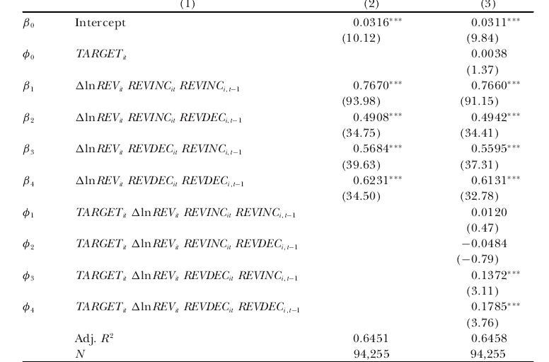
Empirical Results

Slide 25
Summary
In this study, they examine how deliberate choices, motivated by agency-
driven incentives, influence asymmetric cost behavior. they show that delib-
erate managerial choices made to meet earnings targets diminish, rather
than induce, cost stickiness. Our findings suggest that any effort to infer
sources of sticky costs should be made in light of motivations underlying
managers’ resource adjustments. Overall, our results provide useful insightsfor the management and financial accounting literature, and encouragefurther research to enhance our understanding of the role of motivations underlying managers’ decisions in shaping firms’ cost structures.

Slide 26
PPT模板下载：www.1ppt.com/moban/ 行业PPT模板：www.1ppt.com/hangye/
节日PPT模板：www.1ppt.com/jieri/ PPT素材下载：www.1ppt.com/sucai/
PPT背景图片：www.1ppt.com/beijing/ PPT图表下载：www.1ppt.com/tubiao/
优秀PPT下载：www.1ppt.com/xiazai/ PPT教程： www.1ppt.com/potheyrpoint/
Word教程： www.1ppt.com/word/ Excel教程：www.1ppt.com/excel/
资料下载：www.1ppt.com/ziliao/ PPT课件下载：www.1ppt.com/kejian/
范文下载：www.1ppt.com/fantheyn/ 试卷下载：www.1ppt.com/shiti/
教案下载：www.1ppt.com/jiaoan/ PPT论坛：www.1ppt.cn
THANK
YOU

