Slide 1
CEO Overconfidence and International Merger and Acquisition Activity
16720802 康晓鹏

Slide 2
01
Introduction
02
Data and the Measurement of Overconfidence
03
CONTENTS
International Patterns in CEO Overconfidence
04
International Determinants of Overconfidence
05
Cross-Country Influences on CEO
06
Conclusion

Slide 3
01
Introduction

Slide 4
01
Introduction
This study examines the role that chief executive officer (CEO) overconfidence plays in an explanation of international mergers and acquisitions. Overconfidence helps to explain the number of offers made by a CEO, the frequencies of nondiversifying and diversifying acquisitions, and the use of cash to finance a merger deal.Although overconfidence is an international phenomenon, it is most extensively observed in individuals heading firms headquartered in Christian countries that encourage individualism while de-emphasizing long-term orientation in their national cultures.

Slide 5

01
Introduction
In this study, we ask two fundamental research questions concerning overconfidence and international merger activity. The 1st question focuses on whether country or country group patterns exist in the distribution of CEO overconfidence.Comparable legal systems and national cultures or shared standards of business practices might produce similarities in managerial decision making as we examine our sample of international mergers.

Slide 6
01
Introduction
Our 2nd question investigates whether the results reported by Malmendier and Tate (2008) regarding U.S. mergers by overconfident managers hold internationally and focuses on how overconfident managers conduct their mergers. Given significant international differences in the regulation of corporate merger activity and the availability of capital to support acquisitions, it is uncertain whether the results reported for the United States apply to the broader set of global mergers.

Slide 7
01
Introduction
We organize the remainder of this study into 6 sections. Section II describes our data collection and the method of sample construction. We also discuss our process for measuring overconfidence in this section. We present our findings regarding international patterns in CEO overconfidence in Section III. Section IV contains our analysis of the international determinants of overconfidence. The effect of overconfidence on the number of offers, type of merger, and the method of financing is discussed in Section V. In this section, we also examine possible bidirectionality in the relation between press characterizations and merger activity. In Section VI, we examine the extent to which country-level factors might influence the nature of merger and acquisition decisions by overconfident CEOs.Section VII provides a brief summary of our findings and a discussion of their importance to the literature.

Slide 8
02
Data and the Measurement of Overconfidence

Slide 9
02
Data and the Measurement of Overconfidence
A. Data and Sample Construction
Fortune magazine provides an annual ranking of the 500 largest companies in the world based on revenues. We begin our sample selection by compiling these lists during 2000–2006. We select all nonfinancial firms that appear at least once in these lists. We exclude state-owned enterprises. We also identify the country in which our sample firm is headquartered.

Slide 10
02
Data and the Measurement of Overconfidence
B. Measuring Overconfidence
For each CEO of a firm, we record the number of articles related to the firm that refer to the CEO using the terms (a)“confident”or“confidence,”(b)“optimistic”or“optimism,” (c)“notconfident,” (d)“not optimistic,” or (e) “reliable,” “cautious,” “conservative,” “practical,” “frugal,” or “steady.” We the compare the number of articles that portray a CEO as confident and optimistic to the number of articles that portray him as not confident, not optimistic, reliable, cautious, conservative, practical, frugal, or steady. That is,we classify a CEO as overconfident if a + b > c + d + e. We do not classify a CEO with respect to overconfidence if we fail to find any articles that mention the CEO.

Slide 11
03
International Patterns in CEO Overconfidence

Slide 12
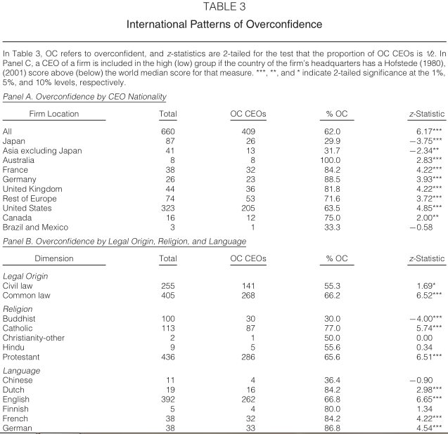
03
研究方法

Slide 13
03
International Patterns in CEO Overconfidence
We examine the ability of national culture to influence CEO overconfidence in another way by analyzing the cultural dimensions in Panel C of Table 3. We observe a high percentage of overconfident CEOs regardless of a country’s power distance. We do find, however, that there are significant differences in the percentage of overconfident CEOs when we consider a country’s preference for uncertainty avoidance, individualism, and long-term orientation. Countries that have a low preference for uncertainty avoidance have cultures that are more accepting of change and capable of taking on more risk. We find that firms headquartered in such countries are more frequently led by overconfident CEOs. It might be that such individuals are more capable of responding to the rapid changes and dynamism of these cultures.

Slide 14
03
International Patterns in CEO Overconfidence
We further find that CEOs of firms headquartered in countries with a high level of individualism are significantly more overconfident than those in low individualism countries.Finally, we observe that CEOs are more overconfident when they lead firms headquartered in countries characterized by a low level of long-term orientation.Such cultures are capable of more rapid change, and long-term traditions are less of a barrier to innovation. Consequently, firms might believe that an overconfident CEO with the ability to make quick decisions and remain committed provides the best leadership in such an environment.

Slide 15
03
International Patterns in CEO Overconfidence
We conclude from Table3 that there are significant differences in the national origin of overconfident CEOs. Most typically, overconfident CEOs originate from Europe and North America. Countries on these continents have English or other European languages as their official language and are Christian in their religious heritage. Overconfident CEOs are also more likely to be found in firms headquartered in countries with a high level of individualism, a low level of uncertainty avoidance, and a short-term orientation.

Slide 16
04
International Determinants of Overconfidence

Slide 17
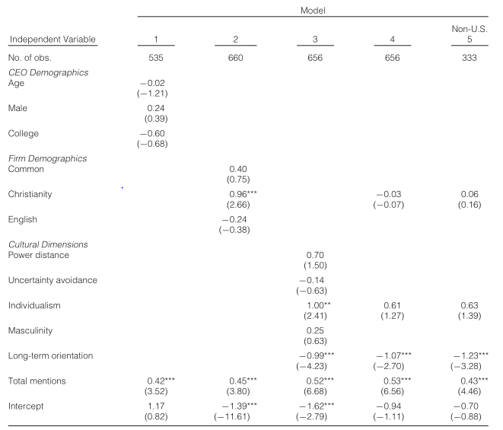
04
International Determinants of Overconfidence

Slide 18
04
International Determinants of Overconfidence
In Model 1 of Table 4, we examine the explanatory power of various CEO demographic characteristics. Model 2 of Table 4 examines the role that various country characteristics exert on the likelihood of CEO overconfidence.The influence of cultural dimensions is examined with Model 3.In Models 4 and 5 of Table 4, we estimate combined specifications, using the significant variables identified in the previous 3 models.We conclude that the effect of long-term orientation on CEO overconfidence is
not simply a U.S. phenomenon, but applies globally.

Slide 19
05
Cross-Country Influences on CEO Overconfidence

Slide 20
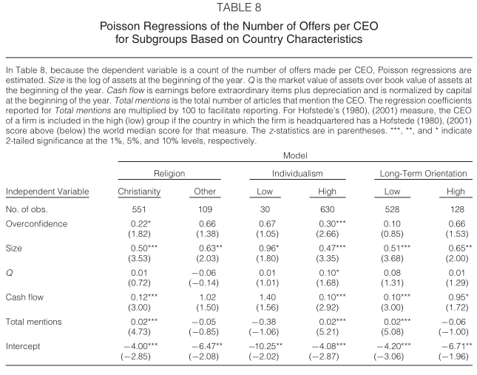
05
Cross-Country Influences on CEO Overconfidence

Slide 21
05
Cross-Country Influences on CEO Overconfidence
In Table 8, We continue to observe important culture effects in the relation between overconfidence and the number of offers.We find that the overconfidence of CEOs in Christian countries enhances the number of merger offers made. CEO overconfidence is not statistically significant, however, for our subsample of nonChristian countries. We also observe that CEO overconfidence increases the number of offers when the CEO leads a firm headquartered in a country with a high level of individualism. Overconfidence appears not to be important when the firm is located in a country whose culture deemphasizes individualism.

Slide 22
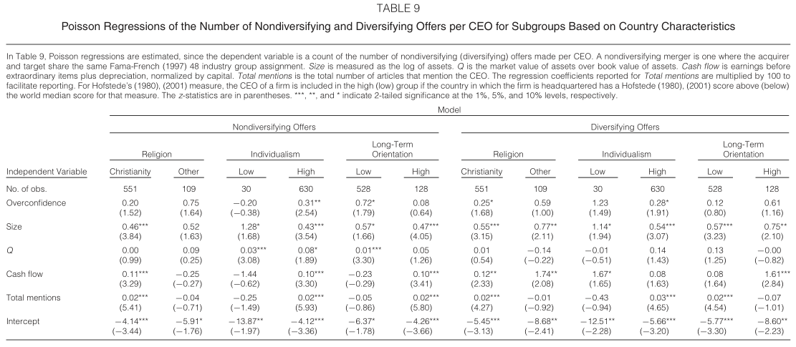
05
Cross-Country Influences on CEO Overconfidence

Slide 23
05
Cross-Country Influences on CEO Overconfidence
Table 9 contains our analysis of country cultural effects based on the type of merger offer made. Again, our use of religion, individualism, and long-term orientation is motivated by their significance in a univariate examination of the
relation between country factors and the frequency of related and unrelated offers.
We observe in the leftmost columns how religion, individualism, and long-term orientation affect the decisions of overconfident CEOs about nondiversifying targets. We find that overconfident CEOs make more nondiversifying mergers only in countries with high levels of individualism or low levels of longterm orientation.

Slide 24
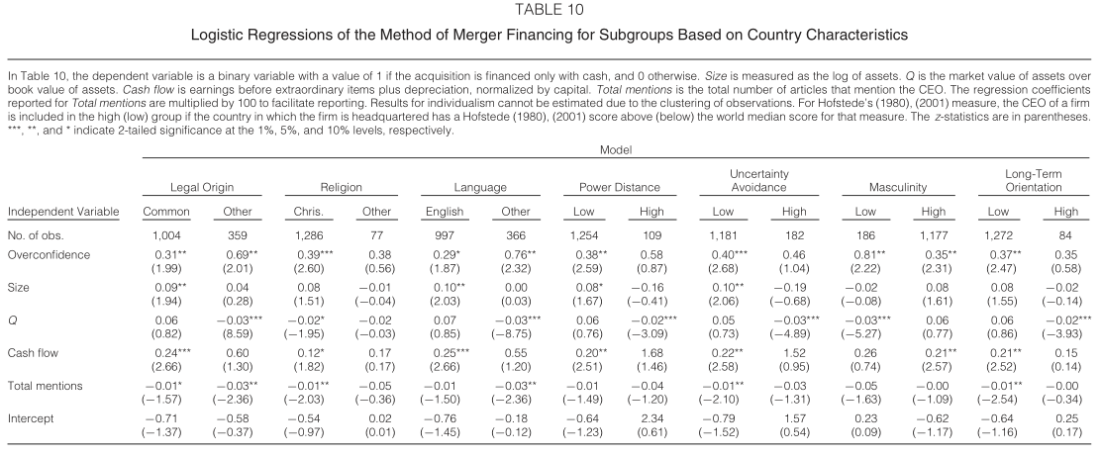
05
Cross-Country Influences on CEO Overconfidence

Slide 25
05
Cross-Country Influences on CEO Overconfidence
We conclude this analysis of cultural factors on international merger activity by examining the effect of country factors on the choice of financing selected by an overconfident CEO. Our untabulated analysis suggests that there are a number of country factors that are related to the number of cash offers extended by an overconfident CEO. These factors are used in the construction of various subsamples that are included in Table 10. We find that a greater use of cash financing by overconfident CEOs holds most strongly in countries where Christianity is the dominant religion.

Slide 26
06
Conclusion

Slide 27
06
Conclusion
Overconfidence
This study is a novel examination of two fundamental research questions concerning CEO overconfidence and international merger activity. We further determine that our conclusions are robust to concerns about the direction of causality by constructing a premerger measure of CEO overconfidence and relating that to subsequent merger activity as well as controlling for prior merger activity.

Slide 28
06
Conclusion
Overconfidence
We also investigate whether there exist country or country group patterns in CEO overconfidence that might otherwise be masked in an aggregate international sample of mergers. The existence of commonalities in CEO demographic across legal systems or national cultures might produce similar patterns in the distribution of overconfident CEOs.

Slide 29
06
Conclusion
Overconfidence
We conclude from our empirical analysis that overconfidence is a factor in the global market for corporate acquisitions. It is not solely a U.S. or Western European phenomenon. The presence of CEO overconfidence in the international merger market indicates that behavioral considerations might occupy an increasing importance in our understanding of executive decision making and the nature of agency conflict within the firm. Our findings also contribute to the growing but still immature literature establishing the importance of human psychological characteristics in understanding corporate decision making.

Slide 30
Thanks for listening!
16720802 康晓鹏

