Slide 1
How does transparency affect bank financial performance?
Aigbe Akhigbe , James E. McNulty b, Bradley A. Stevenson
International Review of Financial Analysis 29 (2013) 24–30
Reporter:Luo Yingxuan 16720827

Slide 2
Contents
1.Introduction
2.Methodology, variable selection and expected relations
3. Descriptive statistics
4. Empirical results for OLS regressions
5. Summary and conclusions

Slide 3
1.Introduction
Theoretical studies suggest that increased transparency reduces a firm's cost of capital (Diamond &Verrecchia, 1991).
More transparency should improve financial performance.
The paper tests for the effect of transparency on bank holding company (BHC)（银行持股公司） performance
using analyst following（财务分析师追随度） and
the standard deviation of analyst earnings per share (EPS) forecasts （分析师每股盈利预测的标准差）
to measure transparency.

Slide 4
1.Introduction—literature review
Why does transparency matter?
Diamond and Verrecchia (1991) construct a theoretical model which shows that reducing asymmetric information（信息不对称） by revealing information to the public reduces a firm's cost of capital. Large investors are more likely to purchase the transparent firm's securities and these securities thus have increased liquidity.
Hirtle (2007) extends this research and finds that more disclosure is associated with lower risk and higher risk-adjusted returns at BHCs.
Pasiouras, Sailesh, and Zopounidis (2009) find that restrictions on bank activities and increased use of market discipline increase profit efficiency. Fewer activities (assuming each are understood by investors) and more market information reflect increased transparency.

Slide 5
1.Introduction—literature review
Analyst following and the dispersion of analyst forecasts are widely used measures to show the level of information investors have regarding a firm.
Jiang and Kim (2005)show that analyst following and institutional ownership are significantly negatively correlated with adverse selection costs （逆向选择成本）and spreads（利差）.
Baker,Nofsinger, and Weaver (2002) use the number of analysts as a proxy for firm visibility.
Flannery, Kwan,and Nimalendran (2004) show that BHC opacity（不透明性） is closely related to the dispersion of analyst expectations （分析师预测的分散度）and analyst forecast deviations（分析师预测偏差）.
Roulstone (2003) also finds that increased public information is related to lower dispersion of analysts' forecasts as well as a higher number of analysts, both of which increase liquidity.
The greater the number of analysts, the more information is available for investors and, therefore, the more transparent the BHC.
In addition, with greater transparency, there should be less dispersion in analysts' forecasts of EPS. Thus larger forecast dispersion is associated with less transparent BHCs.

Slide 6
2.Methodology, variable selection and expected relations—Frontier analysis
Profit efficiency is a sophisticated econometric financial performance measure found by comparing each BHC's efficiency in generating profits with the best achievable performance of all institutions in the sample, i.e., the BHCs on the best practice frontier.
Following Akhigbe and McNulty (2003) and DeYoung and Hasan (1998), the paper uses stochastic frontier analysis (SFA) （随机前沿分析）on all BHCs to determine the efficient frontier.

Slide 7
2.1 Frontier analysis
① Obtain data on all BHCs from the Federal Reserve Bank of Chicago's BHC database for 1996–2006, a total of eleven years of data.
(include balance sheet and income statement data )
②Identify publicly traded bank holding companies by hand-matching the BHCs in this dataset to information from Research Insight.
( use the IBES database from Thomson Reuters to gather the data on the number of analysts and the standardized deviation of analyst forecasts)

Slide 8
2.1 Frontier analysis
A dataset of 3603 publicly traded BHCs.
A smaller sample of 1562 BHCs for whom the standard deviation of analyst EPS forecasts is reported.
For the whole sample of publicly traded BHCs, we also calculate efficiency by disaggregating the sample by size.
We examine three separate size classes – more than $10 billion in total assets, between $1 billion and $10 billion and less than $1 billion
Create one frontier per year
Create a frontier using every two years of data.
Create a frontier for three separate time periods.
Period 1 is 1996–2000, a time of growth in the US economy.
Period 2 is 2001–2003, a time of relative economic decline.
Period 3 is 2004–2006, when the US economy was growing again.

Slide 9
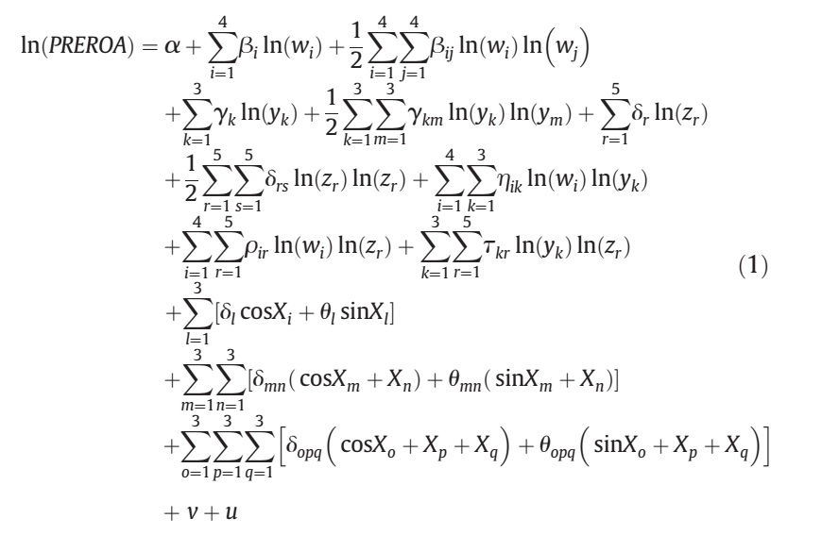
2.1. Frontier analysis
The paper uses a hybrid version of the Fourier form with trigonometric versions of the output variables.
In order to capture the operating environment, we include variables
that reflect the inputs and outputs of the BHC and other BHC-specific characteristics that may affect performance.
Including off-balance sheet items,total loans ,fee revenue,physical capital ,human resource costs ,the cost of deposits ,non-deposit borrowing,the level of non-accrual ,past-due assets at the state level,the Hirschman–Herfindahl index (HHI),total assets and shareholders equity.

Slide 10
2.1 Frontier analysis
The measure of profit efficiency（PROFEFF） is calculated as:
PROFEFF =（Actual PREROA/Potential PREROA） if PREROA > 0;
PROFEFF = 0 if PREROA <0
PREROA is earnings before taxes, extraordinary items and loan losses as a percent of total assets.
Potential PREROA is the actual PREROA plus inefficiency.
For the most efficient banks PROFEFF will be near one, while for the least
efficient it will be near zero.
We then use PROFEFF as a dependent variable（因变量） in the regression analysis（回归分析）.

Slide 11
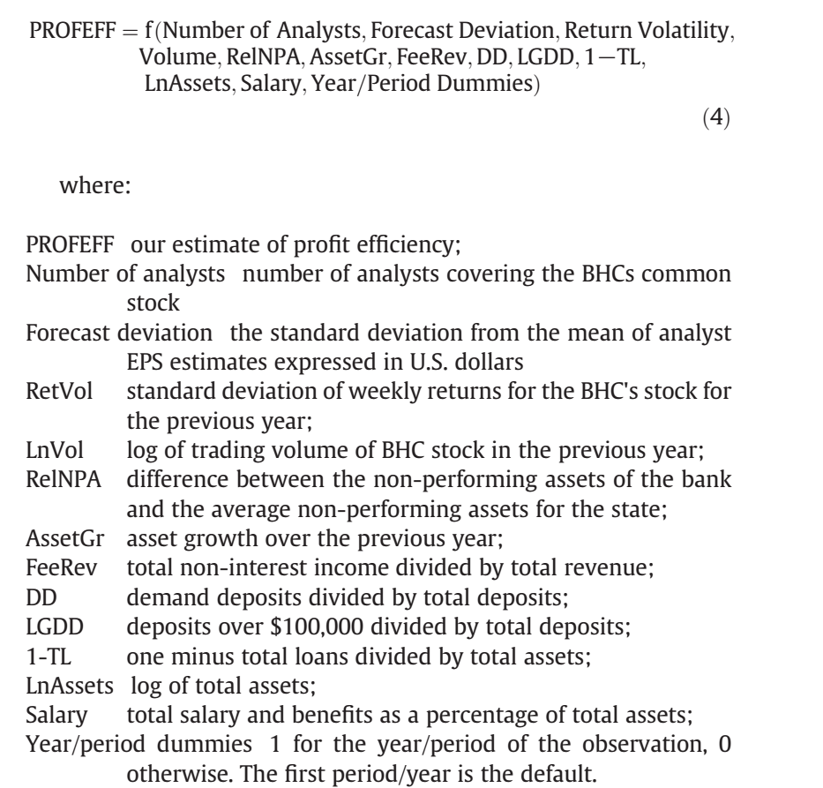
2.2 Effect of transparency on performance — regression analysis
Our hypothesis is that larger analyst following and lower forecast deviation will be associated with more profit efficient BHCs.
Using our estimates of profit efficiency（PROFEFF）, we test this hypothesis with two measures of transparency, number of analysts and the
standard deviation of analyst forecasts.

Slide 12
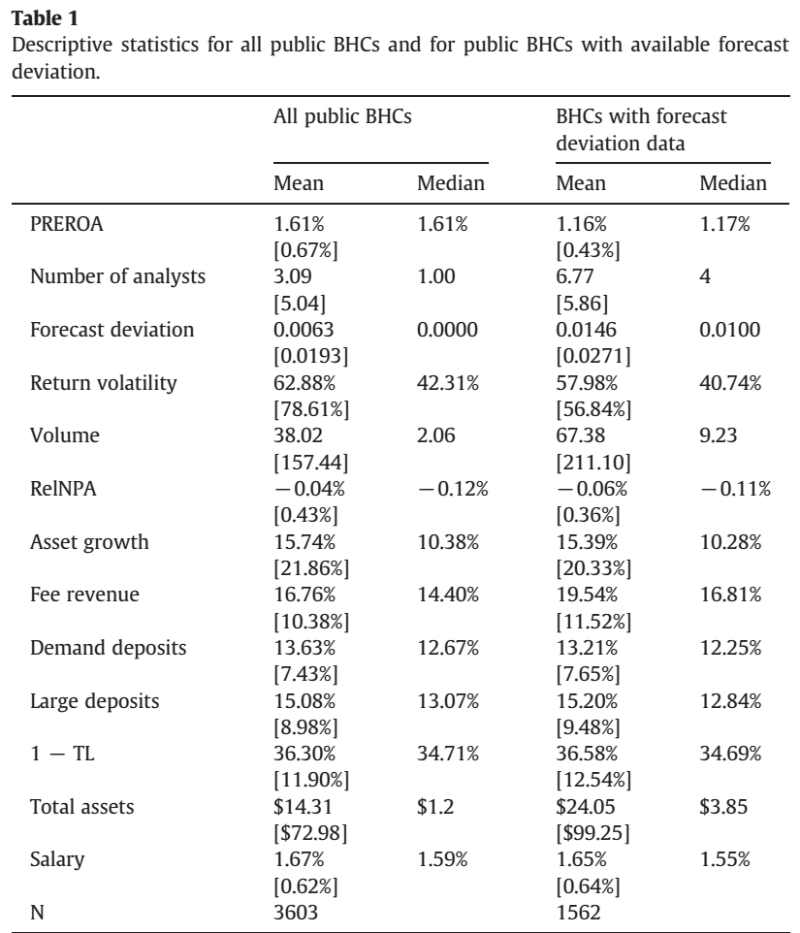
3. Descriptive statistics
Table 1 presents descriptive statistics for our full set of publicly traded BHCs for the period 1996 through 2006 and for the subset of BHCs with available forecast deviation for the same period.

Slide 13
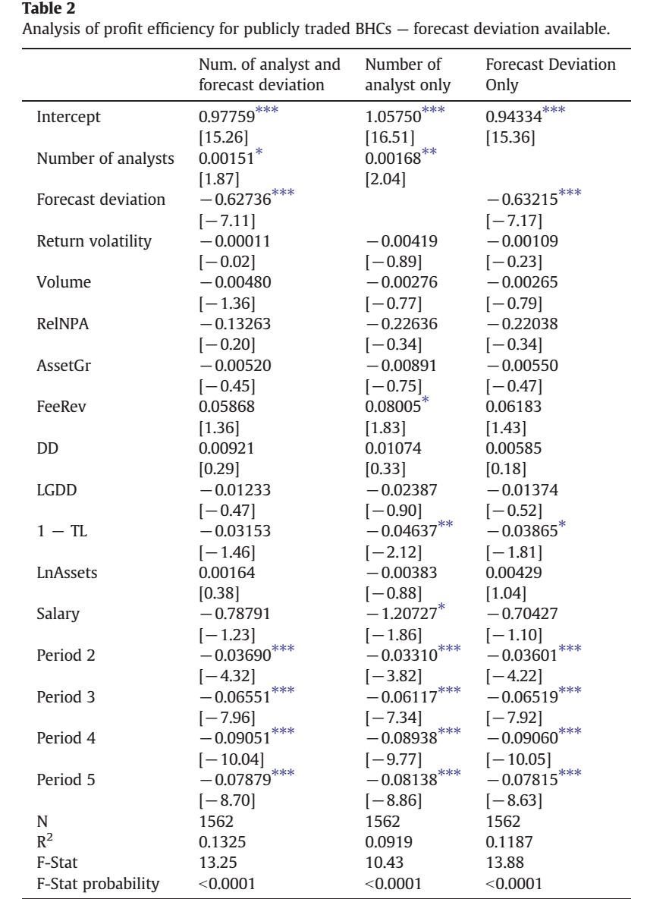
4. Empirical results for OLS regressions
—Analysis of BHCs with available EPS forecast deviation
Table 2 provides regression results using the PROFEFF measures for the sample of 1562 publicly traded BHCs with available forecast deviation data.
In all three columns, both transparency variables are significant with the expected sign.
Forecast deviation is negative and significant, indicating that more transparent BHCs are more profit efficient.
Number of Analysts is positive and significant. Coverage by more analysts leads to more visibility and this dissemination of information leads to greater ability of investors to monitor the firm.

Slide 14
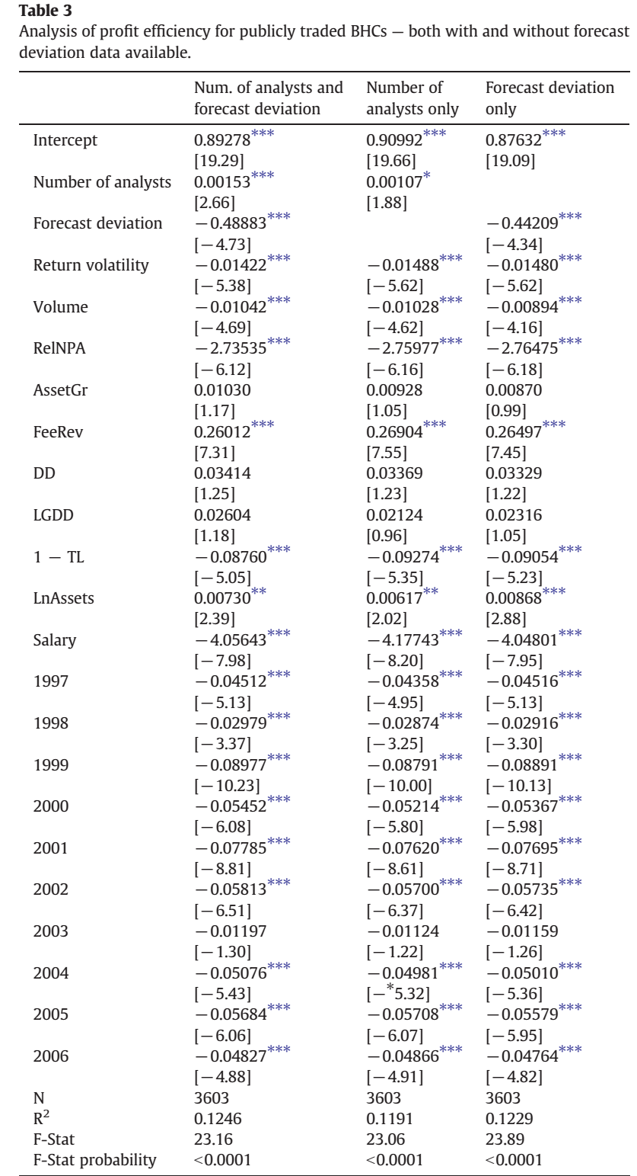
4. Empirical results for OLS regressions
—Analysis of all publicly traded BHCs
Table 3 provides regression results for the sample of 3603 publicly traded BHCs including both those institutions that have forecast deviation data available and those that do not.
As in Table 2, all three regressions in Table 3 show number of analysts and forecast deviation to be significant.

Slide 15
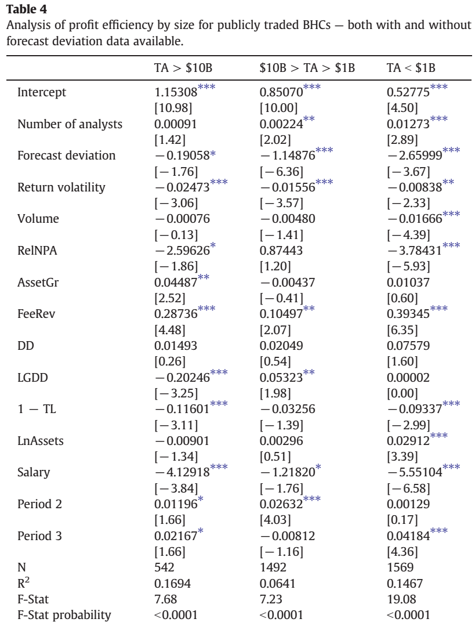
4. Empirical results for OLS regressions
—Analysis of all publicly traded BHCs by size
For Table 4, the full sample of BHCs is divided into bank holding companies above $10 billion in total assets, between $10 billion and $1 billion, and less than $1 billion.
We then determine PROFEFF for each BHC within its size category for the regressions in Table 4.
The result that both transparency variables are significant with the expected sign holds for medium-sized and small BHCs while only
Forecast Deviation remains significant for large BHCs.
（Perhaps since most large BHCs have a high number of analysts ,this measure does not draw a distinction between each BHC's transparency as strongly as in the other size classes.）

Slide 16
5. Summary and conclusions
We ask if transparency affects profit efficiency using the number of analysts following a BHC's stock and the standardized deviation of analysts' forecasts to measure transparency.
We hypothesize that more transparent BHCs would be better managed and thus more profit efficient.
We find that increased transparency translates into better financial performance, as expected. High analyst following is positively related to profit efficiency while higher forecast deviation is negatively related to financial performance, as expected.
The measures of transparency we use are robust even after controlling for other factors that were found in previous studies to affect profit efficiency.
These results hold across different samples including a sample of all publicly traded BHCs, a smaller sample of BHCs with reported forecast dispersion and for BHCs disaggregated by size.

