Slide 1
Capital structure, executive compensation,
and investment efficiency
16720830
齐雪莹

Slide 2
Contents
1
Introduction
2
Hypotheses
Data and variable estimation
3
4
Empirical tests
5
Conclusions

Slide 3
Introduction
The connection between the firm’s leverage ratio and management’s compensation leverage ratio has been the subject of several theoretical and empirical studies.
This paper examines how the similarity between the executive compensation leverage ratio and the firm leverage ratio affects the quality of the firm’s investment decisions.

Slide 4
Introduction
Innovation point | While the current literature primarily focuses on the effect of high inside debt on risk level, we aim to take the empirical evidence a step forward and provide a general set of results on the effect of leverage gap on agency behavior.
 | We provide empirical evidence on whether any difference between compensation leverage and firm leverage (positive or negative) motivates managers to engage in any investment-related type of agency behavior (not only risk-driven behavior). We evaluate the effect of these investment distortions on the market value of the firm’s equity and debt.
Contributions | This finding provides empirical support for the propositions of Jensen and Meckling (1976) and John and John (1993), suggesting that the similarity between executive compensation leverage and firm leverage can mitigate investment-related agency problems.
 | We provide further support for the proposition that set- ting the compensation leverage close to firm leverage can reduce agency costs.

Slide 5
Hypotheses
Conventional financial theory
managers should accept only projects that increase firm value.
In practice, managers can have incentives to deviate from that policy.
Management represents the interests of shareholders, and thus should take actions that increase the value of equity, and not necessarily the value of total assets.
Managers often have their own set of interests that affect their investment decisions. These include reputation concerns, empire-building interests, and risk- aversion.

Slide 6
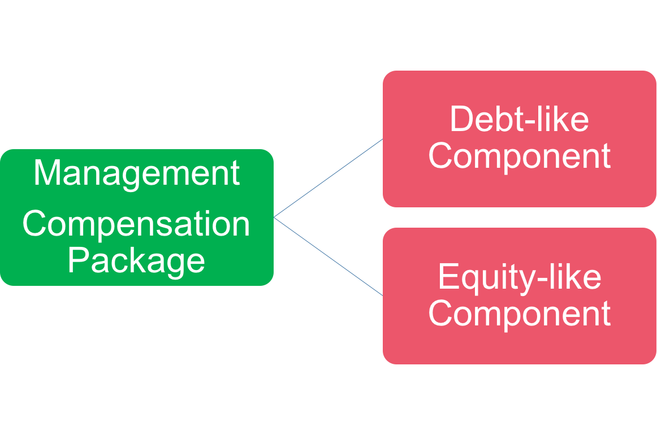
Hypotheses
How managers’ investment decisions affect the value of their compensation package
Pension
Deferred compensation
Stocks
Stock-options
If the compensation’s debt-equity ratio is different from the firm’s leverage ratio, then the value of the firm and the value of the compensation package may not necessarily move in the same direction.

Slide 7
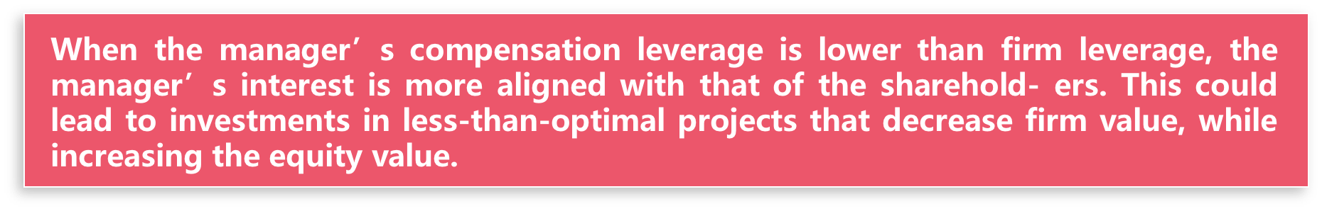

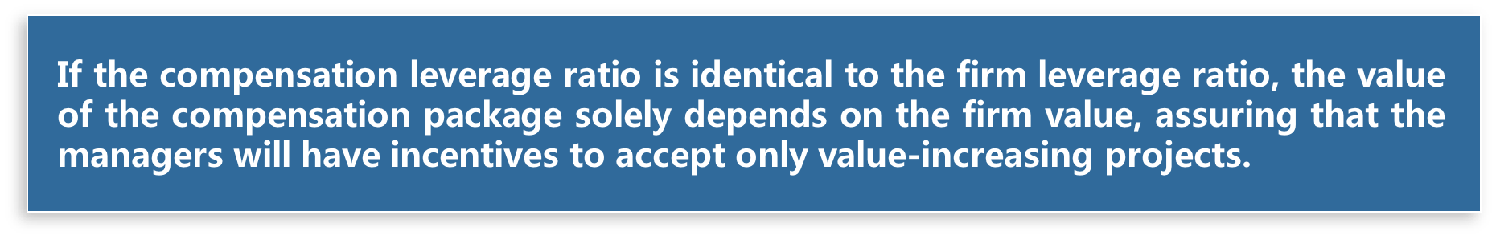
Hypotheses
The implications with respect to the quality of investments
When the compensation leverage is higher than firm leverage, the manager’s interest tends to be aligned more with the interest of the bondholders, and this could also lead to an investment distortion.

Slide 8

Hypotheses
Although the shareholders control the executive compensation policy, it is in their interest to align the compensation’s value to the firm’s value.
Setting the managers’ pensions and deferred salaries as their main compensation component (relative to the firm leverage) will create managerial incentives to increase the value of debt, rather than the value of the equity or the value of the firm in general.
Compensating managers mainly by stocks and stock-options in a levered firm will deter potential creditors and thus can increase the cost of debt financing, especially among firms with high expected costs associated with investment-related bondholder-shareholder conflicts.

Slide 9
Hypotheses
We predict that a larger difference (positive or negative) between compensation leverage and firm leverage leads to more investment distortion in general. In particular, because managers with more debt-like compensation components are more likely to prefer a conservative management policy, we predict a negative relation between the actual leverage gap and the extent of investment intensity.
H1a:
A larger absolute difference between compensation leverage and firm leverage leads to more investment distortions.
H1b:
The difference between compensation leverage and firm leverage is negatively related to the firm’s investment intensity.

Slide 10
Hypotheses
The second set of hypotheses predict that investment distortions that are motivated by executive compensation considerations should be reflected in the values of the firm’s equity and debt.
H2a:
When the compensation leverage is lower (higher) than the firm leverage, an investment distortion is likely to increase (decrease) the equity value, and to decrease (increase) the debt value.
H1b:
When the compensation leverage is lower (higher) than the firm leverage, an over-investment (under-investment) is likely to increase (decrease) the equity value, and to decrease (increase) the debt value.

Slide 11
Data and variable estimation
Information on executive compensation is obtained from hand-collected data, and is combined with the ExecuComp database. Firm-specific accounting variables are drawn from Compustat, whereas stock returns are taken from CRSP.

Slide 12
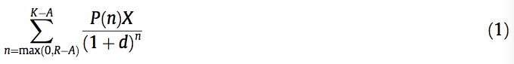
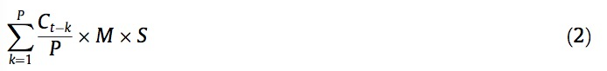
Data and variable estimation
Pension value
Present value of a pension annuity
Annual pension benefit
Stocks and stock-options value
Market value of common
equity of a manager
the number of shares held by the manager multiplied by the share price.
Exercise price of the unexercised stock-options
compute the ratio of the realizable value of in-the-money exercisable options to the number of unexercised exercisable options; then estimate the exercise price by subtracting this ratio from the firm’s stock price at the end of its fiscal year.

Slide 13
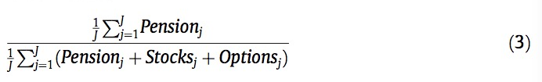
Data and variable estimation
Compensation leverage at the firm level
Firm leverage
book leverage (includes only long-term debt )
Investment distortion
difference between actual and expected investment
Control variables
Size
Investment opportunity set
Financial distress
Regulation
Industry homogeneity

Slide 14
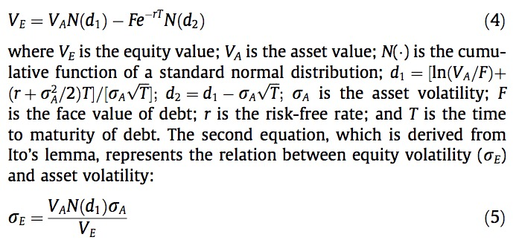
Data and variable estimation
comparing the market values of the firm’s total debt in the current year and the previous year.
Bond return
Value of the firm’s equity
The relation between equity
volatility and asset volatility

Slide 15


Empirical tests
H1a
H1b

Slide 16
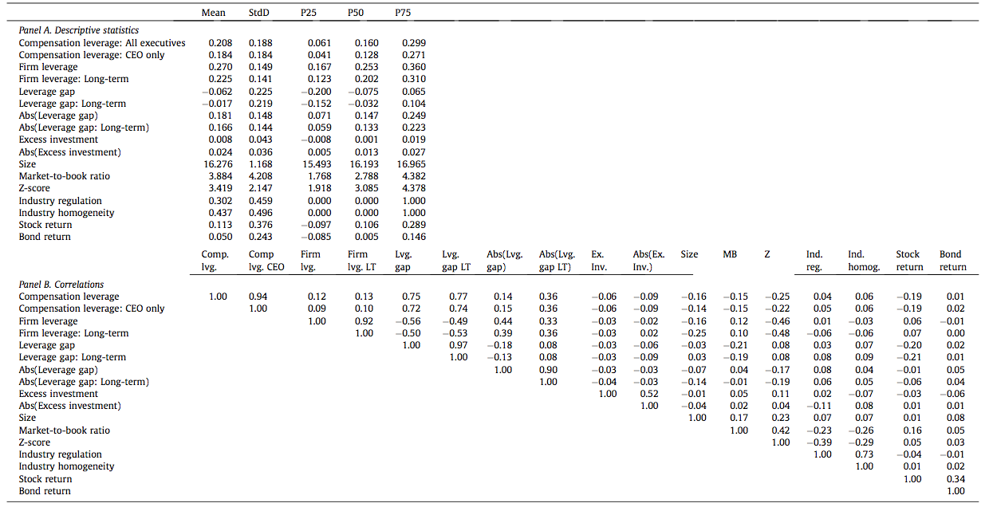
Empirical tests

Slide 17
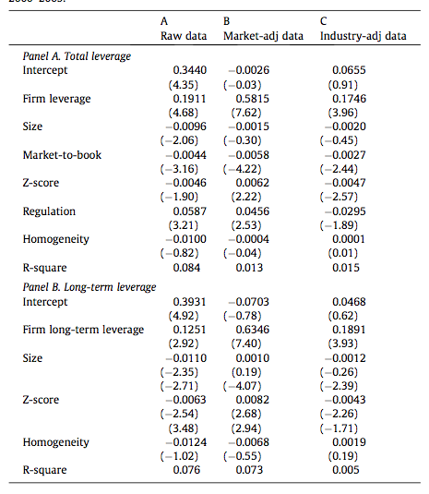
Empirical tests

Slide 18
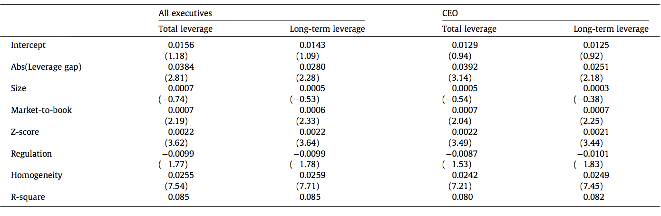
Empirical tests

Slide 19
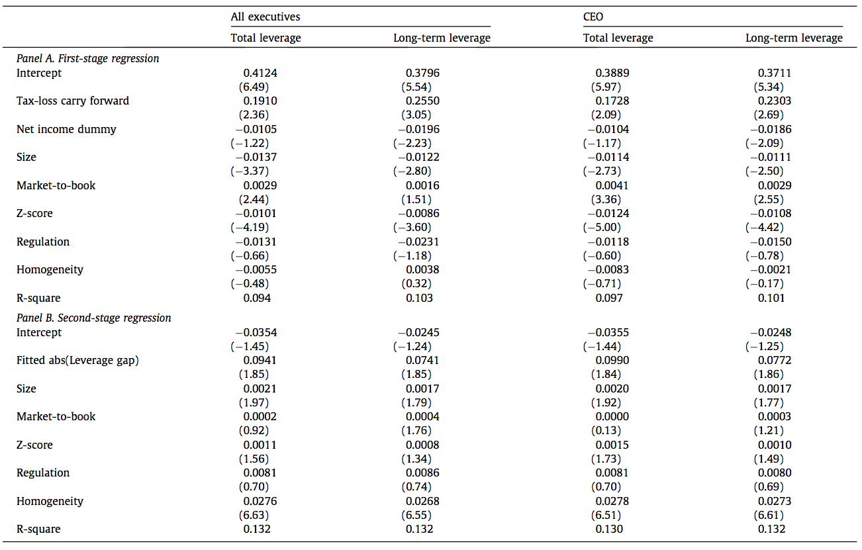
Empirical tests

Slide 20
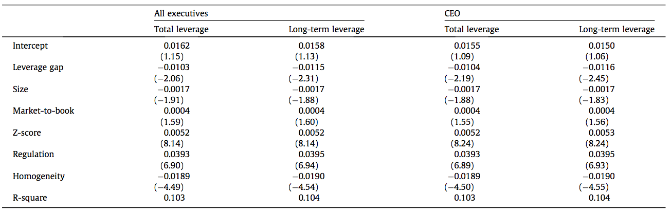
Empirical tests

Slide 21
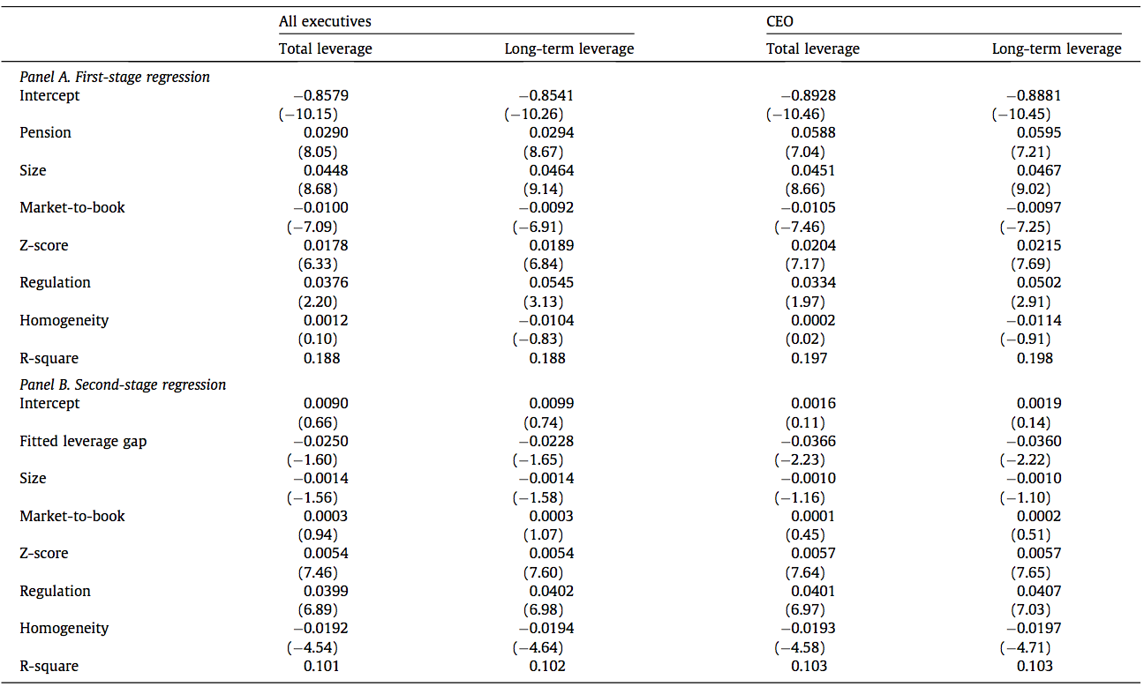
Empirical tests

Slide 22
Empirical tests
H2a

Slide 23
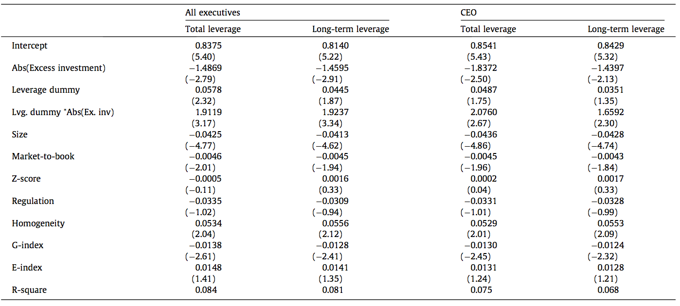
Empirical tests

Slide 24
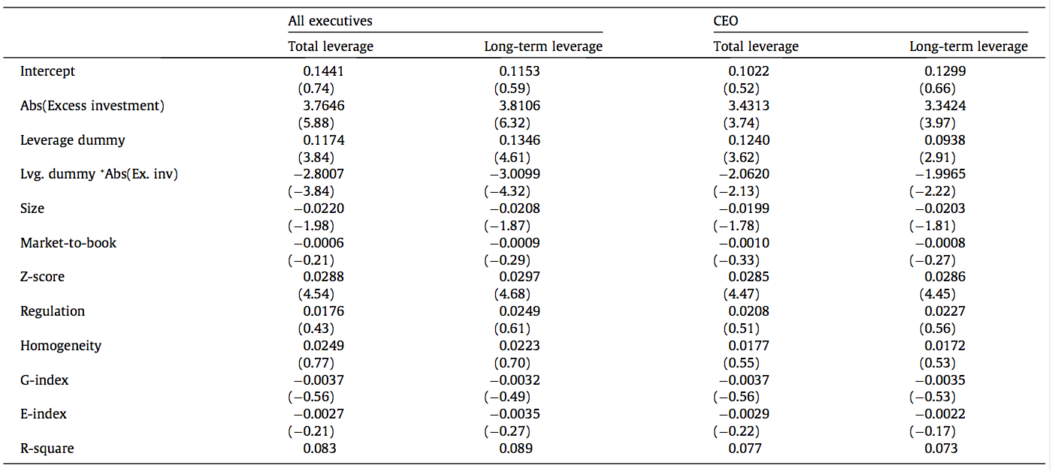
Empirical tests

Slide 25

Empirical tests
H2b

Slide 26
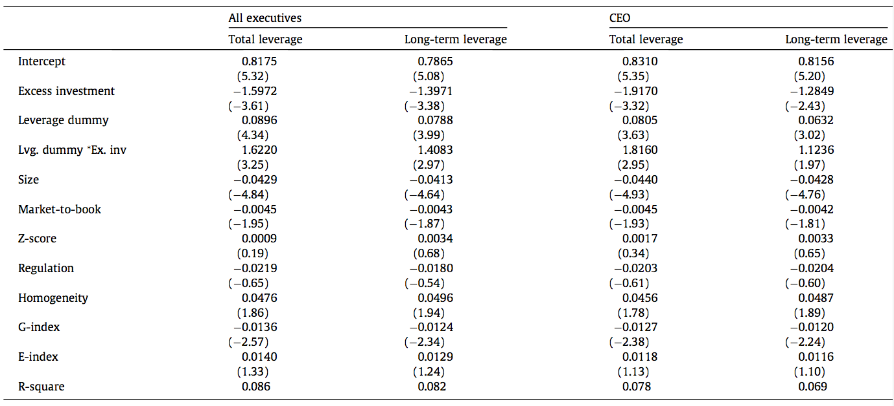
Empirical tests

Slide 27
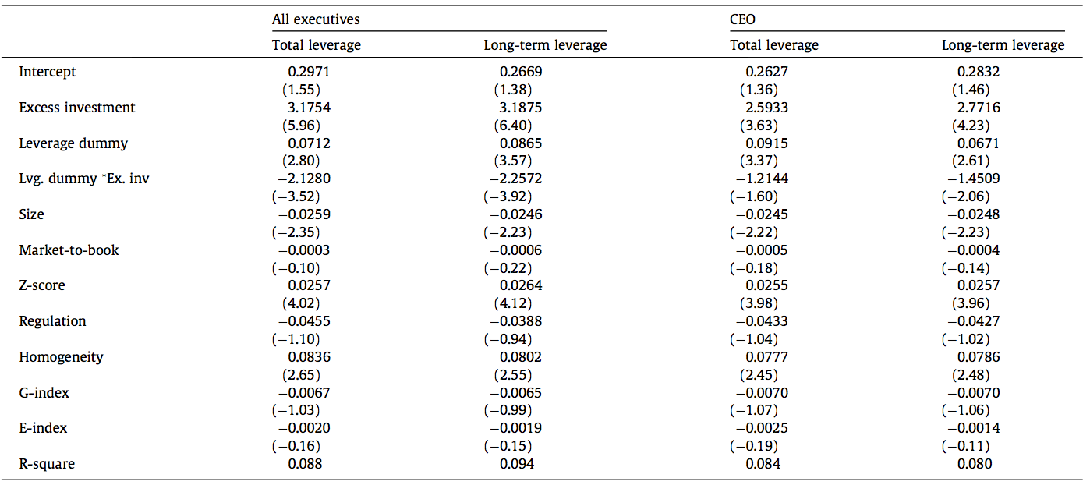
Empirical tests

Slide 28
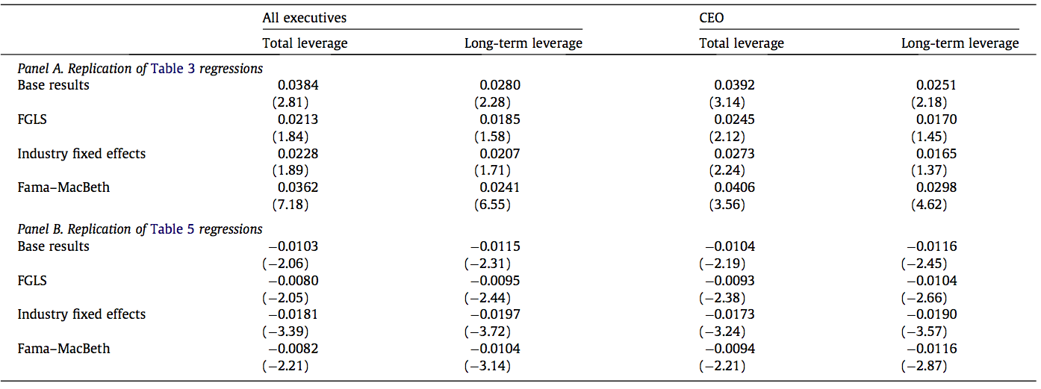
Empirical tests

Slide 29
Conclusions
The connection between the manager’s compensation package and the firm’s capital structure plays an important role in the firm’s investment policy. Firms may be able to mitigate agency costs by setting the compensation leverage of top managers as close as possible to the firm’s leverage ratio.

Slide 30
Conclusions
The absolute difference between compensation leverage and firm leverage increases the extent of the investment distortion.
1
When managers’ compensation leverage ratio exceeds firm leverage ratio, investment distortion, and particularly under-investment, is likely to increase the value of the firm’s debt.
4
2
Managers that are compensated with more debt-like components (relative to firm leverage) tend to under-invest, while managers with more equity-based compensation components tend to over-invest.
3
Investment distortion, and particularly over- investment, is more likely to increase the value of the firm’s equity when the proportion of the equity-like component in the manager’s compensation is larger than the proportion of the firm’s as- sets that are financed by equity.

Slide 31
THANK YOU!

