Slide 1
Accounting Comparability and Economic Outcomes of Mandatory IFRS Adoption
MICHAEL NEEL, University of Houston
Contemporary Accounting Research Vol. 34 No. 1 (Spring 2017) pp. 658–690
Reported by Zhou Bingqian 16720848

Slide 2
1.A brief introduction
what's main ideas on this study:
This study examines the associations between four economic outcomes of the 2005 mandatory adoption of International Financial Reporting Standards (IFRS) and concurrent changes in two important accounting constructs, accounting comparability and reporting quality. Using 1,861 first-time adopters in 23 countries, the study finds that firms with a larger improvement in comparability have larger increases in Q, liquidity, forecast accuracy, and forecast agreement following adoption compared with improvements in reporting quality. what's more, the paper continues to find these results for samples restricted to countries with weaker pre-adoption institutional environments and countries that did not initiate proactive financial statement reviews, indicating that strong institutions and regulatory improvements are not driving the results.

Slide 3
2.Innovations Points
Prior papers :
Prior papers generally examine country-level differences in these economic outcomes of IFRS adoption, focusing on differences in institutional quality and reporting incentives across adopter countries.
This paper innovation:
1. Examining firm-level differences in the economic outcomes of mandatory IFRS adoption.
2. linking the accounting effects and economic effects of IFRS adoption together.
3. Evaluating the relative importance of reporting quality and comparability on the economic effects.

Slide 4
2.Background and hypothesis
Background:
1.Improvements in comparability and reporting quality are primary stated objectives of the International Accounting Standards Board (IASCF 2001).
2.They focus on four previously studied economic outcomes of adoption: firm valuations, stock liquidity, analyst accuracy in forecasting income, and analyst agreement in forecasting income.
3. Prior papers have found the 2005 mandatory adoption of IFRS is likely to lead to positive economic outcomes related to improvements in accounting comparability.
4.Prior research has also found evidence that higher reporting quality is associated with greater liquidity and higher firm valuations (Lang et al. 2012) and smaller analyst forecast errors and dispersion.
Hypothesis:
Relative to improvements in reporting quality, Improvements comparability have a greater positive effect on the valuation, liquidity, and analyst outcomes of mandatory IFRS adoption in cross-country accounting.

Slide 5
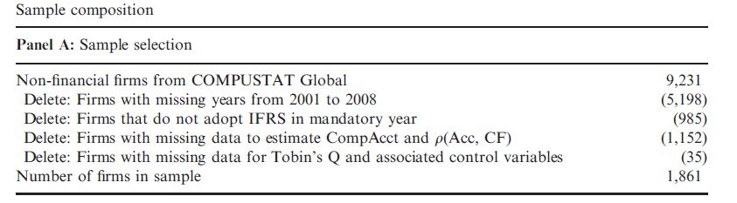
3.Sample selection and research design
Sample selection:
two time periods :a pre-adoption period (2001–2004) &a post-adoption period (2005–2008).
data source：final constant sample contains 1,861 firms (14,888 firm-years) from 23 countries thatadopted IFRS for the first time when it became mandatory in 2005.
data conditions：non-financial public firms & exclude firms that not present for the entire eight-year sample period & exclude firms with missing data.

Slide 6
3.Sample selection and research design
Variables definitions:
Comparability： they report similar accounting amounts when they experience similar economic outcomes.
The paper use three related measures to assess cross-country accounting comparability.(1)CompAcct:use an earnings-return regression to estimate a firm’s mapping between economic events and accounting outcomes;(2) CompCF: uses a regression of earnings on subsequent year’s cash flow to estimate a firm’s mapping between economic outcomes and accounting amounts;(3) CompAccrual: uses contemporaneous cash flows and accruals to proxy for eco-nomic events and accounting amounts.
Reporting quality : use three measures of reporting quality:(1) q(ACC, CF): the firm-level correlation between accruals and operating cash flows, both scaled by beginning assets;(2)AQ1: the standard deviation of residuals from the pooled regression of accruals on prior year, current year, and subsequent year cash flows ; (3) AQ2: equal to the ratio of the standard deviation of residuals from equation.

Slide 7
3.Sample selection and research design
Dependent variables:
firm value : Tobin’s Q (Q).
liquidity: three liquidity measures: (1)ILLIQUIDITY: ILLIQUIDITY is the yearly median of the price impact measure and captures the ability of investors to trade in a stock without affecting its price (2) TRADINGCOST: measures the yearly average roundtrip transaction cost for trading in a firm’s stock;(3) BIDASK: BIDASK is an estimate of the yearly average bid-ask spread based on the negative serial dependence in successive observed market price changes induced by trading costs.
Analyst forecast error (AFE): the absolute difference in the mean annual EPS forecast and actual EPS.
Analyst forecast dispersion (AFD): the standard deviation of annual EPS forecasts.

Slide 8
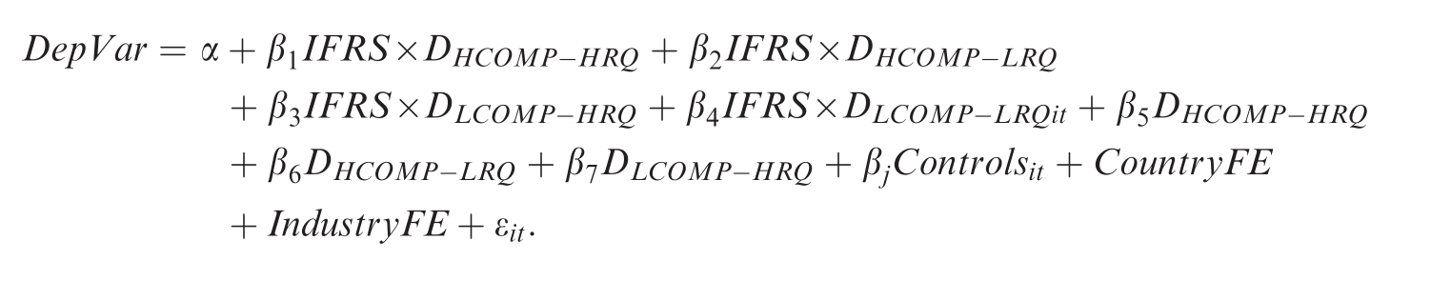
3.Sample selection and research design
Test design:
The paper classify firms with a change in comparability above (below) the sample median as “High Comp” (“Low Comp”) adopters, and firms with a change in reporting quality above (below) the sample median as “High RQ” (“Low RQ”) adopters.
Regression design is based on the following model:

Slide 9
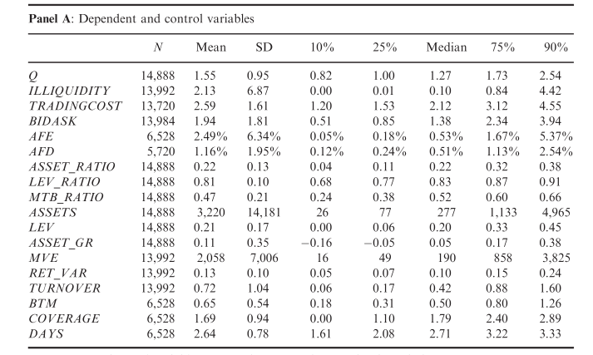
4.Regression Analysis
Descriptive statistics
The chart descriptive statistics for dependent and control variables for the pooled sample:
The mean (median) Q is 1.55 (1.27).
For the liquidity measures, the mean(median) ILLIQUIDITY of 2.13 (0.10) .
the mean (median) TRADINGCOST is 2.59 percent (2.12 percent) of price and mean (median) BIDASK is 1.94 percent (1.38 percent).

Slide 10
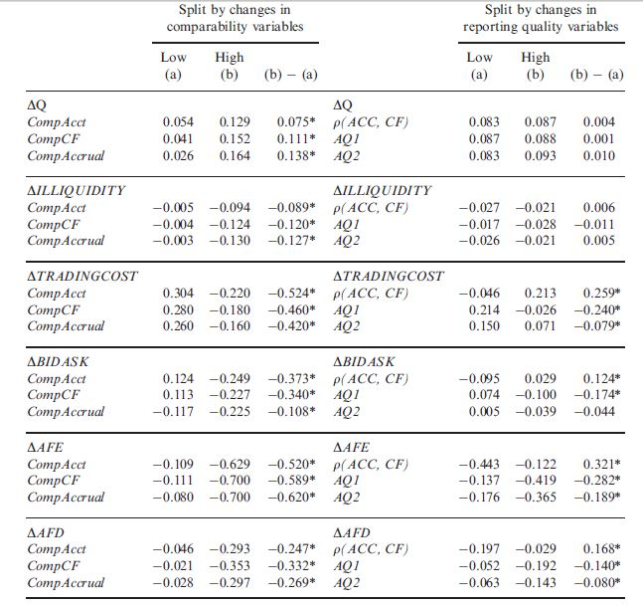
4.Regression Analysis
These results indicate that improvements in comparability are a primary mechanism behind the effect of IFRS adoption on firm value.

Slide 11
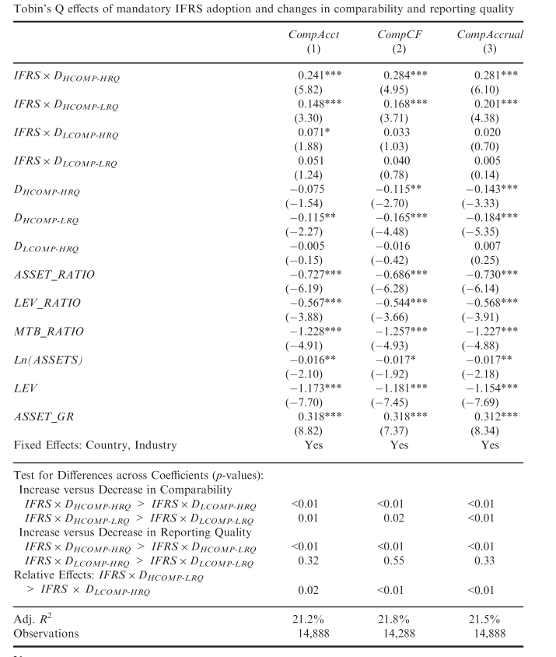
4.Regression Analysis
For example - firm valuation:
This result holds regardless of how reporting quality changes. Focusing on High Comp adopters, the coefficients on IFRS×D_{HCOMP-HRQ} and IFRS×D _{HCOMP-LRQ} are all positive and significant (p < 0.01). Focusing on Low Comp adopters, the coefficients on IFRS×D_{LCOMP-HRQ}and IFRS×D_{LCOMP-LRQ} are generally insignificant across all three measures of comparability.

Slide 12
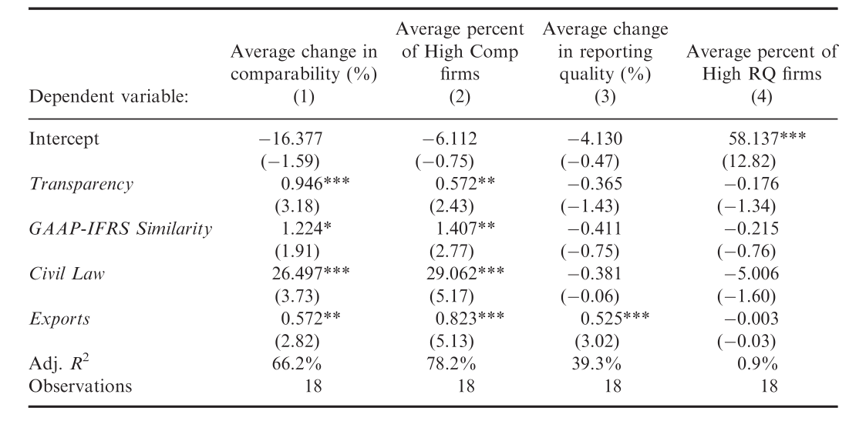
4.Regression Analysis
The results indicate that changes in comparability are larger in countries with more transparent pre-IFRS reporting, pre-IFRS domestic GAAP that was more similar to IFRS, larger export growth, and a civil law legal orientation (see Table 8 for variable definitions)

Slide 13
5.Conclusion
Conclusion:
1.The results show that economic benefits of IFRS adoption are most pronounced among firms that exhibit larger improvements in cross-country accounting comparability. In contrast, an improvement in firm-specific reporting quality appears to have only a marginal effect that is generally limited to valuation effects among those adopters with a concurrent increase in comparability.
2.what's more,the paper finds these results for samples restricted to countries with weaker pre-adoption institutional environments and countries that did not initiate proactive financial statement reviews, indicating that strong institutions and regulatory improvements are not driving the results.
Future Research:
Future research could extend these findings by investigating why comparability is the dominant financial characteristic driving the economic benefits. In addition,Future research could also investigate whether the relative importance of comparability inmy setting is related to the relatively strong institutions of the E.U. In particular, it is possiblethat firms would exhibit a larger improvement in reporting quality in those countries that have weaker institutional environments (and relatively lower pre-IFRS reporting quality).

Slide 14
Thank You
For Watching !

