Slide 1



Adversarial machine learning (攻击方法)
Yevgeniy (Eugene) vorobeychik¹
Bo Li²
¹Assistant Professor, Computer Science & Biomedical Informatics
Director, Computational Economics Research Laboratory
Vanderbilt University
² Post Doctoral Research Associate, UC Berkeley

Slide 2
Part 1: Introduction to AML

Slide 3
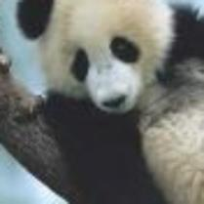

Adversarial examples
Classified as panda
Small adversarial noise
Classified as gibbon
(识别为：长臂猿）

Slide 4

Add adversarial noise…
Small adversarial noise

Slide 5
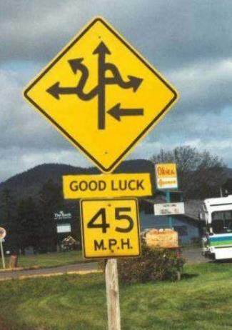
and the ML in your self-driving car thinks it’s

Slide 6
AI & Cybersecurity
Cylance: “Leveraging complex mathematical algorithms, predictive artificial intelligence (AI) capabilities, and the power of machine learning techniques, CylancePROTECT has emerged as the most strategic new offering in the Forrester Wave report.”

Slide 7
Adversarial ML
https://conf.startup.ml/geekdomsf/
Fraud detection
Malware detection
Intrusion detection
Spam detection
What do all of these have in common?
Detect bad “things” (actors, actions, objects)

Slide 8
Bad actors
Key issue in AML: bad actors (who do bad things) have objectives
the main one is not getting detected
they can change their behavior to avoid detection
This gives rise to evasion attacks
Attacks on ML, where malicious objects are deliberately transformed to evade detection (prediction by ML that these are malicious)

Slide 9
Data poisoning
An entirely different class of attacks are data poisoning attacks
In these, an adversary introduces malicious modifications to the data used for training
Can insert instances (for example, send specially crafted emails, either benign or malicious)
Can modify instances in the data (hack one of the servers used to store a part of the data)
Can selectively remove some instances

Slide 10
Evasion vs. poisoning
The crucial distinction between these classes of attacks is
Evasion is an attack on the learned model (e.g., an actual classifier)
Poisoning is an attack on the algorithm (e.g., least-squares regression learning)
they attack the model

Slide 11
Outline of the tutorial
Evasion attacks
Modeling adversarial evasion
Defending against evasion
Poisoning attacks
Understanding poisoning attacks
Defending against data poisoning
AML in Deep Neural Networks
Attacks on DNN
Defensive approaches for DNN

Slide 12
Part 2: adversarial evasion

Slide 13
outline
Evasion Attacks
Evasion-robust Classification
Validating evasion attack models

Slide 14
outline
Evasion Attacks
Modeling evasion
White-box vs. black-box attacks
Evasion-robust Classification
Validating evasion attack models

Slide 15
Classification learning
Class 1
classifier
Class 2
Data set: {(x₁,y₁),…,(x_{n},y_{n})}, (x,y) ~ D
x: feature vectors
y: binary label in {-1, +1} representing which class x belongs to
Learning: train classifier f(x) on data
Prediction: use f(x) to predict label for arbitrary x

Slide 16
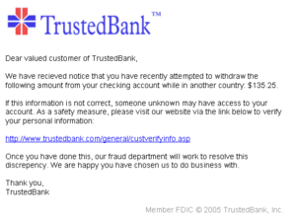
Classification in adversarial settings
Often, classifiers are tasked with telling apart ”good” from “bad”
Spam vs. non-spam (ham)
Benign vs. malicious software
Intrusion detection

Slide 17
Evasion attacks
Adversary who previously chose instance x (which is now classified as malicious) now chooses another instance x’ which is classified as benign

Slide 18
Evasion attacks
Adversary who previously chose instance x (which is now classified as malicious) now chooses another instance x’ which is classified as benign
Benign
Malicious

Slide 19
Evasion attacks
Adversary who previously chose instance x (which is now classified as malicious) now chooses another instance x’ which is classified as benign
Benign
classifier
Malicious

Slide 20
Example of Evasion
From: spammer@example.com
Cheap mortgage now!!!
1.
Feature Weights
2.
cheap = 1.0
mortgage = 1.5
3.
Total score = 2.5
> 1.0 (threshold)
Spam
Notes:
Evasion attack example!!
Bag of words

Slide 21
Example of Evasion
From: spammer@example.com
Cheap mortgage now!!! Joy Oregon
1.
Feature Weights
2.
cheap = 1.0
mortgage = 1.5
Joy= -1.0
Oregon = -1.0
3.
Total score = 0.5
< 1.0 (threshold)
OK

Slide 22
Modeling evasion attacks
Attacker has an “ideal” feature vector x_{ideal}
These are the original malicious feature vectors in training data
Modifying x into another feature vector x’ incurs a cost c(x_{ideal},x’)
The attacker’s goal is to appear “benign” to the classifier
Observation: feature space modeling
Attacker can make arbitrary changes to features
Cost is meant to capture any constraints faced by the attacker in practice
No actual attack instances are generated/validated (this just produces a new feature vector rather than, say, another malicious PDF)

Slide 23
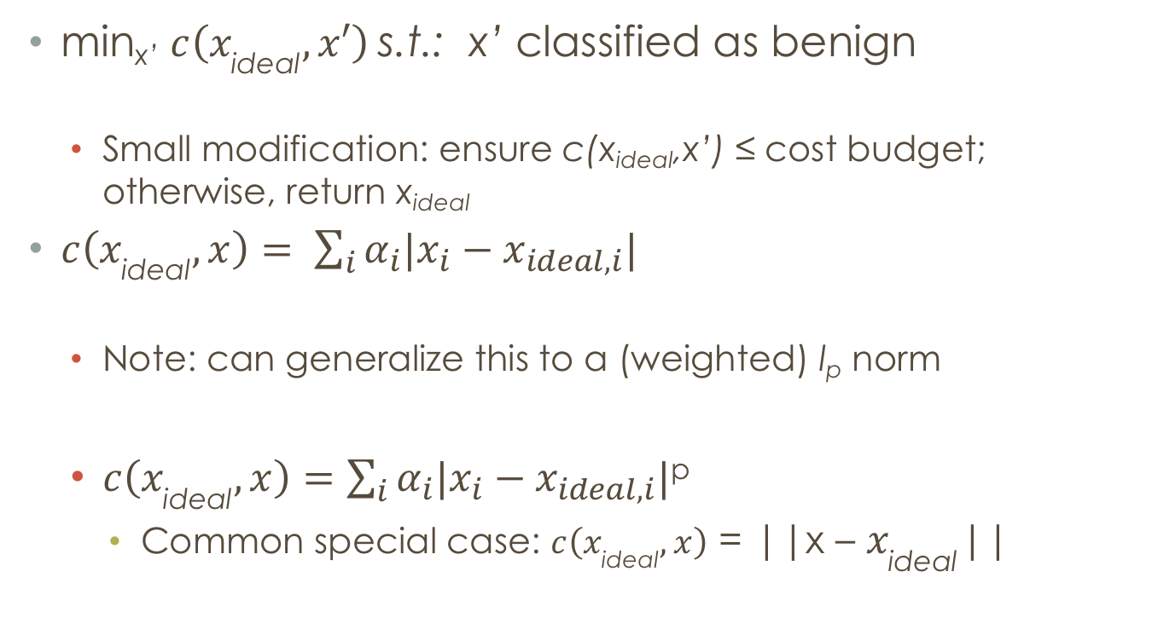
The lowd & meek model
min_{x’} $c\left(x_{\text{ideal}}, x′\right)$s.t.: x’ classified as benign
Small modification: ensure c(x_{ideal},x’) ≤ cost budget; otherwise, return x_{ideal}
$c\left(x_{\text{ideal}}, x\right)= \sum_{i}{α_{i}|x_{i}−x_{ideal,i}|}$
Note: can generalize this to a (weighted) l_{p} norm
$c\left(x_{\text{ideal}}, x\right)=$ $\sum_{i}{α_{i}|x_{i}−x_{ideal,i}|}$^{p}
Common special case: $c\left(x_{\text{ideal}}, x\right)$ = ||x – $x_{\text{ideal}}$||

Slide 24
Other models
Suppose that the classifier can be described as f(x) = sgn{g(x)}, for some g(x) : X -> R
Biggio et al. ECML ‘13:
min_{x} g(x) s.t.: c(x_{ideal},x’) ≤ cost budget
Li and Vorobeychik, ‘16
min_{x} g(x) + λ c(x_{ideal},x’)

Slide 25
Solving attacker optimization
Commonly, these are hard to solve optimally
Approaches depend on the nature of the feature space:
Continuous vs. binary (or discrete)

Slide 26
Continuous features
Lowd & Meek model: easy to solve for linear classifiers
Nelson et al. JMLR ‘12: can approximately solve for convex-inducing classifiers
More generally, gradient descent approaches (Biggio et al., ECML ‘13)

Slide 27
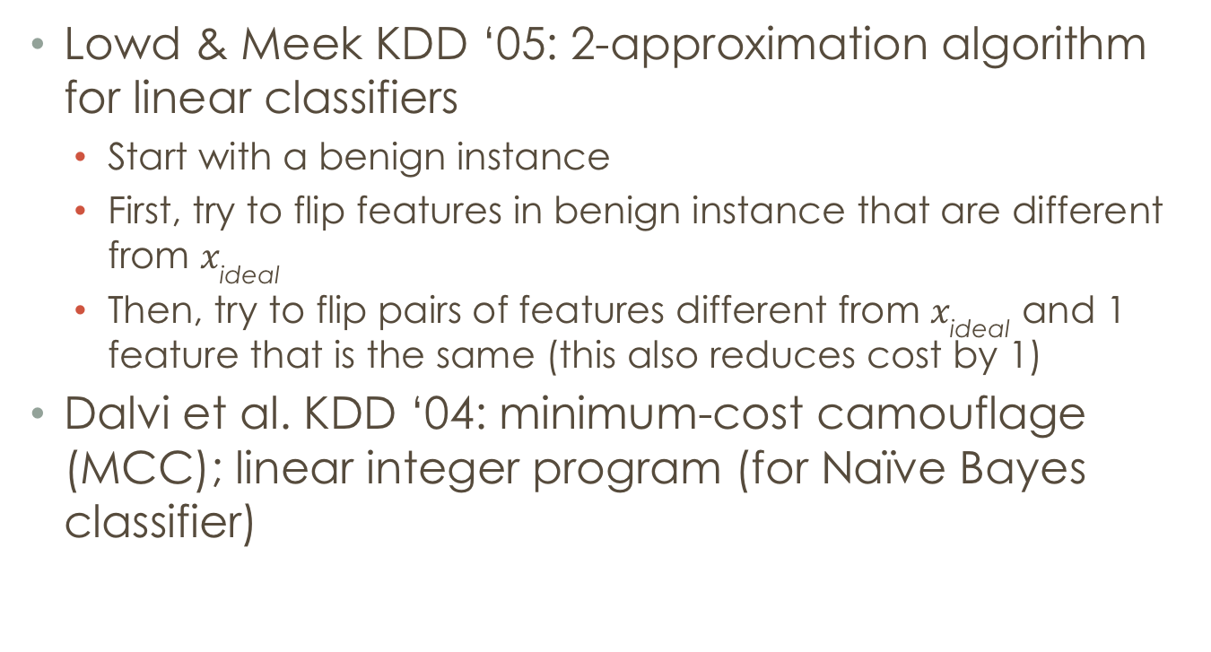
Binary features
Lowd & Meek KDD ‘05: 2-approximation algorithm for linear classifiers
Start with a benign instance
First, try to flip features in benign instance that are different from $x_{\text{ideal}}$
Then, try to flip pairs of features different from $x_{\text{ideal}}$ and 1 feature that is the same (this also reduces cost by 1)
Dalvi et al. KDD ‘04: minimum-cost camouflage (MCC); linear integer program (for Naïve Bayes classifier)

Slide 28
Is distance the right cost function?

Slide 29
Distance Based Cost Function Underestimates Adversary
X
C = 5
Synonym
Spam
Ham
C = 1
Hello!
Are you ready to become more active and attractive than ever before?
Our final product for losing weight is on clearance now.
Follow the link and you will find he cheapest way to gain your body back.
http://www.ebay.com/application_form
Hello!
Are you happy to become more active and attractive than ever before?
Our final merchandises for losing weigbt is on claerance now.
Follow the link and you will find he deapest way to gain your body back.
http://www.ebay.com/application_form
Letter substitution
Notes:
Title!
Explain the meaning of cost!!!

Slide 30
An Alternative Cost Function
Model the adversarial cost function
Traditional: Distance based cost function
Equivalence based cost function
Feature Class
Notes:
Visual, high level idea
Citation
Use this proposed cost function to model the adversarial capabilities
Add results
Align with the xA and x’

Slide 31
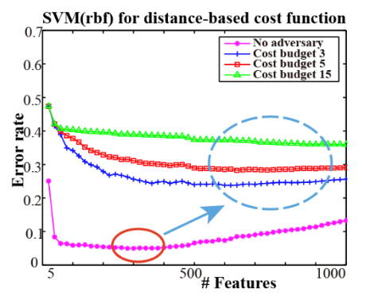
Perils of Dimension Reduction
No Adversary: Dimension Reduction = Good
With Adversary: Dimension Reduction = Vulnerable
Notes:
As a standard solution to the curse of dimensionality, feature reduction can open a wide door for the adversary to evade the classifier
1 standard error
Reasons:
typically, you don’t push right, even it is flat, actually stop earlier instead of right side.
Linear it is flat, if non-linear, it goes up
Feature reduction (check)
citation

Slide 32
White-box vs. black-box attacks
In attack models, assumed that the attacker knows the classifier
Black-box attacks: attacker has a query access to the classifier; can get examples
Lowd & Meek; Nelson et al.: minimizing the evasion cost through a sequence of queries to the classifier
NP-Hard in general (even for linear classifiers)
Poly-time approximations for linear and convex-inducing classifiers
Is the black-box attack fundamentally hard?

Slide 33
Black-box attacks
Can the adversary approximate the classifier h used by the defender to (near)-arbitrary precision?
Using only queries x to find out h(x)?
NP-Hard in general

Slide 34
reverse engineering is easy “in practice”
Previous results on black-box learnability are worst-case over an entire family of classifiers (linear, convex-inducing)
Observation: these classifiers do not spontaneously appear; they are learned from data!
This fact implies a lot of structure: since someone learned them to begin with, they should be learnable
Theorem: suppose a hypothesis class H is efficiently learnable, and h in H is learned (given data). Then h can be efficiently reverse engineered.
Reverse engineered: learned with arbitrarily small error
Follows directly from the fact that H is efficiently learnable and h is in H.
Consequence: theoretical reason why “black-box” attacks, e.g., with DNNs, work

Slide 35
References (evasion modeling)
Dalvi et al. Adversarial classification. KDD ‘04.
Lowd and Meek. Adversarial learning. KDD ’05.
Nelson et al. Query strategies for evading convex-inducing classifiers. JMLR ‘12.
Biggio et al. Evasion attacks against machine learning at test time. ECML/PKDD ‘13.
Li and Vorobeychik. Feature cross-substitution in adversarial classification. NIPS ‘14.
Vorobeychik and Li. Optimal randomized classification in adversarial settings. AAMAS ‘14.
Li, Vorobeychik, Chen. A general retraining framework for scalable adversarial classification. arxiv, 2016.
Not exhaustive
Vorobeychik and Kantarcioglu, Adversarial Machine Learning book will have a more extensive bibliography

