Slide 1
Activation function
Part six： Conclusion
G4-DLB-JIANG Bowen
2021.2.22

Slide 2
Conclusion
01\
Whether to use activation function
02\
What activation functions are currently available
03\
How to choose activation function

Slide 3
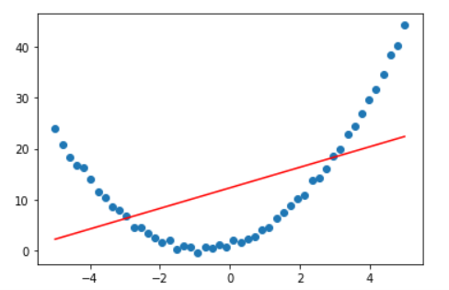
01.Whether to use activation function
The expressive power of the linear model is not enough, the activation function can be used to add nonlinear factors
Neural network without activation function

Slide 4
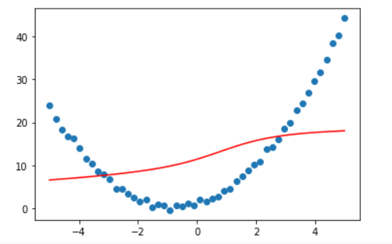
01.Whether to use activation function
The expressive power of the linear model is not enough, the activation function can be used to add nonlinear factors
After adding the sigmoid activation function

Slide 5
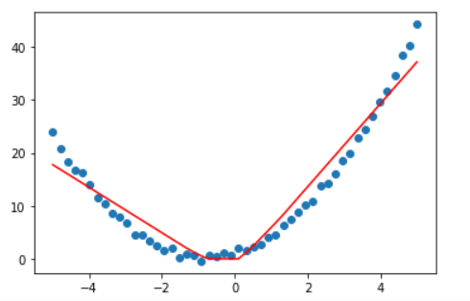
01.Whether to use activation function
The expressive power of the linear model is not enough, the activation function can be used to add nonlinear factors
Using relu activation function

Slide 6
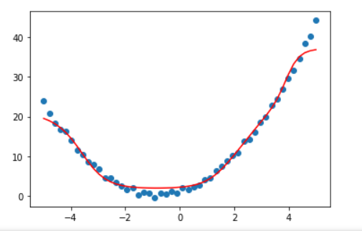
01.Whether to use activation function
The expressive power of the linear model is not enough, the activation function can be used to add nonlinear factors
Deepen the neural network and use the Sigmoid activation function again

Slide 7
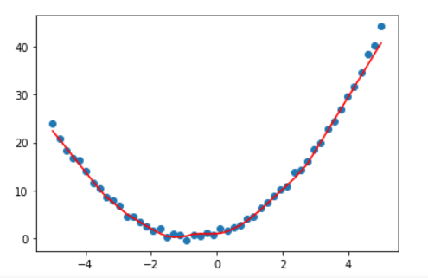
01.Whether to use activation function
The expressive power of the linear model is not enough, the activation function can be used to add nonlinear factors
Deepen the neural network and use the Relu activation function

Slide 8
02.What activation functions are currently available
Among them, relu, sigmoid, tanh, softmax are multiple commonly used activation functions, and the others are improvements based on them.

Slide 9
03.How to choose activation function
1.The ReLu function is preferred。
Currently used in most cases (only in hidden layers).
1) has a faster convergence speed
2) It can solve the problem of disappearing gradient of sigmoid and tanh
But pay attention to the adjustment of the learning rate. In addition, the pure ReLu function may cause neuron death. Therefore, in order to avoid a large number of dead neurons in the network leading to poor results, you can choose Leakly ReLu, elu and other variant functions.

Slide 10
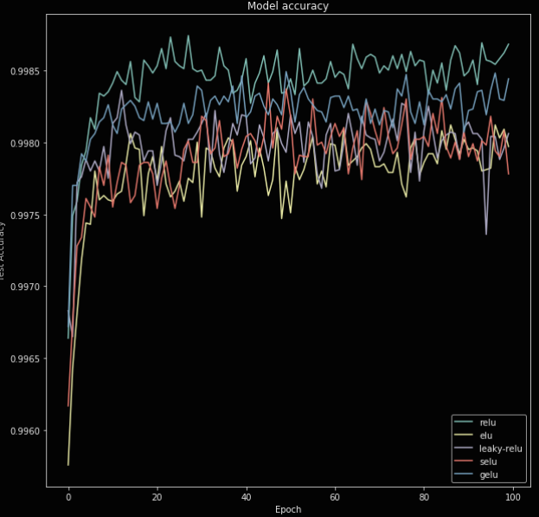
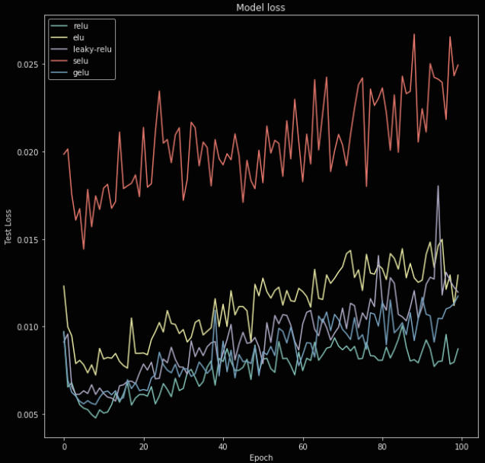
03.How to choose activation function
The performance of Relu and its variant functions on the MNIST data set

Slide 11
03.How to choose activation function
1.When doing classification problems, especially binary classification problems, use the sigmoid function as the output layer.
2.When solving multi-classification problems, choose the softmax function as the output layer.
3.When you need to output symmetrical results, such as (-1, 1), (-6, 6), use the softmax function as the output.

Slide 12
THANK YOU FOR YOUR CRITICISM

