Slide 1
When the comparator population changes
Does a pathway priority survive a change in which perturbations are analyzed?
Public A549 WT / PRDX1-KO × vehicle / AZD7648 screen
Fixed mitochondrial and translation-elongation sets
Finding: the comparator changes; the mitochondrial component is nearly stable.
DDR TargetBridge · Computational functional-genomics case study
1
Notes:
研究的是一个通路比较的对象组成，不是宣称发现新靶点。原实验不是本人完成；本项目是AI辅助二次分析。

Slide 2
One experiment; three analysis populations
16 sample records: four endpoint groups × 3, plus two T0 records per background.
S0 Original genes and targeting units M 89 / E 23
S1 Same genes; expanded targeting units M 89 / E 23
S2 All T0-qualified support M 94 / E 91
M: Mitochondrial translation. E: Eukaryotic Translation Elongation.
DDR TargetBridge · Computational functional-genomics case study
2
Notes:
16条是真实样本记录，不是16个独立建系。S1固定原基因，只扩展靶向单位；S2再扩展基因。双guide构建体仍是一种试剂。

Slide 3
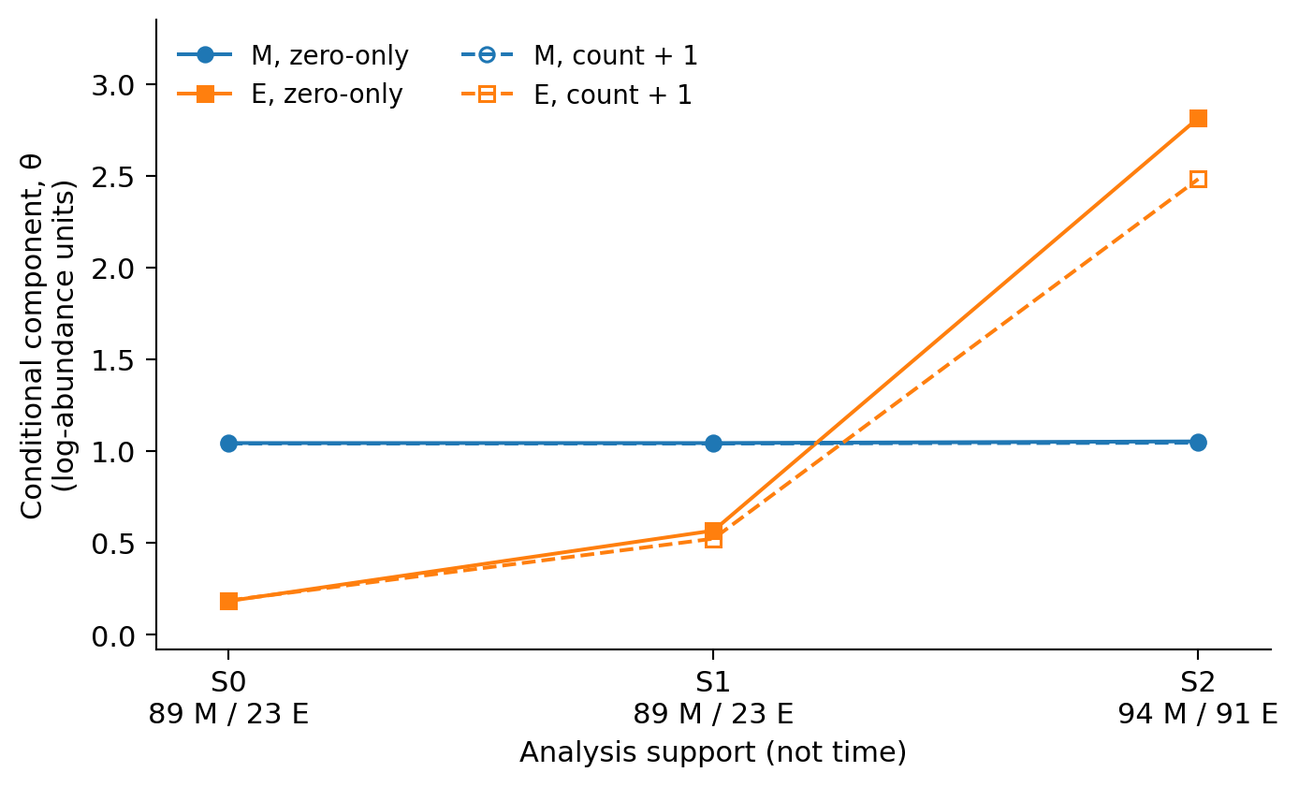
The comparator component changes
M is nearly stable.
E increases with restored support.
Both transforms show this pattern.
DDR TargetBridge · Computational functional-genomics case study
3
Notes:
显示两种变换。横轴不是时间。M基本不变，E随着支持集合变化。没有置信区间；不能称为线粒体机制反转。

Slide 4
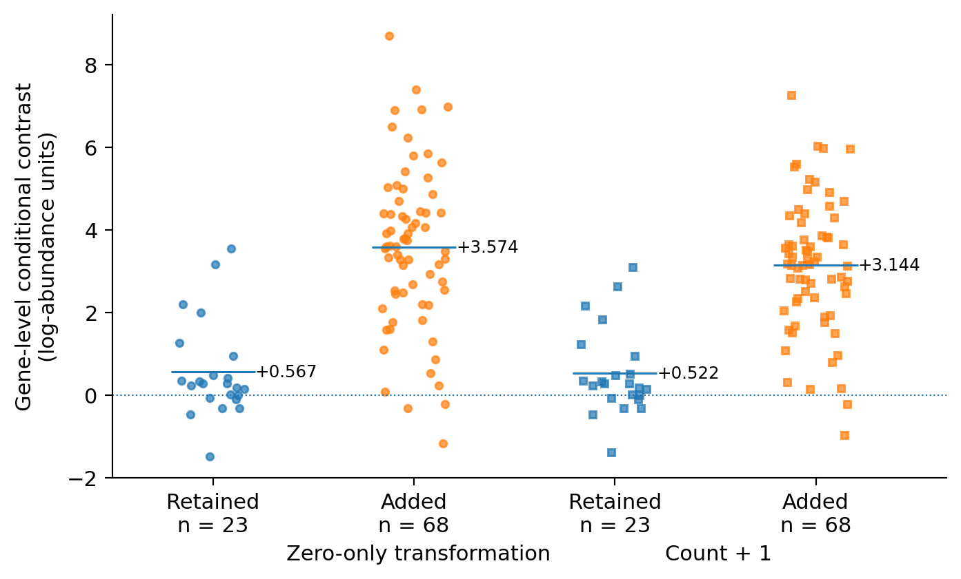
Added comparator genes shift the mixture
Zero-only means
23 retained: +0.567
68 added: +3.574
All members retained in the display.
DDR TargetBridge · Computational functional-genomics case study
4
Notes:
每个点是基因，不是培养重复。全体23个原成员和68个新增成员均展示。均值线不是误差条。这是混合分解，不是候选靶点筛选。

Slide 5
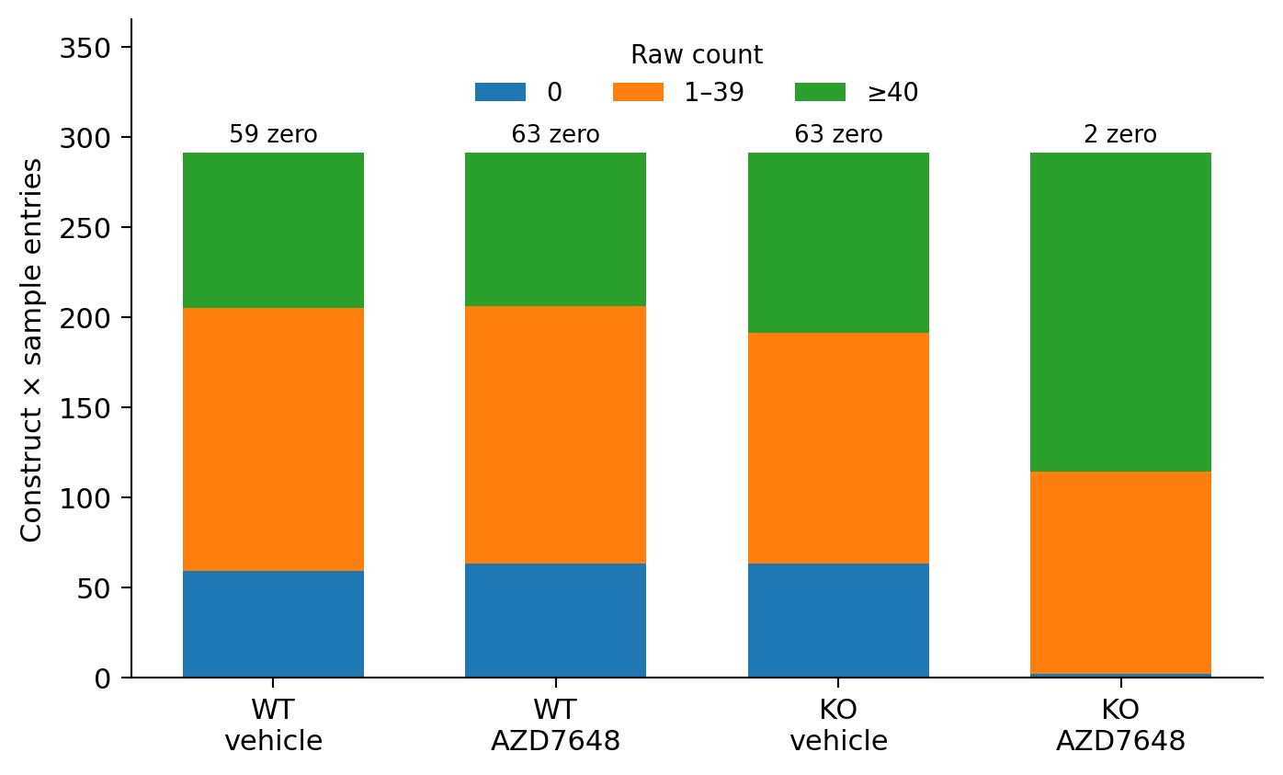
More coverage is not automatically better evidence
Qualification uses vehicle.
The response subtracts vehicle.
Coverage, growth and count floors remain entangled.
DDR TargetBridge · Computational functional-genomics case study
5
Notes:
四组完整展示。扩展E有97构建体乘3样本=291项。新增覆盖与低计数同时变化，所以S2不能叫纠正后的真值。

Slide 6
A finite conclusion, not a target mechanism
The original positive M − E contrast does not provide a membership-insensitive basis for a mitochondrial-specific priority.
The expanded negative contrast is not biological truth.
Clone, growth and perturbation-specific effects are not isolated.
Earlier unsuccessful comparisons remain separate case histories.
DDR TargetBridge · Computational functional-genomics case study
6
Notes:
决策不升级这一项特异性主张。两种不同总体的描述不等于同一个生物学效应的独立重复。旧失败命题不被改写。

Slide 7
Contribution and reproducible scope
Project: fixed comparisons, component decomposition, source-linked code.
Original investigators: laboratory experiments and published mechanisms.
AI assistance: discussion, implementation, testing, figures and writing.
Public core: transformed gene/sample records → pathway summaries → six comparisons.
Historical source tables require separate retrieval.
DDR TargetBridge · Computational functional-genomics case study
7
Notes:
本人责任应实事求是。项目提供具体比较、分解和可运行记录；标准统计及母研究实验不是本人的新方法或新湿实验。当前公开core从派生观测开始，不是原始counts。

Slide 8
Backup: the quantity being compared
β(P, b) = mean drug(P, b) − mean vehicle(P, b)
θ(P) = β(P, KO) − β(P, WT)
Pathway contrast = θ(M) − θ(E)
A common additive center cancels.
Membership, count floors and clone effects do not.
DDR TargetBridge · Computational functional-genomics case study
8
Notes:
所有量是相对log丰度的描述。共同中心在同一样本的M-E中抵消，不会抵消基因特异误差、计数下限或成员选择。三组S0-S2非独立实验。

Slide 9
Backup: inspect, reproduce, then interpret
Report: reports/DDR_TargetBridge_Case_Study.pdf
Claims: docs/SCIENTIFIC_CLAIM_LEDGER.md
Verify: python tools/run.py verify
Public core: python tools/run.py core --output .build/demo
Historical tables: python tools/run.py historical --output .build/history
github.com/jiangboyan0129/DDR-TargetBridge
DDR TargetBridge · Computational functional-genomics case study
9
Notes:
三个命令范围不同。verify检查文件和程序，core从已公开变换值重算，historical需要外部源表。公开未包含全count矩阵，不对外说FASTQ端到端复现。

