Slide 1

Recurrent Neural Networks
Notation
deeplearning.ai

Slide 2
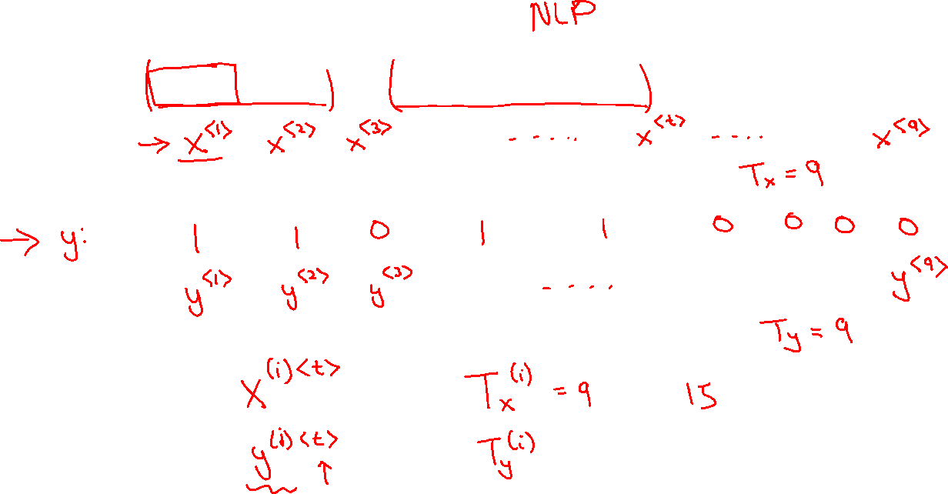
Motivating example
x:
Harry Potter and Hermione Granger invented a new spell.

Slide 3
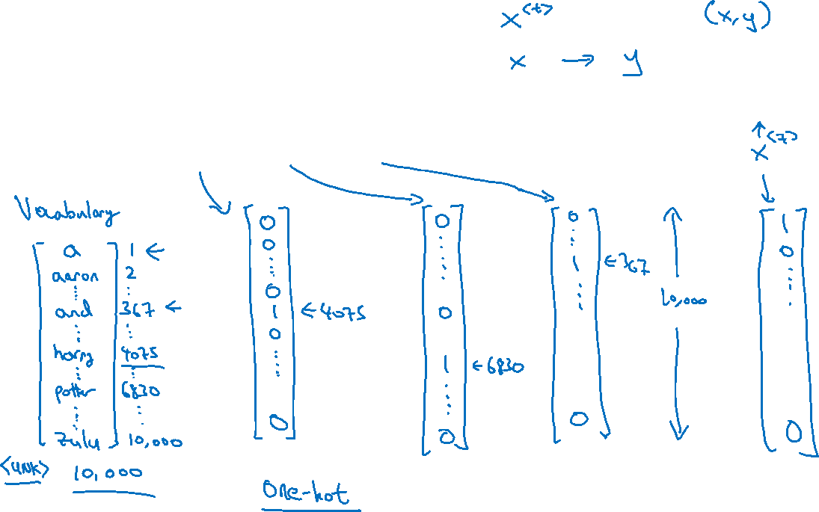





Representing words
x:
Harry Potter and Hermione Granger invented a new spell.
$$x^{<1>}$$
$$x^{<2>}$$
$$x^{<3>}$$
$$⋯$$
$$x^{<9>}$$

Slide 4
Representing words
x:
Harry Potter and Hermione Granger invented a new spell.
$$x^{<1>}$$
$$x^{<2>}$$
$$x^{<3>}$$
$$⋯$$
$$x^{<9>}$$
And = 367
Invented = 4700
A = 1
New = 5976
Spell = 8376
Harry = 4075
Potter = 6830
Hermione = 4200
Gran… = 4000

Slide 5
Recurrent Neural Networks
Recurrent Neural Network Model
deeplearning.ai

Slide 6

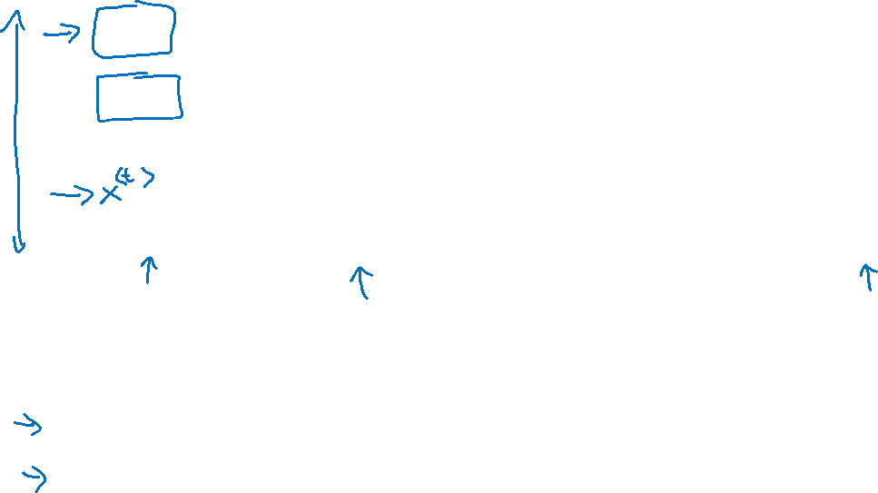









Why not a standard network?
$$x^{<1>}$$
$$y^{<1>}$$
$$x^{<2>}$$
$$y^{<2>}$$
$$⋮$$
$$⋮$$
$$⋮$$
$$⋮$$
$$x^{<T_{x}>}$$
$$y^{<T_{y}>}$$
Problems:
- Inputs, outputs can be different lengths in different examples.
- Doesn’t share features learned across different positions of text.

Slide 7
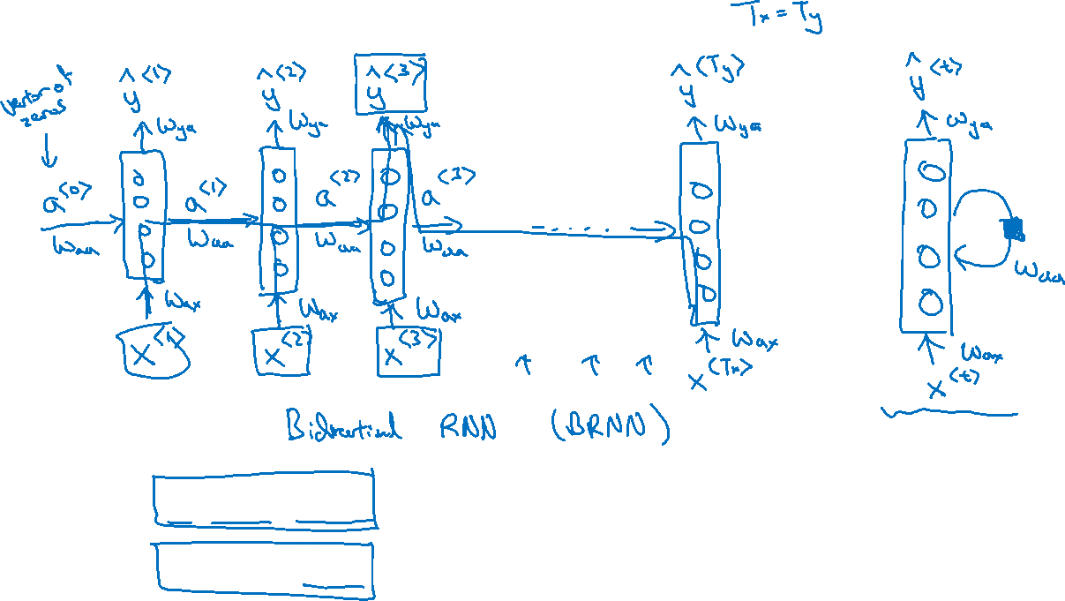
Recurrent Neural Networks
He said, “Teddy Roosevelt was a great President.”
He said, “Teddy bears are on sale!”

Slide 8






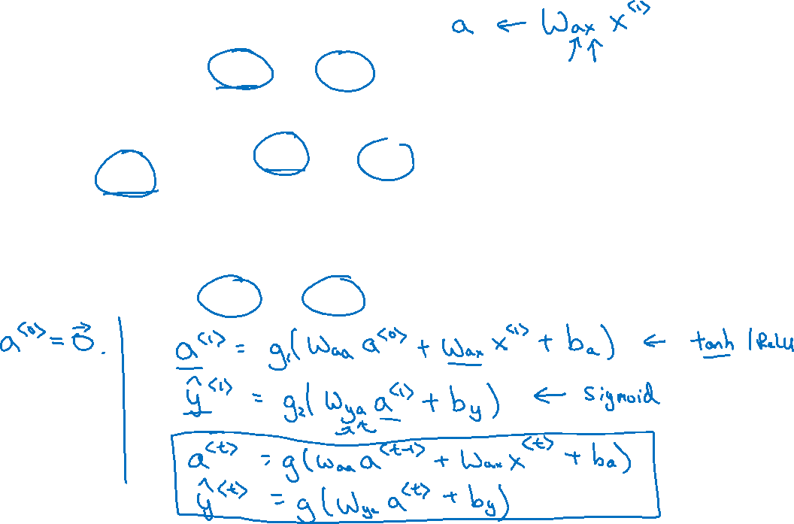







Forward Propagation
$${\hat{y}}^{<1>}$$
$${\hat{y}}^{<2>}$$
$${\hat{y}}^{<3>}$$
$${\hat{y}}^{<T_{y}>}$$
$$a^{<1>}$$
$$a^{<2>}$$
$$a^{<T_{x}−1>}$$
$$a^{<0>}$$
$$⋯$$
$$x^{<1>}$$
$$x^{<2>}$$
$$x^{<3>}$$
$$x^{<T_{x}>}$$

Slide 9


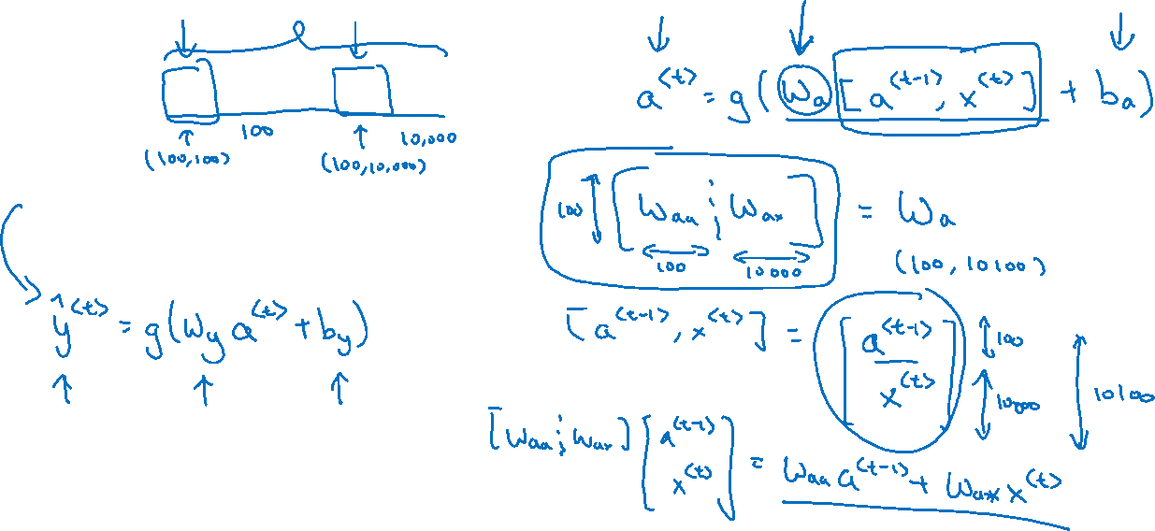
Simplified RNN notation
$$a^{<t>}=g(W_{aa}a^{<t−1>}+W_{ax}x^{<t>}+b_{a})$$
$${\hat{y}}^{<t>}=g(W_{ya}a^{<t>}+b_{y})$$

Slide 10
Recurrent Neural Networks
Backpropagation through time
deeplearning.ai

Slide 11

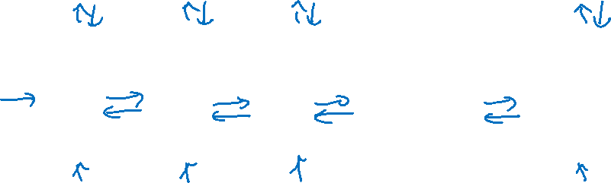



Forward propagation and backpropagation
$${\hat{y}}^{<1>}$$
$${\hat{y}}^{<2>}$$
$${\hat{y}}^{<3>}$$
$${\hat{y}}^{<T_{y}>}$$
$$a^{<1>}$$
$$a^{<2>}$$
$$a^{<T_{x}−1>}$$
$$a^{<0>}$$
$$⋯$$
$$x^{<1>}$$
$$x^{<2>}$$
$$x^{<3>}$$
$$x^{<T_{x}>}$$

Slide 12

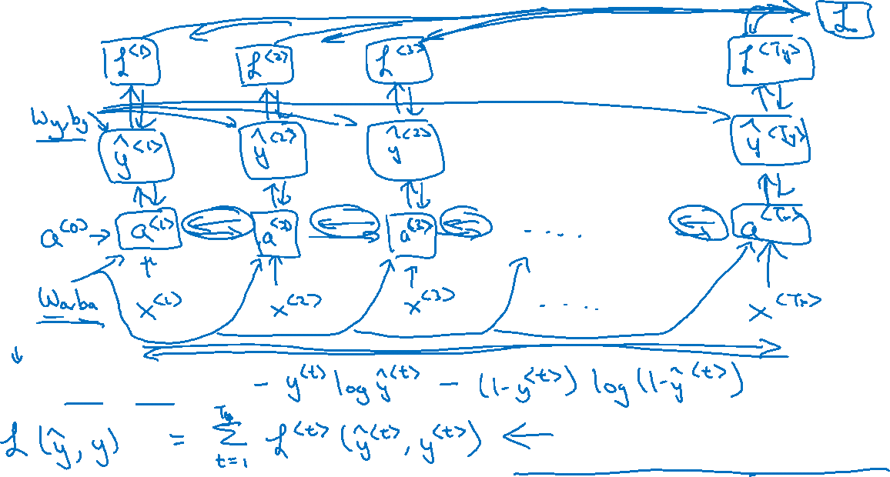
Forward propagation and backpropagation
$$ℒ^{<t>}\left({\hat{y}}^{<t>},y^{<t>}\right)=$$
Backpropagation through time

