Slide 1
Glottis Flow
JD
ME 662 Advanced Fluid Mechanics
December 2, 2025

Slide 2
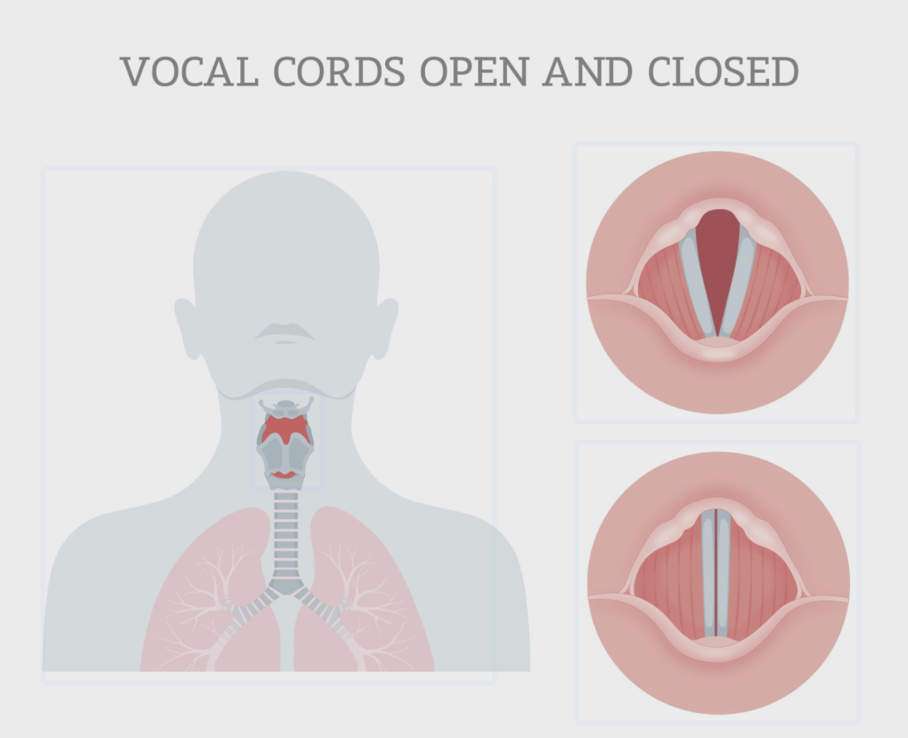
Introduction and Motivation
The Physics of Voice:
  Voice is produced by airflow through the larynx (glottis).
  The intraglottal pressure profile drives the vocal fold oscillation.
The Problem:
  Modeling airflow in the human larynx (glottis) is complex and computationally expensive (usually requires full Navier-Stokes simulations).
  There is a need for faster, simplified models to estimate the aerodynamic driving forces of speech.
Project Objective:
  Develop increasingly sophisticated simplified models based on Potential Flow Theory to predict pressures.
  Validate the model against benchmark experimental data (Scherer et al., 2001).
The python implmentation can be found at https://github.com/jiangdizhu/ME662-Project.git

Slide 3
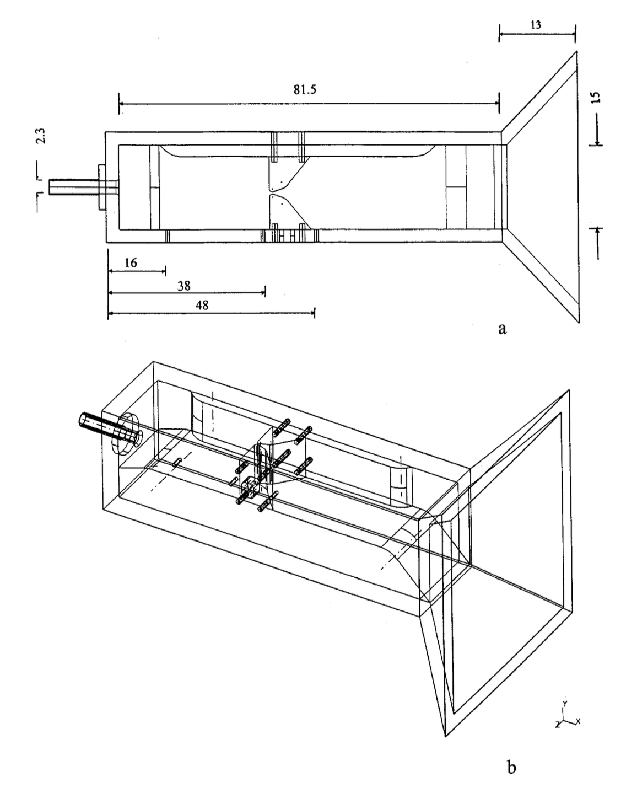
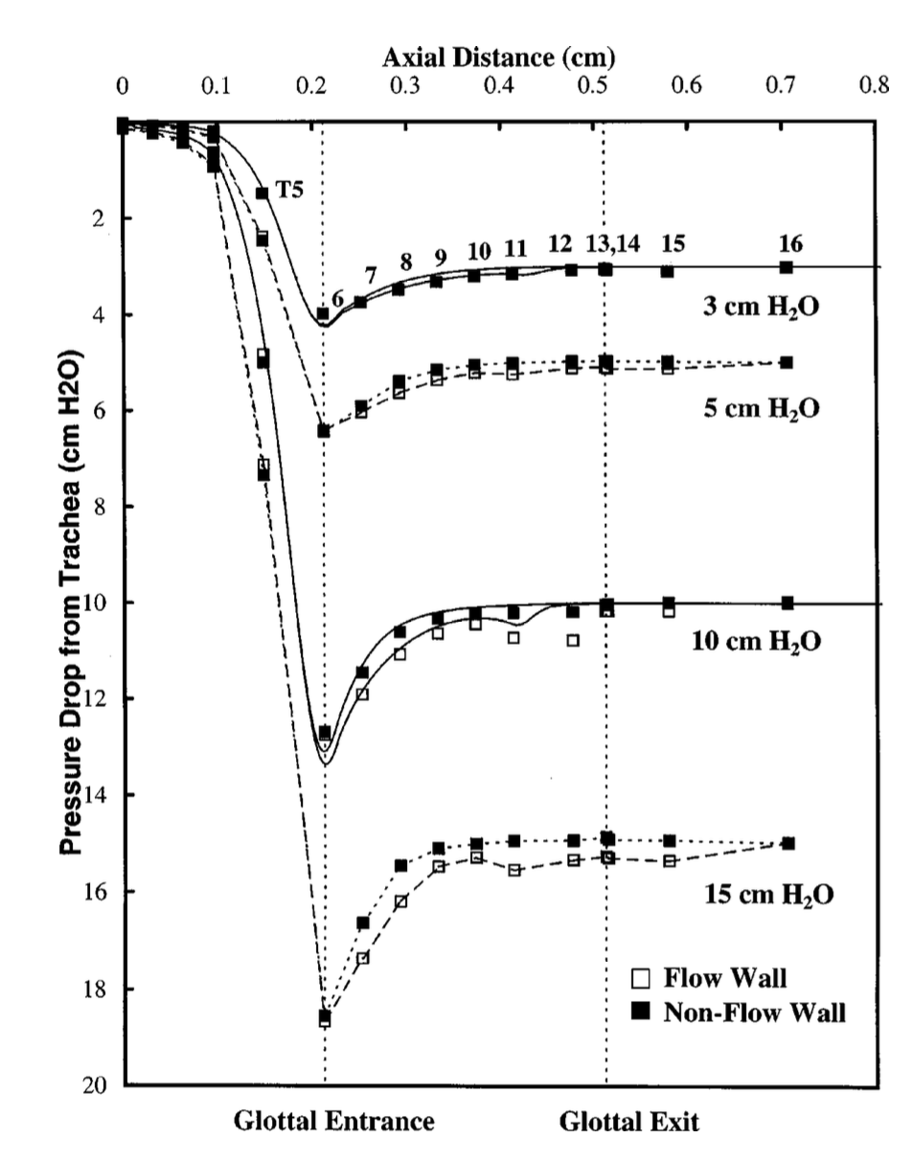
Experimental Apparatus
Setup
Results
Figures adapted from Scherer, R. C., Shinwari, D., De Witt, K. J., Zhang, C., Kucinschi, B. R., & Afjeh, A. A. (2001). Intraglottal pressure profiles for a symmetric and oblique glottis with a divergence angle of 10 degrees. J. Acoust. Soc. Am., 109(4), 1616–1630.

Slide 4
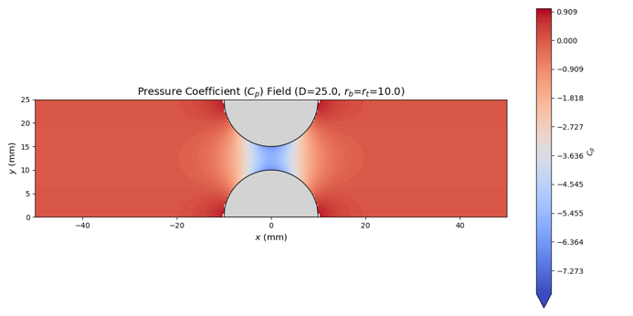
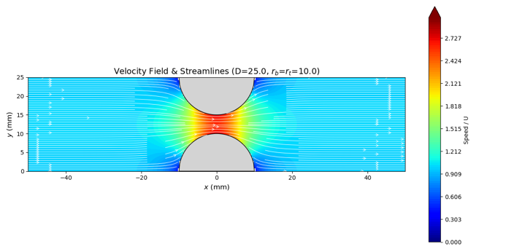
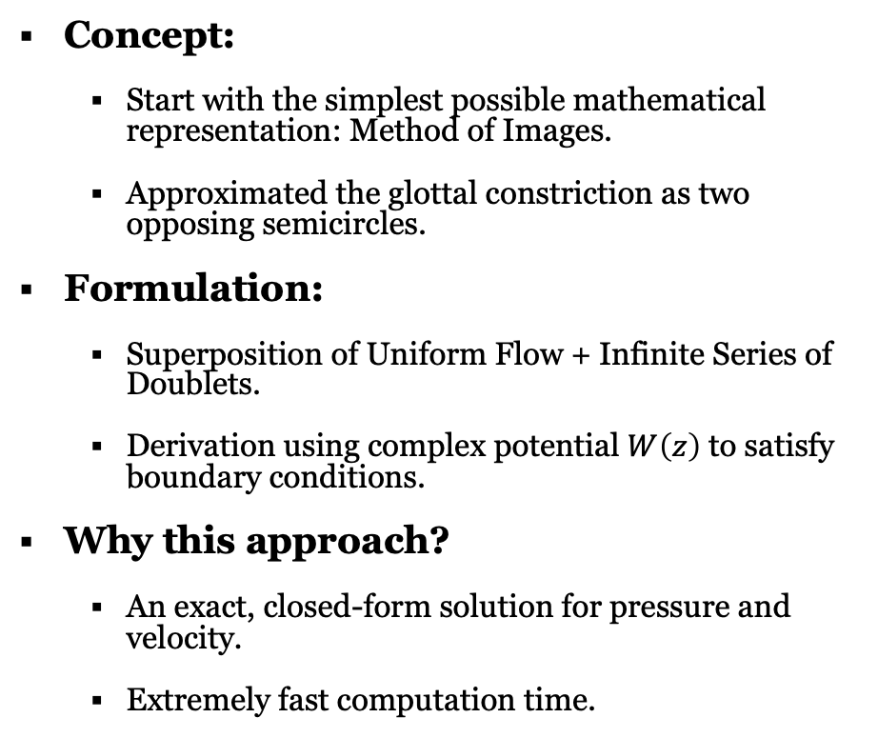
Method of Images
Concept:
  Start with the simplest possible mathematical representation: Method of Images.
  Approximated the glottal constriction as two opposing semicircles.
Formulation:
  Superposition of Uniform Flow + Infinite Series of Doublets.
  Derivation using complex potential $W\left(z\right)$ to satisfy boundary conditions.
Why this approach?
  An exact, closed-form solution for pressure and velocity.
  Extremely fast computation time.

Slide 5
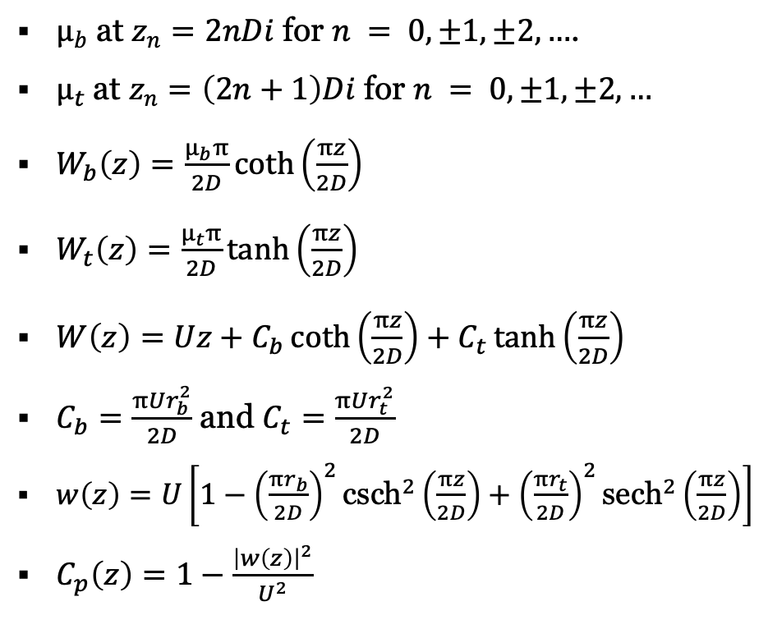
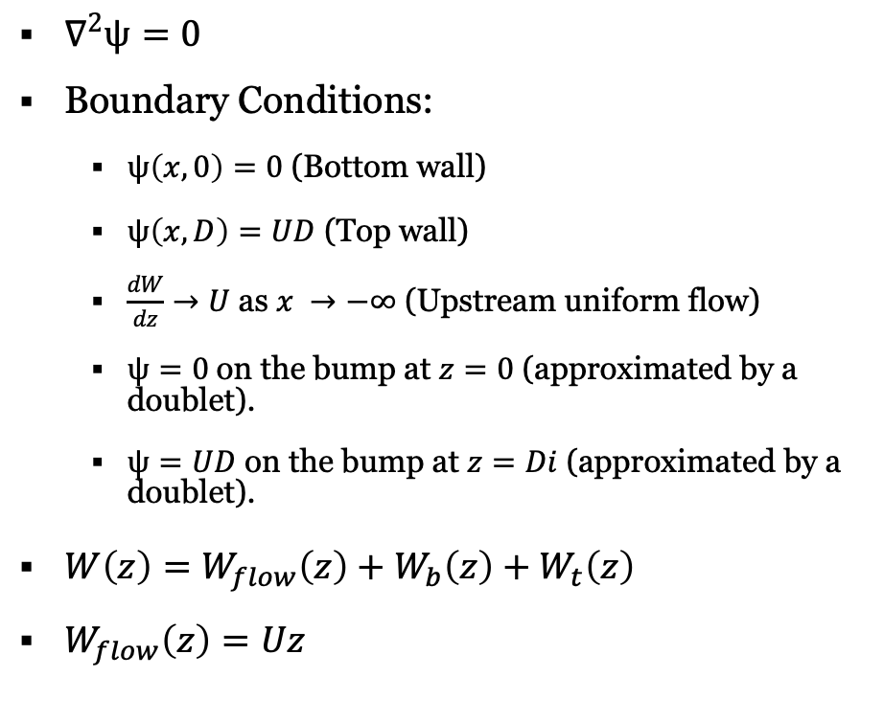
Method of Images - Approach
$∇^{2}ψ=0$
Boundary Conditions:
  $ψ\left(x,0\right)=0$ (Bottom wall)
  $ψ\left(x,D\right)=UD$ (Top wall)
  $\frac{dW}{dz}→U$ as $x →−∞$ (Upstream uniform flow)
  $ψ=0$on the bump at $z=0$ (approximated by a doublet).
  $ψ=UD$ on the bump at $z=Di$ (approximated by a doublet).
$W\left(z\right)=W_{flow}\left(z\right)+W_{b}\left(z\right)+W_{t}\left(z\right)$
$W_{flow}\left(z\right)=Uz$
$μ_{b}$ at $z_{n}=2nDi$ for $n = 0, ±1, ±2, …$.
$μ_{t}$ at $z_{n}=\left(2n+1\right)Di$ for $n = 0, ±1, ±2, …$
$W_{b}\left(z\right)=\frac{μ_{b}π}{2D}\coth\left(\frac{πz}{2D}\right)$
$W_{t}\left(z\right)=\frac{μ_{t}π}{2D}\tanh\left(\frac{πz}{2D}\right)$
$W\left(z\right)=Uz+C_{b}\coth\left(\frac{πz}{2D}\right)+C_{t}\tanh\left(\frac{πz}{2D}\right)$
$C_{b}=\frac{πUr_{b}^{2}}{2D}$ and $C_{t}=\frac{πUr_{t}^{2}}{2D}$
$w\left(z\right)=U\left[1−{\left(\frac{πr_{b}}{2D}\right)}^{2}{\text{csch}}^{2}\left(\frac{πz}{2D}\right)+{\left(\frac{πr_{t}}{2D}\right)}^{2}{\text{sech}}^{2}\left(\frac{πz}{2D}\right)\right]$
$C_{p}\left(z\right)=1−\frac{{\left|w\left(z\right)\right|}^{2}}{U^{2}}$

Slide 6
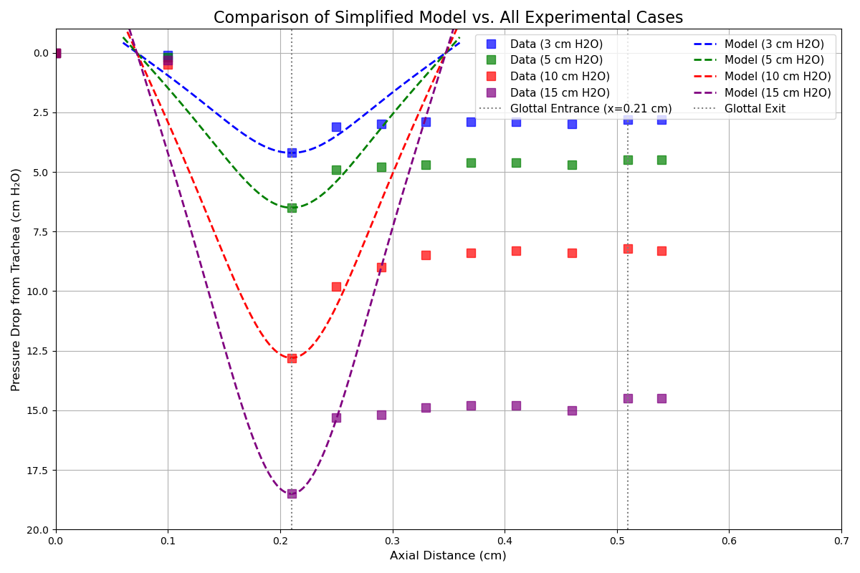
Results
Comparison with Data:
  Convergent Section: Some agreement. The model accurately predicts the pressure drop as flow accelerates.
  Divergent Section: Significant Discrepancy.
    Huge pressure drop.
    Model predicts full pressure recovery.
    Experiment shows a "Pressure Plateau”.
Limitation:
  Is this error due to the Semicircular Geometry approximation?
  Need to refine the geometry to match the experiment exactly.

Slide 7
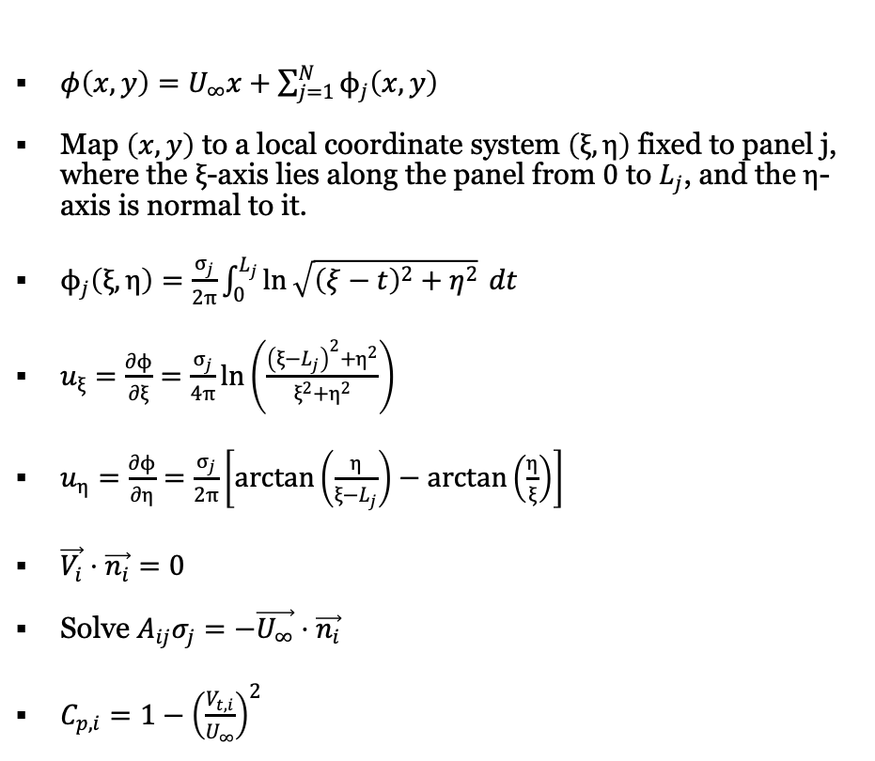
Source Panel Method
Refinement:
  Source Panel Method to better approximate the experimental geometry.
Implementation:
  Discretized the channel wall into N panels with uniform source distributions.
  Solved linear system for source strengths to satisfy BC.
Goal:
  Determine if correct geometry more accurately predict pressure drop.
$φ\left(x,y\right)=U_{∞}x+\sum_{j=1}^{N}{ϕ_{j}\left(x,y\right)}$
Map $\left(x,y\right)$ to a local coordinate system $\left(ξ,η\right)$ fixed to panel j, where the $ξ$-axis lies along the panel from $0$ to $L_{j}$, and the $η$-axis is normal to it.
$ϕ_{j}\left(ξ,η\right)=\frac{σ_{j}}{2π}\int_{0}^{L_{j}}{\ln{\sqrt{{\left(ξ−t\right)}^{2}+η^{2}}} dt}$
$u_{ξ}=\frac{∂ϕ}{∂ξ}=\frac{σ_{j}}{4π}\ln\left(\frac{{\left(ξ−L_{j}\right)}^{2}+η^{2}}{ξ^{2}+η^{2}}\right)$
$u_{η}=\frac{∂ϕ}{∂η}=\frac{σ_{j}}{2π}\left[\arctan\left(\frac{η}{ξ−L_{j}}\right)−\arctan\left(\frac{η}{ξ}\right)\right]$
$\vec{V_{i}}⋅\vec{n_{i}}=0$
Solve $A_{ij}σ_{j}=−\vec{U_{∞}}⋅\vec{n_{i}}$
$C_{p,i}=1−{\left(\frac{V_{t,i}}{U_{∞}}\right)}^{2}$

Slide 8
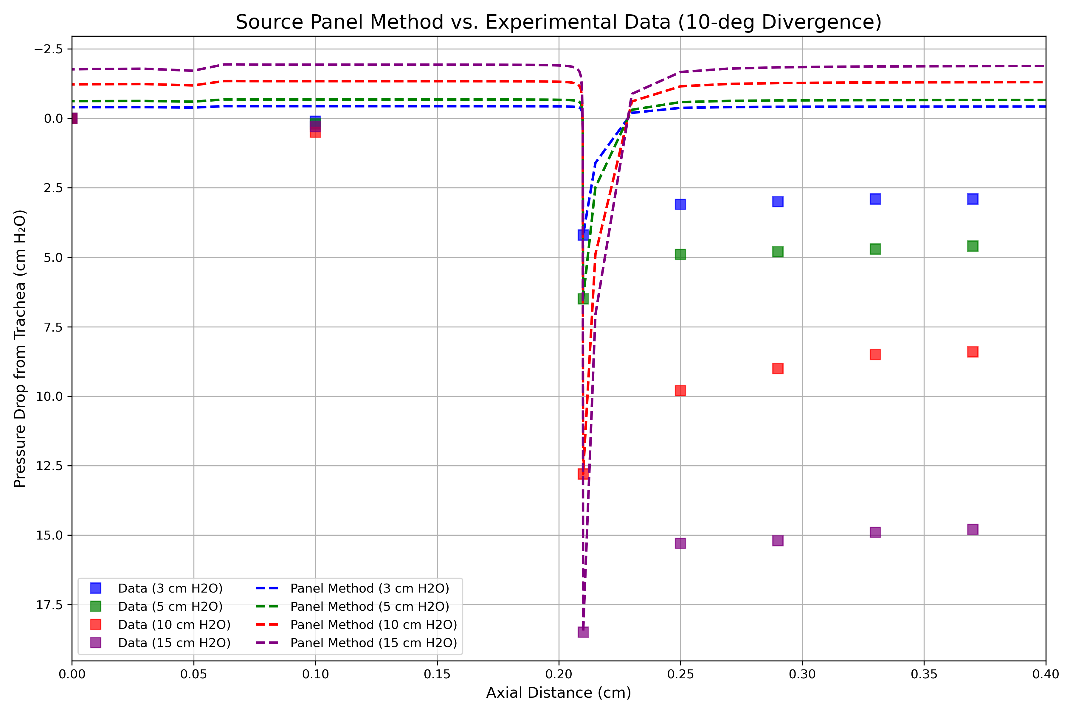
Results
Results:
  The Source Panel Method captures the smooth wall profile perfectly.
  Pressure drop prediction match the experiment.
  The pressure recovery profile remains incorrect (still rises sharply).
Critical Finding:
  Geometry is not the limiting factor.
  Pure Potential Flow (Inviscid) theory cannot predict the wake behavior in the divergent section.
Conclusion: The Simplified Model must include viscous effects to predict the pressure plateau.

Slide 9
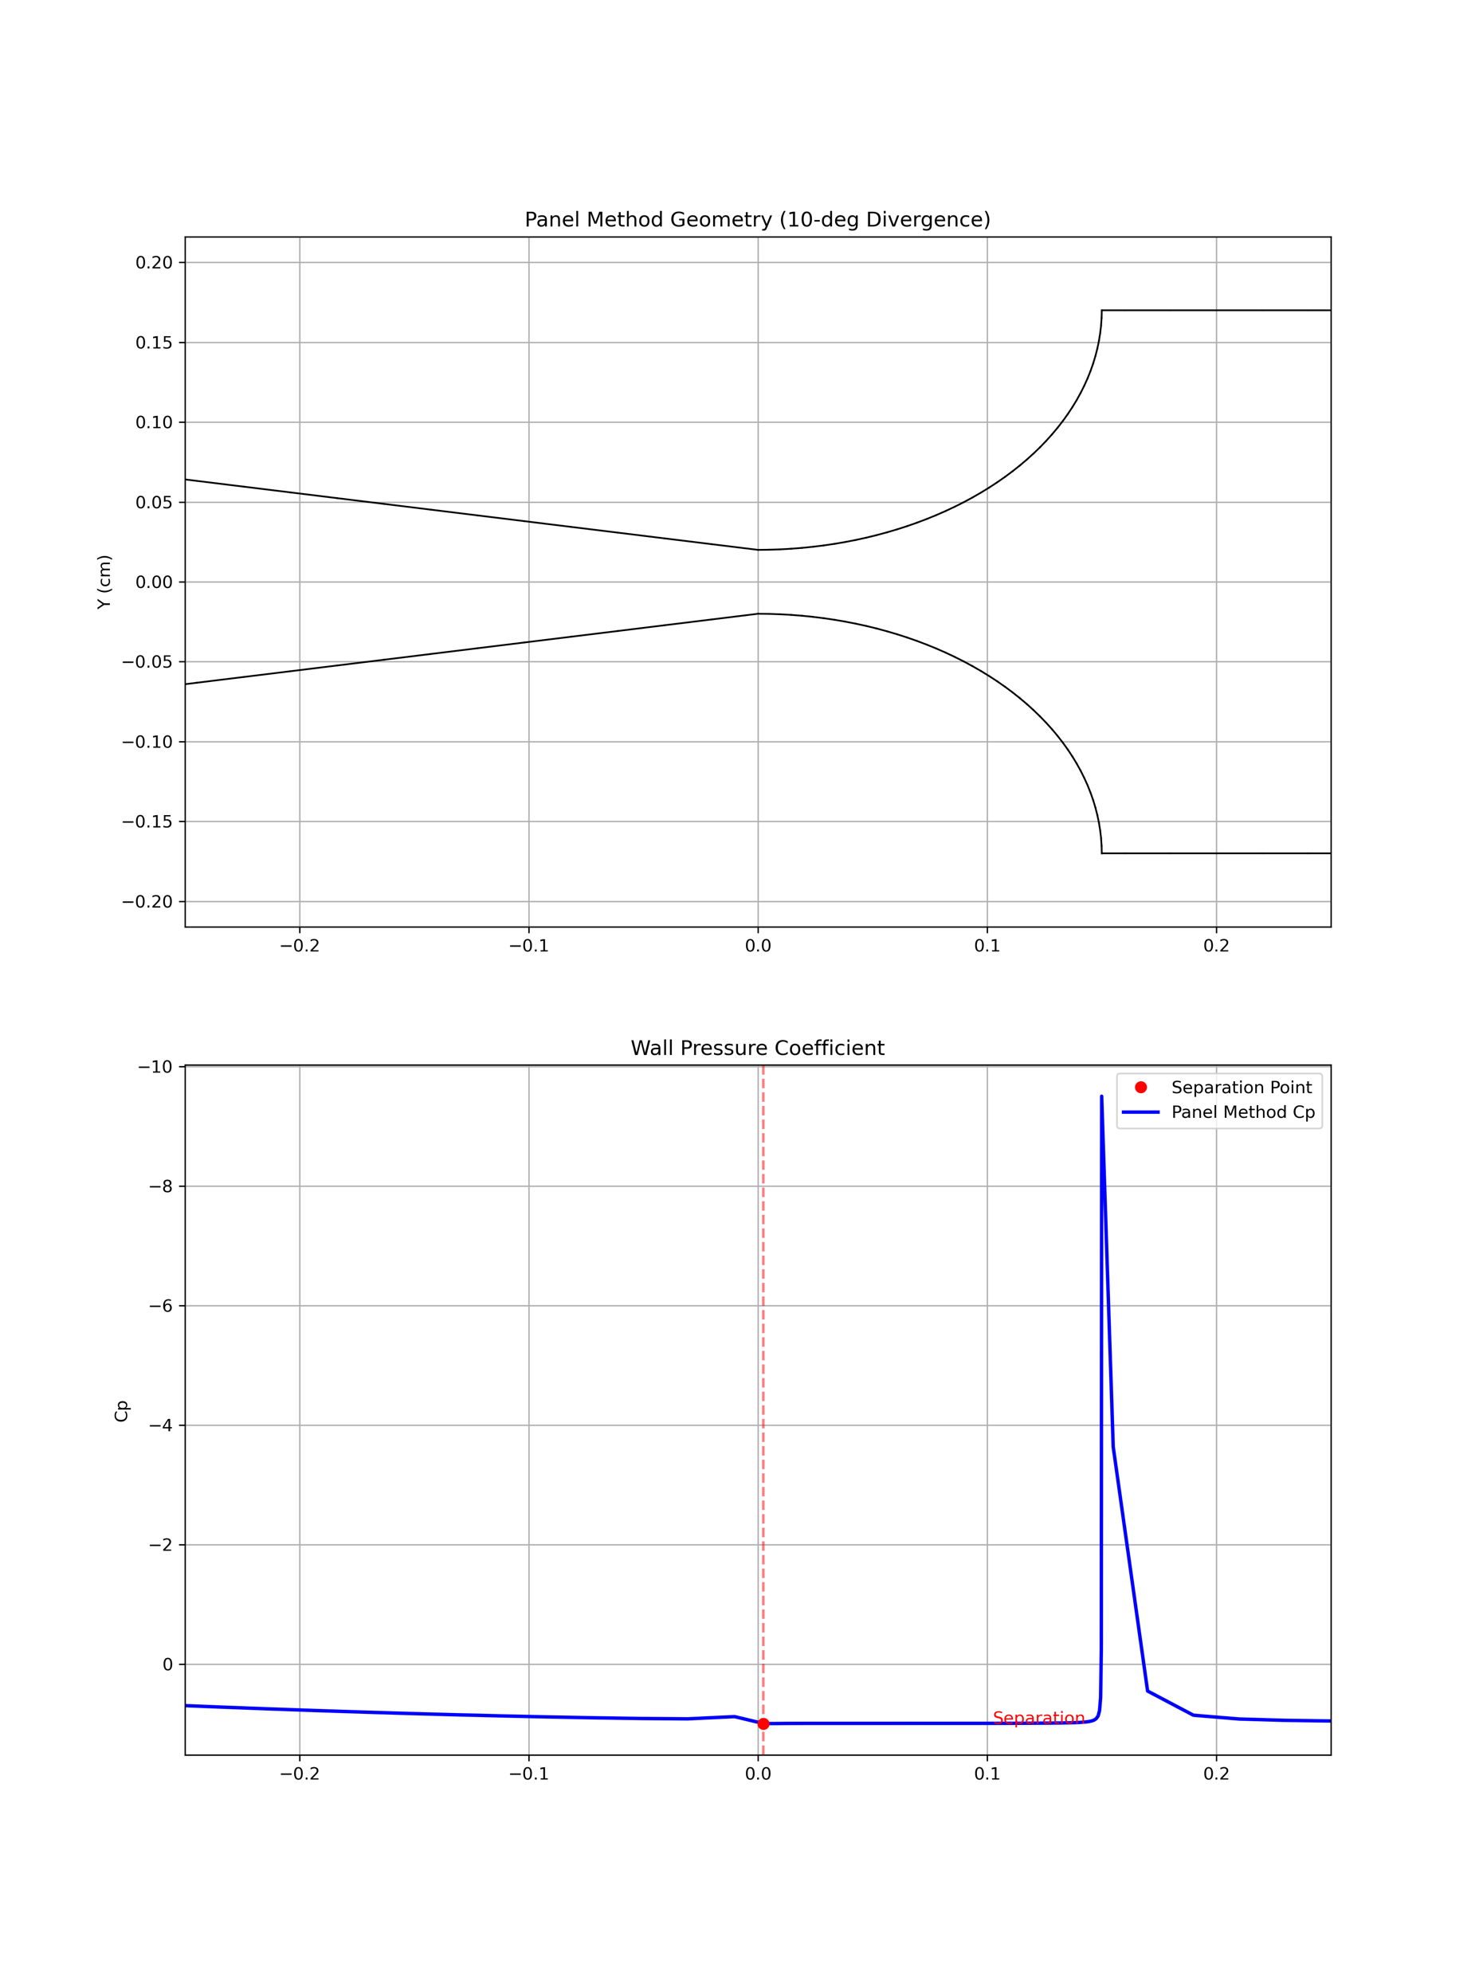
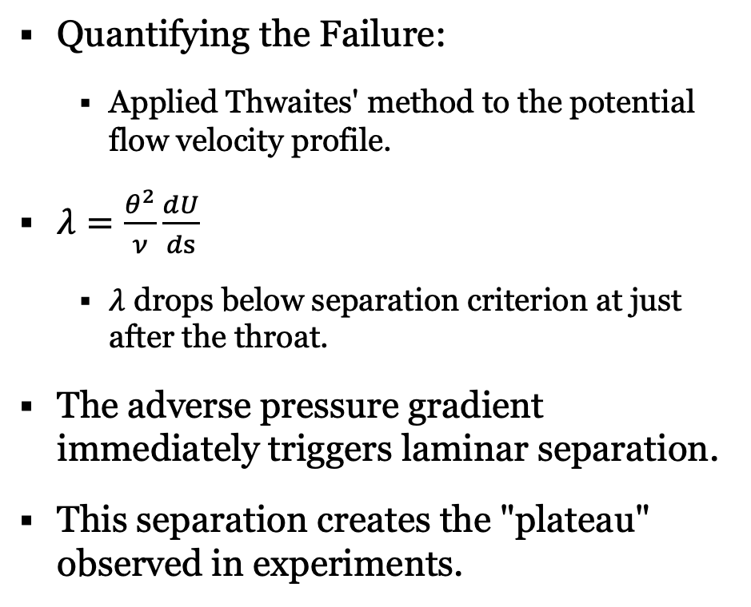
Boundary Layer Analysis
Quantifying the Failure:
  Applied Thwaites' method to the potential flow velocity profile.
$λ=\frac{θ^{2}}{ν}\frac{dU}{ds}$
  $λ$ drops below separation criterion at just after the throat.
The adverse pressure gradient immediately triggers laminar separation.
This separation creates the "plateau" observed in experiments.

Slide 10
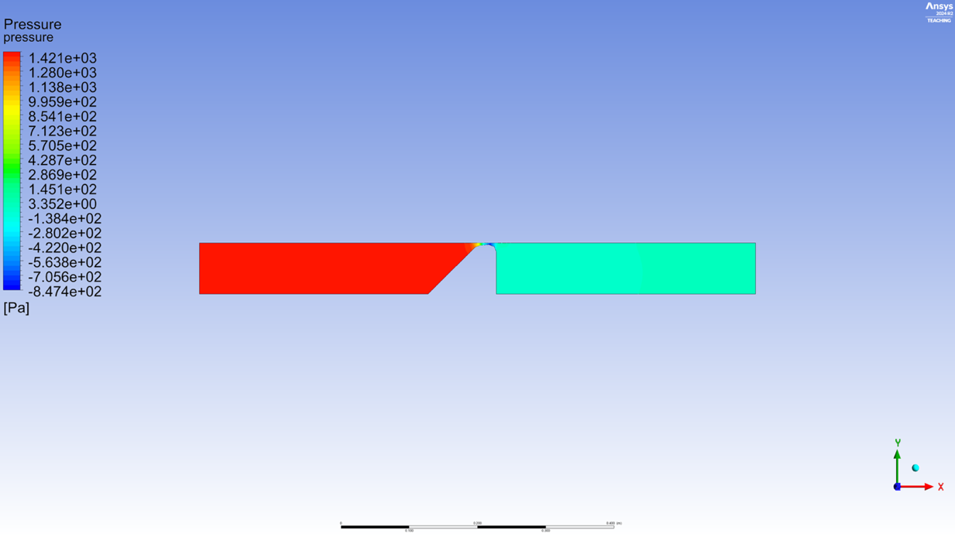
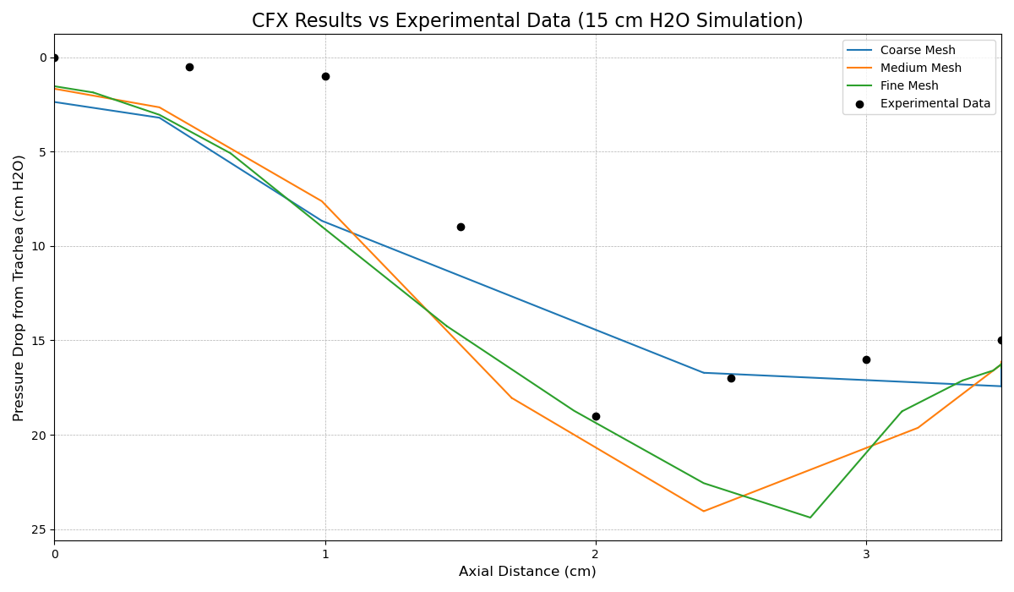
Future Work & Improvement of Prediction
Viscous-Inviscid Interaction
  Concept: Couple the Panel Method with an integral boundary layer solver.
  Benefit: Captures the "squeezing" effect of the boundary layer on the core flow.
  Difficulty: Ill-posed (Goldstein’s Singularity at Separation), stability, stiff, need a hybrid solution.
CFD (RANS/URANS/LES)
  Concept: Move beyond potential flow to simulate turbulence and jet mixing.
  Benefit: Captures the complex vortex dynamics in the supraglottal region.
  Difficulty: Computationally expensive

Slide 11
Limitations and Conclusions
Limitations:
  Geometric Constraints: The analytic Method of Images is restricted to semicircular constrictions, preventing the modeling of the gradual 10-degree divergent channel used in experimental benchmarks.
  Inviscid Assumption: Both the analytic and numerical models assume irrotational flow, neglecting viscous dissipation and boundary layer dynamics entirely.
  Separation Failure: Due to the inviscid assumption, neither model can predict flow separation or the resulting pressure plateau, failing significantly in regions with adverse pressure gradients.
Conclusions:
  Inviscid Models: Valid only for the convergent inlet.
  Success: Source Panel Method can accurately predict pressure drop
  Discrepancy: Pressure plateau is caused by flow separation

Slide 12
References
[1] Scherer, R. C., Shinwari, D., De Witt, K. J., Zhang, C., Kucinschi, B. R., & Afjeh, A. A. (2001). Intraglottal pressure profiles for a symmetric and oblique glottis with a divergence angle of 10 degrees. J. Acoust. Soc. Am., 109(4), 1616–1630.
[2] Schoder, S., Wurzer, G., & Kaltenbacher, M. (2023). Overview on state-of-the-art numerical modeling of the phonation process. Acta Acustica, 7, 1-19.
[3] Pelorson, X., Hirschberg, A., van Hassel, R. R., Wijnands, A. P. J., & Aurégan, Y. (1994). Theoretical and experimental study of quasisteady-flow separation within the glottis during phonation. Application to a modified two-mass model. The Journal of the Acoustical Society of America, 96(6), 3416-3431.
[4] Hess, J. L., & Smith, A. M. O. (1967). Calculation of potential flow about arbitrary bodies. Progress in Aerospace Sciences, 8, 1-138.
[5] Anderson, J. D. (2017). Fundamentals of Aerodynamics (6th ed.). McGraw-Hill Education.
[6] Thwaites, B. (1949). Approximate calculation of the laminar boundary layer. Aeronautical Quarterly, 1(3), 245-280.
[7] White, F. M. (2006). Viscous Fluid Flow (3rd ed.). McGraw-Hill.
[8] Zong H, Porté-Agel F. A momentum-conserving wake superposition method for wind farm power prediction. Journal of Fluid Mechanics. 2020;889:A8. doi:10.1017/jfm.2020.77
[9] Mittal, R., Erath, B. D., & Plesniak, M. W. (2013). Fluid dynamics of human phonation and speech. Annual Review of Fluid Mechanics, 45, 437-467.

