Slide 1
Divide-and-Conquer
7 2 ⏐ 9 4 → 2 4 7 9
7 ⏐ 2 → 2 7
9 ⏐ 4 → 4 9
7 → 7
2 → 2
9 → 9
4 → 4
Divide-and-Conquer
Notes:
Merge Sort

Slide 2
Divide-and-Conquer
Divide-and conquer is a general algorithm design paradigm:
  Divide: divide the input data S in two or more disjoint subsets S₁, S₂, …
  Recur: solve the subproblems recursively
  Conquer: combine the solutions for S₁, S₂, …, into a solution for S
The base case for the recursion are subproblems of constant size
Analysis can be done using recurrence equations
Divide-and-Conquer

Slide 3

Merge-Sort Review
Merge-sort on an input sequence S with n elements consists of three steps:
  Divide: partition S into two sequences S₁ and S₂ of about n/2 elements each
  Recur: recursively sort S₁ and S₂
  Conquer: merge S₁ and S₂ into a unique sorted sequence
Algorithm mergeSort(S)
Input sequence S with n elements
Output sequence S sorted
  according to C
  if S.size() > 1
  (S₁, S₂) ← partition(S, n/2)
  mergeSort(S₁)
  mergeSort(S₂)
  S ← merge(S₁, S₂)
Divide-and-Conquer

Slide 4
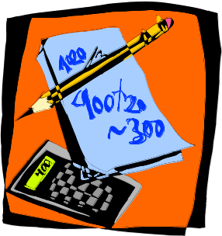
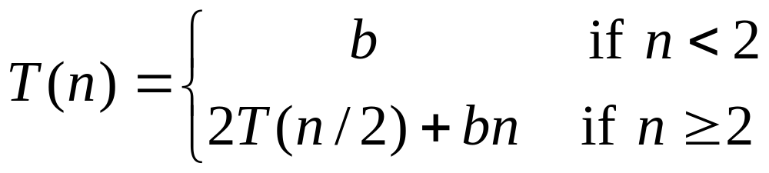
Recurrence Equation Analysis
The conquer step of merge-sort consists of merging two sorted sequences, each with n/2 elements and implemented by means of a doubly linked list, takes at most bn steps, for some constant b.
Likewise, the basis case (n < 2) will take at b most steps.
Therefore, if we let T(n) denote the running time of merge-sort:
We can therefore analyze the running time of merge-sort by finding a closed form solution to the above equation.
  That is, a solution that has T(n) only on the left-hand side.
Divide-and-Conquer

Slide 5

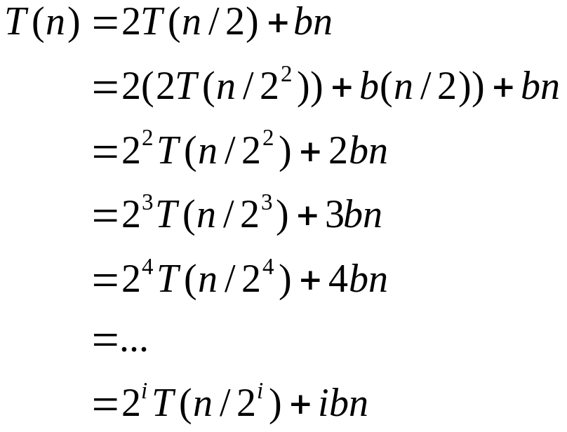

Iterative Substitution
In the iterative substitution, or “plug-and-chug,” technique, we iteratively apply the recurrence equation to itself and see if we can find a pattern:
Note that base, T(n)=b, case occurs when 2^{i}=n. That is, i = log n.
So,
Thus, T(n) is O(n log n).
Divide-and-Conquer

Slide 6

The Recursion Tree
Draw the recursion tree for the recurrence relation and look for a pattern:
depth | T’s | size
0 | 1 | n
1 | 2 | n/2
i | 2^{i} | n/2^{i}
… | … | …
time
bn
bn
bn
…
Total time = bn + bn log n
(last level plus all previous levels)
Divide-and-Conquer

Slide 7
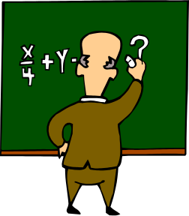
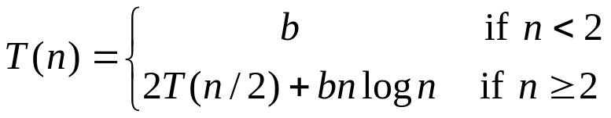
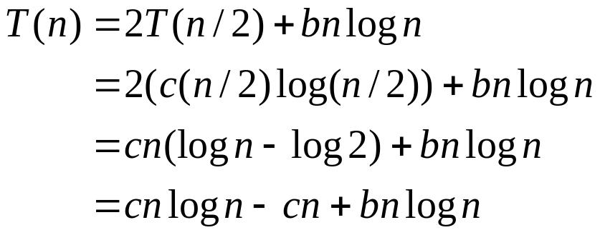
Guess-and-Test Method
In the guess-and-test method, we guess a closed form solution and then try to prove it is true by induction:
Guess: T(n) < cn log n.
Wrong: we cannot make this last line be less than cn log n
Divide-and-Conquer

Slide 8
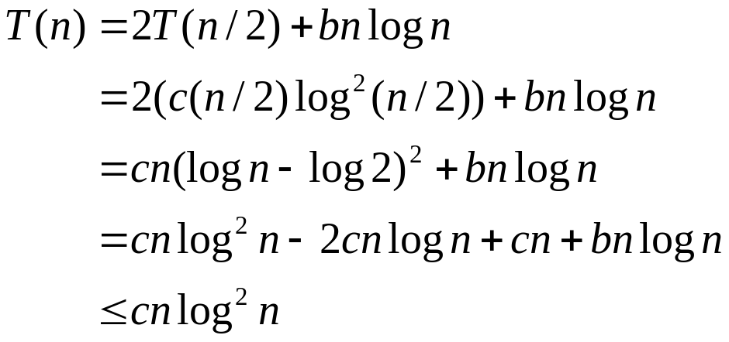
Guess-and-Test Method, (cont.)
Recall the recurrence equation:
Guess #2: T(n) < cn log² n.
  if c > b.
So, T(n) is O(n log² n).
In general, to use this method, you need to have a good guess and you need to be good at induction proofs.
Divide-and-Conquer

Slide 9

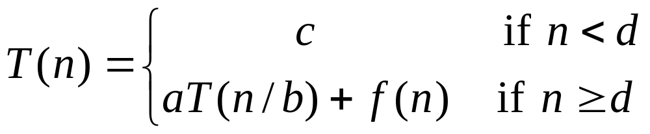
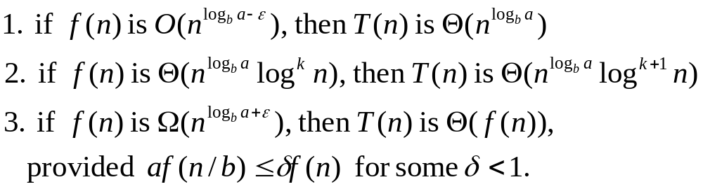
Master Method (Appendix)
Many divide-and-conquer recurrence equations have the form:
The Master Theorem:
Divide-and-Conquer

Slide 10
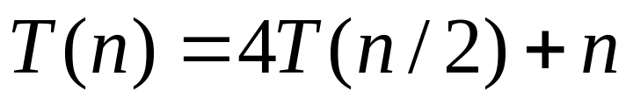
Master Method, Example 1
The form:
The Master Theorem:
Example:
Solution: log_{b}a=2, so case 1 says T(n) is O(n²).
Divide-and-Conquer

Slide 11
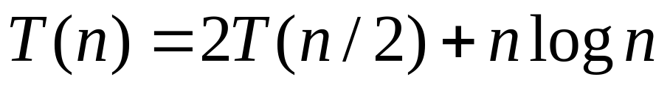
Master Method, Example 2
The form:
The Master Theorem:
Example:
Solution: log_{b}a=1, so case 2 says T(n) is O(n log² n).
Divide-and-Conquer

Slide 12
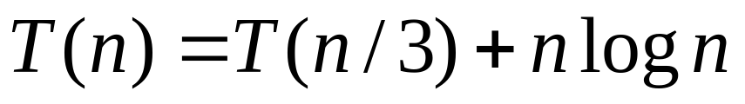
Master Method, Example 3
The form:
The Master Theorem:
Example:
Solution: log_{b}a=0, so case 3 says T(n) is O(n log n).
Divide-and-Conquer

Slide 13
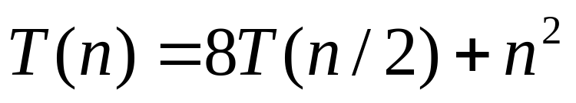
Master Method, Example 4
The form:
The Master Theorem:
Example:
Solution: log_{b}a=3, so case 1 says T(n) is O(n³).
Divide-and-Conquer

Slide 14
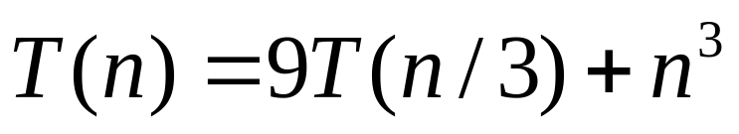
Master Method, Example 5
The form:
The Master Theorem:
Example:
Solution: log_{b}a=2, so case 3 says T(n) is O(n³).
Divide-and-Conquer

Slide 15
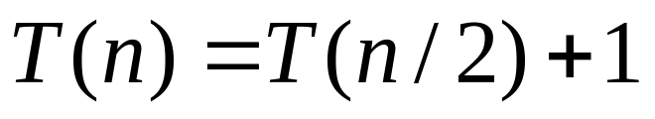
Master Method, Example 6
The form:
The Master Theorem:
Example:
(binary search)
Solution: log_{b}a=0, so case 2 says T(n) is O(log n).
Divide-and-Conquer

Slide 16
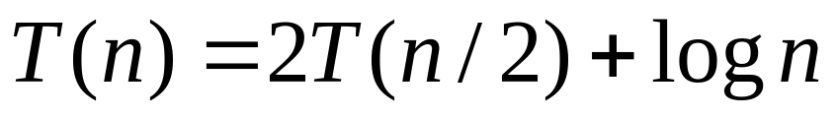
Master Method, Example 7
The form:
The Master Theorem:
Example:
(heap construction)
Solution: log_{b}a=1, so case 1 says T(n) is O(n).
Divide-and-Conquer

Slide 17
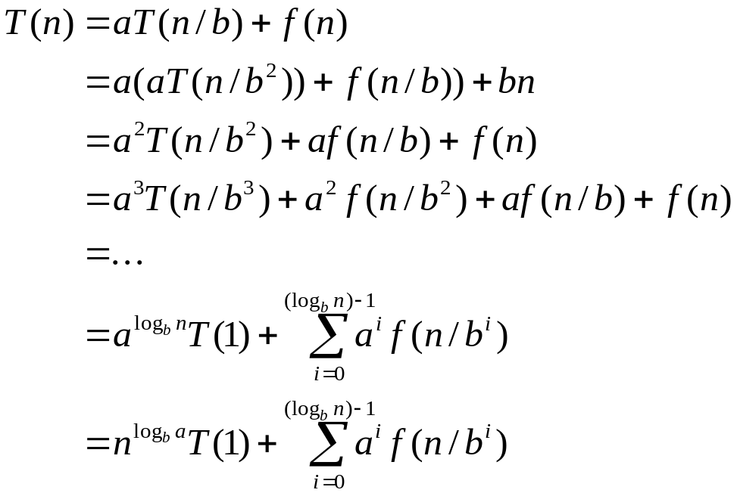
Iterative “Proof” of the Master Theorem
Using iterative substitution, let us see if we can find a pattern:
We then distinguish the three cases as
  The first term is dominant
  Each part of the summation is equally dominant
  The summation is a geometric series
Divide-and-Conquer

Slide 18
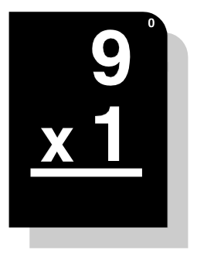
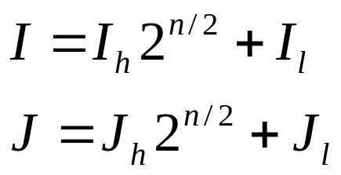
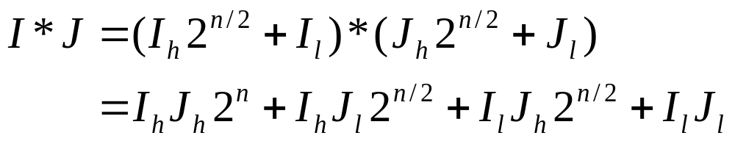
Integer Multiplication
Algorithm: Multiply two n-bit integers I and J.
  Divide step: Split I and J into high-order and low-order bits
  We can then define I*J by multiplying the parts and adding:
  So, T(n) = 4T(n/2) + n, which implies T(n) is O(n²).
  But that is no better than the algorithm we learned in grade school.
Divide-and-Conquer

Slide 19
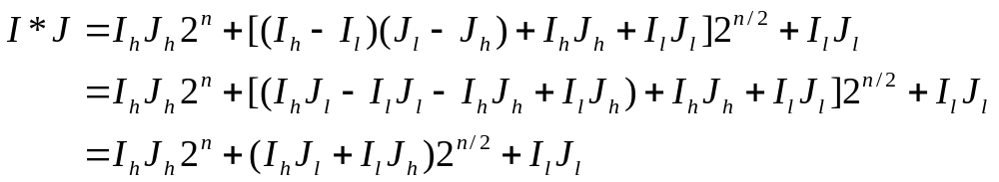
An Improved Integer Multiplication Algorithm
Algorithm: Multiply two n-bit integers I and J.
  Divide step: Split I and J into high-order and low-order bits
  Observe that there is a different way to multiply parts:
  So, T(n) = 3T(n/2) + n, which implies T(n) is O(n^{log}₂³), by the Master Theorem.
  Thus, T(n) is O(n^{1.585}).
Divide-and-Conquer

