Slide 1

Sorting Lower Bound
Sorting Lower Bound
Notes:
(2,4) Trees

Slide 2

Comparison-Based Sorting
Many sorting algorithms are comparison based.
  They sort by making comparisons between pairs of objects
  Examples: bubble-sort, selection-sort, insertion-sort, heap-sort, merge-sort, quick-sort, ...
Let us therefore derive a lower bound on the running time of any algorithm that uses comparisons to sort n elements, x₁, x₂, …, x_{n}.
Is x_{i} < x_{j}?
no
yes
Sorting Lower Bound

Slide 3
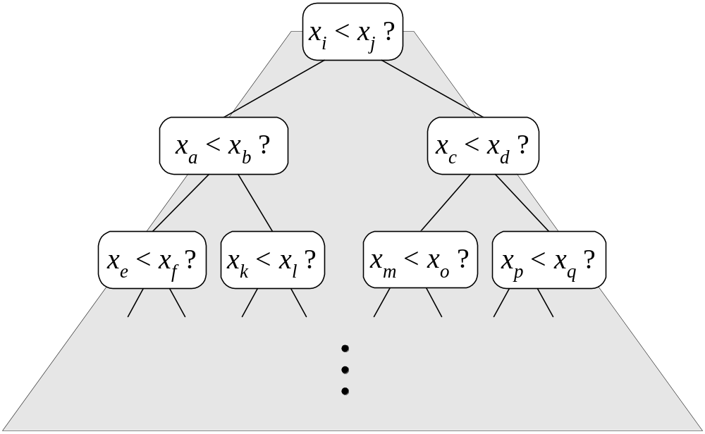
Counting Comparisons
Let us just count comparisons then.
Each possible run of the algorithm corresponds to a root-to-leaf path in a decision tree
Sorting Lower Bound

Slide 4
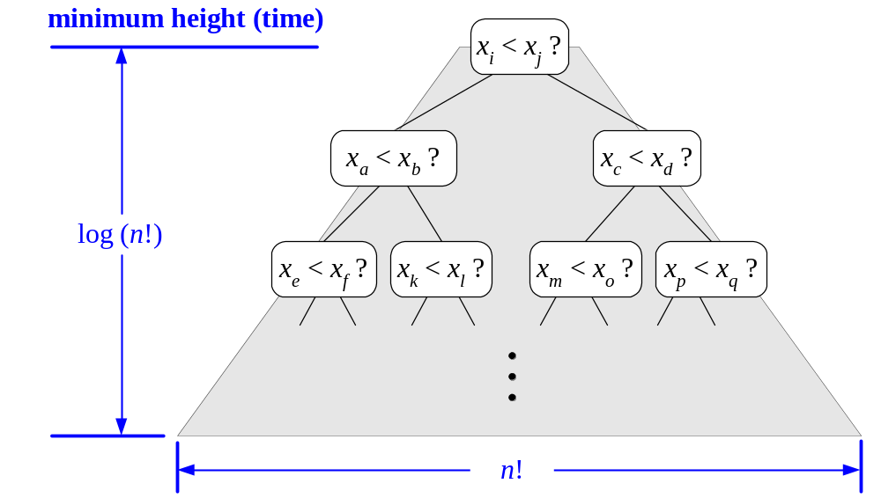
Decision Tree Height
The height of the decision tree is a lower bound on the running time
Every input permutation must lead to a separate leaf output
If not, some input …4…5… would have same output ordering as …5…4…, which would be wrong
Since there are n!=1⋅2 ⋅ … ⋅n leaves, the height is at least log (n!)
Sorting Lower Bound

Slide 5

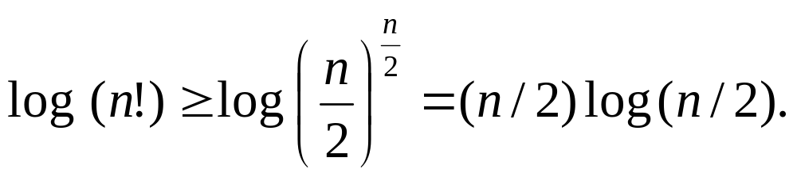
The Lower Bound
Any comparison-based sorting algorithms takes at least log (n!) time
Therefore, any such algorithm takes time at least
That is, any comparison-based sorting algorithm must run in Ω(n log n) time.
Sorting Lower Bound

