Slide 1
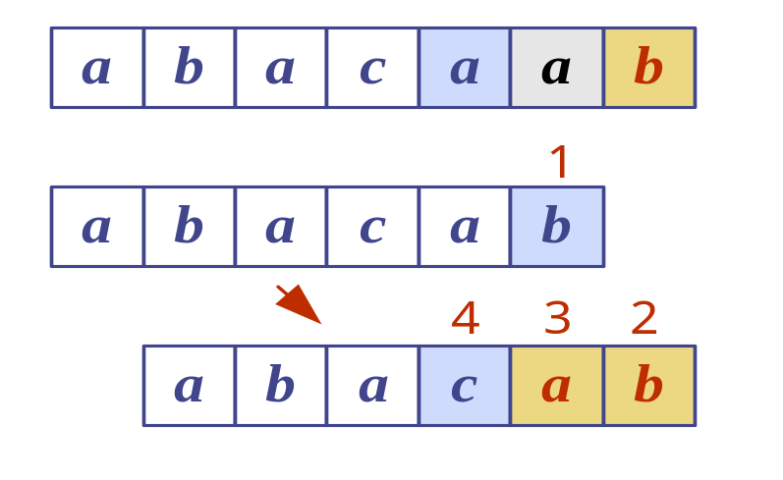
Pattern Matching
Pattern Matching
Notes:
Pattern Matching

Slide 2


Strings
A string is a sequence of characters
Examples of strings:
  Python program
  HTML document
  DNA sequence
  Digitized image
An alphabet Σ is the set of possible characters for a family of strings
Example of alphabets:
  ASCII
  Unicode
  {0, 1}
  {A, C, G, T}
Let P be a string of size m
  A substring P[i .. j] of P is the subsequence of P consisting of the characters with ranks between i and j
  A prefix of P is a substring of the type P[0 .. i]
  A suffix of P is a substring of the type P[i ..m − 1]
Given strings T (text) and P (pattern), the pattern matching problem consists of finding a substring of T equal to P
Applications:
  Text editors
  Search engines
  Biological research
Pattern Matching

Slide 3

Brute-Force Pattern Matching
Algorithm BruteForceMatch(T, P)
Input text T of size n and pattern
P of size m
Output starting index of a
substring of T equal to P or −1
if no such substring exists
  for i ← 0 to n − m
  { test shift i of the pattern }
  j ← 0
  while j < m ∧ T[i + j] = P[j]
  j ← j + 1
  if j = m
  return i {match at i}
  else
  break while loop {mismatch}
  return -1 {no match anywhere}
The brute-force pattern matching algorithm compares the pattern P with the text T for each possible shift of P relative to T, until either
  a match is found, or
  all placements of the pattern have been tried
Brute-force pattern matching runs in time O(nm)
Example of worst case:
  T = aaa … ah
  P = aaah
  may occur in images and DNA sequences
  unlikely in English text
Pattern Matching

Slide 4
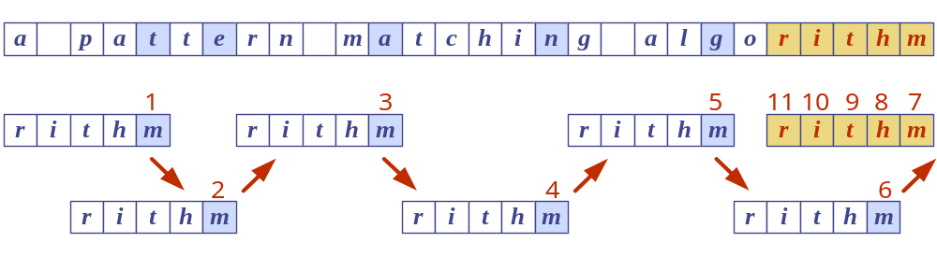
Boyer-Moore Heuristics
The Boyer-Moore’s pattern matching algorithm is based on two heuristics
Looking-glass heuristic: Compare P with a subsequence of T moving backwards
Character-jump heuristic: When a mismatch occurs at T[i] = c
  If P contains c, shift P to align the last occurrence of c in P with T[i]
  Else, shift P to align P[0] with T[i + 1]
Example
Pattern Matching

Slide 5
Last-Occurrence Function
Boyer-Moore’s algorithm preprocesses the pattern P and the alphabet Σ to build the last-occurrence function L mapping Σ to integers, where L(c) is defined as
  the largest index i such that P[i] = c or
  −1 if no such index exists
Example:
  Σ = {a, b, c, d}
  P = abacab
The last-occurrence function can be represented by an array indexed by the numeric codes of the characters
The last-occurrence function can be computed in time O(m + s), where m is the size of P and s is the size of Σ
c | a | b | c | d
L(c) | 4 | 5 | 3 | −1
Pattern Matching

Slide 6
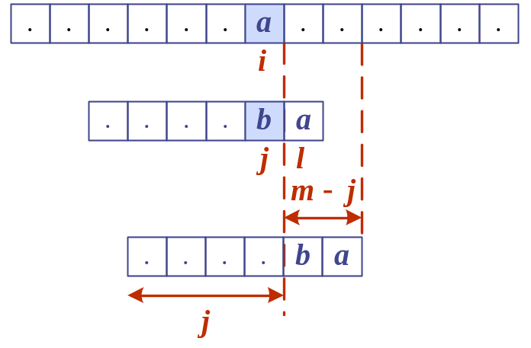
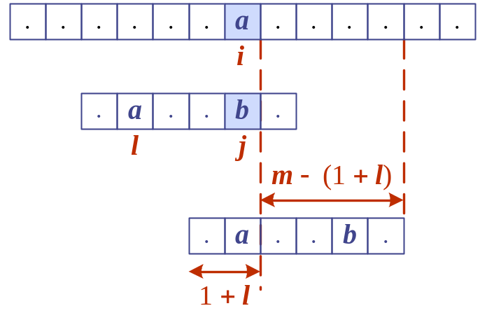
The Boyer-Moore Algorithm
Case 1: j ≤ 1 + l
Algorithm BoyerMooreMatch(T, P, Σ)
L ← lastOccurenceFunction(P, Σ )
i ← m − 1
j ← m − 1
repeat
  if T[i] = P[j]
  if j = 0
  return i { match at i }
  else
  i ← i − 1
  j ← j − 1
  else
  { character-jump }
  l ← L[T[i]]
  i ← i + m – min(j, 1 + l)
  j ← m − 1
  until i > n − 1
  return −1 { no match }
Case 2: 1 + l ≤ j
Pattern Matching

Slide 7
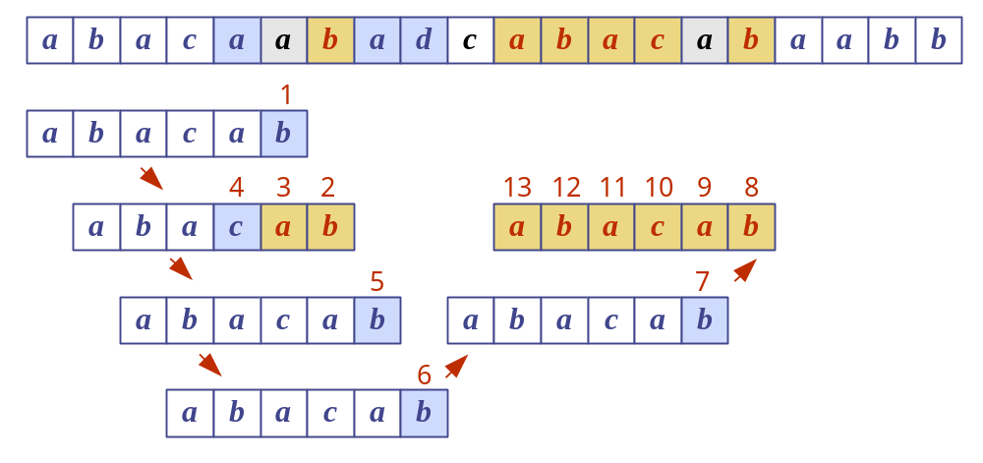
Example
Pattern Matching

Slide 8
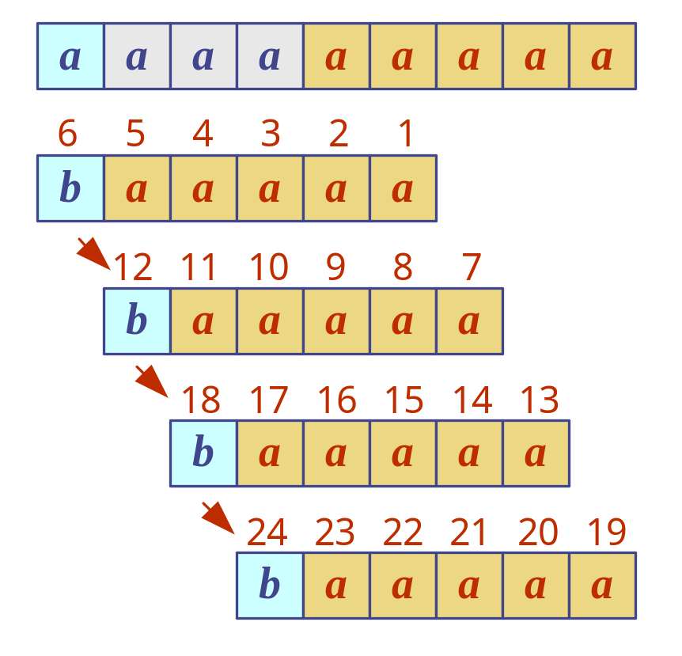
Analysis
Boyer-Moore’s algorithm runs in time O(nm + s)
Example of worst case:
  T = aaa … a
  P = baaa
The worst case may occur in images and DNA sequences but is unlikely in English text
Boyer-Moore’s algorithm is significantly faster than the brute-force algorithm on English text
Pattern Matching

Slide 9
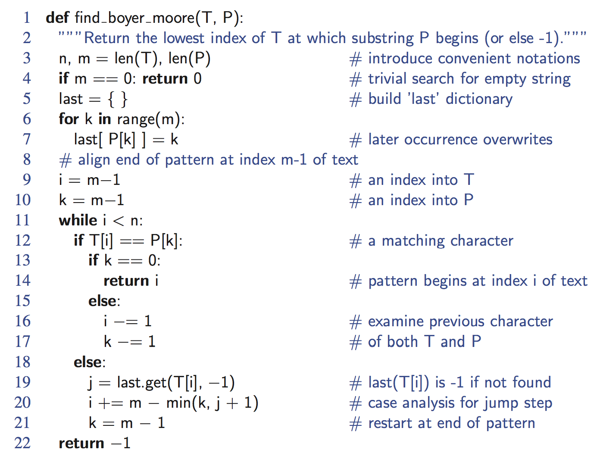
Python Implementation
Pattern Matching

Slide 10
The KMP Algorithm
Knuth-Morris-Pratt’s algorithm compares the pattern to the text in left-to-right, but shifts the pattern more intelligently than the brute-force algorithm.
When a mismatch occurs, what is the most we can shift the pattern so as to avoid redundant comparisons?
Answer: the largest prefix of P[0..j] that is a suffix of P[1..j]
.
.
a
b
a
a
b
x
.
.
.
.
.
a
b
a
a
b
a
j
a
b
a
a
b
a
No need to
repeat these
comparisons
Resume
comparing
here
Pattern Matching

Slide 11
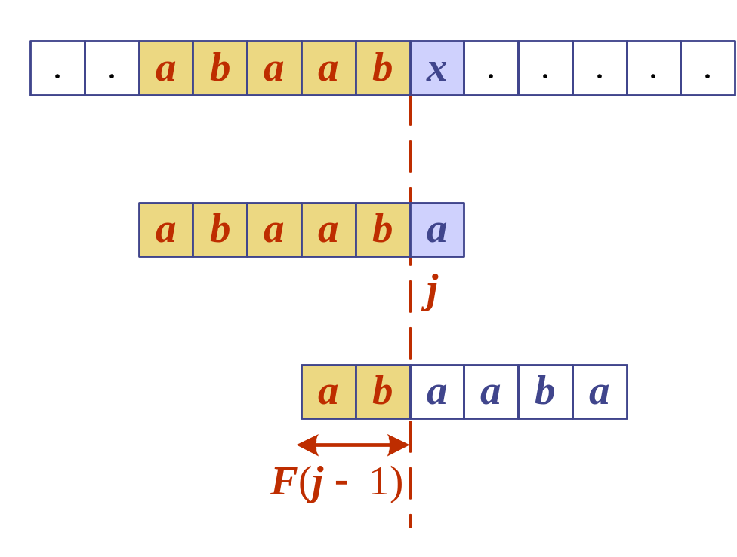
KMP Failure Function
Knuth-Morris-Pratt’s algorithm preprocesses the pattern to find matches of prefixes of the pattern with the pattern itself
The failure function F(j) is defined as the size of the largest prefix of P[0..j] that is also a suffix of P[1..j]
Knuth-Morris-Pratt’s algorithm modifies the brute-force algorithm so that if a mismatch occurs at P[j] ≠ T[i] we set j ← F(j − 1)
j | 0 | 1 | 2 | 3 | 4 | 5
P[j] | a | b | a | a | b | a
F(j) | 0 | 0 | 1 | 1 | 2 | 3
Pattern Matching

Slide 12
The KMP Algorithm
The failure function can be represented by an array and can be computed in O(m) time
At each iteration of the while-loop, either
  i increases by one, or
  the shift amount i − j increases by at least one (observe that F(j − 1) < j)
Hence, there are no more than 2n iterations of the while-loop
Thus, KMP’s algorithm runs in optimal time O(m + n)
Algorithm KMPMatch(T, P)
F ← failureFunction(P)
i ← 0
j ← 0
while i < n
  if T[i] = P[j]
  if j = m − 1
  return i − j { match }
  else
  i ← i + 1
  j ← j + 1
  else
  if j > 0
  j ← F[j − 1]
  else
  i ← i + 1
  return −1 { no match }
Pattern Matching

Slide 13

Computing the Failure Function
The failure function can be represented by an array and can be computed in O(m) time
The construction is similar to the KMP algorithm itself
At each iteration of the while-loop, either
  i increases by one, or
  the shift amount i − j increases by at least one (observe that F(j − 1) < j)
Hence, there are no more than 2m iterations of the while-loop
Algorithm failureFunction(P)
F[0] ← 0
i ← 1
j ← 0
while i < m
  if P[i] = P[j]
  {we have matched j + 1 chars}
  F[i] ← j + 1
  i ← i + 1
  j ← j + 1
  else if j > 0 then
  {use failure function to shift P}
  j ← F[j − 1]
  else
  F[i] ← 0 { no match }
  i ← i + 1
Pattern Matching

Slide 14
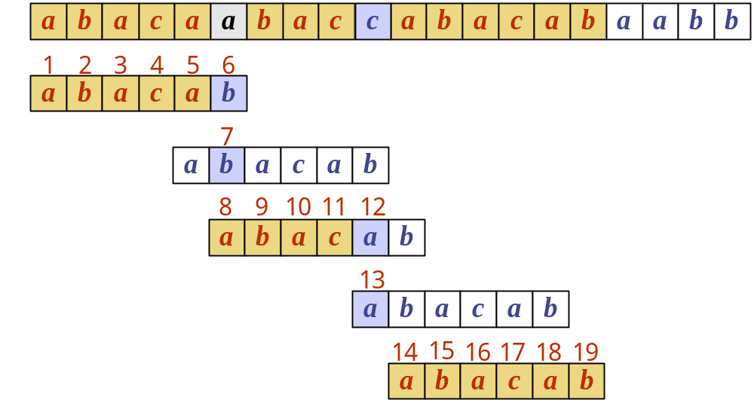
Example
j | 0 | 1 | 2 | 3 | 4 | 5
P[j] | a | b | a | c | a | b
F(j) | 0 | 0 | 1 | 0 | 1 | 2
Pattern Matching

Slide 15
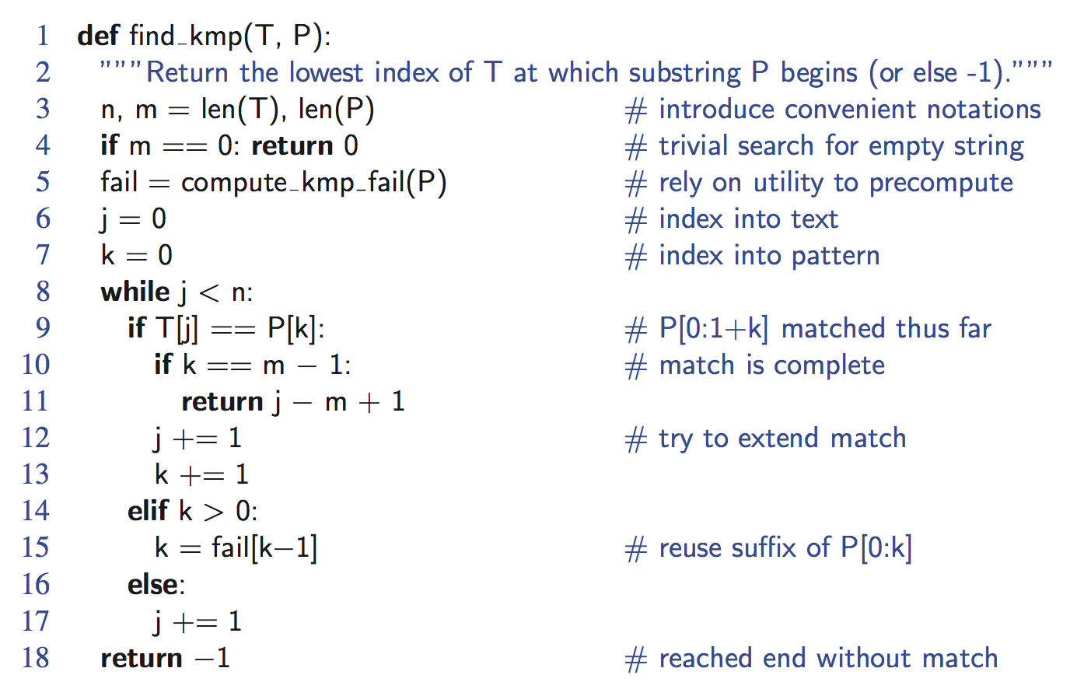
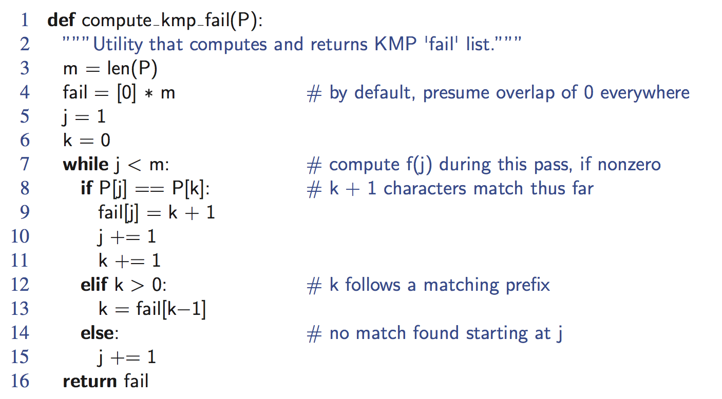
Python Implementation
Pattern Matching

