Slide 1
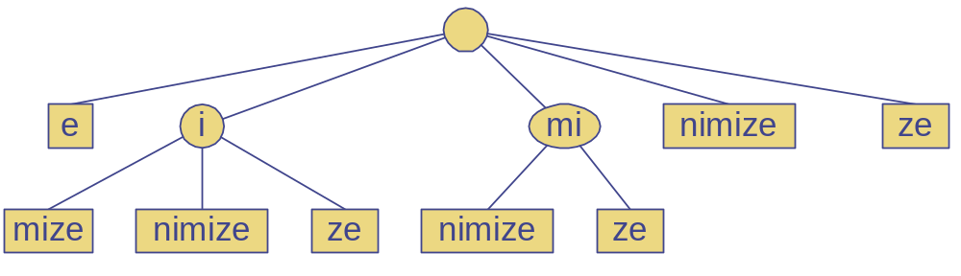
Tries
Tries
Notes:
Tries

Slide 2
Preprocessing Strings
Preprocessing the pattern speeds up pattern matching queries
  After preprocessing the pattern, KMP’s algorithm performs pattern matching in time proportional to the text size
If the text is large, immutable and searched for often (e.g., works by Shakespeare), we may want to preprocess the text instead of the pattern
A trie is a compact data structure for representing a set of strings, such as all the words in a text
  A tries supports pattern matching queries in time proportional to the pattern size
Tries

Slide 3
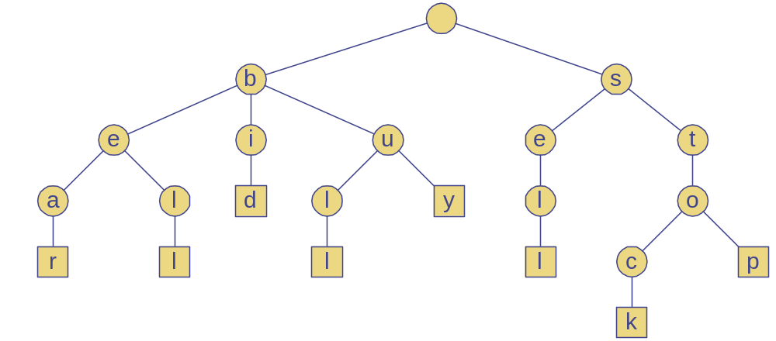
Standard Tries
The standard trie for a set of strings S is an ordered tree such that:
  Each node but the root is labeled with a character
  The children of a node are alphabetically ordered
  The paths from the external nodes to the root yield the strings of S
Example: standard trie for the set of strings
  S = { bear, bell, bid, bull, buy, sell, stock, stop }
Tries

Slide 4
Analysis of Standard Tries
A standard trie uses O(n) space and supports searches, insertions and deletions in time O(dm), where:
  n total size of the strings in S
  m size of the string parameter of the operation
  d size of the alphabet
Tries

Slide 5
Word Matching with a Trie
insert the words of the text into trie
Each leaf is associated w/ one particular word
leaf stores indices where associated word begins (“see” starts at index 0 & 24, leaf for “see” stores those indices)
s
e
e
a
b
e
a
r
?
s
e
l
l
s
t
o
c
k
!
0
1
2
3
4
5
6
7
8
9
10
11
12
13
14
15
16
17
18
19
20
21
22
23
s
e
e
a
b
u
l
l
?
b
u
y
s
t
o
c
k
!
24
25
26
27
28
29
30
31
32
33
34
35
36
37
38
39
40
41
42
43
44
45
46
b
i
d
s
t
o
c
k
!
b
i
d
s
t
o
c
k
!
47
48
49
50
51
52
53
54
55
56
57
58
59
60
61
62
63
64
65
66
67
68
h
e
a
r
t
h
e
b
e
l
l
?
s
t
o
p
!
69
70
71
72
73
74
75
76
77
78
79
80
81
82
83
84
85
86
87
88
b
h
s
e
i
u
e
e
t
a
l
d
l
y
a
e
l
o
47, 58
36
0, 24
r
l
l
r
l
c
p
6
78
30
69
12
84
k
Tries
17, 40,
51, 62

Slide 6
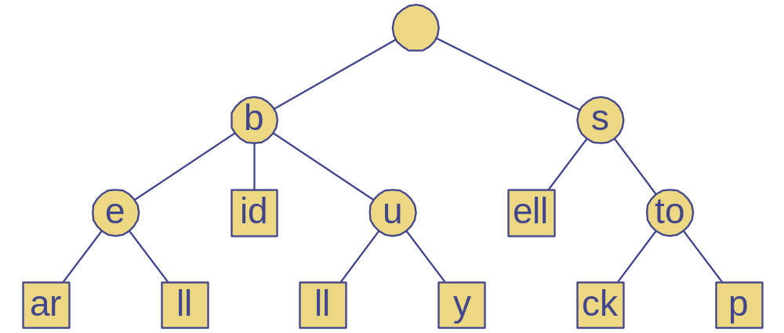
Compressed Tries
A compressed trie has internal nodes of degree at least two
It is obtained from standard trie by compressing chains of “redundant” nodes
ex. the “i” and “d” in “bid” are “redundant” because they signify the same word
Tries

Slide 7
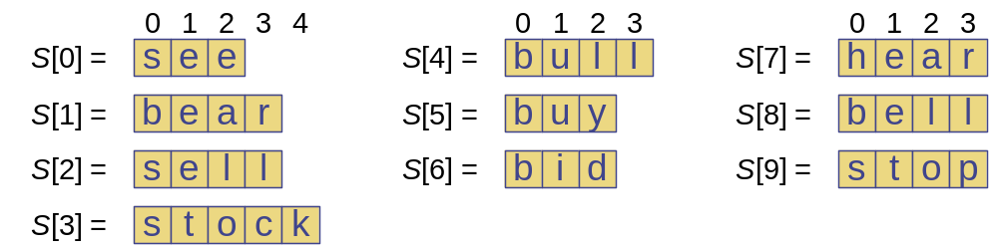
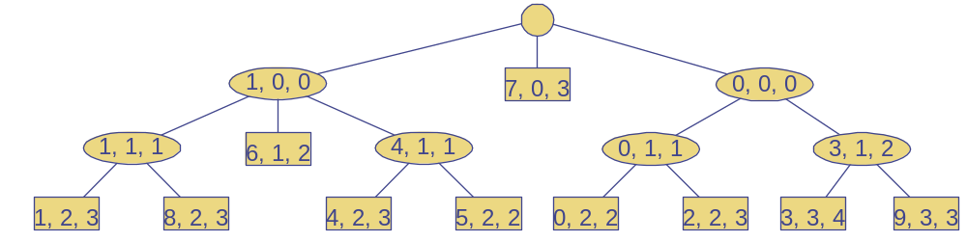
Compact Representation
Compact representation of a compressed trie for an array of strings:
  Stores at the nodes ranges of indices instead of substrings
  Uses O(s) space, where s is the number of strings in the array
  Serves as an auxiliary index structure
Tries

Slide 8
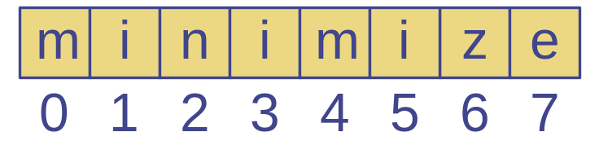
Suffix Trie
The suffix trie of a string X is the compressed trie of all the suffixes of X
Tries

Slide 9
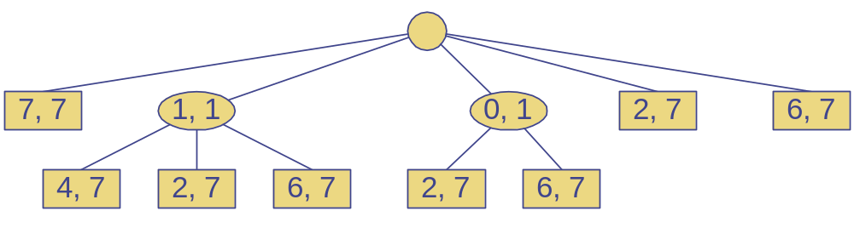
Analysis of Suffix Tries
Compact representation of the suffix trie for a string X of size n from an alphabet of size d
  Uses O(n) space
  Supports arbitrary pattern matching queries in X in O(dm) time, where m is the size of the pattern
  Can be constructed in O(n) time
Tries

Slide 10
Encoding Trie (1)
A code is a mapping of each character of an alphabet to a binary code-word
A prefix code is a binary code such that no code-word is the prefix of another code-word
An encoding trie represents a prefix code
  Each leaf stores a character
  The code word of a character is given by the path from the root to the leaf storing the character (0 for a left child and 1 for a right child
00 | 010 | 011 | 10 | 11
a | b | c | d | e
a
d
e
b
c
Tries

Slide 11
Encoding Trie (2)
Given a text string X, we want to find a prefix code for the characters of X that yields a small encoding for X
  Frequent characters should have short code-words
  Rare characters should have long code-words
Example
  X = abracadabra
  T₁ encodes X into 29 bits
  T₂ encodes X into 24 bits
T₁
T₂
c
d
b
a
b
r
a
r
c
d
Tries

