Slide 1
UCI data case study
Han Jiang

Slide 2
1 Introduction
Problem statement
Direct marketing campaigns based on UC Irvine’s Machine Learning Repository.
Clients are contacted by phone call by banking campaigns, and the outcome is whether they choose to subscribe the term deposit or not
Goal: predict if the client will subscribe the service or not
My approach highlights
EDA indicates a sharp shift at 2009 June, likely due to social and economic factors
Identify several factors that can increase the yes rate
Split the train and test by time, also explore rolling train test in time
Average Precision as the model performance metric
Build classification models using tree ensemble models (catboost and random forest)
The selected model shows consistent performance from train to test, with 58% precision and 92% recall [1]
[1] with the score cutoff = 0.5

Slide 3
2 Dataset Overview
Data
41188 rows
Order by time
From 2008 to 2010
Features
Total 20 features (10 categorical features)
7 client features
8 campaign features
5 social and economic features
Label
Has the client subscribed the service (y=yes) or not (y=no)
Binary value
Imbalanced data (11.2% of yes)

Slide 4
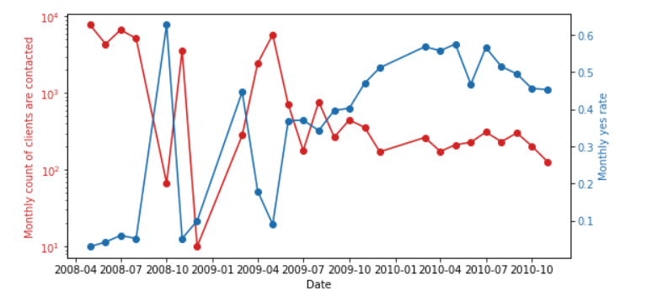
3.1 EDA: Time Series Patterns
Monthly client counts decrease from 3.6K to 310
Yes rate = count of yes / count of clients
Insights
Due to social factors (financial crisis), term deposit is safer than other investment like stock
Due to a better campaign strategy
2009 June
Monthly yes rate increase from 16.8% to 47%
[1]

Slide 5
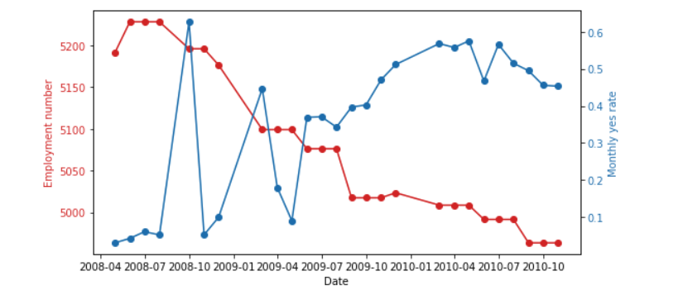
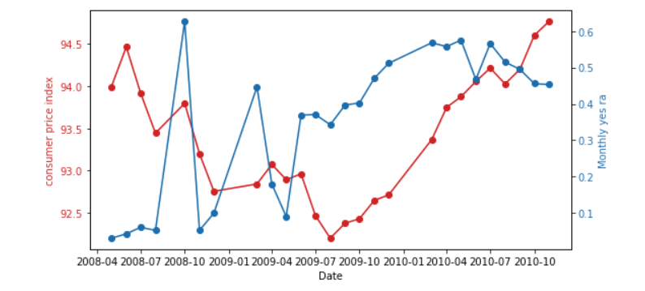
3.2 EDA: Social and Economic impacts
Yes rate
Employment number negatively correlates with yes rate
Consumer price index positively correlates with yes rate (after 2009 June)
Employment number
Yes rate
Consumer price index

Slide 6
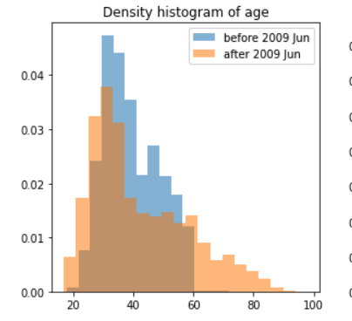
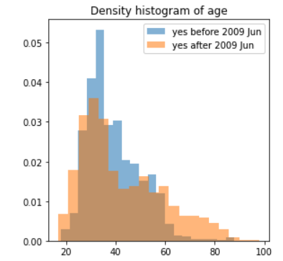
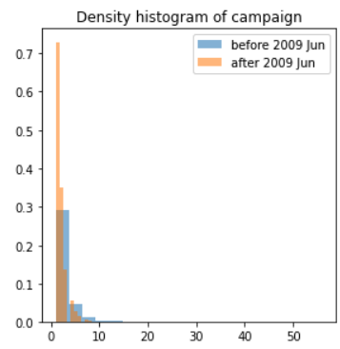
3.3 EDA: Histograms
Age: client age
Campaign: number of contacts performed during this campaign
The age of clients spreads from the center to younger and older groups
The younger and older groups also have a higher yes rate
The median number of contacts decrease from 2 to 1

Slide 7
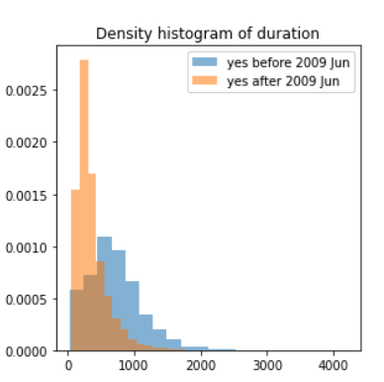
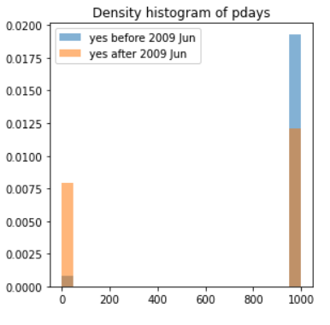
3.3 EDA: Histograms (Continue)
Duration: call duration
Pdays: number of days that passed by after clients was contacted from previous campaign
For clients choose yes
The proportion of clients being contacted in previous campaign increases
The duration decrease
Insights:
The campaign is more effective
The clients willingness increases, especially those being contacted previously

Slide 8
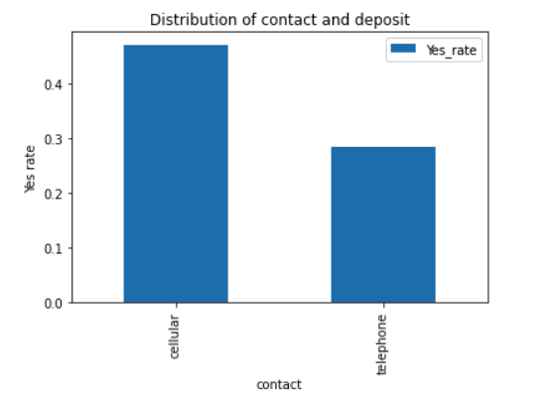
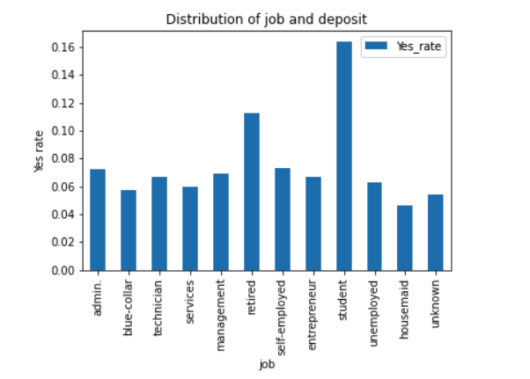
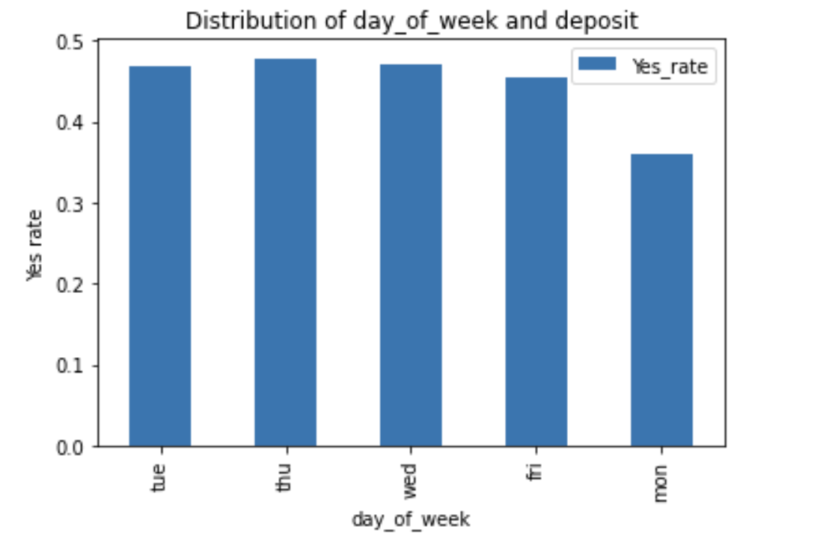
3.4 EDA: Categorical Features
Both before and after 2009 June
Student and retired people have higher yes rate
Cellular contact is the most effective way
Monday has a lower yes rate
retired
student
cellular
telephone
Monday

Slide 9
4.1 Train Test Split
Simple train test in time
Rolling train test in time
Time
train
test
Time
train
test
train
test
train
test

Slide 10
4.2 Modeling
Ensemble methods are more robust than a single ML model
Catboost [1]
Gradient boost tree ensemble; build trees in a series
Support target encoding for categorical variables [2]
Random forest
Bagging boost tree ensemble; build trees in parallel
[1] https://catboost.ai/
[2] target encoding is the process of replacing a categorical value with the mean of the target variable.

Slide 11
4.3 Model Metric
Average precision = the area under the precision recall curve
Is the metric used for this work
Predicted No
Predicted Yes
TN
FP
Precision = TP / (TP + FP)
Recall = TP / (TP + FN)
Actual No
FN
TP
Actual Yes

Slide 12
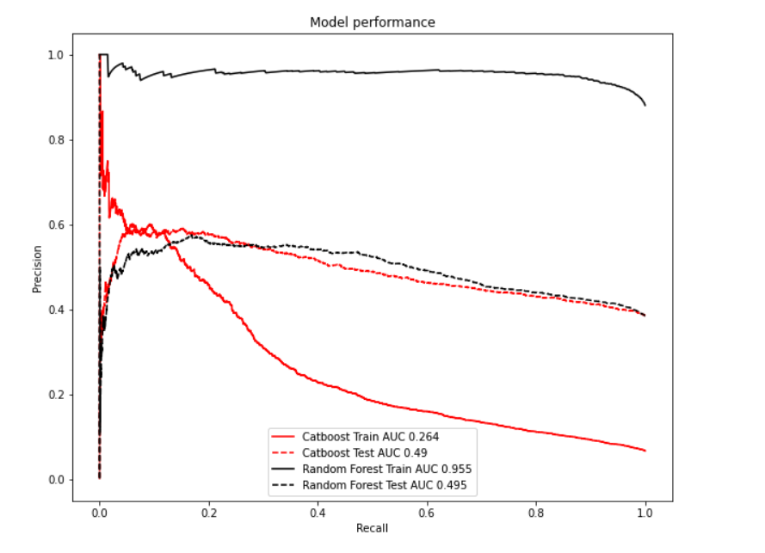
5.1 Model Performance
2018 May to 2010 Oct
train
test
15%
Use all data and simple train test split
Test AUC ~ 0.5
Problems:
Train and test performance is not consistent
This is due to a significant shift at 2009 June
Random Forest Train, Test
Precision
Catboost Train, Test
Recall

Slide 13
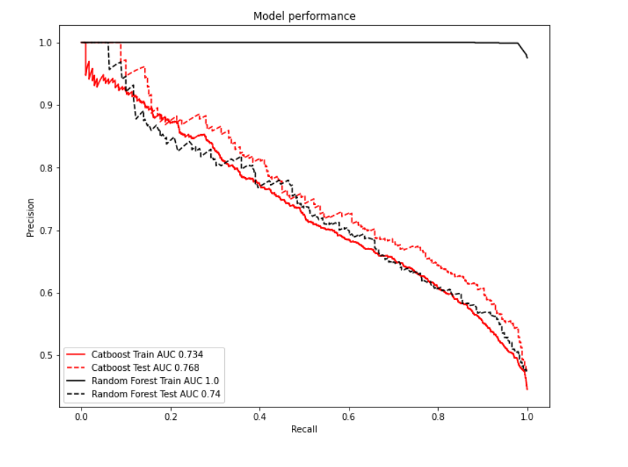
5.2 Model Performance
Use data only after 2019 June and simple train test split
Test AUC ~ 0.75
Catboost has a consistent and good performance from train and test.
Random Forest has a lower test AUC and it overfits
The rolling train test provides similar trend
Random Forest Train, Test
Catboost Train, Test

Slide 14
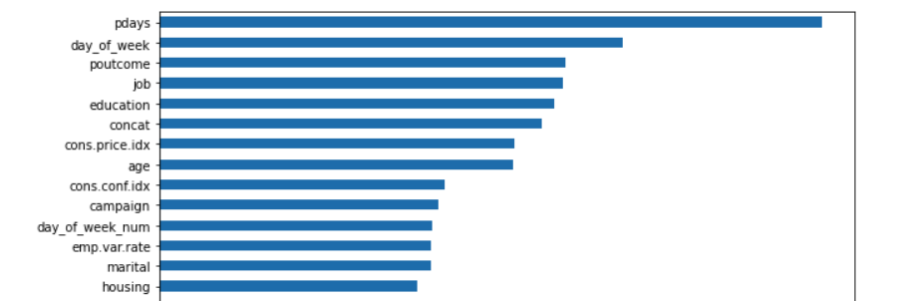
5.3 Feature Importance
Pdays is the most important feature
Day of week also important
Top features based on catboost

Slide 15
5.4 Conclusions
There is a significant pattern change after 2009 June
The social and economic factors correlate with yes rate
The campaign becomes more effective with higher yes rate.
Clients are precisely targeted. Contacts number and call duration reduce.
To increase the yes rate
Contact the clients by cell phone
Reach out to the younger and older groups
Try not to make the call on Monday
Contact clients that were contacted in previous campaign
To get a stable and predictive model, one should train on more recent signal
The retrain frequency needs further investigation
The catboost model is the one can be deployed
It shows consistent train and test performance
58% precision and 92% recall, given cutoff = 0.5

Slide 16
End
Thank you

