Slide 1
UCI data case study
Han Jiang

Slide 2
1 Introduction
Problem statement
Direct marketing campaigns based on UCI data repo
Clients are contacted by phone. The outcome is whether they choose to subscribe the term deposit or not
Goal: predict if the client will subscribe the service (yes) or not (no)
Approach
EDA results
Indicates a sharp shift in 2009 June
Identify several factors that can increase the rate of clients saying yes
Split the train and test by time
Simple split and rolling train test in time
Average precision as the evaluation metric
Build classification models
using tree ensemble models (catboost/ random forest)
The best model shows consistent performance with test average precision of 0.77
[1] with the score cutoff = 0.5

Slide 3
2 Dataset Overview
Data
41188 rows
Time series data, from 2008 to 2010
Features
Total 20 features (10 categorical features)
7 client features
8 campaign features
5 social and economic features
Target variable
Subscribe to the service or not
Binary value
Imbalanced data (11.2% of yes)

Slide 4
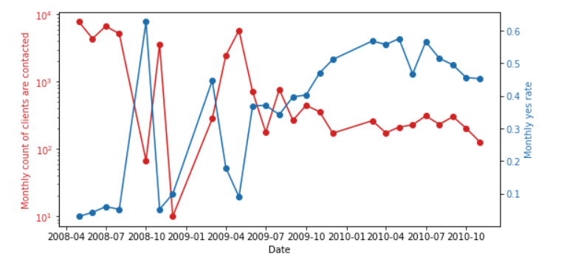
3.1 EDA: Time Series Patterns
Monthly client count = count of client contacted / month
Yes rate = count of yes / count of clients
Before 2009 June
75% of all data
Average monthly client contacted is 3.6k
Average yes rate is 16.8%
After 2009 June
25% of all data
Average monthly client contacted is 310
Average yes rate is 47%
Possible reasons for yes rate increase
Due to social factors (financial crisis), term deposit is safer than other investments like stock
Due to a better campaign strategy
Monthly clients count vs monthly yes rate over time
2009 June

Slide 5
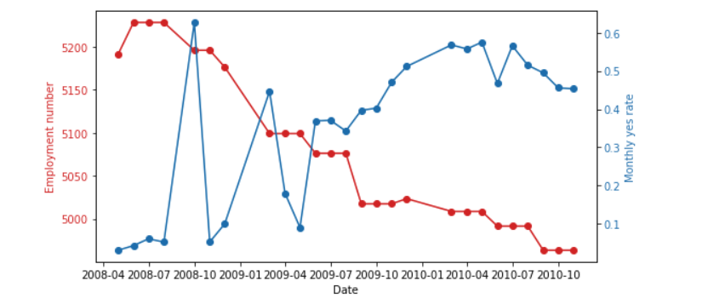
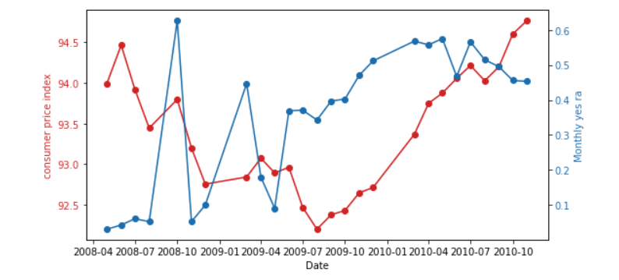
3.2 EDA: Social and Economic impacts
Yes rate
Employment number negatively correlates with yes rate
Consumer price index positively correlates with yes rate (after 2009 June)
Employment number
Yes rate
Consumer price index

Slide 6
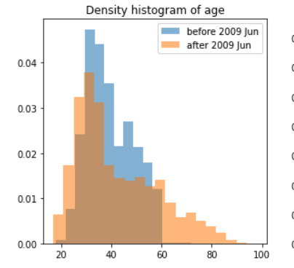
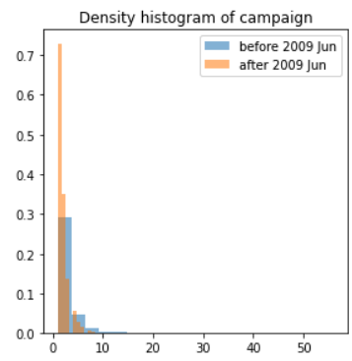
3.3 EDA: Histograms of all clients
Plot A: proportion of older and younger people contacted increase after 2009 June
Plot B: number of contacts per client decrease after 2009 June
Plot A
Plot B
Age of clients
before and after 2009 June
Number of contacts
before and after 2009 June

Slide 7
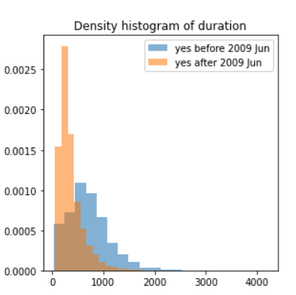
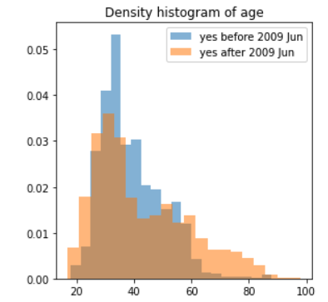
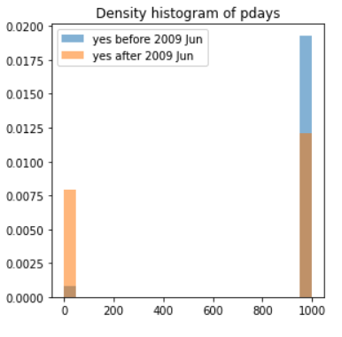
3.3 EDA: Histograms of yes clients
Plot A: In the yes clients, proportion of older and younger people increase after 2009 June
Plot B: in the yes clients, call duration decreases after 2009 June
Plot C:
Pdays = number of days after clients contacted by from previous campaign
In the yes clients, proportion of first time contact clients reduces , after 2009 June
“999” means not being contacted ever before
Plot A
Plot B
Plot C
Age of “yes” clients
before and after 2009 June
Call duration of “yes” clients
before and after 2009 June
Pdays of “yes” clients
before and after 2009 June

Slide 8
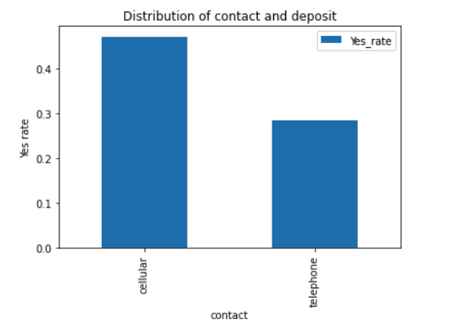
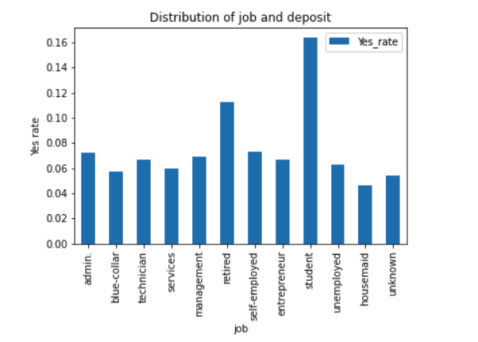
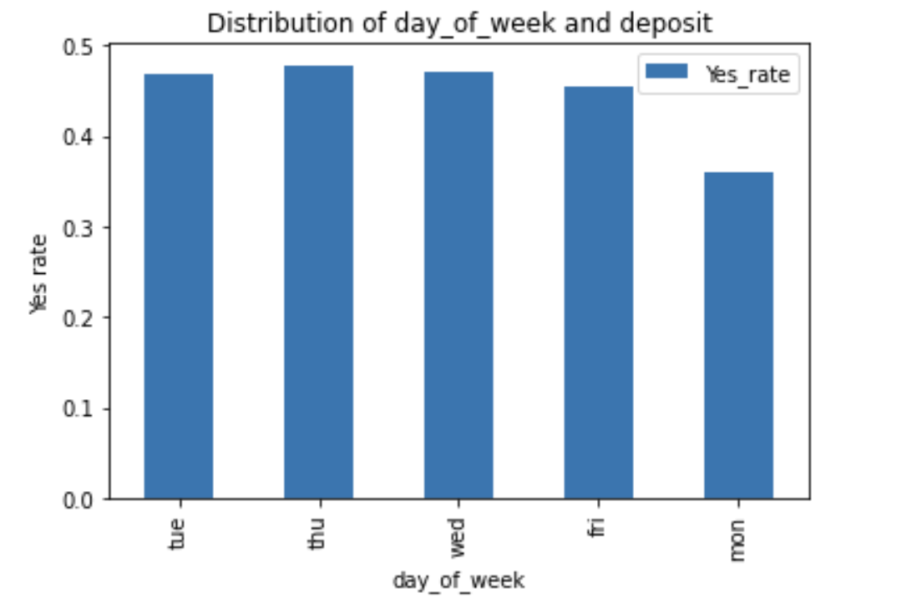
3.4 EDA: Categorical Features
Plot A: cellular contact is the more effective than telephone
Plot B: student and retired people have a higher yes rate
Plot C: Monday has a lower yes rate
Plot A
cellular
Plot B
student
Plot C
retired
monday
telephone

Slide 9
4.1 Train Test Split
Simple train test in time
Rolling train test in time
cross-validation
Simulate real-world retraining of the model
Time
train
test
Time
train
test
train
test
train
test

Slide 10
4.2 Modeling
Feature engineering
Drop duration variable
One hot-encoding for categorical variables
Type of models
Ensemble methods
Catboost [1]
Gradient boost tree ensemble; build trees in a series
Support target encoding for categorical variables [2]
Random forest
Bagging boost tree ensemble; build trees in parallel
[1] https://catboost.ai/
[2] target encoding is the process of replacing a categorical value with the mean of the target variable.

Slide 11
4.3 Model Metric
Predicted No
Predicted Yes
TN
FP
Actual No
Confusion matrix
Precision = TP / (TP + FP)
Recall = TP / (TP + FN)
Average precision = the area under the precision recall curve
Is the metric used for this work
Why not ROC AUC
ROC is not sensitive in the imbalanced data
False positive rate = FP / (FP + TN)
FN
TP
Actual Yes

Slide 12
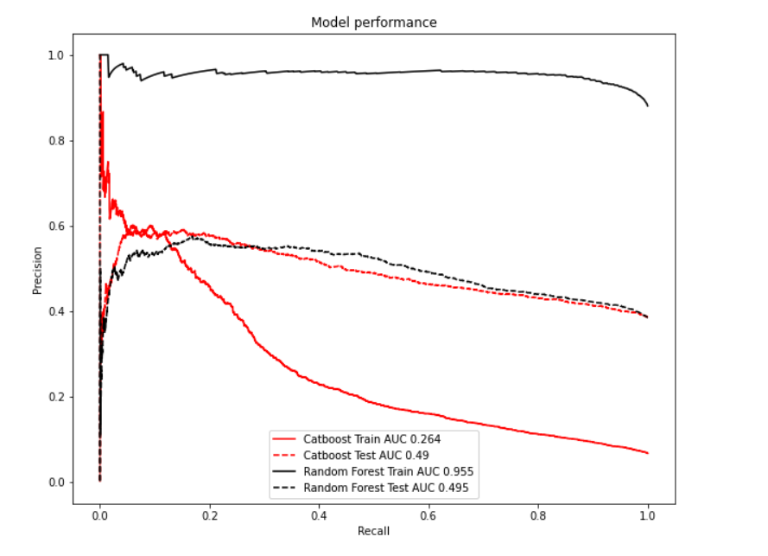
5.1 Model Performance
2008 May
2010 Nov
Use all data and simple train test split
Train
Catboost AUC = 0.264
Random Forest AUC = 0.955
Test
Catboost AUC = 0.49
Random Forest AUC = 0.495
Takeaways:
Huge gap between train and test AUC
This is due to a significant shift at 2009 June
train
test
Model Performance
Random Forest Train
Random Forest Test
Precision
Catboost Test
Catboost Train
Recall

Slide 13
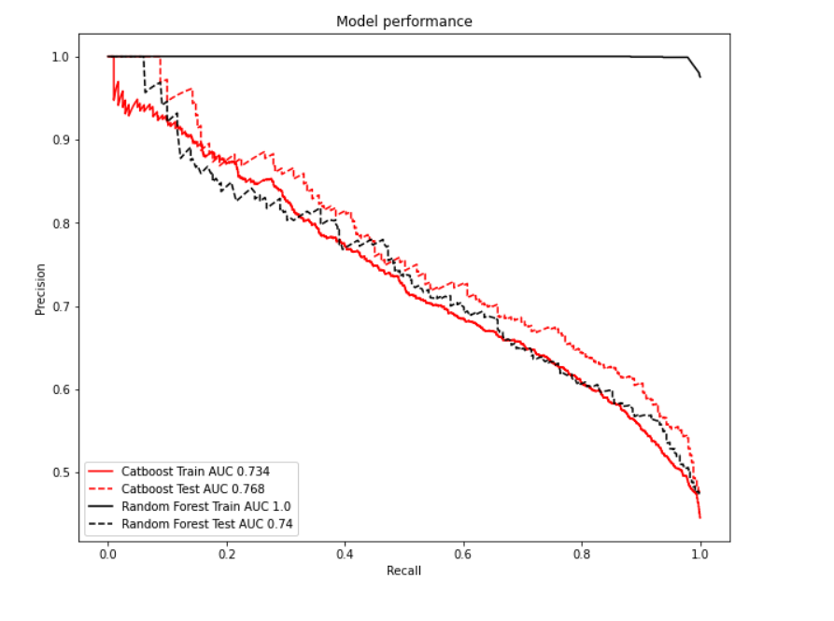
5.2 Model Performance
Use data only after 2009 June and simple train test split.
Train
Catboost AUC = 0.734
Random Forest AUC = 1.0
Test
Catboost AUC = 0.768
Random Forest AUC = 0.74
Takeaways:
Catboost has a consistent and good performance from train and test.
Random Forest has a lower test AUC and it overfits
Rolling train test is also tried, which shows same conclusions
2009 June
2010 Nov
train
test
Random Forest Train
Random Forest Test
Catboost Train
Catboost Test

Slide 14
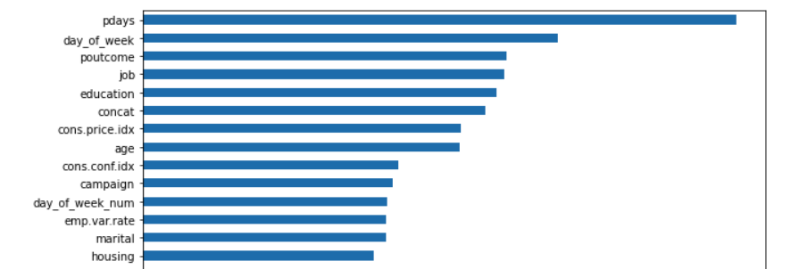
5.3 Feature Importance
Consistent with EDA analysis
Top features based on catboost

Slide 15
5.4 Takeaways
There is a significant pattern shift after 2009 June
Total clients count decrease and yes rate increase after 2009 June
The social and economic factors may impact the yes rate
The campaign becomes more effective after 2009 June
Contacts number / client and call duration reduce after 2009 June
Older and younger are contacted more and their yes rate increase
More calls to previously contacted clients (more follow-ups)

Slide 16
5.5 Action Plan
Actions to increase yes rate
Contact the clients by cell phone
Reach out to the younger and older groups
Reduce calls on Monday
Contact clients that were contacted in previous campaign
Model training
Use train test split in time
train on more recent signal to get a more relevant model
The retrain frequency needs further investigation (as a hyperparameter)
The catboost model is the selected model
It shows consistent train and test performance
Average precision =0.77
precision = 58% , recall = 92%, given cutoff = 0.5

Slide 17
End
Thank you

