Slide 1
Build Intelligent Agents for Tileworld Environment Jing Sun (jing004@e.ntu.edu.sg) AI6125: Multi-agent System

Slide 2
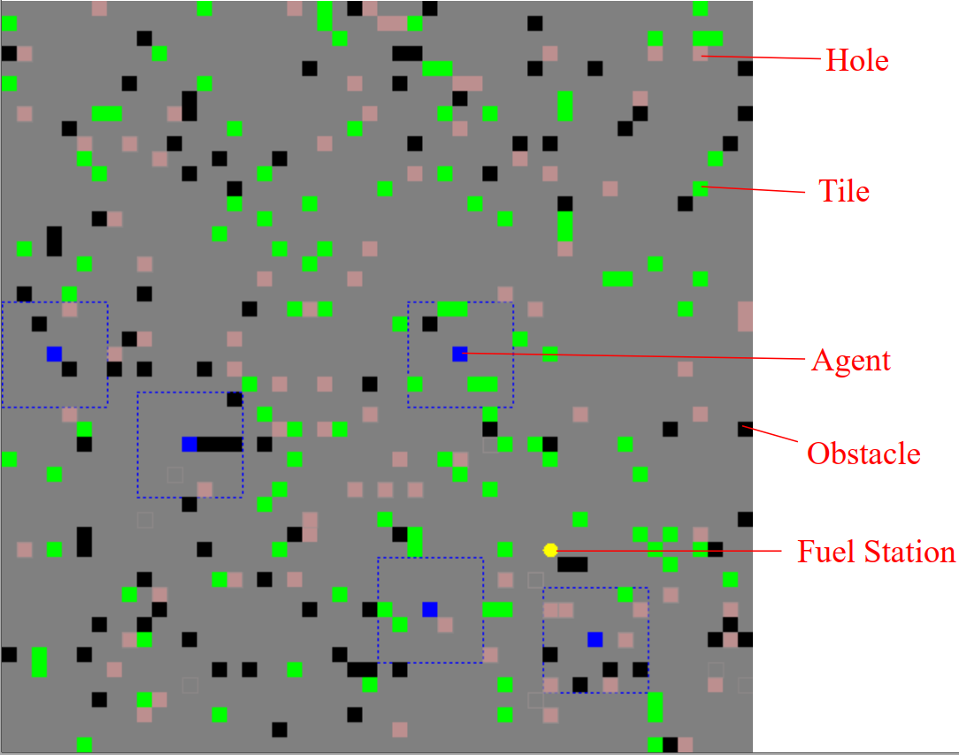
Tileworld

Slide 3
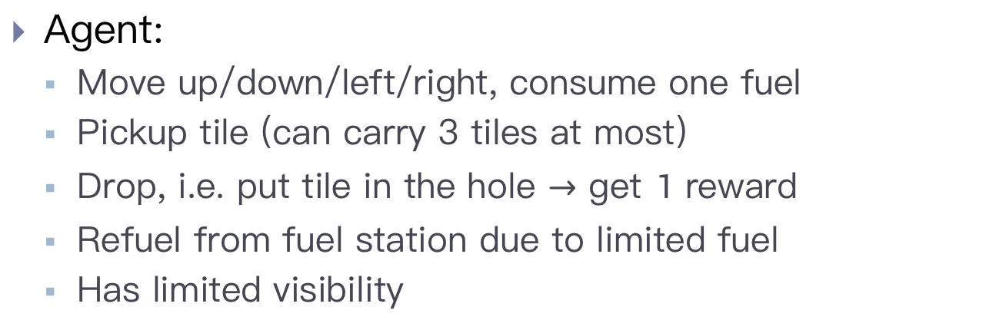
Tileworld
Agent:
Move up/down/left/right, consume one fuel
Pickup tile (can carry 3 tiles at most)
Drop, i.e. put tile in the hole $→$ get $1$ reward
Refuel from fuel station due to limited fuel
Has limited visibility
Obstacles/tiles/holes appear randomly and exist for a certain period
Fuel station has a fixed position that is randomly generated at the beginning. This position is unknown to agents.

Slide 4
Agent Implementation
Objective: get as many rewards as possible within a preset steps of simulation.
In every step, an agent goes through the cycle:
Sense-Communicate (optional)-Plan-Act

Slide 5
Agent Implementation
Three modules to be implemented:
Planning module: after sensing/communication, the agent’s memory is updated. The agent plans its action accordingly.
Memory module (optional): agents store environmental information in their memory. By default, we use TWAgentWorkingMemory module. You may extend “TWAgentWorkingMemory” class and implement your own module.
Communication module (optional): in every step, each agent can broadcast a message encoded by “Message” class. You can extend “Message” class and use your own design to encode information.

Slide 6
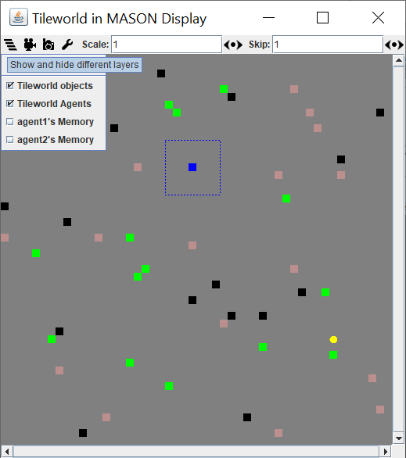
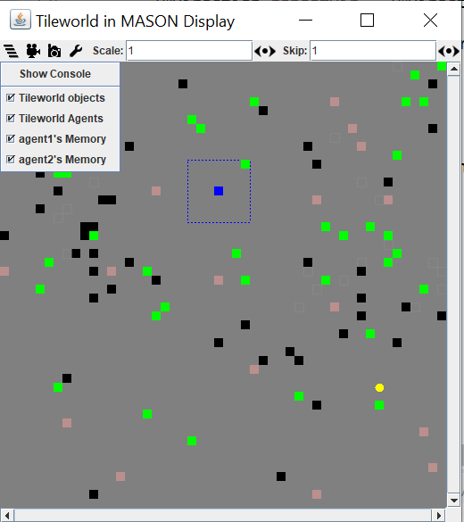
Memory is critical for planning
Use GUI to check memory for implementation/debug

Slide 7
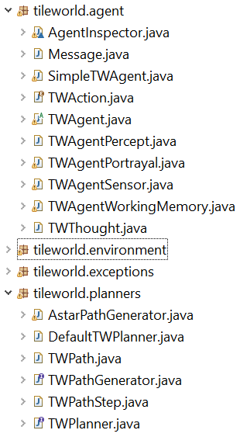
Agent Implementation
To implement your own agent, you should
Extend “TWAgent” class
Create your own planner/message/memory
Override “communicate()”, “think()” and “act()” methods in “TWAgent” class

Slide 8
Agent Implementation
You should NOT
Override other methods of “TWAgent” class
Modify “environment” package of the simulator
Call “increaseReward()” method of “TWEnvironment” class in any methods other than the “putTileInHole()” method of “TWAgent” class

Slide 9
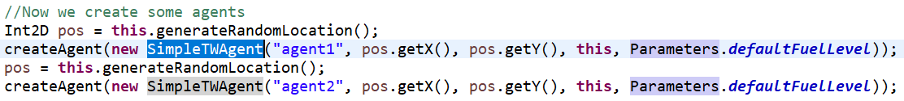
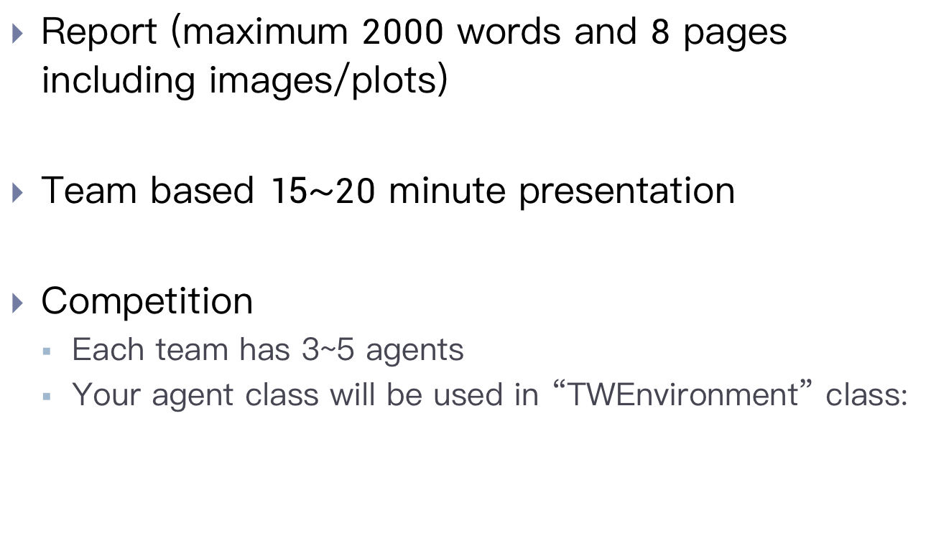
Assessment
Report (maximum $2000$ words and $8$ pages including images/plots)
Team based $15\sim 20$ minute presentation
Competition
Each team has 3~5 agents
Your agent class will be used in “TWEnvironment” class:

Slide 10
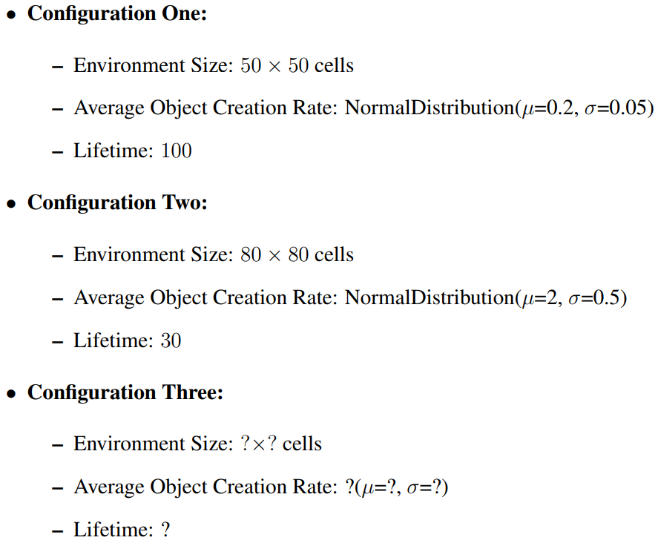
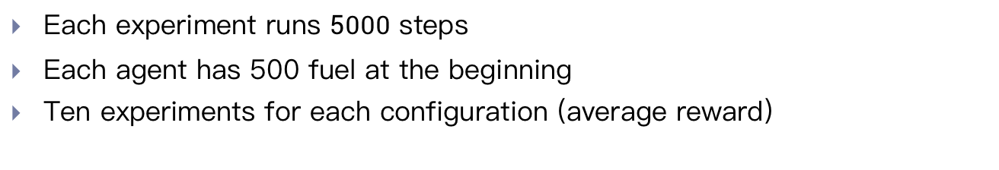
Competition
Each experiment runs $5000$ steps
Each agent has 500 fuel at the beginning
Ten experiments for each configuration (average reward)

Slide 11
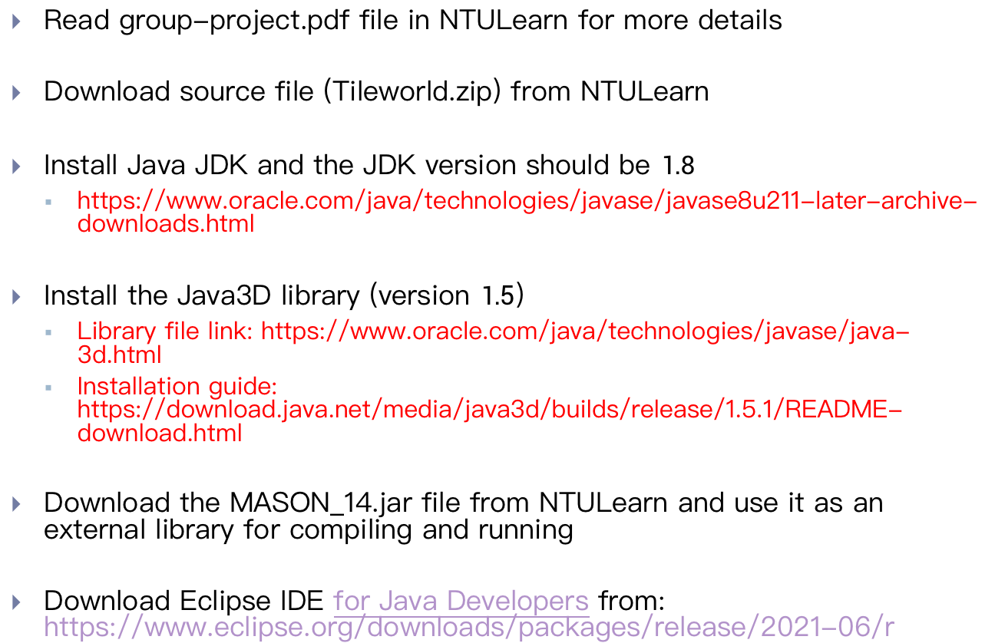
Installation of Tileworld
Read group-project.pdf file in NTULearn for more details
Download source file (Tileworld.zip) from NTULearn
Install Java JDK and the JDK version should be $1.8$
https://www.oracle.com/java/technologies/javase/javase8u211-later-archive-downloads.html
Install the Java3D library (version $1.5$)
Library file link: https://www.oracle.com/java/technologies/javase/java-3d.html
Installation guide: https://download.java.net/media/java3d/builds/release/1.5.1/README-download.html
Download the MASON_14.jar file from NTULearn and use it as an external library for compiling and running
Download Eclipse IDE for Java Developers from: https://www.eclipse.org/downloads/packages/release/2021-06/r

Slide 12
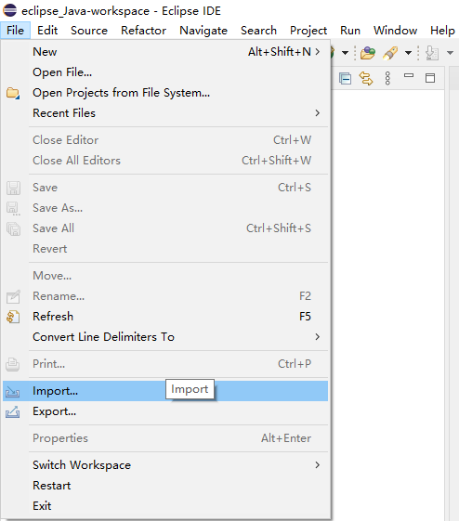
Import Project

Slide 13
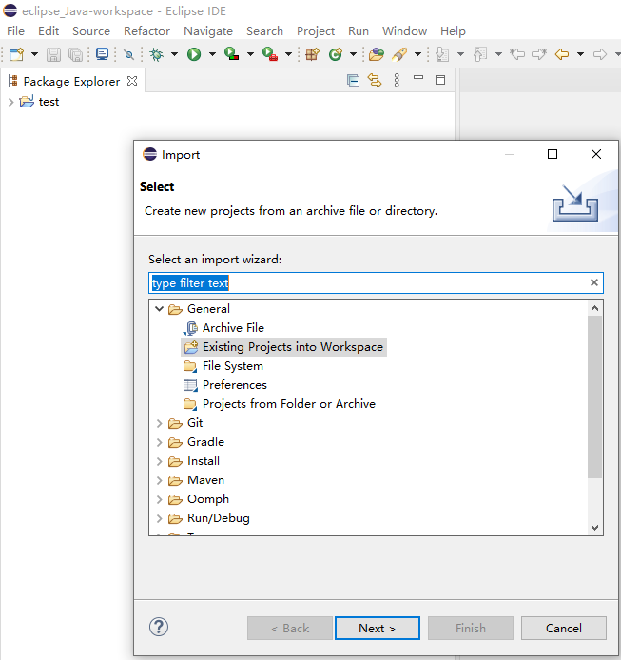
Import Project

Slide 14
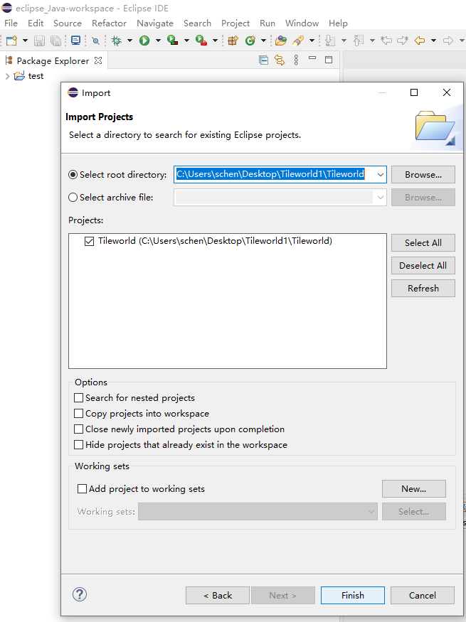
Import Project

Slide 15
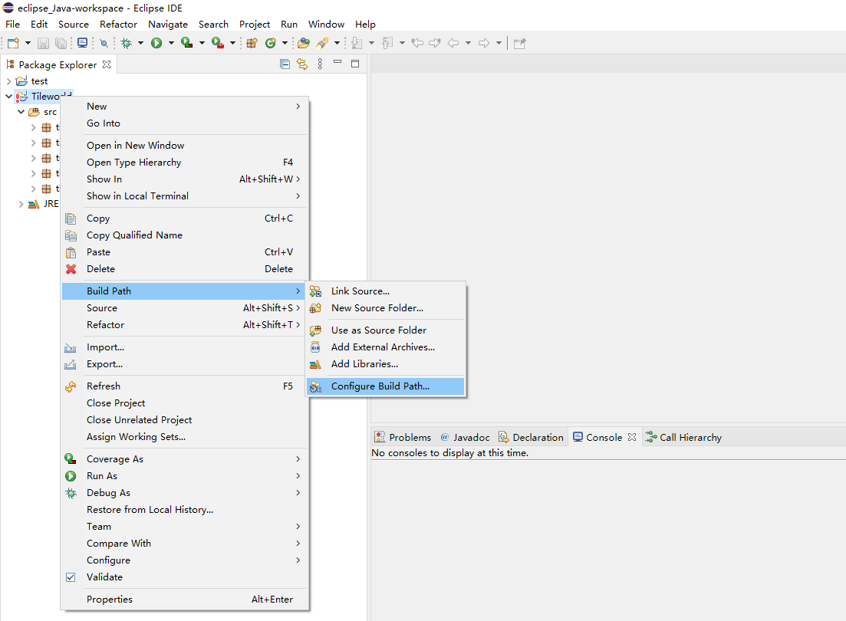
Configuration of MASON External Library

Slide 16
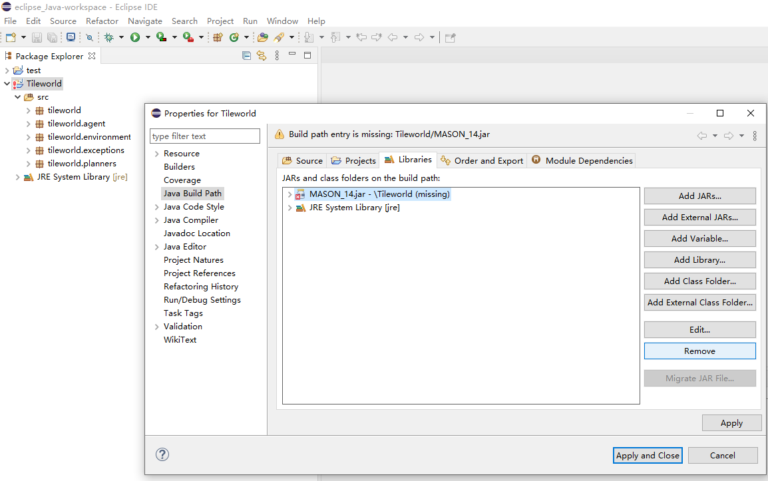
Configuration of MASON External Library

Slide 17
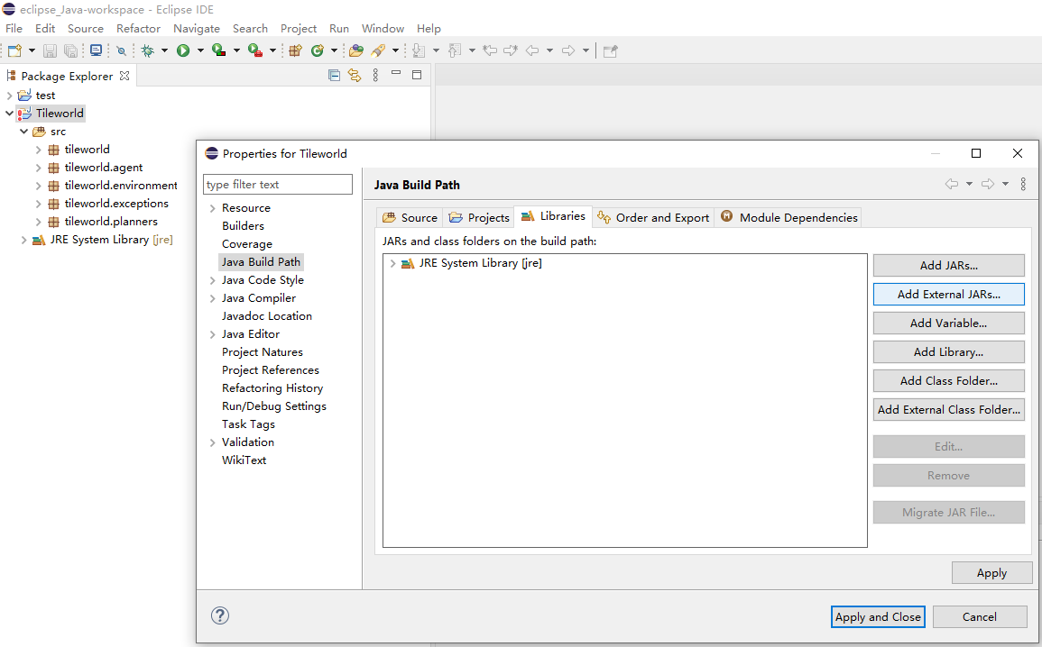
Configuration of MASON External Library

Slide 18
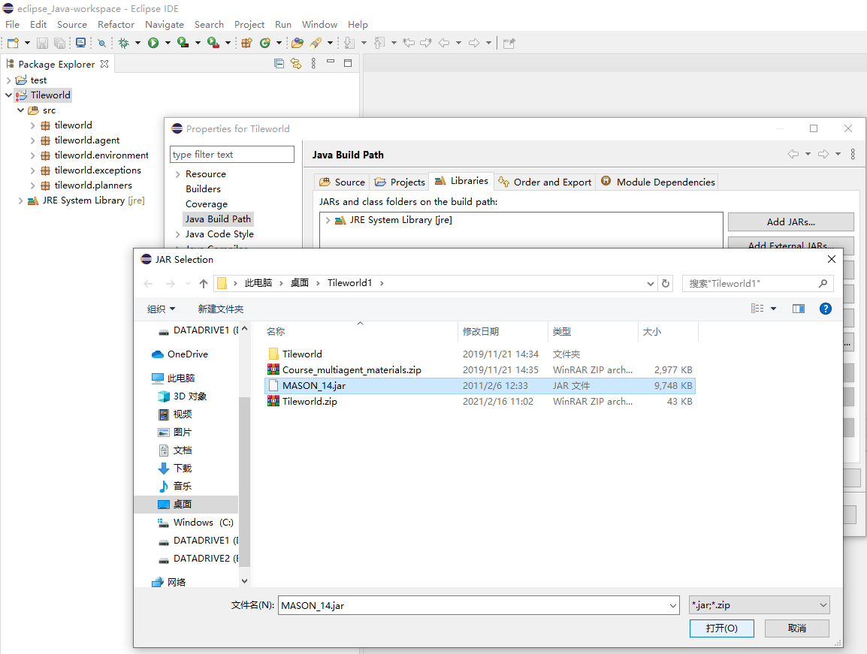
Configuration of MASON External Library

Slide 19
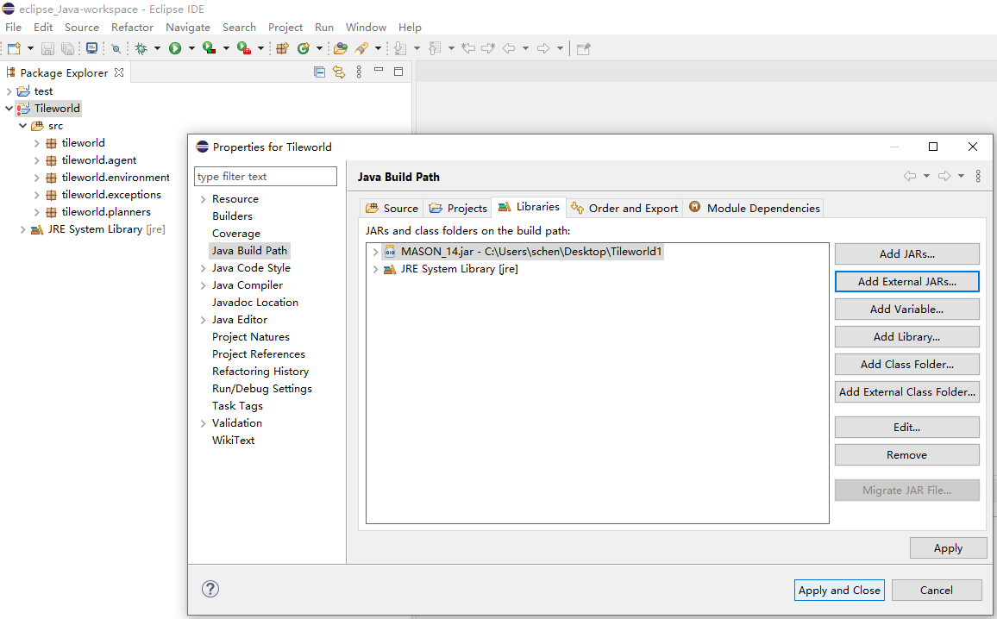
Configuration of MASON External Library

Slide 20
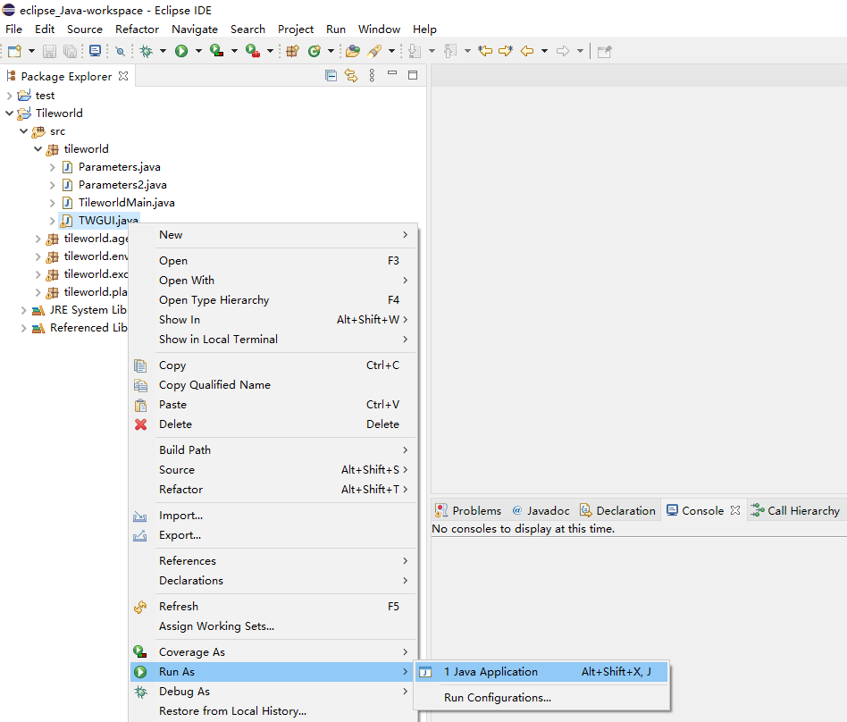
Run Experiment
Without-GUI version
With-GUI version

