Slide 1
Group 10
Jiang Haofeng G2202588D
Zhan Shuo G2202727A
Tong Tian G2202769J
Tan Zhaozhang G2201257D
Ju Xilai G2202544B
Notes:
Good evening, everyone, this is group 10 presentation, the group consists of five person, three of us will talk about concrete methods and one introduction one future vision.

Slide 2
Introduction & Architecture
Fuel-Station Finding
Rule-Based System
Communication & Memory
Work Implementation
Future Vision
Notes:
Our presentation process will be divided into the following four parts: The first three parts are about our system desgin, the last part of our presentation is about our future vision. To compete in Tileworld, we utilize rule-based system to achieve high scores.the system is composed of fuel-station finding, communication and memory, and work implementation.Ok, let’s begin with our system design. The first thing need to clarify is that we design one agent, and we focus on how to make overall arrangements among them.

Slide 3
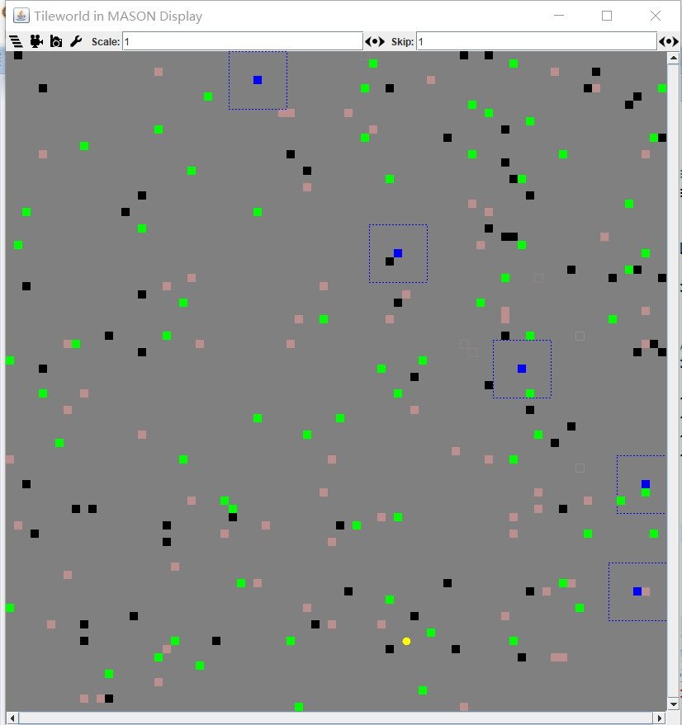
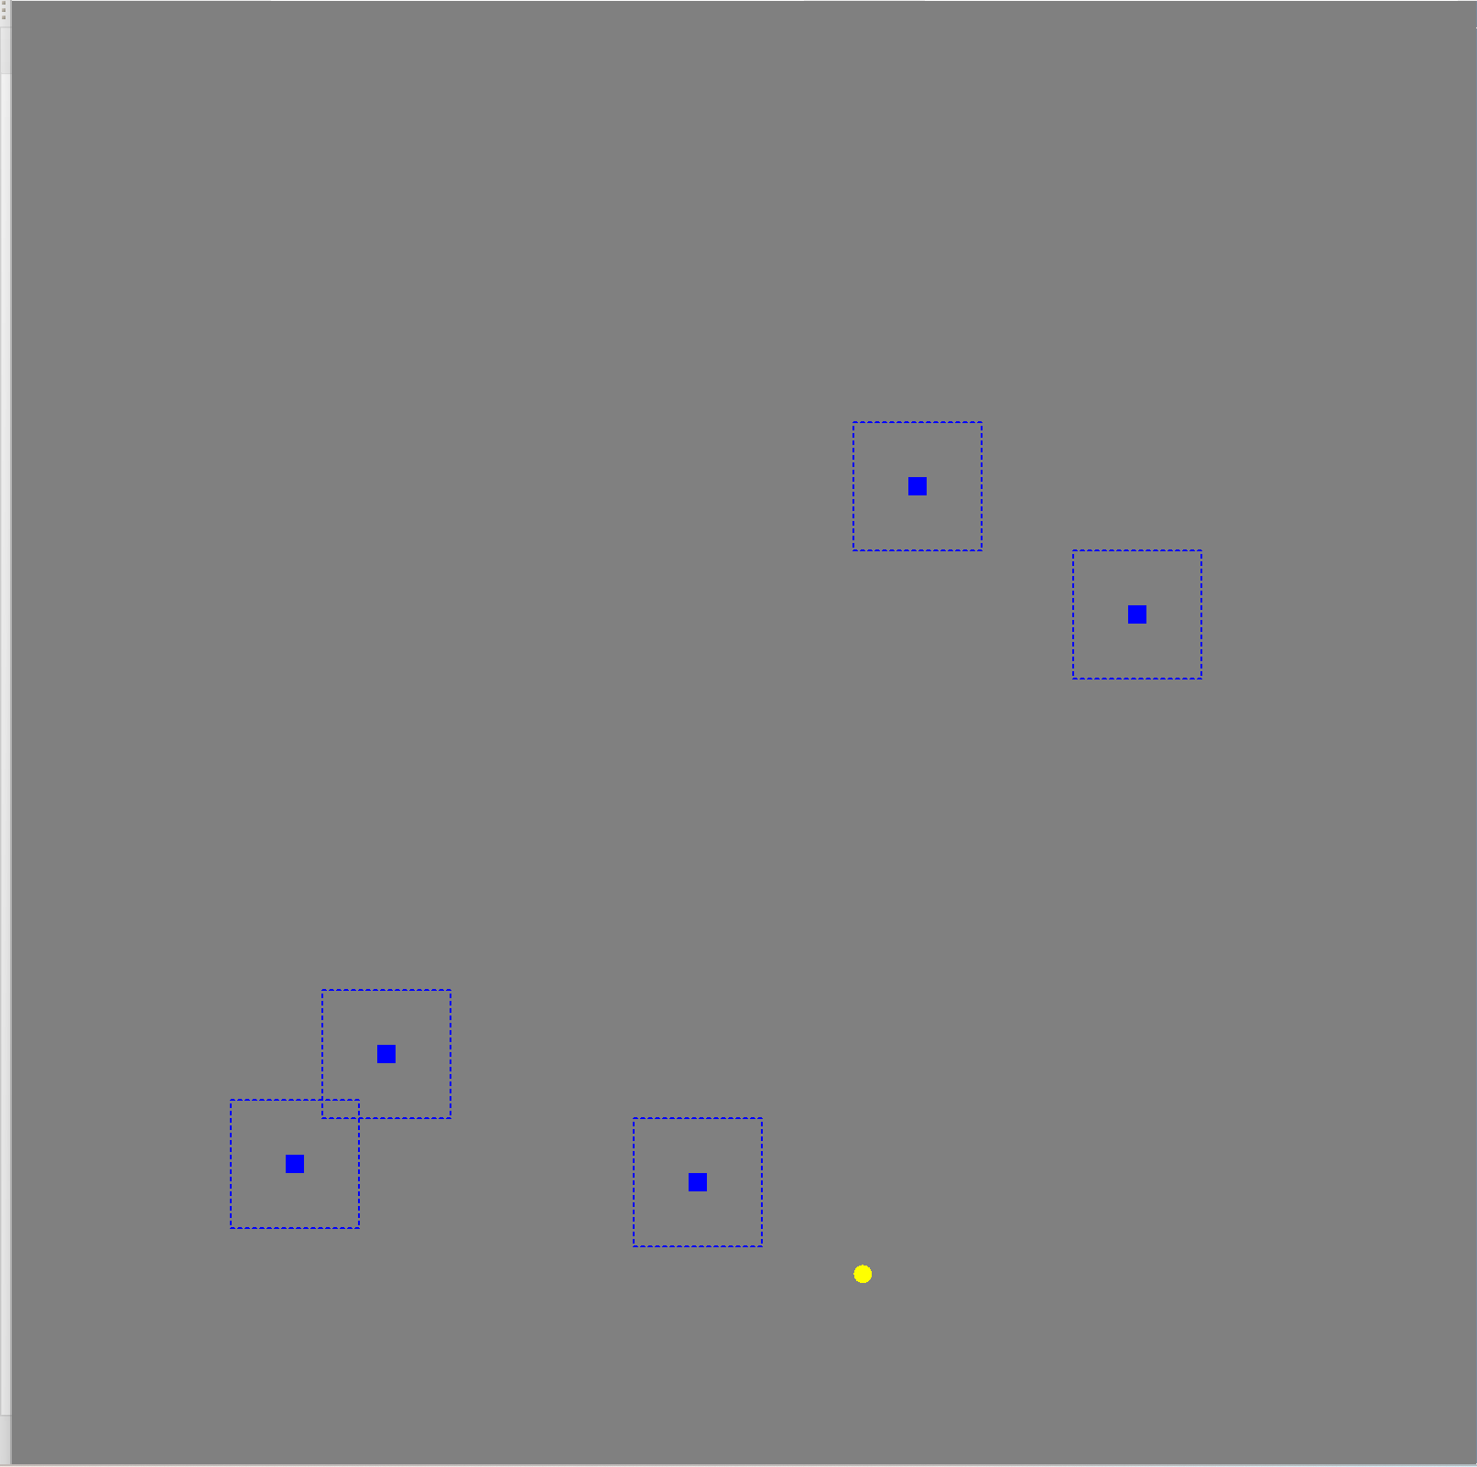
Introduction & Architecture
Fuel-Station Finding
1
2
1
2
Broadcast
3
4
3
4
5
5
Notes:
The picture is the initial situation of Tileworld, we can see the blue dots as agents and the yellow dot as fule station. In terms of fuel-station finding, we seperate the whole Tileworld to 5 parts as we have 5 agents, each agent first goes to their searching area’s closest corner, then searches for the fuel station in the area, once finding the fuel station, the agent broadcast the location to others. Then the agents start to work normally.

Slide 4
Introduction & Architecture
Communication &
Memory
Avoid Collision & Aimless
Global Memory
Notes:
The next part is communication and memory, it’s about local information sharing to avoid collision and aimless. It’s possible that several agents focus on the same target, if this happens, then the efficiency could be very low, thus we need to define a global memory to record local information to avoid this.

Slide 5
Introduction & Architecture
Work Implementation
Notes:
The work implementation part is about how we define the agent work flow to get higher scores. Which means we need to define the routes the agents work on. This part also contains some conditions during our work, why we encountered this? How to fix it? Details will be shown in the following presentations.

Slide 6
Fuel-Station Finding
Fuel-Station finding & Voyage Agent
Rule-Based System
Communication & Memory
Work Implementation
Notes:
Now let’s invite 战硕 to introduce fuel-station finding.
战硕开始：
Hello, everyone. I am ZhanShuo and let me introduce the fuel station finding process and one different type of agent called voyage agent.

Slide 7
Fuel-Station Finding
Start
Separate map to 5 areas efficiently
Get boundary points of each area
Get candidate points of each area
End
Maximize Utility = how efficient to separate the map
+
Calculate the expense of matching methods
Agent works normally
how to minimize total distance to starting point
Y
Agents compete to get their candidate point
Fuel Station found
N
Agents go to starting point
Agents scan in their area
Notes:
Finding the fuel station at very beginning is vital. If agents failed to find fuel station, the overall score will be extremely low because no agents will survive to the end. That is why we put fuel station finding process as our first step.
Here is the flow chart of fuel station finding task.
We could separate this task into basicly three tasks. The first one is to separate the map into 5 exclusive areas efficiently. Then the second task is to match each agent with one point of each area. And the last task is to scan the area with U shaped path. Once one agent finds the fuel station. It will broadcast to other agents about the location of fuel station. And all agents stop scanning and start to work normally.

Slide 8
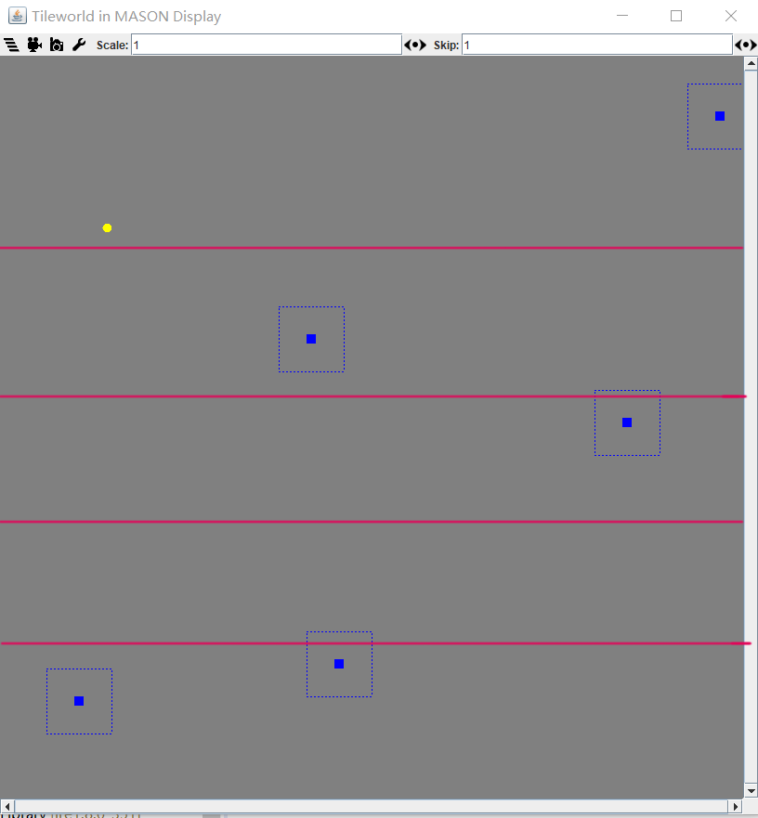
Fuel-Station Finding
Notes:
So how to separate area efficiently. We guarantee the width of each area is the multiple of 7 except the last area, so that most of agents won’t scan overlapped area to improve the efficiency. And once the agent finish its own responsible area, it could start to work normally.
Then how to minimize the distance between agents’ original position and starting points of scanning？In fact, this is one NP-Hard problem while the number of agents is limited and fixed, which is five. So we could solve the problem by fully arranging all the combinations, calculating and comparing the total distance between all agents and corresponding best starting point of each area.

Slide 9
Fuel-Station Finding
Notes:
And here is an example of how agents move when scanning in their own area.

Slide 10
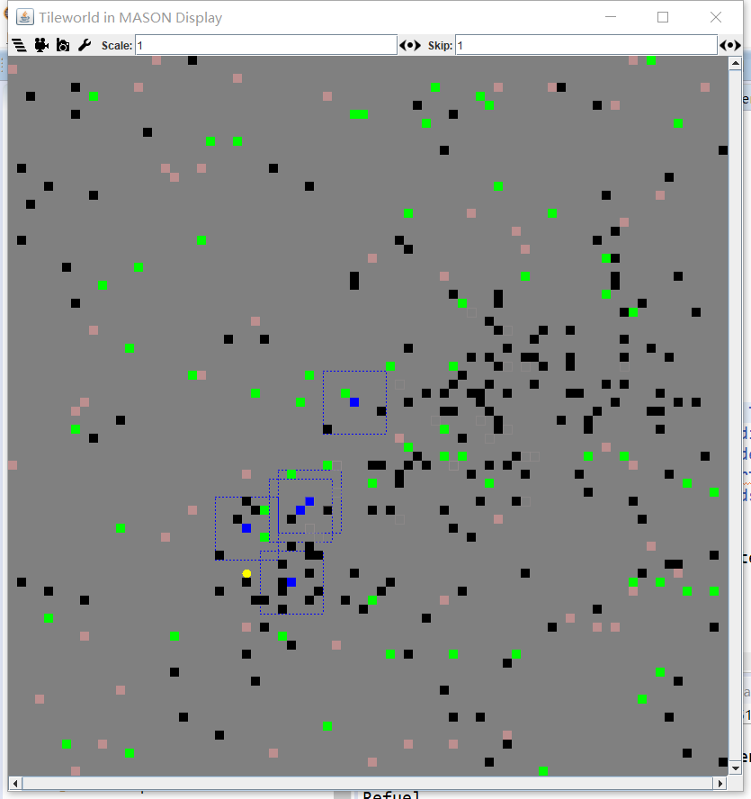
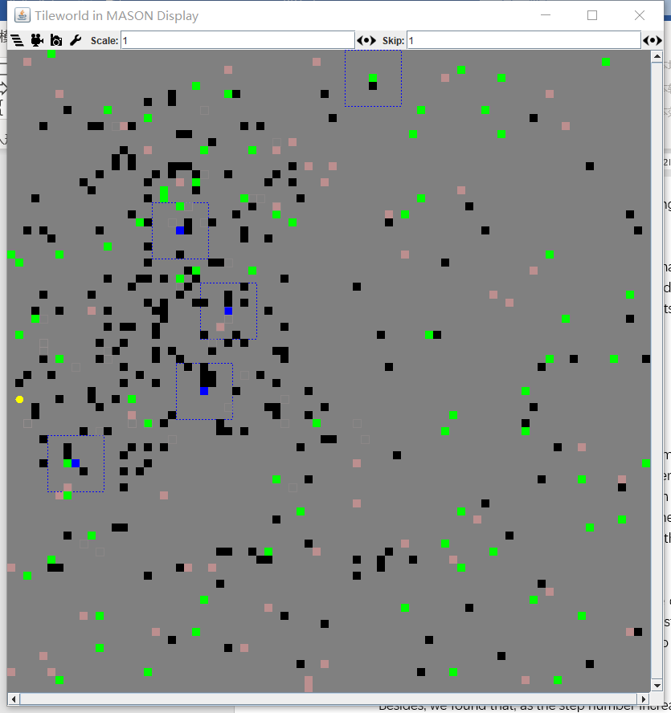
Normal Agents and Voyage Agents
Normal Agent
Voyage Agent
Notes:
Ok, so we finish the fuel station finding part. Let’s look at one different agent.
Through checking the performance of our normal agents working together on GUI atmosphere, we found a phenomenon frequently happened. Because of our refuel algorithm, the agents will arrive at fuel station in close period which means they will perceive similar or even the same atmosphere after refueling so that they would make similar movements based on same thinking logic.This is the example(left figure). So in this case, they will go through overlapped area which reduces the efficiency.
That is why voyage agents come out. They are different with normal agents. After they refuel, they won’t directly work immediately.This is the example(right) Instead, they would go to a random place which means different agents would probably go to different direction to explore different area.

Slide 11
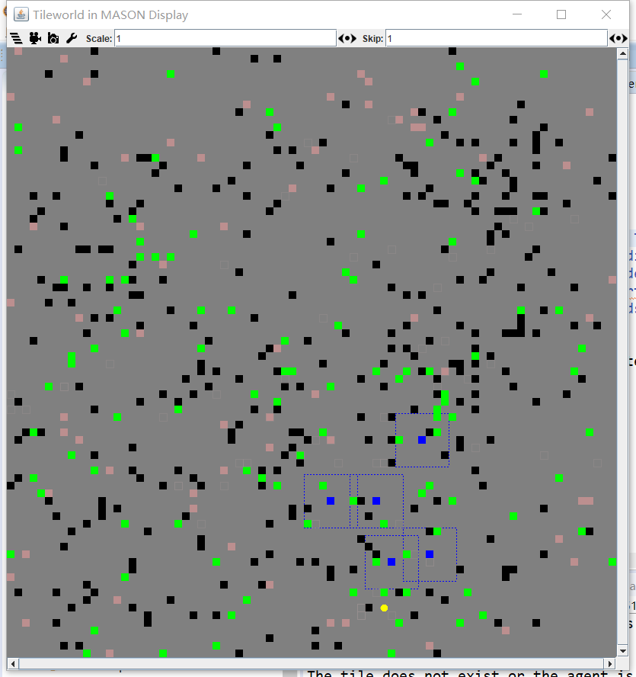
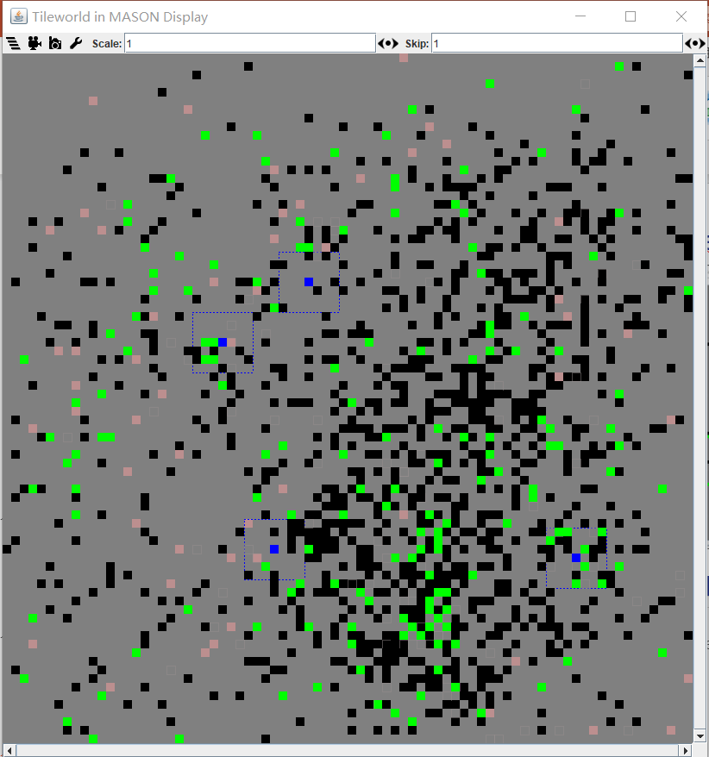
Voyage Agent
Step = 1000
Step = 4500
Notes:
Besides, we found that, as the step number increases, there are more and more obstacles around the fuel station like the right figure. So it would be efficient to make some agents explore further area instead of immediately work normally after refueling. This is the intuition of making voyageAgent, which， as steps number goes up, the starting working point after refueling is farther.
now let’s invite 蒋浩锋 to talk about the communication and memory.
Finish~

Slide 12
Communication & Memory
Fuel-Station Finding
Rule-Based System
Communication & Memory
Work Implementation
Notes:
Hello everyone, I am 蒋浩锋, now let me introduce the most mulit-agent part - communication and memory.

Slide 13
Communication
For each step, each agent has a 7x7 view and a target.
Each agent broadcasts what it knows in this step in the following four types of messages:
“Tile [x] [y]”
“Hole [x] [y]” related to the global memory
“blank [x] [y]”
“target [x] [y]” -> related to target conflict reduction
where [x] and [y] are the actual location of corresponding object.
Notes:
First we talk about communication. For each step, each agent has a 7x7 view and a target. Since we do not care about complexity in this project, we make all the message public to every agent. That is, broadcast every message. Each agent sends messages in the following four ways: tile x y; hole x y; blank x y; and target x y. The tile, hole and blank are related to the global memory, and the target is about dealing with target conflict.

Slide 14
Global Memory
By using the getMessages() method, we can get (7*7+1)*5=250 messages in each step.
We use a 2D array of Strings to store the tiles and holes which sensed by other agents.
If there is a “blank” message, make the corresponding entry null.
x\y | 0 | 1 | … | 49
0
1
…
49
Notes:
Okay, so now let me introduce the global memory data structure. We use a 2D array, or a 50x50 table of Strings to store the tiles and holes which sensed by other agents. The reason we use Strings to store memory is that the message itself is a string. It is more convenient for us to implement. If it is a tile or hole message, we fill the entry; if there is a “blank” message, make the corresponding entry null.

Slide 15
Example: My current memory table:
x\y | 0 | 1 | … | 12 | … | 25 | … | 38 | … | 49
0 |  | Tile
…
17 |  |  |  |  |  | Hole |  | Tile
…
44 |  | Hole |  |  |  |  |  |  |  | Tile
…
49 |  |  |  | Tile
Notes:
Here is a visualized example. Suppose I am one of the agents, and this table, is my current memory table.

Slide 16
“Tile 17 12”
x\y | 0 | 1 | … | 12 | … | 25 | … | 38 | … | 49
0 |  | Tile
…
17 |  |  |  | Tile |  | Hole |  | Tile
…
44 |  | Hole |  |  |  |  |  |  |  | Tile
…
49 |  |  |  | Tile
Notes:
I receive a message – “Tile 17 12”. Then in the table, I input “T I L E” in index 17 12.
【返回上一页再回来】
You see the update process.

Slide 17
“Hole 44 25”
x\y | 0 | 1 | … | 12 | … | 25 | … | 38 | … | 49
0 |  | Tile
…
17 |  |  |  | Tile |  | Hole |  | Tile
…
44 |  | Hole |  |  |  | Hole |  |  |  | Tile
…
49 |  |  |  | Tile
Notes:
Similarly, during the same step, I receive “Hole 44 25”, then I do the same update.

Slide 18
“blank 0 38”
x\y | 0 | 1 | … | 12 | … | 25 | … | 38 | … | 49
0 |  | Tile
…
17 |  |  |  | Tile |  | Hole |  | Tile
…
44 |  | Hole |  |  |  | Hole |  |  |  | Tile
…
49 |  |  |  | Tile
Notes:
For the blank message, we make it null as mentioned. Noticed that the previous table 【返回再回】is already null, so just leave it as is.

Slide 19
“blank 49 12”
x\y | 0 | 1 | … | 12 | … | 25 | … | 38 | … | 49
0 |  | Tile
…
17 |  |  |  | Tile |  | Hole |  | Tile
…
44 |  | Hole |  |  |  | Hole |  |  |  | Tile
…
49
Notes:
Another blank message. Notice that the previous table 【返回再回】had “Tile” in the entry. So we remove this entry. This will happen when this tile had vanished, but I didn’t know, since someone sensed this region, and found that, oh, it has disappeared now, broadcast to me, then I know. It is another utility of this communication process.

Slide 20
“Tile 0 1”
x\y | 0 | 1 | … | 12 | … | 25 | … | 38 | … | 49
0 |  | Tile
…
17 |  |  |  | Tile |  | Hole |  | Tile
…
44 |  | Hole |  |  |  | Hole |  |  |  | Tile
…
49
Notes:
Okay here is another tile message. And we see….. [返回再回]
The entry 0 1 already has a tile, and it is resensed by another agent, proving the existence is true. So we leave it as is.
So this is a visualized example for our implementation of global memory. And we will remention it when we introduce the agent work flow later.

Slide 21
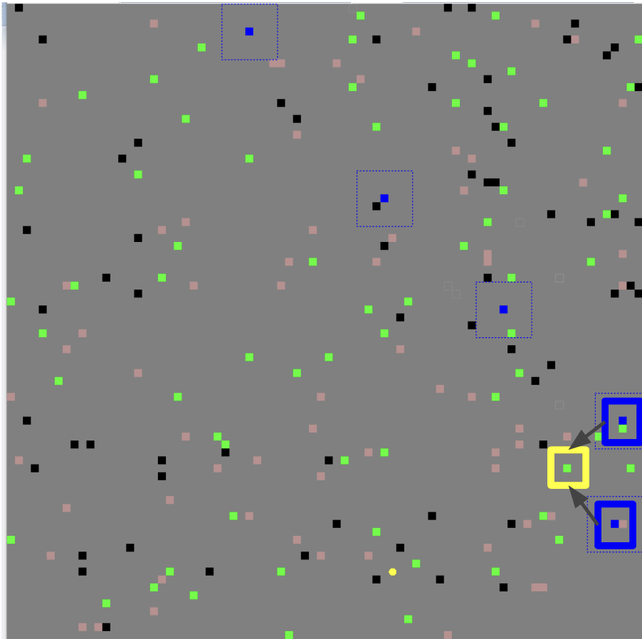
Target Conflict
Our contract is “First-come-first-serve”.
If one agent has a target registered, the nearby region (distance <= 3) cannot be targeted by other agents.
think() method: At the very beginning, broadcast and process messages; At the very end, compare my target to other agents’ targets.
Notes:
There is one concept left, that is target conflict reduction. Remember the messages includes the targets from each agent at this current step. This yields our contract, which is “First-come-first-serve”, If one agent has a target registered, the nearby region cannot be targeted by other agents.
Let’s look at the example on the right. This agent targets at this tile, and registered first, it broadcasts the location of this tile,
and then, another agent will know that, oh, this tile has been targeted, I should not target any object whose distance is less than or equal to 3. Thus, I will choose another target instead. Maybe this one, or this one.

Slide 22
Work Implementation
Fuel-Station Finding
Rule-Based System
Communication & Memory
Work Implementation
Notes:
Okay, so that finishes the communicate and memory part, now let’s invite 佟天 to talk about the work implementation.
There are still some problems during the agent-working period, and we have some methods to solve it.

Slide 23
Work implementation—find fuel station before ran out of fuel
The Manhattan distance between the agent and fuel station
Fuel Level
compare
Fuel level >= Distance + Buffer value
steps/100
Notes:
We need to compare the … to …
When the fuel > distance, the agent continue the tile-hole work. but when the fuel level equals to this distance, the agents destination change to the fuel station.
However, we know that there are some obstacles in this map and the obstacles might cause the agent to take extra steps. And the extra steps may cause the agent ran out of fuel.
To prevent this happen, we set a buffer value. The equation changed to this one (ppt).
And we find an interesting thing that the amount of obstacles will increase as the system operates, which means the agent need more extra steps when their have run 3000 or 4000 steps compare to at first. so It is reasonable to set buffer value to be proportional to steps.
And after some experiments, we find when the buffer value equals steps/100. the system performs very well. But this might not the best value, this can be developed in the future.

Slide 24
Work implementation—find fuel station before ran out of fuel
In this example, the agent can get this tile without taking extra steps ( its destination is fuel station)
Notes:
And when the agent go to the fuel station, it can also do the tile-hole work and doesn’t need take extra steps.
we can think a rectangle between the agent and the fuel station, and the agent can get to the tile or hole in this rectangle without taking extra steps, it can also get to the fuel station before running out of fuel.
just like this figure.

Slide 25
Work implementation—the agents’ priority decided by the number of tiles carried
carried tiles = 0
0 < carried tiles < 3
carried tiles = 3
agent’s target is the closest tile
agent’s target is the closest tile or hole
agent’s target is the closest hole
Notes:
When the agent should go to the hole and when go to the tile,
So we need to know..
When the agent is working, we separate it in 3 conditions by the number of tiles it carried.
when it carries 0, it target is
when it carries 1 or 2 tiles, it target is
when is carries 3, it target is

Slide 26
Work implementation— What should agent do when it lose its “memory”
lose own memory
lose shared memory
Insufficient fuel :
go to fuel station.
Sufficient fuel: random go
Using shared memory
Notes:
when the agent’s memory contains no tile or hole, we call it “lose its memory”, at this time, it lose the target it want to go. so we have another method to fix this problem.
And this can also be divide in two conditions.
it lose its own memory and it lose the shared memory(this need to be clarified, this is a very rare condition which means there is no tile or hole in the 5 agents’ memories.
when it lose own memory, it will use the shared memory and find the closest tile or hole in it(obey the rules I have showed before).
but if it lose shared memory, then we need to justify the condition. if its fuel level less than 2 times of the Manhattan distance between the agent and fuel station. the agent will go to the fuel station. if not, it will random go some where(because, this condition last very short time, and this won’t affect the final score a lot. This point can be improved in the future)

Slide 27
Introduction & Architecture
Fuel-Station Finding
Rule-Based System
Communication & Memory
Work Implementation
Future Vision
Notes:
Now lets invite juxilai to talk about future vision and improvement.

Slide 28
Future Vision
Objects Global Memory
Rule-based System
Partition during implement process
Notes:
Hello I am Juxilai.
Now we have some directions for improvements about our method. The global memory only records the information about the sensors on agents, which means that the tiles and holes in global memory will not disappear unless the agents travel around the neighbouring areas. However, the lasting time of tiles and holes can be recorded in the global memory so we can get the real-time information about tiles and holes.

Slide 29
Future Vision
Objects Global Memory
Rule-based System
Partition during implement process
Notes:
There are still some problems when the agents run out of fuel. All of the agents carry the same amount of fuel, so they will start to find the fuel station nearly at the same time, leading to congestion in the same area. We can just divide the region into five parts during working process, which will avoid congestion, and it will also change the communication. Moreover, mutual exclusion in perceptual region when sensing might be better in such conditions.

Slide 30
Future Vision
Rule-based System
compare
Reinforcement Learning System
Efficient during implement process
High-Dimension during dynamic situations
Easy to be implemented
Notes:
At first we consider to implement with two methods: Rule-based method and Reinforcement Learning method. Naturally we pay much attention to the reinforcement learning method, which will be more efficient if designed wisely.If the obstacles are fixed, we can use some classical reinforcement learning methods like Q-learning. But the dynamic environment makes it hard to be implemented. So we finally choose the Rule-based method.

Slide 31
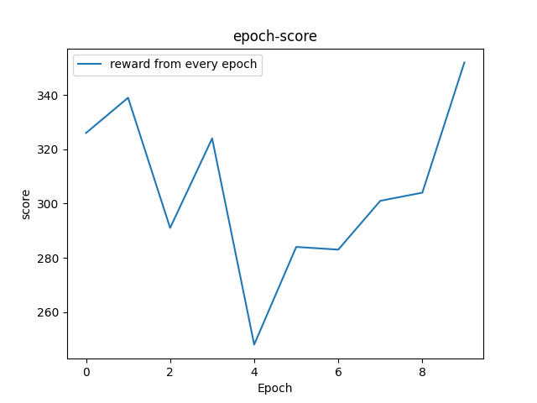
Result-50x50
Average around 305

Slide 32
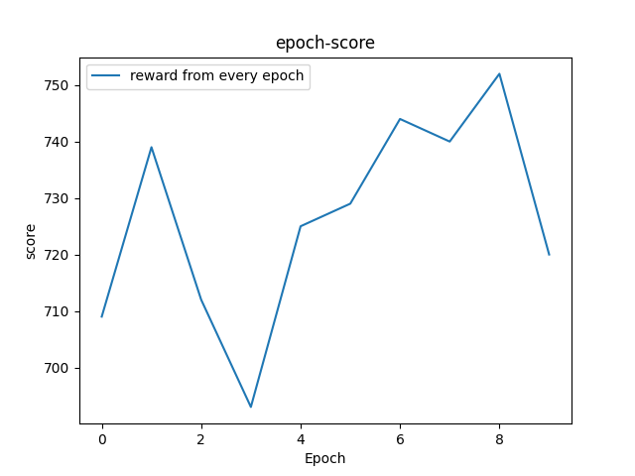
Result-80x80
Average around 726

