Slide 1

Virtual Doctor Queue Team Name: Kangaroo Member Name: Hongcheng Jiang, Shaobin Zhang, Jiaqing lyu

Slide 2
Problem:
Seeing a doctor in India is still practiced the age-old way. If a sick person needs to see a doctor for herself or for her child, the only option for her is to go to a clinic, get her name on the list and wait for her turn patiently. Sometimes the wait can last for several hours. It is not only inconvenient for patients to sit in a crowded and dingy waiting room, it creates unnecessary cross contamination and infection. Clinics need a way to reduce or eliminate wait times and minimize the discomfort of patients. Patients need an easier way to get information on actual wait times, choose the right doctor and checkin from their mobile device, and even pay for services directly from their mobile device. The concept of virtual queue has to be commoditized such that it can be adopted by even small clinics with a single doctor.

Slide 3
Flow Chart: :
Patient
Doctor
Start
Check appointment
Register
Write notes
Confirm information
Manage appointments
Make appointment
Close appointments
send waiting time
Inform payment

Slide 4
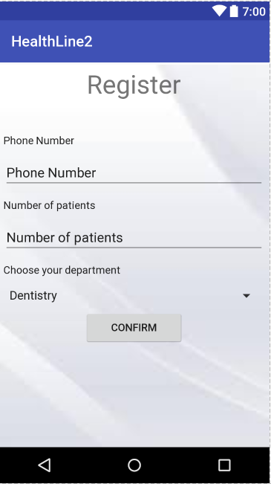
Register page

Slide 5
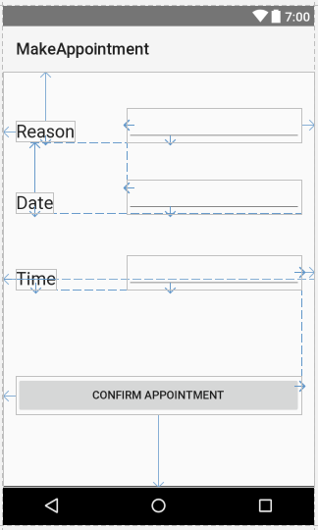
Make Appointment

Slide 6
Doctor home

Slide 7
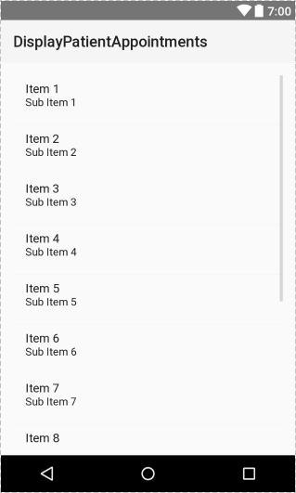
Appointment List for doctor

Slide 8
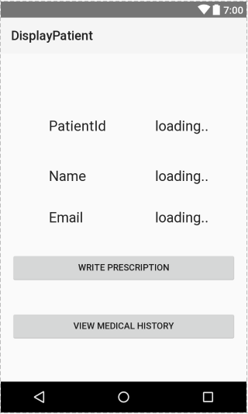
Patient info

Slide 9
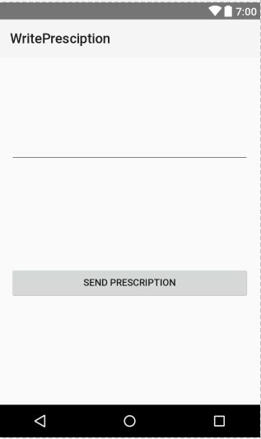
Write prescription

Slide 10
Some xml code(this one is for the register page. ):
For it is the first time to use the Android Studio, we have very limited experience.
<?xml version="1.0" encoding="utf-8"?> <android.support.constraint.ConstraintLayout xmlns:android="http://schemas.android.com/apk/res/android" xmlns:app="http://schemas.android.com/apk/res-auto" xmlns:tools="http://schemas.android.com/tools" android:layout_width="match_parent" android:layout_height="match_parent" tools:context="com.lvzi.healthline2.Register"> <LinearLayout android:background="@drawable/background" android:layout_width="361dp" android:layout_height="638dp" android:layout_margin="10px" android:gravity="center_horizontal" android:orientation="vertical" android:weightSum="1" tools:layout_editor_absoluteX="-1dp" tools:layout_editor_absoluteY="3dp">

Slide 11
<TextView android:id="@+id/textView5" android:layout_width="wrap_content" android:layout_height="wrap_content" android:layout_margin="20px" android:layout_weight="0.11" android:text="Register" android:textAppearance="@style/TextAppearance.AppCompat.Display1" /> <TextView android:id="@+id/textView1" android:layout_width="match_parent" android:layout_height="wrap_content" android:layout_margin="20px" android:text="Phone Number" android:textAppearance="@style/TextAppearance.AppCompat" />

Slide 12
<EditText android:id="@+id/editText11" android:layout_width="match_parent" android:layout_height="wrap_content" android:layout_margin="20px" android:ems="10" android:inputType="numberSigned" tools:text="Phone Number" /> <TextView android:id="@+id/textView2" android:layout_width="match_parent" android:layout_height="wrap_content" android:layout_margin="20px" android:text="Number of patients" android:textAppearance="@style/TextAppearance.AppCompat" />

Slide 13
<EditText android:id="@+id/editText12" android:layout_width="match_parent" android:layout_height="wrap_content" android:layout_margin="20px" android:ems="10" android:inputType="numberSigned" tools:text="Number of patients" /> <TextView android:id="@+id/textView9" android:layout_width="match_parent" android:layout_height="wrap_content" android:layout_margin="20px" android:text="Choose your department" android:textAppearance="@style/TextAppearance.AppCompat" />

Slide 14
<Spinner android:id="@+id/spinner" android:layout_width="match_parent" android:layout_height="wrap_content" android:layout_margin="20px" android:entries="@array/languages" /> <Button android:id="@+id/button2" android:layout_width="133dp" android:layout_height="wrap_content" android:text="Confirm" /> <Spinner android:id="@+id/spinner" android:layout_width="match_parent" android:layout_height="wrap_content" android:layout_margin="20px" android:entries="@array/languages" /> <Button android:id="@+id/button2" android:layout_width="133dp" android:layout_height="wrap_content" android:text="Confirm" />
</LinearLayout> </android.support.constraint.ConstraintLayout>

Slide 15
Some back-end code:
This is a part of the register ‘s java code. It is for a button which is for transferring pages.
public class Register extends AppCompatActivity { @Override protected void onCreate(Bundle savedInstanceState) { super.onCreate(savedInstanceState); setContentView(R.layout.activity_register); Button btn1=(Button)findViewById(R.id.button2); btn1.setOnClickListener(new View.OnClickListener() { @Override public void onClick(View v) { setContentView(R.layout.doctor); } });

Slide 16
Thanks!

