Slide 1
DCT-based residual network for NIR image colorization
Hongcheng Jiang¹, Paras Maharjan¹, Zhu Li¹, Gorge York²
¹University of Missouri-Kansas City, USA,
²US Air Force Academy

Slide 2
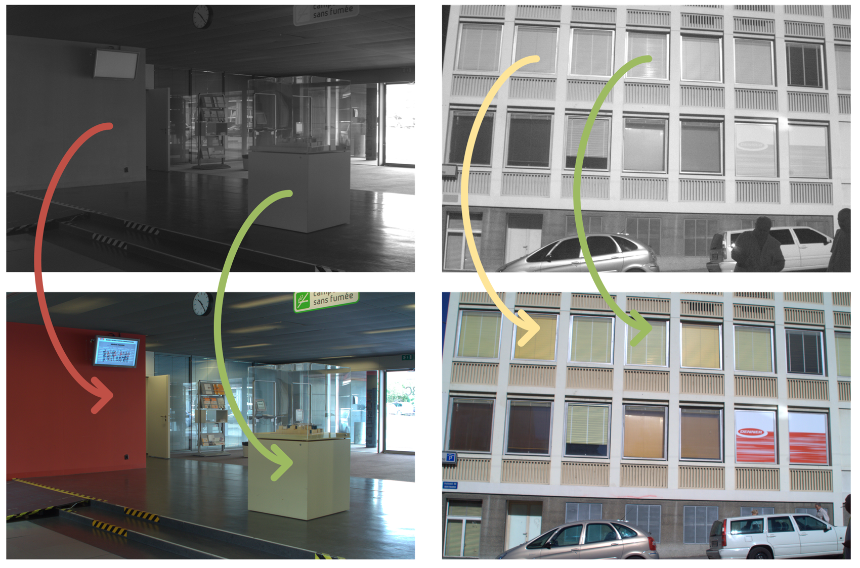
Motivation
Near-Infrared (NIR) photography
Low or no light vision task
Object detection and recognition under low or no light light condition
Surveillance
Figure 1. NIR images to RGB images colorization

Slide 3
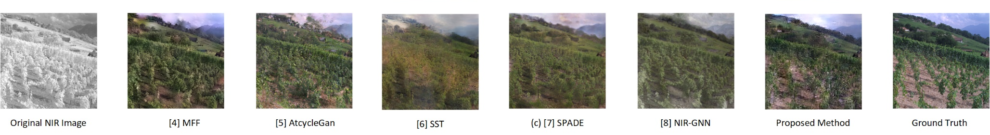
Objectives
To design network with less computational complexity for coloring NIR image
Reduces the training difficulty of our network by explicitly separating low-frequency and high-frequency details into four subgroups.
Figure 2. Comparison of the colorized NIR images

Slide 4
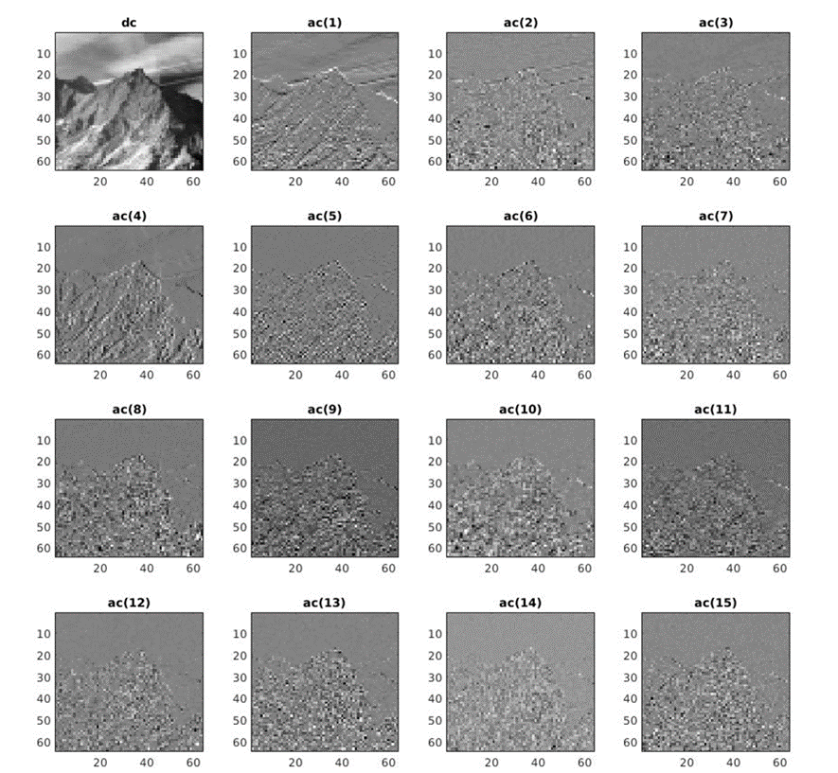
Introduction
Two out of the three image dimensions are lost
Not the same as the grayscale images
Coarse contents and sharp details are separated
Four subgroups generated by the 4×4 DCT RGB images as the output
Computationally efficient and demonstrate competitive results
Figure 3. 4x4 DCT decomposition

Slide 5
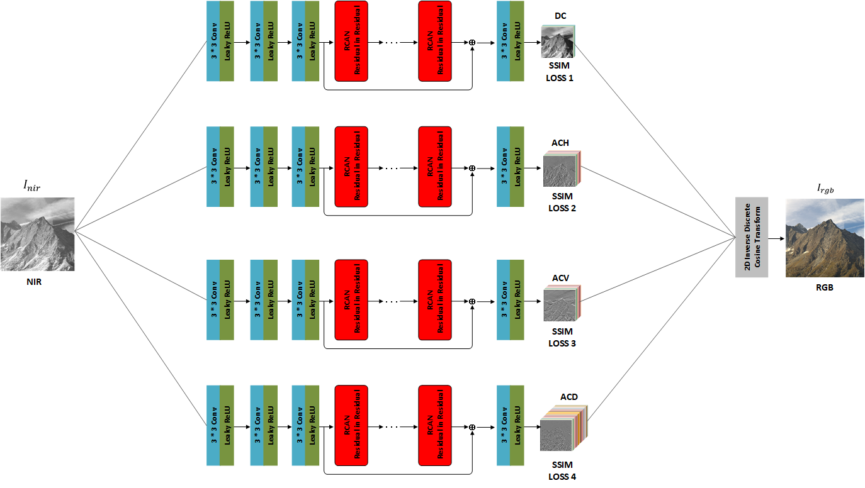

Network and Loss Function
Residual based learning
4×4 DCT RGB images as the output
Subgroup recovery loss functions
Channel attention
Figure 4. Proposed Network Structure

Slide 6
Dataset
Grand Challenge on NIR image colorization of IEEE VCIP 2020.
372 and 28 paired images (NIR and RGB images)
1020 RGB images without paired NIR images
Resolution of all images is 256×256

Slide 7
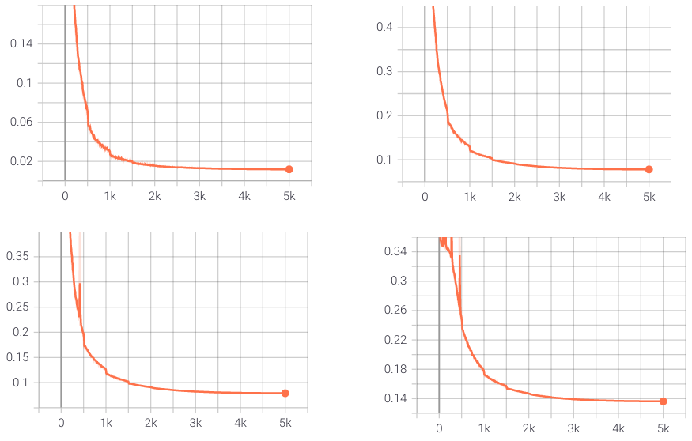
Training Strategy
DC | 35466464
ACH | 35469926
ACD | 35469926
ACV | 35480312
DC subgroup
ACH subgroup
Table 3. Number of parameter
Inference Time | 2.89 Second Per image
ACV subgroup
Table 4. Inference time
ACD subgroup
Figure 6. Subgroup recovery loss figure

Slide 8
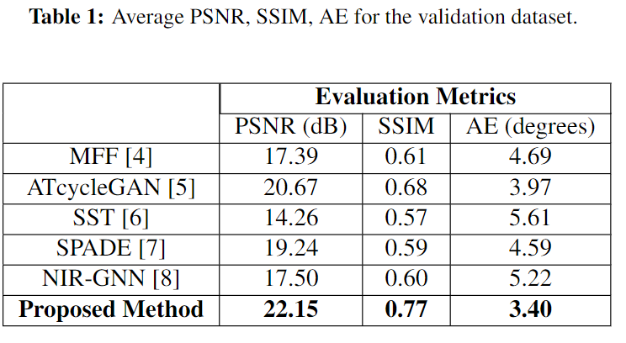
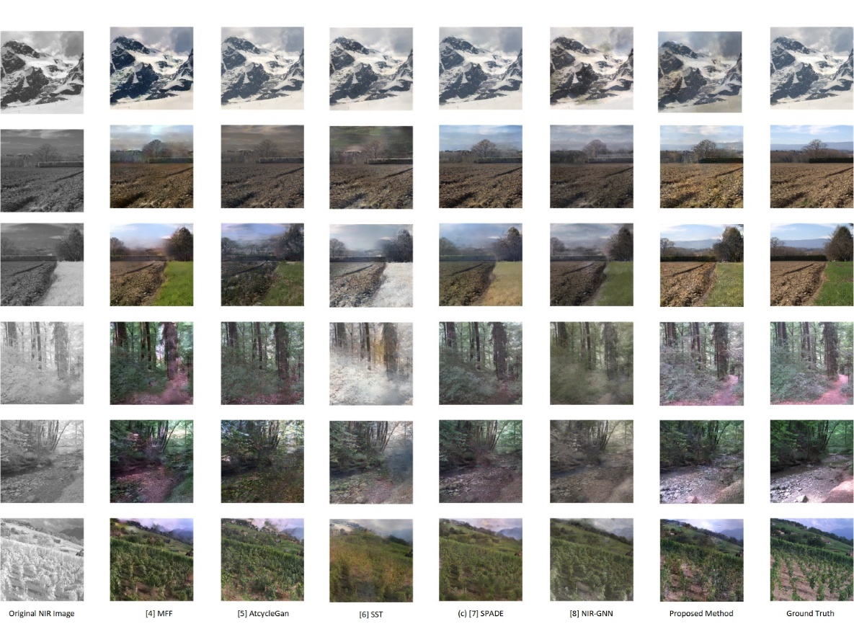
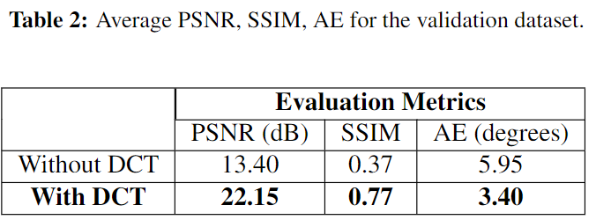
Subjective Result
Table 3: Complexity Analysis
Figure 5. Comparison of the colorized NIR images

Slide 9
Conclusion
We propose a DCT-based residual network (DCT-RCAN) for NIR image colorization.
We adopt lightweight but an effective module RIR to improve the efficiency of NIR image colorization without sacrificing much performance.
Our DCT-RCAN requires relatively fewer parameters and generates competitive results against state-of-the-art methods quantitatively and qualitatively.

Slide 10
References
Matthew Brown and Sabine S ̈usstrunk. Multi-spectral SIFT for scene category recognition. In CVPR 2011, pages 177–184, 2011. doi: 10.1109/CVPR.2011.5995637.
Ziyue Dong, Sei-ichiro Kamata, and Toby P. Breckon. Infrared Image Colorization Using a S-Shape Network. In 2018 25th IEEE International Conference on Image Processing (ICIP), pages 2242–2246, 2018. doi: 10.1109/ICIP.2018.8451230.
Patricia L. Su ́arez, Angel D. Sappa, and Boris X. Vintimilla. Infrared Image Colorization Based on a Triplet DCGAN Architecture. In 2017 IEEE Conference on Computer Vision and Pattern Recognition Workshops (CVPRW), pages 212–217, 2017. doi: 10.1109/CVPRW.2017.32.
Longbin Yan, Xiuheng Wang, Min Zhao, Shumin Liu, and Jie Chen. A Multi-Model Fusion Framework for NIR-to-RGB Translation. In 2020 IEEE International Conference on Visual Communications and Image Processing (VCIP), pages 459– 462, 2020. doi: 10.1109/VCIP49819.2020.9301787.

