Slide 1




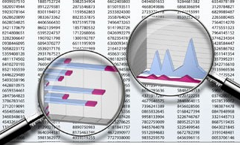
1.Data Collection
2.Data Integration
3.Data Cleaning
4.Data Transformation
7.Action
6.Presentation
5.Data Mining

Slide 2
Criteria | Classification | Clustering
Prior Knowledge of classes | Yes | No
Use case | Classify new sample into known classes | Suggest groups based on patterns in data
Algorithms | Decision Tress, Bayesian classifiers | K-means, Expectation Maximization
Data Needs | Labeled samples from a set of classes | Unlabeled samples

Slide 3
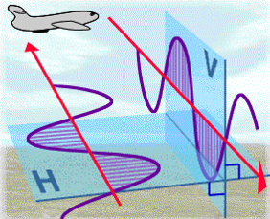
Input
Process
Split data into
train data & test data
Radar Data
Data Preprocess
80%
training data
Train model& test model
until enough accurate
Band1
Band2
Ice_angle
20%
Test data
Prediction
Prediction data
Prediction results:
Is iceberg or not
Output

Slide 4
Model
Input
Model
Layers
Model
Compilation
Model
Training
Model
Prediction

